Slide 1

中国-欧盟就业和社保政策对话与研讨会
China-EU Employment and Social Security Policy Dialogue &Workshop
2016年4月26日 ·北京 Beijing, April 26, 2016

Slide 2
Functionality of Social Security from a Labour Market Perspective
从劳动力市场角度看社会保障的功能
(bilingual version)
（双语版）
Koen Vleminckx
Director, Research and International Cooperation,
Federal Public Service Social Security, Belgium
koen.vleminckx@minsoc.fed.be
科恩·弗莱明克斯
比利时联邦社会保障公共服务部研究及国际合作司司长

Slide 3
INTRODUCTION
导言

Slide 4
Social Security
社会保障
… mitigates the loss of earnings associated with a set of recognized risks, such as unemployment and conditions that negatively affect a person’s earnings
… 缓解系列风险引起的收入损失情况，例如失业和影响人们收入能力的一些负面因素
capacity, such ill health, disability, work-related injury and the real or assumed loss of earnings capacity due to old age.
包括健生病、残疾、工伤和由年老造成的实际或可能的收益能力损失。
… provides benefits that replace to a certain extent the income from earnings and/or that to a certain extent compensate the partial loss of earnings.
… 提供待遇，替代一定水平的收入/或在某种程度上补偿部分收入损失。
… is financed by contributions paid by the employed and/or his/her employer, who withholds contributions on the payments of wages.
… 资金来自雇员和/或其雇主的缴款，雇主在支付工资时进行扣款。

Slide 5
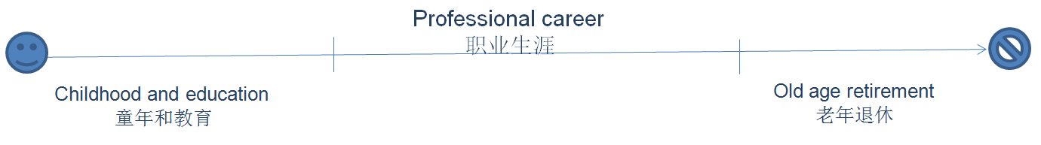

Social Insurance regulates the professional career throughout the various fases of the life-course…
社会保险调节人生历程各个阶段的职业生涯……

Slide 6

Functions of social security from a labour market perspective
从劳动力市场看社会保障的功能
Employability: Income replacement helps beneficiaries to maintain their employability.
可就业性：收入替代有助于受益人维持就业能力
Job matching: Income replacement allows them time to find a job that matches their skills
工作匹配：收入替代使其有时间寻找与技能匹配的工作
Job retention: As social security rights are acquired and built up by the regular payment of contributions it promotes job retention.
持续工作：社会保障权是通过定期缴款取得并累积的，因而能够促进工作持续。
Job retention allows allowers to invest in training and lifelong learning.
工作保持可以使允许者投资于培训和终身学习。
Social insurance smoothens the functioning of the labour market
社会保障使劳动力市场运转顺畅

Slide 7
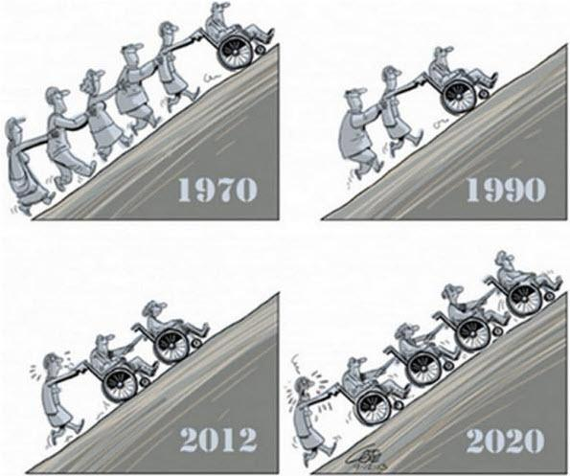

Social insurance requires a balanced labourmarket, foremost a balance between the
numberof active contributors to the system and the number of beneficiaries.
社会保险要求劳动力市场平衡，首先是实际缴费的人数和受益人数之间的平衡。
Volume and Cost Control
数量和成本控制

Slide 8
SOCIAL SECURITY IN
LABOUR MARKET – SOCIAL WELFARE NEXUS
劳动力市场中的社会保障 – 社会福利纽带

Slide 9
Social insurance is part of a broader set of policies in the labour market - social welfare nexus
社会保险是劳动力市场更为广泛的一系列政策中的一部分 - 社会福利纽带
Education 教育
Labour market regulation 劳动力市场监管
Labour market services 劳动力市场服务
Care & leave policies护理及休假政策
Fiscal policies 财政政策
…

Slide 10
Different European countries have a different vision on the role of social insurance within this policy nexus.
不同的欧洲国家对社会保险在这一政策纽带中的作用持有不同的看法

Slide 11
Different visions on the role of social insurance within this labour market – social welfare nexus.
社会保险功能的几种认识：就劳动力市场-社会福利纽带而言。
Scandinavian: Strong link between social insurance and labour market policies.
Social benefit are generous and access is universal. Strong emphasis on labour market
Reintegration (activation, with very developed labour market services and programs
facilitating a dynamic labour market.
斯堪的纳维亚：社会保险和劳动力市场政策密切相关。社会福利宽松而且普及，高度
重视重新融入劳动力市场（积极参与，高度完善的劳动力市场服务和促进劳动力市场活力的计划。
Conservative: Developed social insurance systems, but linked to labour
market performance and focused on compensation, while labour market regulation protects
those already ‘inside’ the labour market.
保守主义：社会保险制度完善，但是与劳动力市场表现挂钩并且以补偿为重点，劳动力市场
监管对已经跻身劳动力市场“以内”的人员予以保护。

Slide 12
Different visions on the role of social insurance within this labour market – social welfare nexus.
社会保险功能的几种认识：就劳动力市场-社会福利纽带而言。
Mediteranean: Social insurance strongly linked to labor market performance. Social
Provisions for those outside the labour market are more residual. Strong labour market
regulation, protecting those already ‘inside’ the labour market.
地中海国家：社会保险和劳动力市场表现密切相关，对劳动力市场以外的人员，社会权利是
补缺性质的。劳动力市场监管力度大，对劳动力市场“内部人”的人员予以保护。
Liberal: Social insurance has a residual focus, while labour markets are more
deregulated.
自由主义：社会保险需要补差，劳动力市场管制放松。
Central European (East Asia?): Combines liberal and conservative features.
中欧（东亚？）：自由和保守兼而有之。

Slide 13
DESIGN OF SOCIAL INSURANCE FROM A
LABOUR MARKET PERSPECTIVE
从劳动力市场角度设计社会保险

Slide 14
Policy chain
政策链
Prevention
of risks
风险防范
Restoring situation
before risk occurred
发生风险以前
挽回局势
Compensation
if risk occurs
发生风险
予以补偿
1
2
3
Regulation监管
Education & lifelong learning
教育及终身学习
Health prevention健康预防
Safety at work劳动安全
…
Health-care
保健
Labour market services
劳动力市场服务
…
Income replacement
收入替代
Poverty prevention
防止贫穷
…

Slide 15
Designing benefit system
设计待遇
1
Short-term:
短期：
Reasonable income replacement is important to compensate loss of
purchasing power and protect employability.
合理的收入替代水平对于补偿购买力损失和保护就业能力很重要
Expectancy to participate in reintegration efforts, including training
努力重新融入市场的预期，包括培训
Obligation to be available for suitable work
强制参加适合的工作
2
Long-term：
长期：
Preventing poverty and social exclusion
防止贫困与社会排斥
Avoid poverty trap (benefit levels, integration stimuli, sanctions)
避免贫穷陷阱（补助金水平、融入刺激、制裁）
Expectancy to participate in reintegration efforts, including training
努力重新融入市场的预期，包括培训
Obligation to be available for work offered
强制参加所提供的工作岗位

Slide 16
Accompanying labour market services
附属劳动力市场服务
Employment services to facilitate job matching
有助于工作匹配的就业服务
Specific services for target groups
针对目标群体的具体服务
Lifelong learning and (re) training
终身学习和（再）培训

Slide 17
LABOUR MARKET CHALLENGES
劳动力市场的挑战

Slide 18
Main labour Market Challenges, both in Europe and China
中国和欧洲面临的主要劳动力市场挑战
Economic crisis and labour market restructuring
经济危机和劳动力市场结构调整
Population ageing
人口老龄化

Slide 19
Economic Crisis
经济危机
During the economic crisis of the eighties:
八十年代的经济危机期间：
Strong increases in unemployment due to labour market restructuring
劳动力市场结构调整引发失业飙升
Governments prefered ‘exit’ strategies for less productive workers, such as early retirement to facilitate restructuring (reduce social conflict, limit poverty, …)
各国政府对生产能力较低的工人首选“退出”战略，如提前退休，以促进结构调整（减少社会冲突、限制贫穷，……）
As a result, benefit dependency and cost of social insurance system increased
所以，福利依赖和社会保险制度成本增加

Slide 20
Economic Crisis
经济危机
Recent financial and currency crisis:
近期的金融和货币危机：
Temporary unemployment schemes, allowed employers to retain workers (labour hoarding) to bridge crisis
临时性的失业计划，使雇主得以保留工人（劳动力储备）以渡过危机
Reliance on services aimed at retraining and reintegrating redundant workers
依靠服务，以保留和重新整合冗余工人

Slide 21
Population ageing
人口老龄化
Longer and more intensive careers:
延长和更高强度的职业生涯：
Increasing retirement age
提高退休年龄
Other measures to lengthen labour market careers, to maintain productivity and finacial equilibrium of social insurance system
采取其他措施，延长劳动力职业生涯，以保持生产率和实现社会保险制度财务平衡
Shorten duration of unemployment, sickness and invalidity
缩短失业、疾病和失能的周期

Slide 22
Population ageing
人口老龄化
Phasing in and Phasing-out:
渐进引入和渐进退出：
Introduction of part-time disability to facilitate labour market reintegration
引入非全时残疾，促进重新融入劳动力市场
Introduction of part-time retirement to allow older workers to retire gradually
引入非全时退休，使老龄工人得以逐步退休
Allow retired workers to supplement income with income from employment
使退休工人可以利用就业所得补充收入

Slide 23
Population ageing
人口老龄化
Measures to make longer and more intensive professional careers acceptable:
使延长、高强度职业生涯得到认同的措施:
Leave policies for parents, care for sick relatives, …
父母亲休假政策、护理患病亲属、……
Leave policies to facilitate lifelong learning
促进终身学习的休假政策
Time-credits and life-course accounts
时间抵免和终生学习账户

Slide 24
THANK YOU
谢谢！

