Slide 1
中国-欧盟就业和社保政策对话与研讨会
China-EU Employment and Social Security Policy Dialogue &Workshop
2016年4月26日 ·北京 Beijing, April 26, 2016

Slide 2
Labour market changes, worker security and policy reforms
劳动力市场的变化，工人保障和政策改革
(bilingual version)
（双语版）
Prof. Stefano Sacchi
University of Milan
Special Commissioner ISFOL, Rome
Strategic Policy Unit, Italian Prime Minister’s Office
stefano.sacchi@unimi.it
斯特法诺·萨奇
米兰大学教授
意大利劳动、培训和社会政策研究院特别委员

Slide 3
Relationship between labour market flexibility and worker security,
with examples taken from the Italian case.
劳动力市场的弹性和工人保障之间的关系，以意大利为案例。
Worker security (or, on the contrary, insecurity or “precariousness”) emerges as the outcome of the interaction between labour market dynamics and the social protection system, with the latter that may or may not compensate for failures of the labour market and the other way around
工人保障（或与之相反的无保障或“不稳定”）是劳动力市场机制和社会保护制度之间相互影响的结果，社会保障可对劳动力市场失灵提供补偿，也可能不会提供；二者间的关系反过来亦然。

Slide 4
Labour market reforms and flexibility
劳动力市场的改革与弹性
Labour market flexibility is a multidimensional concept
劳动力市场的弹性是一个多维度的概念
Focus on numerical flexibility: easing EPL for open ended workers; making it easier for firms to hire fixed-term workers
关注数量式弹性稳定：降低对开放（非固定限期）合同制工人的就业保护（EPL）；便于企业雇佣固定期员工
In the 1990s and 2000s many EU countries introduced labour market reforms “at the margin” as a strategy of response to high unemployment rates, and to accommodate productive necessities that could no longer be satisfied with existing instruments. In doing so, they sought to shelter the core workforce from regulatory changes, shifting the burden of functional adjustment mostly on new entrants in the labour market.
二十世纪90年代及此后十年，很多欧盟国家引入劳动力市场的“边缘化”改革，作为应对高失业率的策略，并适应产出的需求性，现有市场工具已经无法满足需要。在此过程中，他们试图保护核心劳动力，免于监管发生变化影响，将结构性调整的负担转嫁给劳动力市场的新进入者。

Slide 5
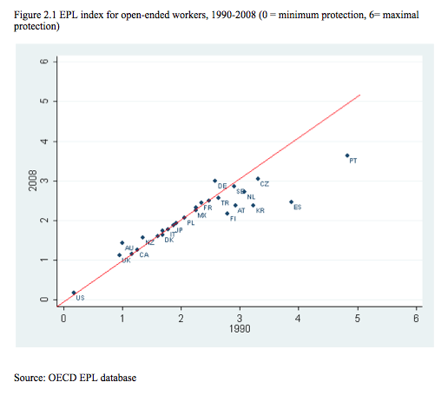
图2.1 1990-2008年开放合同制工人的EPL指数（0=最低保护，6=最高保护）
来源：经合组织EPL数据库

Slide 6
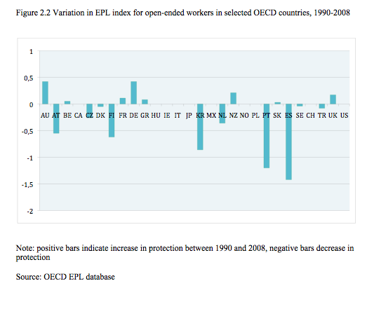
图2.2 1990-2008年选定国家开放合同制工人EPL指数的变动情况
注：正值条表示1990至2008年保护增加，负值条表示保护减少。
来源：经合组织EPL数据库

Slide 7
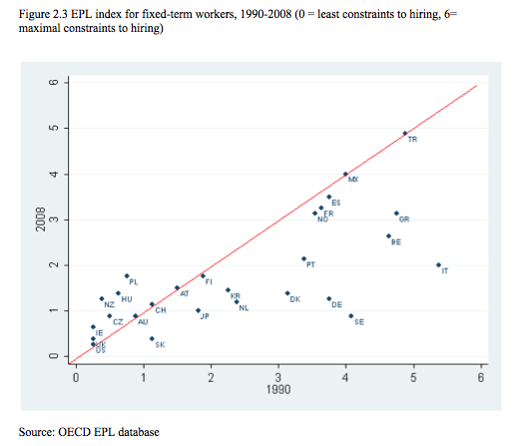
图2.3 1990-2008年固定期限工人的EPL指数（0=雇佣限制最小，6=雇佣限制最大）
来源：经合组织EPL数据库

Slide 8
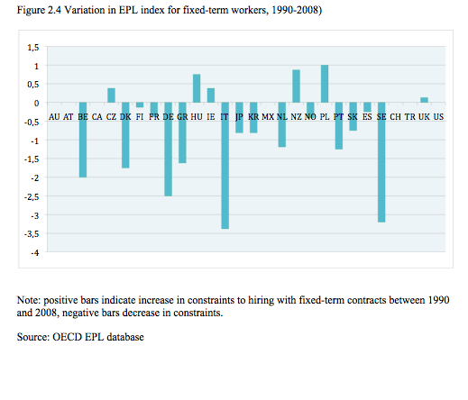
图2.4 1990-2008年固定期限工人EPL指数的变动情况
注：正值条表示1990-2008年固定期限合同雇佣限制增加，负值条表示限制减少
来源：经合组织EPL数据库

Slide 9
Share (%) of temporary in total dependent employment 临时雇员占附属就业总数的比例（%） Source: OECD 来源：经合组织
 | 1990 | 2000 | 2012
UK 英国 | 5 | 7 | 6
Denmark 丹麦 | 11 | 10 | 9
France 法国 | 11 | 16 | 15
Germany德国 | 11 | 13 | 14
Italy 意大利 | 5 | 10 | 14
Spain 西班牙 | 30 | 32 | 24
EU-21 欧盟-21国 | 10 | 13 | 14
oecd经合组织 | 10 | 11 | 12

Slide 10
Share (%) of temporary in total dependent employment, 15-24 临时雇员占附属就业的比例（%），15-24 Source: OECD 来源：经合组织
 | 1990 | 2000 | 2012
UK 英国 | 10 | 13 | 15
Denmark 丹麦 | 30 | 30 | 21
France 法国 | 38 | 55 | 55
Germany 德国 | 34 | 52 | 54
Italy 意大利 | 11 | 26 | 53
Spain 西班牙 | 66 | 69 | 63
EU-21 欧盟-21国 | 26 | 36 | 39
OECD 经合组织 | 20 | 24 | 24

Slide 11
New hires, Italy 2012
2012年意大利新雇雇员
Less than 20% of new contracts are open-ended contracts; more than 80% are temporary contracts
新合同中开放式合同不足20%；80%以上为临时合同
6 open-ended contracts out of 10 involve workers aged more than 34. Only 1 in 10 workers aged less than 24
每10份开放式合同中有6份涉及年龄在34以上的工人。每10名工人中年龄在24以下的只有1人
40% of all temporary contracts last less than 6 months; 50% less than one year
所有临时合同中有40%持续不到半年；50%的临时合同持续不到一年

Slide 12
Worker security
工人保障
Worker security: capability of an individual to mantain an adequate living standard through labor market participation and/or (public or mandatory private) social protection when not in work
工人保障：指个人维持充足生活标准的能力，这种能力通过参与劳动力市场获得；或当无工作时通过（公共或强制性私营）社会保护获得。
Worker security is given by a combination of employment security, wage security and social security
工人保障由就业保障、工资保障和社会保障结合起来提供

Slide 13
Substitutability between security dimensions
保障尺度之间的可替换性
Even if they should take place, interrupted (‘bumpy’) careers do not lead to insecurity per se, provided that when in employment workers earn wages high enough to allow for precautionary savings and income smoothing; or if income-maintenance schemes during periods of no employment or top-up benefits for low incomes allow for the enjoyment of an adequate standard of living
职业间歇（“坎坷”）就算会发生，其本身也不会导致无保障的情况，只要工人在就业期间赚取的工资足够进行预防性储蓄和收益平滑；或者通过在非就业期间的收入维持计划及为低收入者提供的追加补助，使工人维持适足的生活水平。

Slide 14
Employment security
就业保障
reasonable expectation of having secure and continuous employment careers, which may entail changing employers and jobs
对拥有稳定而持续的职业工资进行合理预期，这可能带来雇员和工作的变化
Employment continuity is a matter of:
就业连续性指的是：
duration of the contracts 合同的有效期限
frequency of job-to-job transitions 工作到工作之间的转换频率
duration of non-employment非就业期间
frequency of transitions towards contracts with longer duration向期限更长的合同转换的频率

Slide 15
2012年以前，意大利
Italy, before 2012
fixed-term contracts have shorter durations than open-ended ones (but open-ended contracts are far from being ’permanent’)
固定期限合同持续时间比开放式合同短（但开放式合同远非“永远不变” ）
2. fixed-term workers (temps) are roughly as likely as standard workers to enter non-employment when the job spell ends, or even slightly better off
工作期限一到，固定期限工人（临时工）同标准合同工人基本一样，进入非就业状态，情况甚至可能略好
3. temps experience on average non-employment spells of shorter duration
平均非就业期间较短的临时工体验
4. (2) and (3) are not sufficient to compensate for (1)
(2) 和 (3) 不足以对 (1) 进行补偿
5. moreover, temps are more likely to get other fixed-term contracts (than open-ended ones)
另外，临时工更可能得到其他固定期限合同（与开放式合同相比）
Thus, fixed-term jobs are associated to lower employment security
因此，固定期限工作是与较低的就业保障相联系的

Slide 16
Employment security: comparative findings
就业保障：比较结果
Wrt open-ended ones, fixed-term contracts tend to entail negative effects on employment continuity, but in different degrees
相对于开放式合同，固定期限合同往往对就业连续性产生不利的影响，但程度各不相同
In Germany fixed-term employment not too detrimental for career; exception: TAW
在德国，固定期限就业对职业不会有大的危害；例外：TAW
In Italy and Spain: relative entrapment (TAW at the beginning of one’s career not so bad in Italy)
在意大利和西班牙：相对引诱（意大利人职业开始阶段的TAW还不错）

Slide 17
Transitions in Italy, before 2012
2012年以前，意大利的转换情况
Port of entry: Transitions twd open-ended contracts always more likely for those empoyed – irrespective of contract type – than for not-employed
切入端口：向开放式合同转换往往更可能针对已就业人员——无论哪种合同类型——而不是未就业人员
Persistence (entrapment): Individual characteristics being equal, irrespective of the type of contract currently held, the most likely future event is to hold the same type of contract currently held
持续（引诱）：个体特征相同，与现有合同类型无关，将来最可能发
生的事情就是拿到一份和现有合同没有两样的合同
Reduced human capital accumulation in fixed-term contracts is both cause and consequence of persistence
固定期限合同人力资本累积水平的降低，是“持续”因素的因果

Slide 18
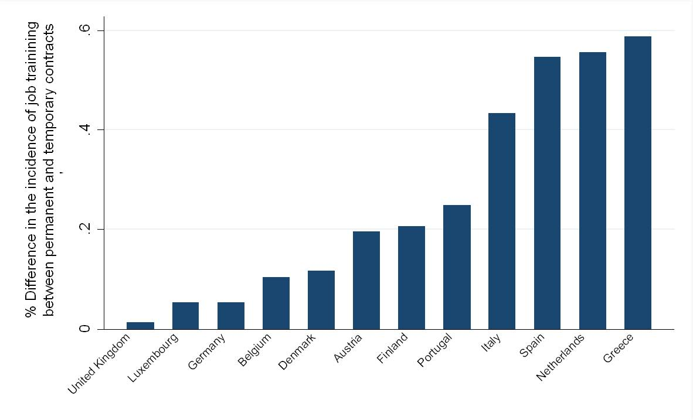
On-the-Job Training Opportunities for Temporary Workers
临时工的在职培训机会
(Boeri, 2010)
（博埃里，2010年）
长期合同和临时合同岗位培训发生率差异%
英国
卢森堡
德国
比利时
丹麦
奥地利
芬兰
葡萄牙
意大利
西班牙
荷兰
希腊

Slide 19
Consequences, Italy
意大利，结果
Segmentation btw standard/non-standard becomes a generational divide
标准和非标准之间的细分成为代际分界线
Negative effects on human capital at the macrolevel through reduced investment in training at the individual level
通过减少对个体培训的投资，在微观层面对人力资本产生的不利影响
Negative systemic effects: low productivity growth (wealth of evidence: Bank of Italy, Isfol)
负面的系统性影响：低生产率增长（证据的财富：意大利银行，Isfol）
Through social insurance, segmentation in social protection: flex-insecurity
通过社会保险，社会保护细分：弹性-无保障

Slide 20
Wage security: comparative findings
工资保障：比较结果
Nowhere do non-standard workers enjoy higher wages: compensation hypothesis rejected
没有任何一个地方的非标准工人享有高工资：补偿假说被否定
At best, comparable wages after controlling
充其量，管制以后的可比工资
Some country-specific categories are worse off, even after controlling for individual characteristics:
一些特定国情类别的情况更糟，即使是在对个体特征予以管制以后：
Independent contractors in Italy
意大利的独立承包人
TAW in Germany
德国TAW

Slide 21
Access to unemployment benefits 获取失业补助 (Italy, 2012) （意大利，2012年）
OPEN-ENDED开放式 | 90%
DIRECT-HIRE TEMPS 临时工 | 62%
TAW | 52%
APPRENTICE 学徒工 | 22%
TOTAL 共计 | 82%

Slide 23
Drop in Open-Ended Contracts among the Youths during the Crisis
危机期间青年开放式合同的下降

Slide 24
Policy response: Italy’s “Jobs Act”
政策回应：意大利《就业法案》
A consistent project of both labour market institutions and social protection reform, inspired by flexicurity
受弹性安全的启示，劳动力市场机构和社会保护改革均需有一个连续性计划
Introduced in Parliament in April 2014, government entrusted by Parliament with the introduction of reform within set guidelines in December 2014
2014年4月在议会制定，2014年12月议会委托政府在既定准则范围内进行改革
First (most important) reform decrees introduced two weeks after entrustment: new EPL, new unemployment protection
委托两周后出台的第一批（最重要）改革政令：新的EPL，新的失业保护
Whole reform (8 decrees) completed by September 2015 (10 months)
2015年9月整个改革（8项政令）全部完成（10个月）

Slide 25
New open-ended contract
新的开放式合同
Applies to new hirings 适用于新聘岗位
You pay, you fire. You know how much.你付钱，你炒人。花多少钱你清楚。
Firing costs increase with seniority within the firm 解雇费用随在公司的工龄增加
Employer can make an offer to the employee: 1 monthly wage per year of seniority – min 2 max 18 monthly wages 雇主可以主动向雇员提供：每年工龄一个月工资-最低2个月、最高18个月工资提供聘用金
Offer is tax-free for the worker 对工人来说，这项优惠是免税的
If the worker accepts, contract is terminated 如工人接受，则合同终止
If worker does not accept, goes to court and wins the lawsuit for unfair dismissal, NO LONGER REINSTATED 如果工人不接受，可以上法庭并因不合理解雇胜诉，不再恢复原职
Price for unfair dismissal: 2 monthly wages per year of seniority – min 2 max 18 monthly wages – TAXED 不合理解雇的价格：每年工龄2个月工资-最低2个月、最高18个月工资-税后
Reinstatement only for discriminatory dismissals 恢复原职仅限歧视性解雇

Slide 26
Policy objectives
政策目的
To reassure and invite investors: firing costs are certain and known in advance; very limited role of the courts
安抚和吸引投资者：解雇费用明确，事先已知；法庭作用十分有限
To make the (new) open-ended contract the “master contract” through the functioning of the labour market: tackling the human capital trap
通过劳动力市场发挥作用使（新的）开放式合同成为“主合同”：解决人力资本陷阱的问题

Slide 27
Share of open-ended new contracts on total new contracts 开放式新合同占全部新合同的比例
来源：Isfol processing on Sisco data

Slide 28
Unemployment benefit requirements
失业补助规定
New Italy’s UB: 3 months in the past 4 years
意大利新上限：过去四年有3个月
Germany: 12 months in the past 2 years
德国：过去两年有12个月
Spain: 12 months in the past 6 years
西班牙：过去六年有12个月
Denmark: 12 months in the past 3 years
丹麦：过去三年有12个月

Slide 29
Unemployment benefits: duration and generosity 失业补助：持续期间和慷慨性
 | Italy 意大利 | Germany 德国 |  | Spain 西班牙 | Denmark 丹麦
Duration rule (weeks of duration:weeks of contribution) 持续期间规定（持续周数：贡献周数） | 1:2 | 1:2 |  | 1:3 | -
Maximum duration (months) 最长持续期间（月数） | 24 | Depends upon age 依年龄而定 |  | 24 | 24
 |  | <50 | 12
 |  | 50-55 | 15
 |  | 55-58 | 18
 |  | >58 | 24
Replacement rate (first month) 替代率（第一个月） | 工资总额的75%至上限（1195€）），然后25% 75% gross wage up to a ceiling (1195€), then 25% | 60% net wage 工资净额60% |  | 70% gross wage 工资总额70% | 90% gross wage 工资总额90%

Slide 30
Access to UB: the new Italian benefit 获取上限：新的意大利补助金
 | 2012 | NOW 现在 | DIFFERENTIAL 差别
OPEN-ENDED 开放式 | 90% | 99% | +9%
DIRECT-HIRE 直接雇佣 TEMPS 临时工 | 62% | 90% | +28%
TAW | 52% | 89% | +37%
APPRENTICE 学徒工 | 22% | 94% | +72%
TOTAL 共计 | 82% | 97% | +15%

Slide 31
Conclusions
结 论
Heterogeneity across countries wrt worker security
各国在工人保障方面的差异性
Empirical interplay between labour market institutions and social protection schemes is key to understanding
劳动力市场制度和社会保障计划之间的经验相互影响是认识的关键
Common trends towards strained relations between labour market flexibility and worker security
劳动力市场弹性和工人保障之间紧张关系的普遍趋势
Human capital accumulation (on-the-job training) is key
人力资本累积（在职培训）是关键
Social protection is key
社会保护是关键
Reforms that tackle with both are possibile even in least likely countries
即使是在可能性最小的国家，为解决这两个问题进行改革也是可能的

