Slide 1


China’s Reform on Pension Insurance:
From the Perspective of Fair Distribution
对中国养老保险制度改革的认识
——基于公平性再分配功能视角
Cao Wenlian,ICC, NDRC
国家发展改革委国际合作中心
曹文炼
29-09-2016, Beijing
北京， 2016年9月29日

Slide 2
养老保险的四个基本属性 Four Natures of Pension Insurance 十八届三中全会提出：建立更加公平可持续的社会 保障保制度 The 3rd Session of the 18th CPC Central Committee: Build up a fair and sustainable social security system! 十八届五中会会提出：共享发展 ，全体人民共同迈入小康社会 The 5th Session of the 18th CPC Central Committee: Share the profit of development and enjoy a moderately prosperous society with the people!
充足性
Adequacy
可支付性
Affordability
公平性
Fairness
可持续性
Sustainability
覆盖率和替代率
缴费水平
再分配功能
财务收支
Coverage rate and Replacement rate
Contribution Level
Redistribution Effect
Financial Balance

Slide 3
公平性与其他三个属性之间是辩证关系 Dialectical Relation Between Fairness and The Other 3 Natures
公平性建立在全覆盖和充足的待遇水平之上
Fairness is based on full coverage and adequate benefit.
缴费负担只有可支付，才能体现公平性
Only when contribution is affordable can fairness be realized.
财务可持续性要靠公平性的手段来实现
Fairness is a way to financial sustainability of the system.

Slide 4
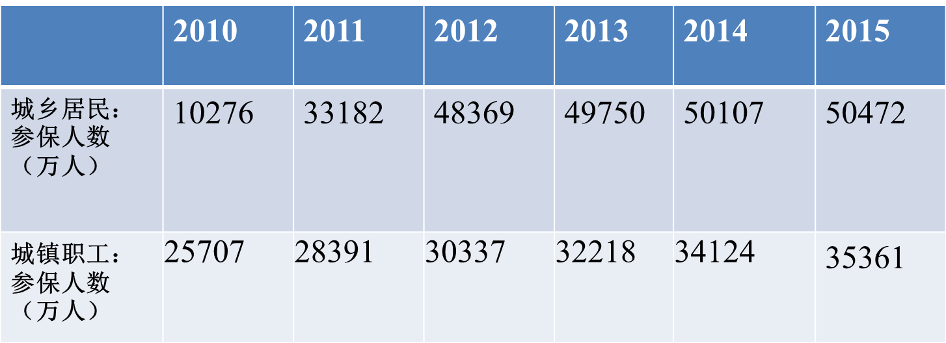
公平性与充足性 Fairness and Adequacy
2010-2015 年城镇职工和城乡居民养老保险参保情况
Participation of Old Age Insurance for Urban Employee and Old Age Insurance Urban and Rural Residents, 2010-2015
OAI for Urban Employee
(Unit:10k)
OAI for U&R Residents
(Unit:10k)
城乡养老保险制度合计已覆盖8.5亿人口
850 million people are covered in the Old Age Insurance for Urban and Rural Residents.
机关事业单位与企业实现了制度并轨
The old age insurance schemes for public organ and institutions and for state-owned enterprise are converged.

Slide 5
2010-2014 年城镇职工和城乡居民养老保险待遇情况 Pension Benefit of Urban Employee and U & R Residents, 2010-2014
养老保险待遇水平不断提高
Benefit of Old Age Pension is Increasing.
 | 2010 | 2011 | 2012 | 2013 | 2014
农村 月均养老金 （元） Monthly Pension (¥) of Rural Resident | 58 | 57 | 73 | 82 | 91
替代率（相对上年农村人均纯收入） Replacement Rate (ratio to average rural income of the previous year) | 13.55% | 11.55% | 12.60% | 12.36% | 12.33%
城镇职工 月均养老金 （元） Monthly Pension (¥) of Urban Employee | 1395 | 1558 | 1742 | 1914 | 2110
替代率（相对上年城镇单位就业人员） Replacement Rate (ratio to the employee population in the previous year) | 51.92% | 51.18% | 50.00% | 49.11% | 49.18%

Slide 6
结论（一） Conclusion 1
公平性的目标之一：实现全民覆盖，满足基本的替代率目标要求
1st Objective of Fairness: full coverage and acceptable replacement (according to certain objectives)
建议一：“十三五”期间实行全民参保计划 ，进一步提高参保质量
Suggestion 1: Encouraging full participation during the 13th Five-Year Plan period and improving the quality of participation.
建议二：建立制度化的待遇调整机制，进一步提高城乡居民养老保险待遇水平
Suggestion 2: Setting up institutionalized benefit adjustment mechanism and leveling up the benefit of the Old Age Insurance for Urban and Rural Residents.

Slide 7
公平性与可支付性 Fairness and Affordability
社保缴费过高，带来企业和个人负担
Contribution is so high that enterprises and individuals suffer the burden.
养老保险费率不统一，影响地区间公平竞争环境
Lack of universal contribution rate poses impact on fair competition among regions.
缴费激励机制不足，影响收入公平
Incentives are not sufficient, which impacts income fairness.

Slide 8
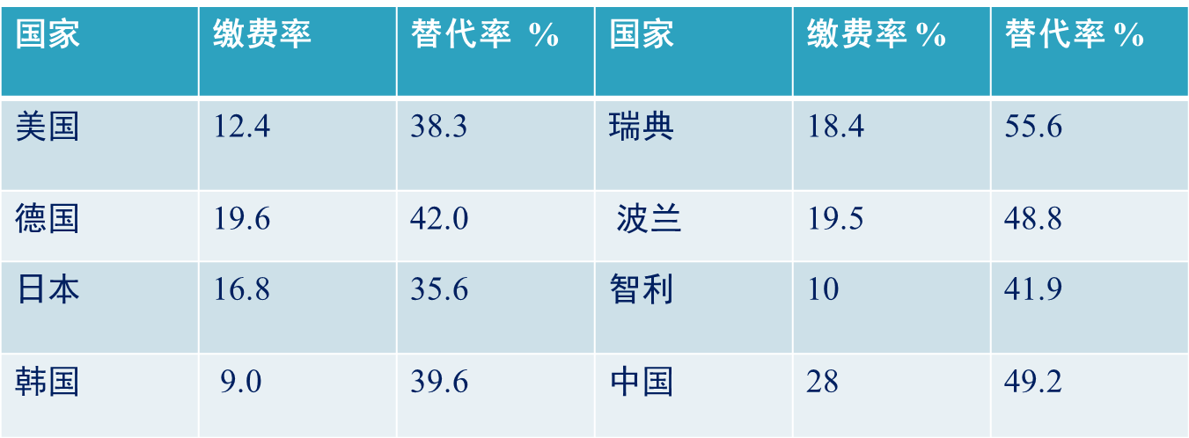
主要国家养老保险制度缴费率比较
International Comparison of Contribution Rate of Old Age Insurance Schemes
Country
Cont. Rate
Cont. Rate
Country
Repl. Rate
Cont. Rate
US
Sweden
Germany
Poland
Japan
Chile
South Korea
China

Slide 9
结论 （二） Conclusion 2
公平性的目标之二：实现养老保险缴费的可负担性
2nd Objective of Fairness : affordability of contribution to old age insurance
建议三： 做实缴费基数，费率有下调空间
Suggestion 3: Setting Realistic contribution base and providing space to adjust contribution rate.
建议四：建立多缴多得的激励机制是关键
Suggestion4 : The key is setting up incentive mechanism that provide more benefit to he or she who has higher contribution

Slide 10
公平性与可持续性 Fairness and Sustainability
养老金支出水平适度：财务才能可持续
Pension Expenditure must be moderate: only in this way can the finance be sustainable.
解决转轨成本问题 ：涉及代际公平
Transition costs should be covered: it is relevant to inter-generational fairness
地区间社保收支不平衡：影响竞争环境
Disparity of social security balance among regions: it impacts on inter-regional competition

Slide 11
2014年末各省城镇职工养老保险基金累计结余（亿元） Accrual Surplus of the Old Age Insurance for Urban Employee (Unit: RMB 100 m)
全 国 National | 31800
广 东 Guangdong | 5444 | 云 南 Yunnan | 573
江 苏 Jiangsu | 2854 | 福 建 Fujian | 490
浙 江 Zhejiang | 2696 | 内蒙古 Inner Mongolia | 472
北 京 Beijing | 2161 | 广 西 Guangxi | 448
四 川 Sichuan | 2013 | 陕 西 Shanxi | 446
山 东 Shandong | 1973 | 江 西 Jiangxi | 430
辽 宁 Liaoning | 1284 | 吉 林 Jilin | 424
上 海 Shanghai | 1260 | 贵 州 Guizhou | 407
山 西 Shanxi | 1233 | 天 津 Tianjin | 362
河 南 Henan | 931 | 甘 肃 Gansu | 361
安 徽 Anhui | 882 | 黑龙江 Heilongjiang | 323
湖 南 Hunan | 879 | 宁 夏 Ningxia | 165
湖 北 Hubei | 822 | 海 南 Hainan | 104
河 北 Hebei | 819 | 青 海 Qinghai | 84
新 疆 Xinjiang | 702 | 新疆兵团 Xinjiang Corp | 42
重 庆 Chongqing | 662 | 西 藏 Tibet | 40

Slide 12
结论（三）Conclusion 3
公平性的目标之三：维护社保财务可持续
3rd Objective of Fairness: Financial Sustainability of Social Security
建议五：提高统筹层次，解决地区间不平衡问题
Suggestion 5: Social pooling should be conducted at higher governmental level in order to smoothen disparity among regions.
建议六：划转国有资产，充实社保储备
Suggestion 6: State-owned assets can be utilized to fund the reserve of social security.
建议七：实现精算平衡，实现制度“以收抵支”
Suggestion 7: Actuarial balance should be achieved, so that the system can balance its expenditure with adequate income.

Slide 13
谢谢!
Thank you for your attention!

