Slide 1
Protecting Migrant Workers under Social Security Schemes in Europe
欧洲社保制度下对流动就业人员的保护
Beijing, China, 28 – 29 September 2016
中国北京，2016年9月28-29日
Dr. Katerina – Marina Kyrieri
卡特里娜-玛丽娜·奇里艾瑞博士
Notes:
What it needs to be remembered is that the EU is not a nation-state. It is a sui-generis on-going project where States are trying to come together by adopting common rules which can overcome the heterogeneity of the national legislative systems for the benefit of EU citizens and not only.

Slide 2

Structure 结构
Key figures of mobility and immigration within the European Union (EU)
欧盟流动就业和移民关键数据
Presentation of the social security coverage in the EU
欧盟社保覆盖的表现
Issues of administrative cooperation
行政合作问题
Problem-solving tools on social security issues
社保问题解决工具
Recommendations for policy-making
政策制定建议
The Employers’ Sanctions Directive
雇主制裁指令
Considerations for good decision-making
良好决策的考量因素
Useful Internet links
有用互联网链接

Slide 3
Key figures – European Union as an entity 关键数据：作为一个整体的欧盟
EU population: 500 million
欧盟人口：5亿
Third Country Nationals (TCNs): 19,5 million (3,9%)
第三国国民：1950万（3.9%）
Foreign-born population: 40 million (8% acquired Member State citizenship)
外国出生人口：4000万（8%取得了成员国国籍）
EU citizens living or working in another Member State: 11,5 million (2.3%)
在另一成员国生活或工作的欧盟公民：1150万（2.3%）
6 millions working in another EU Member State
在另一欧盟成员国工作的人口：600万
1,6 millions over 65 years old are residing in another EU Member State
在另一欧盟成员国居住且年龄在65岁以上的人口：1600万
1 million frontier and other cross-border workers
边境及其它跨境工人：100万
40000 unemployed looking for a job in another Member State
寻求在另一成员国就业的失业人口：4万
Notes:
10% have lived and worked in another country - 65 million,
3% lived in another country but did not work there,
17% envisages working abroad in the future – 85 million,
Learning mobility: 8% went to school in another country, 3% to university and 4% participated in training abroad.
More than 50% of Sweden, Norway, Luxembourg, Austria and Germany have friends from another country. Around 30% for Belgium, UK, Portugal, France, Italy, Greece and the Netherlands.
Significant also increases exist in commuting streams with Switzerland being +59000, Luxembourg +40000, Austria + 34000, the Netherlands + 25000.
250.000 people at least would need to export a part of their pension rights every year
Frontier workers are persons employed or self-employed in one MS, residing in another MS to which they return, as a rule, daily or at least once a week.
Other cross-border workers are persons employed in one MS and residing in another MS to which they return less often than a frontier work (e.g. less frequently than once a week). However, they are still considered to have their place of residence (e.g. centre of their personal interests, family etc.) in a MS other than the state of employment.
Among recent active EU-28 movers, highly educated people are slightly more likely to move (2.3% have moved) than the total active population of working age (1.9%). The number of TCNs is slightly higher than that of EU-28 movers TCNs make up around 58% of all foreigners, EU-28 movers make up around 41% and EFTA movers only around 1%. Both across the EU-28 and EFTA and in the five main countries of residence (DE, UK, ES, FR, IT), the largest shares of EU-28 movers are of working age (over 65%).

Slide 4
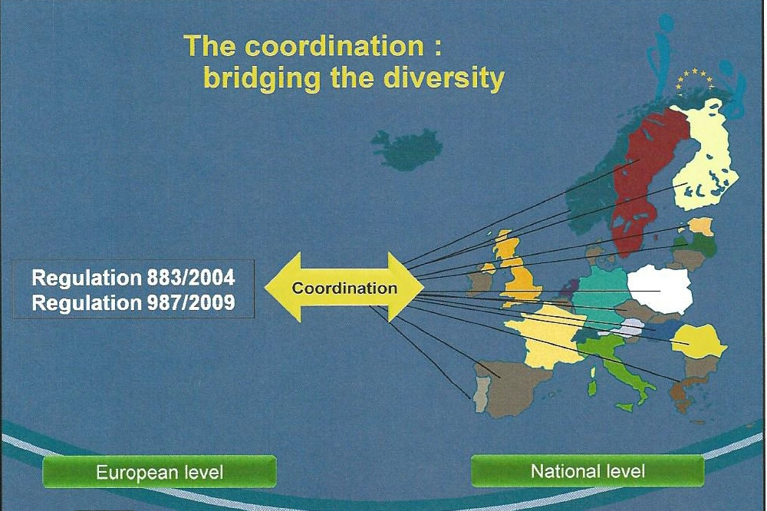
Universal coverage in European Social Security Systems 欧洲社会保障体系的普遍覆盖
协调：连接多样性的桥梁
协调
第883/2004号条例
第987/2009号条例
欧盟层面
国家层面
Notes:
The EU provisions on social security coordination do not replace national social security systems with a single European one. Yet, they prevail.
As regulations have general legal force they apply directly in all MS. They are binding upon everyone and they have to be observed by national authorities and administrations, social security institutions and courts. Even in cases of conflict with national law, the EU rules have priority.
Rather than harmonizing the national social security systems, the EU provisions provide for their coordination. Harmonization is, from a political point of view, not possible as the social security systems of the Member States are the result of long-standing traditions deeply rooted in national culture and preferences.
In terms of coordination, it means that every MS is free to decide who is to be insured under its legislation, which benefits are granted and under what conditions, how these benefits are calculated and what contributions should be paid. The coordination provisions provide common rules and principles by all national authorities, social security institutions, courts and tribunals when applying nationals. We will examine these at a later stage. What is the importance of coordination of social security rights? It is to ensure that citizens do not lose their rights when using freedom of movement. Examples:
I reside in Greece and regularly do seasonal work in different EU countries. Where I am insured? (social security)
What happens if I have an accident whilst looking for a job abroad? Will my health insurance cover me? (health)
I work in Finland, but my family has remained in Estonia, our home country. Where should I claim child benefits? (family benefits)
As a German worker posted to France by my employer, where can I claim unemployment benefits if I am made redundant while in France, and have my residence in Germany? (unemployment)
I am a British pensioner. If I decide to live in Spain, will I get my pension there? (pensions)

Slide 5
Personal Scope and application of the rules 规定的范围和适用
Legislation 法律 | Moving within the EU 在欧盟境内流动者
Basic Reg. 883/2004 第883/2004号基本条例
Implementing Reg. 987/2009 第987/2009号实施条例 | All EU nationals who are covered under national law 受本国法律保护的所有欧盟国民
Association agreements 成员协议 Decisions No 76/2011 & No1/2012 第76/2011号和第1/2012号决定 | EEA (28+Norway, Iceland, Lichtenstein) and Switzerland 欧洲经济区（28国+挪威、冰岛、列支敦士顿）和瑞士
Reg. 859/2003 第859/2003号条例
Reg. 1231/2010 (replaces Reg. 859/2003 – except for UK) Does not apply to DK or to EFTA States 第1231/2010号条例（替代了第859/2003号条例，但在英国除外），不适用于丹麦或欧洲自由贸易联盟成员国 | 1/3 legally resident Third-Country Nationals ‘in a situation not confined in all respects within a single Member State’ 1/3“在一成员国不受任何限制”且在第三国合法居住的国民
Notes:
Personal scope: Nationals of a MS (and stateless persons or refugees) who ‘are or who have been subject to the legislation of a MS’ (Art. 2 of the Reg. No 883/2004) in a cross-border situation plus extension of the Regulation via Reg. 1231/2010 for TCNs.
Material scope: List of social security risks set out in Art. 3 of the Reg. No 883/2004;
However, the provisions do not apply to: social and medical assistance: these are benefits which are normally means-tested and not linked to the categories of risks that we will examine. They also do not apply to benefits granted to victims of war, military actions or their consequences, to victims of crime, assassination or terrorist acts, to victims of damages occasioned by agents of the state in the course of their duties, or to victims who have suffered a disadvantage for political or religious reasons or for reasons of descent.
Yet, special / hybrid non-contributory cash benefits (e.g. adoption allowances, child benefits) which are not exportable are also included.
One effect of the 1231/2010 is that TCNs in cross-border situations can benefit from the principle of equal treatment contained in Art. 4 of the Reg. No 883/2004. This means that those TCNs who are entitled to an old-age pension from an EU State, will enjoy equal treatment with nationals of the paying State as regards payment of this pension outside the EU (closely assimilated to a property right protected by the ECHR).

Slide 6
The impact of EU law on national bilateral agreements with Third Countries (TCs) 欧盟法律对成员国与第三国之间双边协议的影响
In cases of conflict, EU Regulations take precedence over national rules contained in bilateral agreements with TCs;
在冲突情况下，欧盟条例优先于成员国与第三国之间双边协议的规定；
Bilateral agreements should apply in a compatibility with Reg. 1231/2010;
双边协议应与第1231/2010号条例相兼容；
A clause in this regard should be included in all agreements with TCs;
这种条款应纳入成员国与第三国之间签订的所有双边协议；
A common EU approach to social security coordination with TCs is needed and is now developing.
欧盟协调第三国社会保障问题的共同方法不仅有必要，而且已经在开发过程中。
Notes:
Reg. 1231/2010 gives the European Union exclusive competence as regards the social security coordination rights of TCNs who are in cross-border situation within the EU. Thus for example, an Indian who is sent to Belgium under the terms of the bilateral agreement of the two contracting parties and then moves to the Netherlands, Reg. 1231/2010 will apply to this second move. Also, where an Indian works in both Portugal and Spain for his company which is outside of the EU, the EU rules on applicable social security legislation will apply.
The principle of non-discrimination (Gottardo judgment) needs to be incorporated in every bilateral agreement concluded. This suggests that Member States may need to obtain data such as on insurance records, employment, residence periods from TCs for nationals of EU states other than their own, and/or verify information.
As the national approach whereby MS make bilateral agreements with selected countries is patchy and agreements tend to have a differing content from country to country, a common EU approach is currently under development. If Member States cooperate and where appropriate, act together, they will enjoy a stronger bargaining position vis-à-vis TCs, be better placed to solve common challenges/problems and ensure together that the way they apply bilateral agreements complies with EU law.

Slide 7
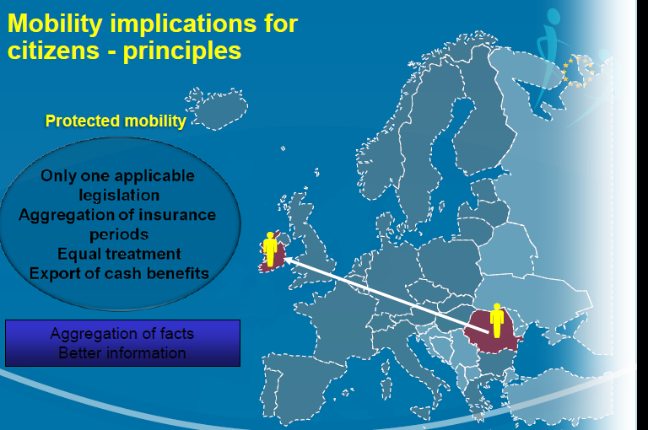
Principles 原则
流动对公民的影响：原则
受保护的流动
只有一项适用法律
保险期间的叠加
平等待遇
现金福利的出境
事实聚合 信息优化
Notes:
Only one applicable legislation: the “principle of unicity” suggests the prevention of overlapping benefits. Contributing to compulsory social security systems in two or more MS during the same period of insurance does not confer the right to several benefits of the same kind. Even persons who are employed in 4 or 5 MS are subject to the legislation of one single MS at a time. The new regulations also introduce the possibility for a citizen to have a temporary registration and access to benefits when MS’ views diverge over which legislation should be applied. This guarantees that no one will be left without social security coverage while waiting for a MS decision.
- Economically active persons are subject to the legislation of the MS where they work; There is an exemption though with regard to posted workers and mariners. A posted worker is a person who is normally employed in one State but is sent temporarily to another State to work for his/her undertaking. The maximum period for posting is 24 months and in this case he/she remains insured in the state where he/she is normally employed, meaning he/she continues paying contributions to the social security system of that State.
A mariner who works on board a sea vessel flying the flag of a MS, he/she will be covered by the legislation of that State. If the registered place of business of the employer is in a different MS than the one flying the flag and this is also the place of residence, then the mariner will be covered by the state of residence.
Non-economically active: the MS of their residence;
The aggregation principle means that the competent MS must take into account of periods of insurance and employment completed under another MS’s legislation in deciding whether a worker satisfies the requirements regarding the duration of the period of insurance or employment.
The principle of equal treatment is composed of 3 elements: equalization of facts or assimilation of benefits, income or events, aggregation of periods and retention of rights. The right to equal treatment applies unconditionally to any worker or self-employed person from another MS having resided in the host State for a certain period of time.
Exportability suggests that social security rights can be paid throughout the Union and MS cannot reserve the payment of benefits to only residents in the country.

Slide 8
Which matters are covered by the EU provisions on social security coordination? 欧盟的社会保障协调规定覆盖了哪些问题？
Art. 3 Reg. No 883/2004
第883/2004号条例第3条
10 ‘traditional’ risks
10项“传统”风险
Sickness benefits,
疾病津贴，
Maternity and equivalent paternity benefits,
生育及丈夫陪产假津贴，
Invalidity benefits,
伤残津贴，
Old-age pensions,
养老金，
Survivors’ benefits,
抚恤金，
Benefits in respect of accidents at work and occupational diseases,
工伤事故和职业病津贴，
Death grants,
死亡补助，
Unemployment benefits,
失业津贴，
Family benefits,
家庭津贴，
Pre-retirement benefits.
退休前津贴。
Notes:
Sickness benefits in cash - are paid according to the legislation of the State where the person is insured. Sickness benefits in kind - are given by the State where the person resides or stays as if he/she was insured in that State. If the person is a cross-border worker or member of his/her family the rights are derived from the State of work. Yet there are restrictions for family member of other frontier workers (commuters once a week) and pensioners (State of residence).
Accidents at work and occupational diseases – important to notify the authorities where a worker is insured when an accident happens or a professional disease is diagnosed for a first time. Failure to so can negatively affect the process for granting benefits in cash.
Invalidity pensions are calculated in a similar way to old-age pensions- the amount of invalidity pension depends on the length of the insurance periods in some MS and in some others it is independent so the same amount of pension will be paid regardless of years of insurance. This reflects the principle of so-called risk-based schemes where the amount of pension does not depend on the length of insurance and a person needs to be insured at the time he/she becomes invalid.
Old-age pensions: any periods of insurance completed in another MS and contributions paid will be taken into account. Nothing is lost but it is important to receive information from the States paying the pensions and the consequences delaying the payments (65 or 67 pensionable difference age).
Survivors benefits – have to be paid without any reduction, modification or suspension regardless of where the surviving spouse resides.
Death grants – these will be paid by the institution of the State where the deceased person was insured. Special rules apply in the event of death of pensioner or his/her family members (e.g. country of residence).
Unemployment benefits – to be claimed in the state where the person was last employed (except for cross-border workers). If family members reside in another MS, unemployment benefit increases according to the number of members and they will be taken into account as if they were residing in the state which pays the benefits. In case of partial employment, responsible is the State of work. If a person looks for a job in another MS, he/she is entitled up to 6 months unemployment benefit.
Family benefits – to be claimed in the State where the person was insured as employed or self-employed. If family members reside in another MS they will receive the benefit from the State which gives the highest amount as a difference supplement, not possible to receive benefits twice over the same period and for the same family members. The State which pays based on employment or self-employment takes precedence over the one based on pension or residence. In cases where family benefits are based on residence, the state where the children reside prevails. Pre-retirement benefits: periods of insurance, employment or residence are not considered when benefits are awarded.

Slide 9
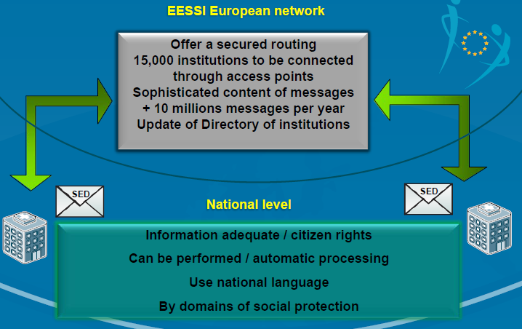
EESSI欧洲网络
提供安全可靠的路径
通过接入点连接了15000个机构
详细的信息内容
每年1000多万信息
机构黄页的更新
国家层面
充足的信息/公民权得以行使/自动处理
使用本国语言
按社会保护领域划分
Notes:
One of the main innovations introduced by the new Regulations is the obligation for MS to exchange social security information only by electronic means (Art. 4 of the Implementing Regulation 987/2009). In order to reach the objective set by the Regulations, an integrated system providing a common secure framework was set up. This system is called EESI (Electronic Exchange of Social Security Information). Currently 32 States are participating in the information exchange (28 MS + Iceland, Norway, Lichtenstein and Switzerland). EESI is a messaging system that allows over 50.000 national social security institutions to exchange social security information electronically in a secure manner. It replaces the previous paper E-forms and eliminates errors and fraud.
Legal Framework: Art. 78 of Reg. 883/2004, Art. 4(2) of Reg. 987/2009: “The transmission of data between the institutions of the liaison bodies shall be carried out by electronic means either directly or indirectly through the access points under a common secure framework that can guarantee the confidentiality and protection of exchanges of data”. It includes information which respects the rights of the mobile citizens.
One of the problems of the system is the overlap of the competencies of the insurance institutions. Capacity to identify what is the relevant and competent partner in the other country.
It is about information which can be processed automatically at national level.
The Structured Electronic Documents (SED) are organized according to the type of the one of the traditional risks or benefits described above, and the type of action needed. It is important to organize the documents in such a way which can be understood and analyzed without translation (in 24 languages). Unnecessary information should be avoided. The system can support the exchange of 10 million electronic messages.
Possibility of identifying 85 business flows and elaborate 300 messages structured in an electronic way.

Slide 10
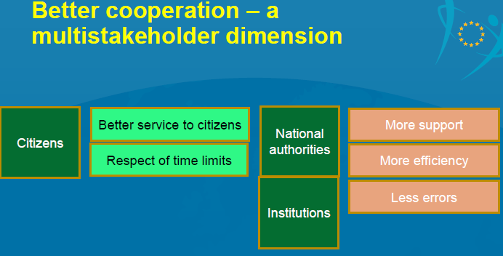
Principle of good administrative cooperation 进行良好管理合作的原则
更好的合作-多利益相关方维度
为公民提供更好的服务
更多的支持
公民
国家当局
尊重时限
更高的效率
更少的错误
机构
Notes:
Overall aim: to make citizens' rights more effective whilst at the same time facilitating institutional processes
Art. 3(1) IR: mutual requirement on citizens and institutions to provide each other with information
Enhanced administrative cooperation between all stakeholders has been made the driver of the new regime: Between MS authorities to eliminate fraud and errors,
Between MS authorities and social security institutions; between those Institutions and between the citizen and the Institutions (better service).
Providing an efficient service to the person concerned, helping institutions to exchange with each other the necessary information smoothly and timely is required in a lot of the provisions of the Reg. even though they seem less detailed than the Regulation No 574/72.
Dialogue and conciliation procedures in case of conflict among institutions and/or authorities
6(3) IR: Dialogue and conciliation procedure through an administrative Commission in the event of:
• Doubts about the validity of a document or the accuracy of the facts
• Difference of views concerning the determination of the applicable legislation
• Difference of views about which institution should provide the benefits in cash or in kind.
Unfamiliarity with foreign languages is not a problem. Claims, letters, certificates and other documents may be presented in the mother tongue of one of the EU official languages.

Slide 11
Art. 5(2) (3) IR No 987/2009 – Combating fraud 第987/2009号IR第5（2）、5（3）条 - 打击欺诈
Art. 5(2): “Where there is doubt about the validity of a document or the accuracy of the facts on which the particulars contained therein are based, the institution of the Member State that receives the document shall ask the issuing institution for the necessary clarification and, where appropriate, the withdrawal of that document. The issuing institution shall reconsider the grounds for issuing the document and, if necessary, withdraw it”.
第5（2）条：“如对某一文件的合法性或支持该文件所含细节信息的事实的准确性存在疑问，则接收文件的成员国机构应要求文件发布机构进行必要澄清，如果适当，甚至可要求其收回该文件。文件发布机构应重新审查发布该文件的依据，必要时应收回文件。”
Art. 5(3): “[…] where there is doubt about the information provided by the persons concerned, the validity of a document or supporting evidence or the accuracy of the facts on which the particulars contained therein are based, the institution of the place of stay or residence shall, insofar as this is possible, at the request of the competent institution, proceed to the necessary verification of this information or document”.
第5（3）条：“【……】如对相关人员提供的信息、某一文件或其支持证据的合法性或支持该文件所含细节信息的事实的准确性等存在疑问，则该人员逗留或居住地的机构须应相关机构的请求尽可能对该信息或文件进行必要核实。”
Notes:
Obtaining data from another EU insurance institution is crucial in the context of combating fraud. The legal provisions of the IR allow MS to request verification of information from the MS where the beneficiary resides. This enables paying institutions to ensure, for example, that the beneficiary of a pension is still alive or that a person meets the conditions for receiving an invalidity pension.
According to the new coordination rules, a person has the right to ask for a review of a national decision for instance on a pension entitlement, where it appears that rights may have been adversely affected by the interaction of the decisions taken by two or more institutions. The time limit for asking for such a review runs from the date the person receives the summary note and within the time limits applicable in national law.

Slide 12
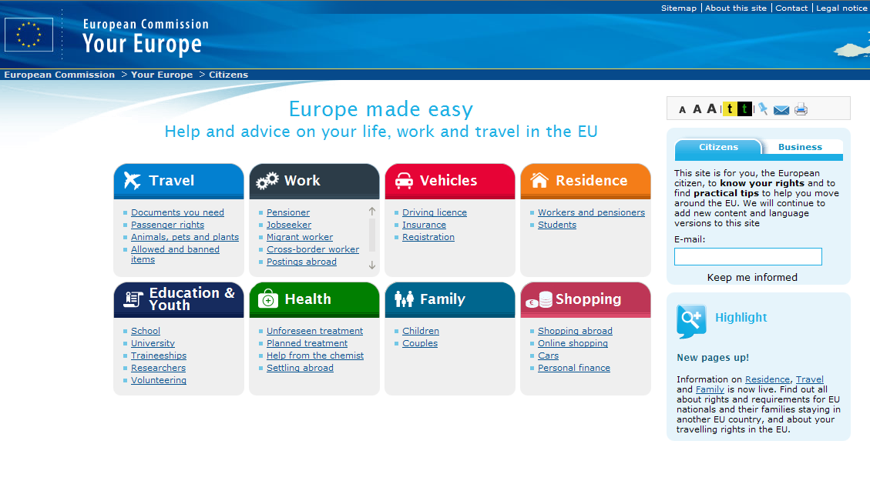

Problem-solving tools on social security
Notes:
Your Europe Advice provides advice on EU rights and on the implementation of EU law in all Member States. It consists of a network of experienced multilingual lawyers.
EU citizens can seek an advice or help with EU rights. Service can be given regarding personal advice as to EU rights or get help to get EU rights recognized. A wide range of topics is covered.
Social security issues remain the top area of concern for EU citizens who exercise their free movement rights. Almost 30% of the enquiries that Your Europe Advice legal experts handle yearly touch exclusively upon this area, representing about 6,000 enquiries per year.
Enquiries can vary from simple requests to real analyses of EU law. They can be submitted either online or by telephone and replies are provided either on the phone or by email. More than 20.000 replies were provided in 2014 and on high time.
Within social security enquiries, access to healthcare is a particular source of concern for mobile EU citizens. About 2,300 enquiries of sickness benefits are being handled every year by Your Europe Advice legal experts. Tailor-made replies are provided within less than a week and in any EU official language.
Since 2013, there exists the EU rights clinic- EU rights clinic fills in the gap between advice and active help by supporting citizens to draft letters to the authorities or intervening on their behalf. The database of 120.000 records is the largest single source of evidence of citizens’ preoccupation and evidence of barriers to free movement.
Solvit was set up in 2002 to deliver real solutions within a short period of time. It is committed to defend the EU citizens’ rights and businesses; There is emphasis on fast and pragmatic solutions with the help of online case-handling database; it has knowledge of EU law and access to Commission experts’ advice; there is a strong network of contacts with relevant authorities at national level.
If faced with a cross-border problem caused by the incorrect application of EU rules by a public authority at national, regional or local level. Citizens or businesses can fill out an online complaint form or contact their national SOLVIT centre by email or telephone. The online form and all contact details for national SOLVIT centres are available on the SOLVIT website.

Slide 13
社会保障问题解决工具
便利欧洲
欧盟生活、工作和旅行相关帮助和建议
公民
本网站专为作为欧洲公民的您了解自身权利并寻求实用建议提供帮助，以便你在欧盟境内顺利旅行。我们将继续为您增加新的内容和语言版本。
旅行
工作
汽车
住宅
所需文件
旅客权利
动物、宠物和植物
允许和禁止携带的项目
退休人员
寻求就业人员
流动工人
跨境工人
国外职位
驾照
保险
注册
在职人员和退休人员
学生
教育和青年
健康
家庭
购物
新网页上线了！
关于居住、旅行和家庭的信息现在已经上线了。请通过相关网页了解欧盟国民及其家庭在另一欧盟国家逗留所享有的权利和应满足的要求，同时了解在欧盟境内旅行的所有权利。
学校
大学
培训
研究人员
志愿者
突发疾病治疗
计划治疗
药剂师的帮助
国外定居
儿童
夫妻
国外购物
在线购物
汽车
个人理财
有效解决你在欧洲遇到的所有问题
Notes:
Your Europe Advice provides advice on EU rights and on the implementation of EU law in all Member States. It consists of a network of experienced multilingual lawyers.
EU citizens can seek an advice or help with EU rights. Service can be given regarding personal advice as to EU rights or get help to get EU rights recognized. A wide range of topics is covered.
Social security issues remain the top area of concern for EU citizens who exercise their free movement rights. Almost 30% of the enquiries that Your Europe Advice legal experts handle yearly touch exclusively upon this area, representing about 6,000 enquiries per year.
Enquiries can vary from simple requests to real analyses of EU law. They can be submitted either online or by telephone and replies are provided either on the phone or by email. More than 20.000 replies were provided in 2014 and on high time.
Within social security enquiries, access to healthcare is a particular source of concern for mobile EU citizens. About 2,300 enquiries of sickness benefits are being handled every year by Your Europe Advice legal experts. Tailor-made replies are provided within less than a week and in any EU official language.
Since 2013, there exists the EU rights clinic- EU rights clinic fills in the gap between advice and active help by supporting citizens to draft letters to the authorities or intervening on their behalf. The database of 120.000 records is the largest single source of evidence of citizens’ preoccupation and evidence of barriers to free movement.
Solvit was set up in 2002 to deliver real solutions within a short period of time. It is committed to defend the EU citizens’ rights and businesses; There is emphasis on fast and pragmatic solutions with the help of online case-handling database; it has knowledge of EU law and access to Commission experts’ advice; there is a strong network of contacts with relevant authorities at national level.
If faced with a cross-border problem caused by the incorrect application of EU rules by a public authority at national, regional or local level. Citizens or businesses can fill out an online complaint form or contact their national SOLVIT centre by email or telephone. The online form and all contact details for national SOLVIT centres are available on the SOLVIT website.

Slide 14
Bringing a case to court 诉讼
1. Unfamiliarity from local institutions with the relevant provisions of national or EU law and the respective case-law of both national courts and the Court of Justice of the European Union (CJEU)
国内机构对国内法或欧盟法律及国内法院和欧盟法院的各种惯例法不甚了解
2. Narrow or broad interpretation of existing provision by the institution concerned.
相关机构对现有规定的解读过窄或过宽
3. Gaps in legal texts and unforeseen situations which need correction and thus a court decision (e.g. Suspension of pension or other benefits for unjustified reasons)
法律文本与未预料到情形之间存在鸿沟，因而需要纠正和法院判决（如养老金或其它福利因不合理原因被中止的情形）
Precondition! All appeals before the social security institutions are exhausted.
前提条件！ 在社会保障机构的所有上诉程序均已用尽。
Notes:
In case there are doubts always insist on receiving a written decision in order to be able to support a potential appeal.
Exhaustion of all national legal means is important as otherwise the claimant risks to lose the right to go to court. The same applies in case the claimant waits too long after the final decision was made by the competent institution to deal with the appeal.
As a court case in general can prove to be very expensive, regardless of whether the appeal succeeds or fails, it is recommended to first contact a legal adviser specializing in the subject.
Over 50 years ago, the CJEU has delivered more than 600 judgments on the provisions’ interpretation. Most of them are in favour of migrant workers and their family members.
Without the case-law of the Court of Justice the protection offered by the EU provisions on social security coordination would be less efficient, less complete and less satisfactory. The Court of Justice is the legal guardian of European citizens exercising their right of movement and stay in Europe. The Court of Justice does not directly rule on individual cases. Its judgments are limited to the interpretation of the provisions and this interpretation is binding on all parties.
The route is to exhaust all national legal procedures and appeals and in case of doubt the national court through a reference for a preliminary ruling will ask the CJEU how a specific provision should be interpreted.
The European Commission may also refer a matter to the CJEU when it considers that provisions of national laws and regulations are incompatible with EU rules (the so-called infringement procedure). However, this is not much used as it is time-consuming.

Slide 15
Social Security Challenges 社会保障面临的挑战
EU citizens are not well-informed of their social security rights and mechanisms of redress;
欧盟公民对其社会保障权利和救济机制并不是特别了解；
Lack of sufficient information towards citizens;
缺乏面向公民的充分告知；
Lengthy or unclear administrative procedures and harmonisation gaps;
管理程序冗长或不清晰，或存在协调上的不足
For highly mobile workers, there is a cumulative impact of diverse factors:
对具有高度流动性的工人而言，下列各种因素会产生叠加影响：
Frequent short-term mobility,
经常出现短期流动，
Various employment status,
存在多种就业身份，
Several employers,
拥有多名雇主，
Low predictability of work assignments,
工作任务可预测性较低，
Administration complexities,
管理复杂，
Lack of stability.
缺乏稳定性。
Notes:
Across the EU, just over 4 in 10 respondents say they feel informed about their rights as citizens of the European Union, and close to 6 in 10 feel that they are either not very well informed or not at all informed. When it comes to information about the existing tools for enforcement, less than 3 in 10 Europeans know what to do if their rights as EU citizen are not respected, which shows that there is still significant room for improvement in the context of providing citizens with information.
In a survey between September to December 2015 by the Directorate-General for Justice and Consumers, in which ECAS also participated, close to 4 in 10 respondents out of those who had either lived or were living in another EU country for at least 3 months said they had experienced difficulties in exercising their rights as EU citizens after having moved, and they pointed to lengthy or unclear administrative procedures and to a lack of sufficient information as main hurdles.
Indeed, there is more need for Increase of the access to information and for provision of administrative advice and support, including the role of the EU Institution.
Also, there is a need for stability of the applicable legislation for a period of 12 months in case of hyper mobility. This can be defined as frequent short-term mobility, with various employment status, several employers, low predictability of work assignments or being a posted worker, cross-border, other frontier worker.
Any new proposal that would be part of the upcoming Labour Mobility Package should focus in particular on a number of areas which have not been satisfactorily covered up to now, namely unemployment, the portability of health-care and long-term benefits.
A further area which needs to be tackled refers to the way the social security coordination rules on the idea of standard employment relationships, so as to exclude or limit the social security rights in atypical employment (e.g. part-time, casual, fixed-term, temporary agency workers, self-employed, independent, home-workers and tele-workers) to name but a few.

Slide 16
Recommendations for policy-making 政策制定相关建议
General Remark: Changing general attitude: the right to practice mobility, move, reside and work freely within the EU, should be understood as a POSITIVE challenge, it should be encouraged.
一般评述：改变大众态度：在欧盟境内自由流动、迁徙、居住和工作的权利应视为一种积极挑战，应该得到鼓励。
What can be concretely done?
具体应该做些什么？
Raising awareness about first-hand information on EU law available at EU level has to be considered an essential part of enabling citizens to exercise and enforce their rights.
提高公民对欧盟层面现有法律相关第一手信息的意识应视为促使公民行使自己权利努力的重要组成部分。
Raising awareness of the informal redress mechanism available for citizen, at the local, national and European level and develop them. It will lead to a faster resolution of citizens’ problems in a citizen-friendly way.
提高公民对地方、国内和欧盟层面现有非正式救济机制的意识并大力开发这种机制。这将加速以公民友好方式解决公民问题。
Develop a more proactive approach:
(e.g. training of the civil servants)
开发更加积极的方法：
（开展如公务员培训）
Notes:
Example of the Hungarian referendum on 2 October 2016 – The question of the Hungarian referendum will be: “Do you agree on having a quota on immigration by constraint from the European Union”?

Slide 17
Illegal employment and employers’ sanctions 非法就业和雇主制裁
One way to reduce illegal immigration is to sanction employers of illegally staying third country nationals
减少非法移民的方法之一，是对那些非法容留第三国国民的雇主进行制裁。
7 - 16% of the Union’s Gross domestic Product (GDP) is estimated to come from the shadow economy, though this is not entirely staffed by irregular migrants
据估计，欧盟GDP总量的7-16%源自影子经济，尽管这些GDP并不是全部由非正规移民创造的。
led to wide –scale regularisations
这导致了大规模的正规化运动。
Directive 2009/52/EC providing for minimum standards on sanctions and measures against employers of illegally staying third country nationals
第2009/52/EC号指令针对非法容留第三国国民的雇主制订了最低制裁标准和措施。
Removal of incentives in the destination countries
要求目的地国家取消激励措施。
Promote legal immigration channels for the benefit of migrants, employers and Member States.
倡导合法移民途径，以利于移民、雇主和成员国等各方。
Notes:
In 2013, 386.230 TCNs were found to be irregularly present in the EU, down from 608.870 in 2008 . This decrease is partly attributed to economic crisis.
However, the phenomenon of illegal immigration is by nature hard to quantify and ranges between 5 and more 8 million. Employment of TCNs who are illegally staying is the result of migrants seeking a better life, meaning demand from employers who are willing to take advantage of workers, ready to undertake low-skilled, low-paid jobs in labour-intensive sectors.
Construction, agriculture, cleaning, hotel/catering and textile industries are the main sectors which greatly involve undocumented work in general and attract irregular migrants in particular (e.g. in Italy 18.4% of irregular migrants were employed in the service and 18.3% in the agricultural sector). It is not a coincidence that given the difficulties in tolerating the sustained presence of significant numbers of illegally residing TCNs in their territories, some MS (e.g. UK and the Netherlands) initiated regularisation programmes and others (e.g. Belgium, France, Italy, Greece, Portugal and Spain) undertook large-scale fait accomplit regularisations for those who were illegally employed.
The Directive toughens sanctions for illegal employment and improves the detection mechanisms, while providing for protective measures designed to undress injustices suffered by irregular migrants. It tries to strike the right balance between securitisation against migration flows and prevention. Prior to the Directive’s entry into force it was possible not only to expel an alien not having a work permit but also to imprison an irregular migrant (e.g. Denmark).
Illegal employment is damaging, causing a lack of contributions to public budgets in the form of taxes or social security payments, replacing workers or non-hiring of workers through legal channels, resulting in individuals having to work under hazardous conditions without insurance. Yet, an illegally employed TCN should not derive a right to entry, stay and access to the labour market from the illegal employment relationship or from the payment or back payment of remuneration, social security contributions or taxes by the employer or by a legal entity which has to pay instead of the employer (Preamble 14 of the Directive).

Slide 18
The Employers Sanctions Directive 2009/52/EC – Objectives 雇主制裁指令（2009/52/EC）-目标
Generally prohibits the employment of TCNs who are illegally staying with the EU territory (Art. 3)
普遍禁止非法在欧盟境内逗留的第三国国民进行就业（第3条）
requires employers to check permits (Art. 4)
要求雇主检查工作许可证（第4条）
Sanctions’ infringements
违反制裁规定的惩罚：
fines (Art. 5)
罚款（第5条）
back payments (Art. 6)
补缴税费（第6条）
other penalties like exclusion from public benefits (Art. 7)
诸如剥夺公共福利之类的其它惩罚（第7条）
criminal penalties (Arts. 9 & 10)
刑事制裁（第9、10条）
allows foreign nationals to register complaints (Art. 13)
允许外国国民进行投诉（第13条）
requires Member States to undertake inspections (Art.14)
要求成员国实施检查（第14条）
Notes:
In July 2011, MS were to transpose the Directive. The Commission launched infringement proceedings against 20 MS which have all been closed since then. Several MS go now beyond the scope of the Directive by applying it also to TCNs who are illegally-staying but whose residence permit does not allow them to perform economic activity (e.g. family members).
In order to ensure the effectiveness of this prohibition, employers would be required before recruiting a TCN to check that they have a residence permit or another authorisation for stay valid for the period of employment (Art. 4). Infringements would be sanctioned by penalties (which may be administrative in nature - (Art. 7), of fines (e.g. financial penalties for each illegally employed TCN and payments of return costs) - (Art. 5), as well as back payments comprising outstanding remunerations, taxes, social security contributions (Art. 6).
The directive also allows foreign nationals to register complaints and have protection against exploitative working conditions (Art. 13).
Finally, the Employers Sanctions Directive requires Member States to undertake inspections in identified sectors of activity where illegal employment increases (Art. 14). The selection of the companies subject to control will be based on a risk assessment analysis carried out by the competent national bodies considering the sector in which a company operates. Whether inspections will be linked to those designed to detect breaches of health and safety law, breaches of tax or customs regulations and other crimes, it still appears not to be the case.

Slide 19
Overview of financial sanctions in Member States 成员国经济制裁概述
Art. 5 (financial sanctions)
第5条（经济制裁）
The amount shall proportionally increase with the number of illegally staying TCNs.
制裁金额应随着非法容留的第三国国民数的增加而相应增加。
Only CY, FI, HU, NL and PL have used the option for reduced sanctions Art. 5(3) where the employer is an individual (a), employment is for private purposes (b) and where no particular exploitative working conditions are involved (c).
只有塞浦路斯、芬兰、荷兰和波兰等国采用了下列减轻制裁措施选项，即第5（3）条：如（a）雇主为个人、（b）雇佣属私人目的且（c）不存在特别具剥削性质的劳动条件，则可减轻制裁。
Other than SE and IT, which include the average cost of return in the financial penalty, MS require the employer to pay the costs of return, on top of the financial sanction.
除瑞典和意大利将平均遣返成本纳入经济制裁额度之内，其它所有成员国均要求雇主在经济制裁之外另行支付遣返成本。
MS fall into two categories:
成员国分为两类：
1^{st.} The fine increases proportionally with every illegally employed TCN.
第1类：罚款金额随着每一非法雇用第三国国民的增加而相应增加的国家。
2nd. The judge sets the precise amount depending on the number of irregular migrants involved.
第2类：法官就非正规移民数设定明确罚款金额的国家。
Notes:
For the 1st category: The minimum or fixed amount of the financial sanction per illegally employed irregular migrant varies from 300 EUR in BE to 10.001 EUR in ES. Most MS have also set a maximum fine which varies from 854 EUR in CY to 100.000 EUR in ES for a natural person.
For the 2nd category: The maximum amount of the fine varies from 500 EUR in LV to 500.000 EUR in DE. This shows that the amounts of the fines vary considerably among MS and could raise concerns that the level of financial sanctions does not outweigh the benefits of employing irregular migrants. Thus, a comparison with a minimum wage can serve as an indication to provide an assessment of the proportionality of sanctions.
In this context, the maximum penalty per irregular migrant in LU is 1.3 times the monthly minimum wage. In LV, it is 1.7 times higher than the monthly minimum wage. In BG, the maximum fine is striking, 24.2 times the minimum monthly wage, and CZ where the overall amount for the maximum is 584 times the monthly minimum wage per person.
At all times, having the political will to tackle illegal employment and immigration will always find opponents and hurdles. Also, imposing the hardest financial sanctions will not necessarily lead to the best results of legality and rule of law; however, it can prevent fractions. Proportionality and regular inspections/controls with a political will to tackle illegal employment is a good approach in reducing actual and potential numbers of employers’ abusing or considering to abuse the national systems.

Slide 20
Overview of criminal sanctions (Arts. 9,10 & 7) 刑事制裁概述（第9、10、7条）
MS:
成员国：
In BE, FI, FR, IT, MT, NL, SE illegal employment constitutes a criminal offence with or without aggravating factors;
在比利时、芬兰、法国、意大利、马耳他、荷兰和瑞典等国，无论有无加重情节，非法雇佣均构成刑事犯罪；
The remaining MS have in general criminalized illegal employment in all circumstances;
剩下的欧盟成员国通常均已将所有情形下的非法雇佣行为入刑；
RO did not specifically penalize illegal employment in cases of ‘particularly exploitative working conditions’ - (National legislation on human trafficking);
罗马尼亚特别规定，“存在特别具剥削性劳动条件”的非法雇佣情形不予入刑（国家人口贩卖相关立法）；
CZ, ES and LT did not also penalize in cases ‘where the employer knows that the worker has been a victim of human trafficking – (National legislation on human trafficking);
捷克、西班牙和立陶宛也不将“雇主明知工人为人口贩卖受害者”的情形入刑（国家人口贩卖相关立法）。
Legal Entities:
法人：
Fines, liquidation, limitation of rights and confiscation of property;
罚款、清算、权利限制和财产没收等；
Loss of entitlements to some or all public benefits for up to 5 years;
在最长达5年的时间里丧失享受全部或部分公共福利的权利；
Exclusion from participating in public contracts for up to 5 years;
在最长达5年的时间里剥夺参与公共合同的权利；
Recovery of some or all public subsidies given to employer in the 12 preceding months prior to detection;
收回被发现前12个月内给予雇主的全部或部分补贴；
Temporary or permanent closure of the business;
临时或永久关停企业。
Notes:
Art. 9 provides for criminal sanctions for particularly serious cases of illegal employment such as:
Persistently repeated infringements,
Significant number of TCNs involved,
Employment in particularly exploitative working conditions,
When the employer knows that worker is a victim of human trafficking,
Illegal employment of a minor.
There are still considerable differences in the severity of criminal sanctions which raises doubts as to the deterrent effect of penalties. LV, AT penalize illegal employment with prison up to 3 months and 6 months respectively. The remaining MS provide for a maximum sentence of 1 to 5 years in prison. Imprisonment can also be coupled with or replaced by a fine which can vary from 600 EUR in BE to 240.000 EUR in PT for an individual employer.
With regard to criminal sanctions for legal entities, all MS provide these (fines, liquidation, limitation of rights, confiscation). Yet, the additional measures of loss of entitlements to all or some public benefits, exclusion from public contracts, recovery of all or part of public subsidies and temporary or permanent closure of the business have not been transposed by BE, GR, BG, FI, LU, CZ, IT and EE.
Only AT, CY, SK have additionally taken the option of Art. 12(2) to publish a list of employers who have committed the criminal offence of Art. 9.

Slide 21
Liability of the entire chain of employers (Arts. 2, 8, 9 and 11) 整个雇主链的责任（第2、8、9、11条）
Point 1. The entire chain of employers is held liable to pay the fines (e.g. subcontracting);
第1点：整个雇主链都有支付罚款的责任（如分包情形）；
Point 2. Where the employer is a direct subcontractor, the contractor should be liable to pay, in addition to or in place of the employer any fine;
第2点：如雇主为直接分包商，则承包商负有替雇主支付任何罚款或在雇主之外支付任何罚款的责任；
Point 3. The majority of MS (except EE and LT) ensure that where the employer is a subcontractor, the main contractor and any intermediate subcontractor may also be held liable to pay fines when there is knowledge that the subcontractor has employed irregular migrants;
第3点：大多数成员国（爱沙尼亚和立陶宛除外）均保证，如雇主为分包商，则主承包商及与该雇主同级的其它分包商在知悉雇主雇用非正规移民的情况下均负有支付罚款的责任；
Point 4. A contractor who has carried out due diligence obligations will not be liable;
第4点：履行了尽职调查义务的承包商均不负责；
Point 5. Inciting, aiding and abetting the intentional employment of illegally staying migrants is also punishable;
第5点：煽动、协助和教唆雇主故意雇佣非法逗留移民的行为也在惩罚之列；
Point 6. Liability of legal entities for criminal offences when executives benefit or there is a lack of supervision.
第6点：法人在其管理人员受益或缺乏监管的情形下应承担的刑事犯罪责任。
Notes:
Point 1. All MS use the wide definition of employment which covers all activities that are or ought to be remunerated, undertaken for, or under the direction and/or supervision of an employer, irrespective of the legal relationship.
Point 4. Many MS have not defined such due diligence in their national legislation, but they often refer to the general provision of contract/civil law.
When employers notify the relevant authorities within a specific period when they start employing a TCN they are exempt from liability unless they knew that the document presented was forged.
Point 6. It does not matter if executives act either individually or under instructions as part of the legal entity.

Slide 22
Preventive measures (Arts. 6 & 8) 预防措施（第6、8条）
MS provide for irregular migrants’ right to be remunerated for the work performed,
成员国就非正规移民就其工作受偿的权利作出了规定，
Employers should pay all taxes and social security contributions,
雇主应支付所有税款和社会保障费，
Calculation of the amounts:
金额的计算：
Assumption that the employment relationship lasted at least 3 months, unless it can be proven otherwise,
假定雇佣关系持续了至少3个月，除非可另行证明，
Employers should pay any cost arising from sending back-payments to the third country where the migrant has been returned,
雇主应支付向移民被遣返第三国汇付后付款所产生的任何费用，
In addition to employers, direct contractors and any intermediate subcontractor may also be required to pay.
除雇主外，直接承包商和任何次级分包商可能也要支付。
Notes:
In calculating the due amounts, all Member States except RO, EE, ES have introduced the assumption of the 3 months employment relationship in their national legislations.
The NL even provides for an assumption of six months.
A good practice where the migrant is owed money and has been returned to his country is the one of France. The French Office of Immigration and Integration can issue enforcement orders to receive the money on behalf of illegally employed migrants and then transfer the money to them. Other countries rely on general provisions relating to enforcement of judgments.

Slide 23
Access to justice and facilitation of complaints (Arts. 6 & 13) 司法正义和上诉协助（第6、13条）
Weak or non-existing mechanisms to facilitate enforcement,
实施促进机制较弱或不存在，
Few MS have transposed the right of illegally employed migrants to make claims for outstanding remunerations against employers,
很少有成员国规定了被非法雇佣移民向其雇主主张未付报酬的权利，
The majority of MS merely refers to general provisions entitling illegally employed migrants to bring a case before civil or labour courts,
大多数成员国仅有允许被非法雇佣移民向民事或劳动法源提起诉讼的一般规定，
Limited use of the possibility of establishing ad hoc procedures to recover outstanding remuneration without a claim.
在被非法雇佣移民未提出主张的情况下，创建临时程序追回未付报酬的选项使用不多。
Notes:
Point 1. Member States’ transposition efforts have often resulted in weak or non-existing mechanisms to facilitate the enforcement of the irregular migrants’ rights.
Point 2. BG, CY, EL, SI have explicitly transposed the right of illegally employed migrants to make a claim for outstanding remuneration.
Point 3. A number of MS do not inform systematically and objectively the irregular migrants about their rights. This means that MS rely on information on particular websites which irregular migrants are unlikely to be aware of or may not have access to.
Point 4. Few Member States, for example, BG, FR, HU, MT and PL have made use of the option of establishing procedures to recover outstanding remuneration without TCNs introducing claims.
In several MS, trade unions are entitled to lodge complaints on behalf of irregular migrants and to represent them in national proceedings. More rarely, organizations of migrant workers and public authorities with powers of inspection have this role.
LU, MT, NL have not yet designated such third parties in legislation.
Only some MS in addition grant permits of limited duration linked to the length of the relevant national proceedings to TCNs involved in criminal proceedings and define the conditions under which the duration of the permit can be extended until back payments have received (AT, DE, EL, ES, HU, IT, LU, SE, SI, SK).
In general, the lack of specific mechanisms in many MS to remedy the difficulties that irregular migrants may face in having access to justice and enforcing their rights may be counterproductive to the fight against illegal employment.

Slide 24
Inspections (Art. 14) 监察（第14条）
Conducting inspections based on assessment to identify sectors at risk,
通过评估对各部门实施监察，以发现存在风险的部门，
Effective and adequate inspections are indispensable for tackling illegal employment,
充分、有效的监察对于打击非法雇佣行为不可或缺，
Delays in transmitting inspection reports can raise concerns,
推迟提交监察报告可引起警觉，
The information from the results of the inspections is limited and it is difficult to give a comprehensive EU-wide overview of the inspections carried out and their results.
监察结果提供的信息有限，难以对整个欧盟范围内实施的监察及其结果进行全面概述。
Notes:
Without proper inspections, any sanction may remain a theoretical threat.
In 2012, only 4 MS (DE, FR, LV, SK) reported on the inspections carried out in 2011.
In 2013, only 9 MS (FI, FR, HU, LT, LV, PL, RO, SK, SI) submitted reports on time.
In 2013, the Commission sent pre-infringement letters to the remaining 15 MS.
Since 2013, all MS have communicated a report.
However, the information reported is partly incomplete, based on different calculation methods and definitions. The Commission circulated in 2010 a reporting template to MS. This has recently been updated in order to ensure that MS provide comparable data and information which should allow the Commission to assess the effective enforcement of the Directive.
The sectors most affected by illegal employment are the same in most MS though there is not sufficient information on whether and how sectors at greater risk have been identified. These are: construction, agriculture, horticulture, housework/cleaning, catering and hospitality services.
The number of inspections carried out in some MS is unlikely to dissuade an employer from hiring irregular migrants. In BG, EE, PL, RO and SE, fewer than 1% of all employers were inspected in 2012, as compared with 16.98% in AT, 17.33% in IT and 28.93% in SI. This suggests that the inspection rate is very low and there are big differences in enforcement efforts.
As MS are obliged to report each year before 1 July, the Commission will continue to monitor the national measures, will be engaged in bilateral exchanges and will launch EU pilot procedures where necessary.

Slide 25
Considerations for good-decision making 良好决策的考量因素
Financial sanctions and criminal offences
经济制裁和刑事犯罪
sanctions should be equalized among all MS
所有成员国的制裁均应实现均等化
Effectiveness
有效性
difficult to evaluate efficiency
效率评估难以进行
Enforcement issues
执行问题
The Directive does not remedy existing national enforcement difficulties
指令并未解决现有的国内执行难问题
Other recommended measures:
其它措施建议：
Simplification of administrative formalities,
管理程序的简化，
Better coordination, exchange of information and surveillance,
改善协调、信息交换和监控，
Mainstreaming migrant/diversity policy objectives,
实现移民/多元化政策目标的主流化，
Increasing awareness of sanctions,
提高对制裁措施的意识，
Identifying and exchanging good practices.
识别和交流良好惯例。
Notes:
financial sanctions and criminal offences
The activation of effective, proportionate and dissuasive penalties against employers of illegally staying third-country nationals should only be seen as a legal alternative to reducing illegal migration. The Commission does not have competence to decide on the amount of fines or types of penalties and therefore it does not aim to harmonise substantive criminal law or rules of criminal procedure. As we already attested not only does the scope and scale of these measures vary greatly, but also the enforcement measures. More regulation? More self-regulation? Or more cooperation? To be debated!
effectiveness
Preventing any migration activity would be impractical as total control of the external borders would be prohibitively costly. Despite Member States’ consensus that combating illegal work (in general and that of illegally staying TCNs in particular) is a governmental priority, it appears that the human resources allocated to monitoring are not sufficient and therefore few controls are actually made. In general, it is difficult to evaluate the efficiency of measures and sanctions available in the area. Furthermore, if administrative fines are small and the authorities’ checks are not continuously carried out, sanctions will not contribute to reducing the number of illegally employed TCNs.
enforcement issues
Enforcing legislation on immigration is a national responsibility. This suggests that MS are the standard setters with regard to notification of illegal presence and controls which could lead to repatriations. There is a two-fold role for action at EU level: 1) to facilitate the exchange of good practice, and 2) to facilitate the exchange of relevant information.
Additional measures include
Clear, concise legislation and guidance as well as uncomplicated procedures to aid compliance and reduce illegal working. The Directive on the establishment of a residence/work permit which contains biometric identifiers is a good example of such practice.
Improvements in the resources, expertise, control capacity of law enforcement authorities and in their cooperation with social partners can contribute to reductions in the incentives to undeclared work.
Provision of more and better information about migrant workers’ rights and level of protection, and development of varied models of service provision to match their needs.
Increasing awareness of sanctions in case of detection;
Identifying and exchanging good practices with the aim to assess: 1. the systematic and large-scale illegal employment, 2. the application of sanctions, 3. methods for regularizing or removing irregular TCNs through the enforcement process of inspection, 4. the links of illegal employment with the wider informal economy. A balanced policy approach of measures and enforcement is needed.

Slide 26
Useful internet links 有用的互联网链接
Information on social security coordination in Europe
关于欧洲社会保障协调的信息
http://ec.europa.eu/social-security-coordination
http://ec.europa.eu/social-security-directory (EESSI Electronic Exchange of Social Security Information Institution Directory)
（电子社会保障信息交换系统机构黄页）
http://ehic.europa.eu (European Health Insurance Card)
（欧洲健康保险卡）
http://www.tress-network.org (Training and Reporting on European Social Security)
（欧洲社会保障相关培训和报告）
Information on the free movement of workers
关于工人自由流动的信息
http://ec.europa.eu/free-movement-of-workers/
Information on national social security systems
关于国别社会保障体系的信息
http://www.ec.europa.eu/missoc (Mutual Information System on Social Protection)
（社会保护相互信息系统）
Problem-solving tools:
问题解决工具
http://ec.europa.eu/citizensrights
https://europa.eu/european-union/index_en
http://europa.eu/youreurope/advice/index_en.htm
http://ec.europa.eu/solvit
EU Immigration Portal
欧盟移民门户
http://ec.europa.eu/immigration/eu-immigration-portal-home_en

Slide 27
Any questions? 问题？
Thank you very much for your attention!
谢谢关注！

