Slide 1
China-EU Social Protection Reform Project (SPRP) 2016 High Level Event Perspectives of Employment Policy and Social Security Reform 2016-2020 Beijing, 28-29 September 2016
Session Two – New-type Urbanisation and Support Policies for Employment and Job Creation
EU Perspective
Mr Stefan OLSSON, Director for Employment, DG Employment, Social Affairs and Inclusion, European Commission
Notes:
Grace
1

Slide 2
EU Employment and social priorities
Investment
Education and skills
Social investment
Job creation
Labour taxation
Foster entrepreneurship
Long term and youth unemployment
Sustainability
Wages and productivity
Extend working lives
Supplementary pension schemes
Reforms
Flexibility (segmentation)
Income support systems
Integration measures
Skills
Notes:
Some context to these EU employment and social priorities for the Member States:
Labour market indicators are now improving…
Falling unemployment in almost all Member States
Effects of the gradual recovery increasingly visible
Signs of reviving convergence, but wide differences persist
… and the social situation only recovers slowly
Slightly rising household disposable income
Poverty rates broadly stabilising …
However, divergence in social situations increases

Slide 3
Employment and social situation in Europe
Summer 2016
EU EA
Employment rate (total) 70.4 69.3
(% of working age population 20-64)
Unemployment rate (total) 8.7 10.2
(% of labour force)
Unemployment rate youth 18.8 21.1
(% of labour force 15-24)
Long-term unemployment 4.3 5.4
(% of labour force)
Notes:
The EU employment rate had returned to its pre-crisis level by the fourth quarter of 2015, but large disparities remain and many MS are well below the EU employment rate target of 75% of people aged 20-64.
Unemployment has continued to gradually decrease, but remains above 2008 levels.
Youth uneployment has gone down. But if still high, a positive sign is that MS' positions are converging due to significant improvements for those MS that had seen a substantially worsening of their youth situatio during the cisis relative to others;
Long term unemployment declined further and fell proportionally more than short-term unemployment.
3

Slide 4
EU key policy messages (I)
Promoting job creation remains a priority
Three million more jobs last year
Increase in open-ended contracts, but challenges from new forms of work
Productivity slowdown, job creation mainly in services sector
Long term unemployment is still very high at 4.3%
Social protection systems must be modernised
Better protection against poverty, become more individualised and integrated
…while sustaining labour market and life-course transitions
Notes:
The EU policy orientations to Member States linked to the EU employment and social priorities:
JOB CREATION
Increase of the overall employment rate, for both the EU and the euro area – an increase representing 3 million more employed people in the EU than one year before.
Permanent , full-time jobs continue to contribute to employment expansion. 2.2 million more full-time and permanent jobs in the last year. New forms of work related to digital economy and collaborative platforms raise a new regulatory challenge, including for EU labour law.
Productivity growth has slow down markedly as employment growth matched output growth. Most employment growth in service sector, often with low productivity. Reforms have strengthened wage-setting mechanisms that promote the alignment of wage developments to productivity. Overall, recent wage developments appear to be rather balanced in most Member States and have contributed to rebalancing within the Euro Area.
Long term unemployment accounts for almost half of total unemployment, although now it is decreasing faster than short-term unemployment. This shows that the fundamentals of our labour markets have become more solid compared to previous recessions.
SOCIAL PROTECTION SYSTEMS MUST BE MODERNISED
Social protection systems must better protect against risk of poverty and become encompassing instruments at the service of individual development, labour market and life-course transitions and social cohesion. Investment in the working age population, including through the provision of childcare, is essential to secure inclusive employment outcomes as well as sustainable public finances.

Slide 5
EU key policy messages (II)
Investing in labour supply, in skills and in competences remains essential
Youth Guarantee starting to drive reductions in youth NEET rates …
Participation in training is increasing, but over-qualification is a challenge.
Reforms supporting dynamic and inclusive labour markets
Support of social dialogue
Inflow of refugees: a labour market challenge
Notes:
INVESTMENT
Labour supply has been supported by reduced early exists into early retirement and also by reforms in personal income taxes. But the quality of labour supply needs sustained investment to improve employability and productivity.
The EU has initiated an EU-wide activation programme for youth, the Youth Guarantee which has very positive results.
There is also increasing participation in company-based training and overall participation in lifelong learning is increasing.
FLEXIBILITY AND SEGMENTATION
Reforms in favour of well-functioning labour markets are ongoing in many MS and are starting to improve situations. But the balance between flexibility and security in labour markets needs to improve to combat labour market segmentation between labour market insiders and outsiders. This particularly affects young workers in Southern European countries, who face precarious work contracts.
In recent years the overall tax wedge on labour has increased in a considerable number of Member States, notably for low-wage and average wage earners. In other cases, reforms of tax systems have been initiated so as to reduce disincentives to take up jobs and decrease labour costs for employers, often targeted at groups such as the young and long-term unemployed.
INVOLVEMENT OF SOCIAL PARTNERS IS KEY
The involvement of social partners in designing and implementing labour market policies varies considerably across MS. In addition, social dialogue is being reformed in many MS, mostly linked to collective bargaining reform but also to workers' representation. In a context of more decentralisation, coordination of collective bargaining and structures for workers representation are important.
REFUGEES
Europe is doing its share in welcoming unprecedented numbers of refugees. Labour market inegration remains a very important challenge. MS must ensure that asylum seekers have access to labour markets withing 9 months from application.

Slide 6
Recent EU policy initiatives - European Pillar of Social Rights-
General objectives: Upward convergence of employment and social outcomes across the EU, increase resilience to economic shocks in euro area
Consultation focus on:
Equal opportunities and access to the labour market
Working conditions
Social protection
Notes:
Broad consultation on overall vision for employment and social policies in light of:
New world of work – Uber and collaborative economy, digital work
Secular trends such as demographic decline and growing inequalities
Lessons learned from the crisis on the need to re-balance economic and social policies

Slide 7
Recent EU policy initiatives - Youth unemployment -
General objective:
An EU Youth Guarantee
Member States should:
ensure that all young people under 25
receive a good-quality offer of
employment, continued education, an apprenticeship or a traineeship
within four months of becoming unemployed or leaving formal education.
Notes:
In April of 2013, on a proposal of the Commission, the Council adopted a recommendation to deliver an EU Youth Guarantee.

Slide 8
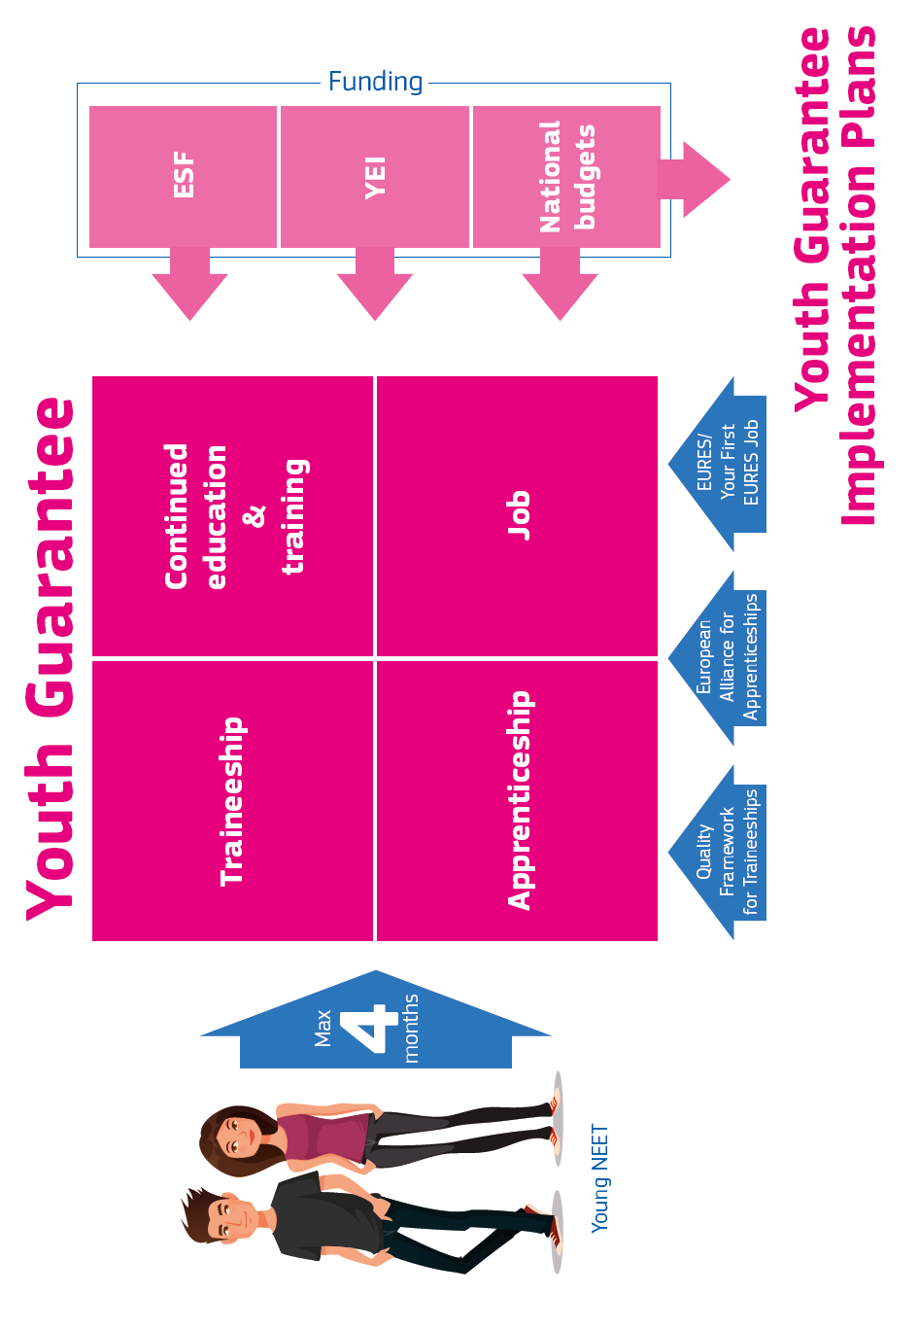
Notes:
As to financing, the Youth Guarantee is financed from different sources:
Member states' national budgets, the European Social Fund and a dedicated Youth Employment Initiative in regions with youth unemployment over 25%

Slide 9



Recent EU policy initiatives
– Long term unemployment -
Objective
Support Member States to increase transitions from long term unemployment to employment
2. Individual assessment
3. Job Integration Agreement
1. Registration
12 - 18 months
Notes:
This year, we have launched a new initiative aimed at simplifying and integrating support for the long-term unemployed to get a job.
We propose a three step approach:
- Ensuring that all long-term unemployed are registered with an employment service, that support goes to everyone who needs it
- Promoting individual assessments of employability potential, to give each long-term unemployed tailored support
- Establishing job integration agreements which put together in a contractual document individualised, tailored support combining active measures, employment services and social support.

Slide 10
Capacity building
Integration of employment and social services
Core role of public employment services for integrating services
Better alignment of social benefits and activation incentives under an active inclusion approach
Promoting a single point of contact for long-term unemployed
Individualised support offers under the Youth Guarantee and long-term unemployment recommendation.
EU in supporting role through:
- European Semester
- European Social Fund
- European Network of Public Employment Services
Notes:
The Commission promotes an active inclusion approach, aiming to better align social benefits and activation incentives. We work with Member States to strike a balance between avoiding benefit traps and providing adequate benefits for those left behind to re-joint the workforce.
We've learned that a key success factor for successfully activating the young is good collaboration between employment and education institutions.
For the long-term unemployed, a group with complex needs, a strong coordination of support is essential. This is why the recommendation puts forward a single point of contact, to simplify access to support and boost administrative delivery for this group.
Capacity to deliver employment and social services is very uneven across the EU.
We work actively to guide national reforms through the European Semester, which focuses increasingly in the last years on social issues
The European Social Funds serves to a large degree to put in place active measures in many of the Eastern and Southern EU Member States. Well designed programmes rely on integration of services and on good monitoring and evaluation.
The European Network of Public Employment Services carries a very ambitious programme of peer evaluation of the organisational and delivery capacity of the PES.

Slide 11
Thank you for your attention!
Questions ?

