Slide 1
Labour Market Policies in the European Countries
Complementing structural reforms with growth
Stefano Sacchi
China-EU Social Protection Reform Project (SPRP)
中国欧盟社会保障改革项目（SPRP）
2016 High Level Event, Beijing, 28 September 2016
2016高级别会议，北京，2016年9月28日

Slide 2
Index
EU member states after the crisis: employment and social outcomes
Selected labour market reforms in Spain, Italy and France
Balance between structural reforms and macroeconomic policy in the EU
The politics of austerity and the future of the EU

Slide 3
EU Member States after the crisis: child poverty rates

Slide 4
EU Member States after the crisis: growth rates

Slide 5
EU Member States after the crisis: employment rates

Slide 6
EU Member States after the crisis: youth unemployment rates

Slide 7
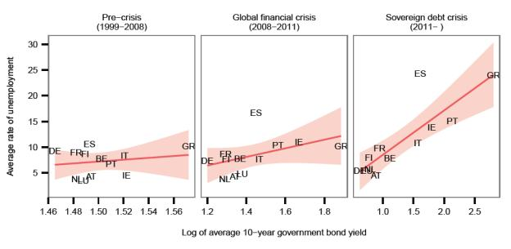
Relation between financial stress and unemployment
Source: ECB

Slide 8
The standard diagnosis: need for structural reforms
Segmented/dualized labor markets
High barriers to entry for the young, women, skilled migrants
Lead to entrapment in inferior jobs, lower investment in human capital, depletion of skills
At a systemic level, lead to lower productivity growth and thus lower economic growth
Interacting with insurance-based welfare system, dual labor markets lead to inferior social protection for large groups of workers and welfare gaps

Slide 9
Extensive labor market reforms in Spain, Italy and France
Spain 2012
Italy 2012 and 2015
France 2016
Making it easier to dismiss workers on open-ended contracts (ES, IT, FR)
Putting a cap on claims the worker can make in case of unjustified dismissal (ES, IT)
Shifting wage bargaining closer to the plant level (ES, FR; soon IT)
Investing in Active Labour Market Policies (IT)
Strengthening safety nets (IT, FR) and making them more inclusive (IT)
Making employers internalize the costs of their behavior (IT)

Slide 10
However, supply side measures alone are not enough
The rationale of structural reforms is all focused on the micro level: lowering the NAIRU, raising economic efficiency
Correct, but incomplete strategy: needs a complementary macro leg
Consumption-led vs export-led growth models. Most countries are still (at last partly) consumption-led, the only exception being Germany (Baccaro and Pontusson, 2016)
Importance of domestic demand for growth
Wrong policy mix: structural reforms have been coupled with austerity, depressing public investment, social investment, disposable income, thus internal demand
(Expansionary fiscal contraction is a myth)

Slide 11
Austerity (K. Armingeon – S. Sacchi, work in progress)
Definition of austerity: reduction of planned structural primary deficit/increase of planned structural primary surplus
OECD countries, based on IMF Fiscal Monitor data, 270 observations, period 2010-2015, different model specifications
Findings:
Very robust | Quite robust | Not significant
Lagged primary balance (-) | Market pressure (interest rates on sovereign debt) (+) | Partisan politics
Current account balance (-) | Economic growth (+) | Union density
Membership of the Eurozone (+)

Slide 12
Austerity (K. Armingeon – S. Sacchi, work in progress)
Real austerity
Estimated austerity based on model 1 (pooled TSCS)

Slide 13
Backlash all over the EU
Structural reforms create losers, need nurturing environment
New context of political impatience (Ferrera, 2016)
Compounded by technological change and new forms of work: opportunities for some, risks and losses for many
Formation of social blocs of losers and rentiers against reforms
Low growth means fear of the future, economic policy (and politics) becomes a zero sum game
Massive refugee inflow reinforces fear and bitterness
Rise of populism all across Europe
Against domestic elites, but also against the EU

Slide 14
High time for a change of tack
Juncker Commission
ECB President Draghi at Jackson Hole, August 2014
Japanese syndrome: accommodating monetary policy necessary to survive, insufficient to thrive
Structural reforms must be accompanied by growth-friendly fiscal policy
Sheltering the losers, severing the ties with anti-reform rentiers
Initiatives that rebuild trust and allegiance in the EU:
pan-European social protection schemes (UB)
reviving schemes such as European Globalization Adjustment Fund
reframing Social investment in normative (equity) rather than economic terms

Slide 15
High time for a change of tack
The EU and national welfare states are on a “collision course”, the next few years are crucial for the survival of the EU as a polity in its own right, rather than simply a market-making policy regime (see Brexit)
Complacency and “more of the same” mean the EU (as a polity) is doomed
Support for the EU still large in the centre of the political spectrum
Need for a normative framing: more values, less scoreboards
Reassure the people, give hope for the future
Future-friendliness should be the EU’s comparative advantage (K. Nicolaidis)

