Slide 1
Perspective of Employment Policy and Social Security in the EU
Michel Servoz
China-EU Social Protection Reform Project (SPRP)
2016 High Level Event, Beijing, 28 September 2016

Slide 2
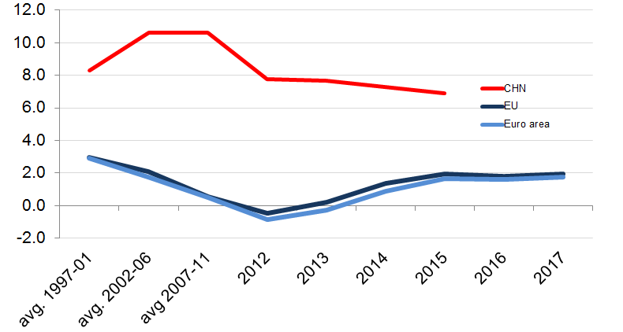
The EU's growth performance Real GDP growth year-on-year, percent

Slide 3
The EU's employment performance since 2007 Index 2007 = 100

Slide 4
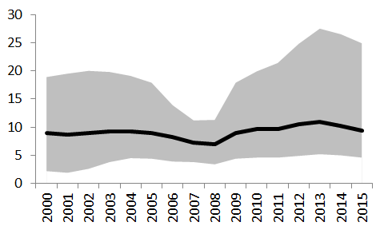
Unemployment rate in percent, EU-28 convergence vs divergence
Greece
Maximum
Slovakia
Poland
Slovakia
Spain
Average
Minimum
Ireland
Denmark
Netherlands
Austria
Germany
Luxembourg

Slide 5
Important Europe 2020 indicators EU-27
People at risk of poverty or
Social exclusion
Employment rate, age 20-64 years
Percent
Million people

Slide 6
Asylum applications in the EU, 1985-2015

