Slide 1
A Study of the Transfer and Continuation of the Pension Insurance Relationship of Migrant Workers in China 流动就业人员养老保险关系转移接续研究
Sun Yat-sen University
中山大学
Kinglun Ngok
岳经纶
2016.9

Slide 2
rundown
Background Information
The Case of Huizhou
Problems concerning T and C policy for migrant workers in China
policy suggestions

Slide 3
I Background 背景
Over the past three decades, China has been in the transition from a command economy towards a market economy, which has resulted in rapid industrialization and urbanization.
过去30多年，中国一直处于从计划经济向市场经济的转型中，带来了迅速的工业化和城镇化
One spectacular socio-economic consequence of this transition is the large scale of rural-urban migration.
这一转型过程一个重要社会经济后果是从农村到城市的大规模人口转移
Millions of rural young people flooded into cities to seek job opportunity every year. In 2014, it was estimated that there were 253 million migrant populations in China, among them, 78% are those who are at the age from 15 to 59.
每年都有大批农村青年到城市寻找工作。2014年，中国大约有2.53亿流动人口，其中，78%的人处在15-59岁这个年龄段。

Slide 4
I Background 背景
However, China has not established a unified pension system until now. Different pension systems have been designed for different groups of people based on their employment and Hukou status.
目前，中国并没有建立全国统一的社会养老保险制度，而是根 据户籍和就业状态，对不同群体建立不同的社会养老保险制度。
Due to the decentralization of social insurance system, the current social pension insurance in China is charaterized by both social and geographical fragmentation.
由于统筹层次不高，所以中国的社会养老保险体系呈现出分割化和碎片化的特点。

Slide 5
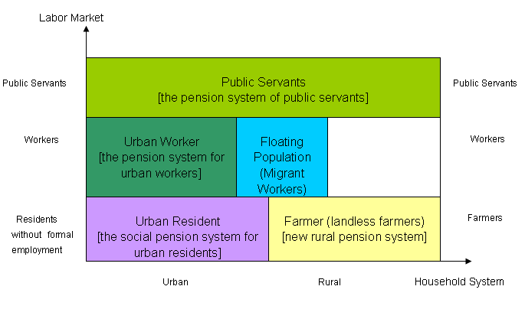
The fragmented social insurance system (two dimensions of fragmentation: hukou status and labor market status )

Slide 6
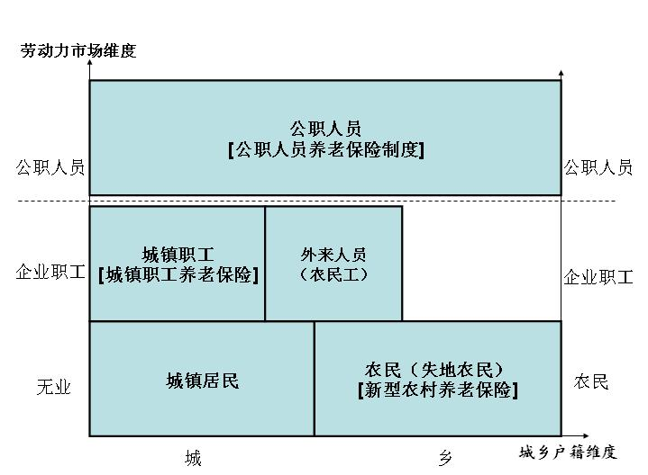
社会保险制度的碎片化 (两个维度：户籍身份和就业身份)
3．我国社会养老保险制度发展的特点
（1）劳动力市场和城乡户籍二维分割

Slide 7
Background
Third dimension: fragmentation based on administrative jurisdiction or location (localization of social rights)
碎片化第三个维度：行政区
Social security programs are administrated by county or city level government, which indicates a lower level of risk sharing.
Meanwhile, it creates a spatial obstacle for migrant workers who needs to change their jobs nationwide.

Slide 8
Background
Currently, two basic pension insurance systems existing in China:现行养老保险制度主要包括：
Urban employee basic pension scheme (UEBPS)
城镇职工基本养老保险制度
Urban-rural resident basic pension scheme (URRBPS)
城乡居民基本养老保险

Slide 9
China’s Pension Framework
 | Contents | Characteristics
The First Pillar | Urban employee basic pension scheme (UEBPS) Urban-rural resident basic pension scheme (URRBPS) Pension scheme for civil servants and PSUs | Mandatory; Social pool & individual account
The Second Pillar | Enterprise annuity schemes Occupational annuity schemes | Voluntary & defined contribution
The Third Pillar | Private savings | Voluntary

Slide 10
Background
These three-dimension fragmentation has brought about the problem of social insurance rights of migrant workers
First, the transfer and continuation of social insurance rights between different social pension insurance schemes (Trans-system TC)
Second, the transfer and contiuation of social insurance rights betweeen different localities (Trans-regional TC)

Slide 11
Background
Current policies on transfer and Continuation of social insurance relations现行养老保险转移接续办法：
The interim measures for the transfer and contiuation of the basic social pension insurance relations of urban employees (2009), which aims to solve the problem concerning the trans-regional T and C.
《城镇企业职工基本养老保险关系转移接续暂行办法》（2009）
The Interim Measures for the Integration of Urban and Rural Pension Insurance Systems (2014), which aims to solve partially the problems concerning the trans-scheme T and C.
《城乡养老保险制度衔接暂行办法》（2014）

Slide 12
Background
So, in terms of the institutional arrangement, China has established the rules for the T and C of the social pension relations 从制度层面上讲，我国已经建立了养老保险关系转移接续办法。
However, many doubts exist on its rationality , appropriateness and effectiveness.
对于养老保险关系转移接续办法的合理性和科学性，社会各界还存有质疑，尤其是在保护流动就业人员的养老金权益方面。

Slide 13
background
According to China Daily (2012/05/03), around 730,000 workers had their pension accounts successfully transferred by the end of 2011, though many more people than that had changed workplaces.
Local governments are not well prepared for the implementation because they do not share the same information system and software, so problems can occur when linking up accounts.
Many places also lack sufficient skilled personnel.
Insufficient facilities in some remote areas also delay transfers.

Slide 14
II The Case of Huizhou 惠州案例
Huizhou：a prefecture level city in Guangzhou
Borders Guangzhou, Shenzhen and Dongguan
with about 4.6 million residents
both a hosting and sending city of migrant workers
It seeks to be a site for a world-class petrochemical industry, as well as a hub for developing information technology, and expanding exports and trade.

Slide 15
the Case of Huizhou
Specific methods used in T and C of pension insurance relations of migrant workers in Huizhou 具体做法：
Confirming the verifying place of migrant workers’ pension benefits
确定流动就业人员养老保险待遇核发地
Unifying the administrative procedures of T and C
统一流动就业人员养老保险关系转移办理程序
Migrant workers who are qualified for receiving pension benefits in Huizhou can apply for their benefits in Huizhou.
流动就业人员符合在本市核发养老保险待遇的，均可在惠州市申领养老待遇
Migrant workers can transfer and continue their pension insurance relations between the rural pension scheme and urban pension scheme.
流动就业人员城乡养老保险制度之间可转换衔接

Slide 16
The Huizhou Case
Currently, there is an increasing trend for migrant workers within the urban workers’ pension scheme to transfer and continues their pension relations.
It seems that more migrant workers transfer their pension relations outward from within Huizhou than those who transfer inward from outside Huizhou
惠州市城镇企业职工养老保险流动就业人员养老保险关系转移接续办理次数总体呈现转移人数逐年增加且转出多于转入的态势。

Slide 17
The Huizhou Case
2010年转入1794次、转出3238次；
2011年转入5253次、转出7463次；
2012年转入6255次、转出8752次；
2013年转入10115次，转出11813；
2014年转入9049次，转出12116次；
2015年截止8月31日止转入6412次，转出8449次。

Slide 18
The transfer situation in Huizhou
Year | inflow (transfer into Huizhou) | Outflow (transfer out Huizhou)
2010 | 1794 | 3238
2011 | 5253 | 7463
2012 | 6255 | 8752
2013 | 10115 | 11813
2014 | 9049 | 12116
2015 (by the end of Auguest) | 6214 | 8449

Slide 19
III Problems of the T and C process 流动就业人员养老保险关系转移接续存在的问题
Two Types of T and C of pension insurance relations concerning migrant workers 流动就业人员在城镇之间、城乡之间转移都涉及到养老保险关系转移接续问题，主要包括以下两种情况：
Type I: Trans-regional T and C within the UEBPS
城镇职工基本养老保险跨统筹地区转移接续
Type II: Trans-system T and C between urban RBPS and rural RBPS
城乡基本养老保险关系转移接续

Slide 20
Type I: Trans-regional T and C within the UEBPS
According to The interim measures for the transfer and contiuation of the basic social pension insurance relations of urban employees (hereafter the 2009 Policy),
where an insurant (including migrant worker) gets employed in another province, the social insurance agency at the place where he purchases insurance shall issue an insurance premium payment receipt, and his basic pension insurance relations shall be transferred to the new place.
When an insurant meets the conditions for obtaining the basic pension insurance money, the number of years when insurance premiums have been paid shall be calculated on a consolidated basis, and the amount of deposit (including principal and interest) in his individual account shall be calculated on a cumulative basis.
《城镇企业职工基本养老保险关系转移接续暂行办法》规定了包括农民工在内的参加城镇企业职工基本养老保险的所有人员在跨省就业时将其养老保险关系随同转移，除了转移个人账户全部资金以外，还转移部分单位缴费；参保人员在各地的缴费年限合并计算，个人账户储存额累计计算，对农民工一视同仁。

Slide 21
specific practices 具体做法
The following principle will be followed when confirming the place of receiving benefits:
a. where is the place of origin (hukou)of the migrant worker, then whether his or her the accumulated years of insurance reach ten years.
b. if his or her basic pension insurance relations is not affiliated to his or her place of origin, and his or her accumulated years of insurance premium payment in each place of work have not reached ten years, his or her basic pension insurance relations and the correspondent money should be allocated to the place of origin, and the authorities of the place of origin will cope with the procedures of receiving benefits according to regulations, then he or she will enjoy the pension benefits
待遇领取地的确定遵循以下原则：先看户籍所在地，再看缴费年限是否满十年；如果基本养老保险关系不在户籍所在地，且在每个参保地的累计缴费年限均不满10年的，将其基本养老保险关系及相应资金归集到户籍所在地，由户籍所在地按规定办理待遇领取手续，享受基本养老保险待遇。

Slide 22
specific practices 具体做法
When the insurant gets employed in another province and transfers his or her pension insurance relations to the new place, a portion of the pooling funds (payments made by the employer) should be transferred; and
the amount to be transferred shall be the total amount of 12% of the actual wage based on which the insurance premium is paid in each year
参保人员跨省流动就业转移基本养老保险关系时，需要按实际缴费基数的12%转移统筹基金。
After the insurant completed the T and C process, and is qualified for pension benefit, his or her basic pension benefits will be calculated based on the actual wages based on which the insurance premium was paid every year, the years of contributions and the annual average wage level of the employees in the place where the pension benefits will be given.
参保人员转移接续基本养老保险关系后，符合待遇领取条件的，以本人各年度缴费工资、缴费年限和待遇领取地对应的各年度在岗职工平均工资计算其基本养老金。

Slide 23
The real effect of the policy implmentation 实际效果
It is reasonable to say that the 2009 Policy is beneficial for the different provinces to share the pressure imposed by the pension funds, and is helpful for increasing the mobility of labour forces
该《暂行办法》的出台有利于平衡各统筹地区的基金压力，在一定程度上促进了劳动力合理流动。
However, in the implementation process, the effect of this policy has been damaged by the decentralization of both social insurance policy and the fiscal policy.
但是在实际执行当中，其政策效果仍然会受到我国统筹层次低、财政“分灶吃饭”等客观因素的制约。

Slide 24
Problems existed 存在的问题
For a migrant worker, if he or she has not paid the pension insurance premium for more than ten years in anyone place, he or she should transfer his or her pension insurance relations to his or her place of origin. Because he or she is rural hukou holder, and cannot join the UEBPS. Therefore, the place of origin will not accept the transfer of pension insurance relation, which demonstrates the difficulties migrant workers facing when their pension relations are transferred.
流动就业人员在每个地方的参保年限都没有达到10年以上的，需要将养老保险关系转回户籍地，由于户籍为农村户籍，在户籍地不能参加企业职工养老保险，因此，户籍地不接受流动就业人员的养老保险关系转入，造成流动就业人员养老保险关系转移困难，在一定程度上造成流动就业人员在就业时不愿参保。

Slide 25
Problems existed
If the average wage of employees in the place where the pension benefits are paid is lower, the pension benefits of the migrant worker will be damaged. 如果待遇领取地的在岗职工平均工资偏低，对于流动就业的参保人来说，其养老金权益将会受到损失。
The existing measures of transfer and continuation of pension insurance relations of urban employees are handicapped by local interests, lack of proactive perspective, therefore further reform is necessary.
目前实行的城镇企业职工基本养老保险关系转移接续办法受地方利益的影响比较大，缺乏前瞻性，有必要进行进一步改革。

Slide 26
Type II Trans-system T and C 2、城乡基本养老保险关系转移接续
 | From ‘URRBPS’ transfer to ‘UEBPS’ | From ‘UEBPS’ transfer to ‘URRBPS’
Requirements | Pension contributions at least 15 years in UEBPS | Pension contributions less than 15 years in UEBPS
Specific Measures | ① The pension fund in individual accounts will be transferred totally； ② The contribution years in URRBPS will not be calculated accumulatively. | ① The pension fund in individual accounts will be transferred totally, but the social pooling funds are not transferred； ② The contribution years in UEBPS are combined to URRBPS for accumulative calculation.
Remarks | If migrant workers participate in both UEBPS and URRBPS in the same year, only the contribution of UEBPS is remained for calculation purpose and the contribution of URRBPS will be returned.

Slide 27
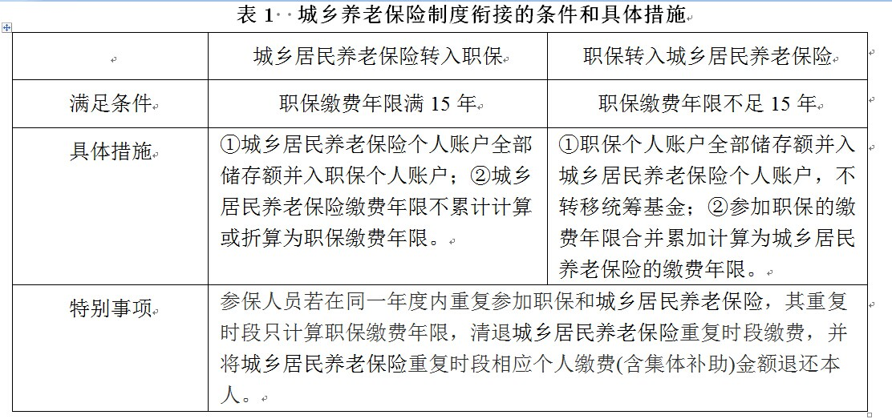
Type II Trans-system T and C 2、城乡基本养老保险关系转移接续

Slide 28
Problems existed 存在的问题
Under these interim measures (the 2014 Policy), migrant workers who are covered by UEBPS will face great pension benefits loss if they cannot reach the minimum requirements of contribution years (15 years) for pension claim when they retire.
It is unreasonable not to recognize the pension benefits accumulated by migrant workers under UEBPS.
Migrant workers’ pension right based on his or her periods of contributions under UEBPS should be calculated even if the contribution is less than 15 years.
For migrant workers, if these interim measures (the 2014 Policy) are not revised , it is better for them to contribute at least 15 years so as to receive pension benefit after retirement under UEBPS, and never transfer to URBPS.
根据《城乡养老保险制度衔接暂行办法》的规定，本课题组运用情景假设和精算模拟方法，定量测算了流动就业人员职保缴费年限未满15年，由职保转入城乡居民养老保险所带来的基础养老金权益损失（与在职保缴费满15年的情形相比较，具体结果请参考研究报告）。

Slide 29
Problems existed 存在的问题
According to our measurement, the Interim Measures for the Integration of Urban and Rural Pension Insurance Systems (the 2014 Policy) fails to provide enough protection for the pension interests of migrant workers. 测算结果表明：《城乡养老保险制度衔接暂行办法》确实在保护流动就业人员养老金权益方面存在很大的不足。
Under the 2014 policy, the integration of the two system has brought about unacceptable loss for migrant workers' pension entitlement. 按照该《暂行办法》，城乡养老保险制度衔接所带来的基础养老金权益损失令人难以接受。

Slide 30
reason analsis 原因分析
The key reason is : the different methods of benefit calculation and distribution between the URRBPS and UEBPS:
the fundamental annuities of the URRBPS is dependent on the fiscal subsidy, while the fundamental annuities of the UEBPS is linked up to average wage growth rate, individual wage which the pension premium is based, the contribution years and so on.
Due to the huge rural urban division of economic development, the benefit level of the URRBPS is relatively low.
城乡居民养老保险和城职保的基础养老金计发办法很不一样，城乡居民养老保险的基础养老金部分是靠财政补贴，职保的基础养老金是与在岗职工平均工资增长率、个人缴费基数、缴费年限等因素挂钩，而且我国城乡经济发展水平差距很大，城乡居民养老保险的保障水平起点较低。

Slide 31
IV Policy suggestions for improving the T and C process 四、完善中国流动就业人员养老保险关系转移接续的对策
CCP's policy goal until to 2020： to build a more equal, more sustainable social security system, to implment univeral social insurance plan, and to accomplish the national coordination of basic pension benefits.
For this policy goal, it is necessary to improve the measures concerning the transfer and continuation of pension insurance relations of migrant workers, to increas the institutional attraction of the basic pension insurance, and the safeguard the pension entitlement of migrant workers.
中国共产党十八届五中全会公报强调“建立更加公平更可持续的社会保障制度，实施全民参保计划，实现职工基础养老金全国统筹。”
要实现这些目标，必须完善流动就业人员养老保险关系转移接续办法，提高基本养老保险制度的吸引力，充分保障流动就业人员的养老金权益。

Slide 32
IV Policy suggestions for improving the T and C process 四、完善中国流动就业人员养老保险关系转移接续的对策
For details, the following policy suggestions are advised:
first, to eliminate the obstacles imposed by the hukou system, and allow migrant workers to join the UEBPS as flexible employees.
second, to make reference to the European Union experience and follow the principle of “totalling insurance periods and apportioning benefits” when calculating pension benefits for migrant workers who changed to UEBPS.
1、消除户籍障碍，允许农村户籍流动就业人员在户籍地以灵活就业人员身份参加企业职工养老保险。
2、参保流动就业人员转移城镇基本养老保险时，建议参考欧盟经验，采用“分段计算、统一发放”的原则计发养老金。（前提：是否实现了职工基础养老金全国统筹）

Slide 33
IV Policy suggestions for improving the T and C process 四、完善中国流动就业人员养老保险关系转移接续的对策
third, for those migrant workers who have joined the UEBPS for less than 15 years, and have changed to the URRBPS, the “apportioning benefits” principle should be followed when calculating their fundamental annuities accumulated during their UEBPS period, and their fundamental annuities should be paid through the social pooling funds after they retire.
3、当流动就业人口参加职保缴费未满15年，由职保转向城乡居民养老保险时，同样需要分段计算参保人在职保缴费期间所对应的基础养老金权益，在其退休后通过社会统筹基金进行支付。

Slide 34
IV Policy suggestions for improving the T and C process 四、完善中国流动就业人员养老保险关系转移接续的对策
Fourth, the government should increase the fiscal subsidy for the fundamental annuities of the URRBPS, and shorten gradually its gap with that of the UEBPS, so as to lay the foundation for the integration of the urban and rural basic pension insurance systems
4、政府应加大对城乡居民养老保险基础养老金的补贴力度，逐步缩小与企业职工基础养老金的差距，为城乡养老保险制度衔接创造有利条件。
Fifth, the government should strenghten its publicity of the basic pension insurance system, encourage and create conditions for migrant workers to work and live in cities, and join the UEBPS, so that they can enjoy the benefits of the UEBPS when they retire.
5、政府要加强对基本养老保险的正面宣传，鼓励并创造条件让流动就业人员在城镇地区就业生活，并参加企业职工养老保险，退休后享受职工的养老保险待遇。

