Slide 1

Population Changes, Labor Market, and Reform of Urban Employee Basic Pension Insurance System
ZHANG Juwei
Institute of Population and Labor Economics
Chinese Academy of Social Sciences
Beijing, September 28, 2016

Slide 2
Outline
Forecast of Population Change Trends
Characteristics of Labor Market Changes
Labor Market Changes and Situations and Issues of Urban Employee Basic Pension Insurance
Reform of Urban Employee Basic Pension Insurance System

Slide 3
Current Population Situation
Since the early 1990s, the total fertility rate has been below the replacement level; China’s fertility level has been declining steadily. Since 1996, it has already been in a ultra-low fertility status of less than 1.5 for a long time
Since 2010, the total fertility rate has been at a level close to 1.5
Since the selective two-child policy in 2014, the total fertility rate has been slightly higher than 1.5
The universal two-child policy has been implemented since 2015, but it takes some time to assess the impacts of the policy
Overall, it seems that the universal two-child policy will not significantly change the trends of population changes

Slide 4
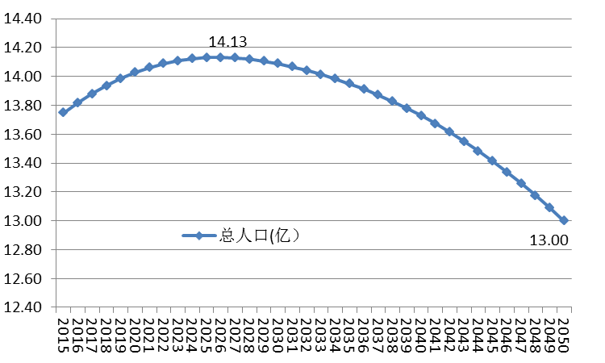
Forecast of Population Change Trends
China’s population will continue to maintain an upward trend and reach the peak of 1.413 billion around 2026 and decline since then
China’s population will reach about 1.375 billion in 2015, 1.403 billion in 2020, 1.409 billion in 2030, down to 1.341 billion in 2040, and drop to 1.300 billion in 2050

Slide 5
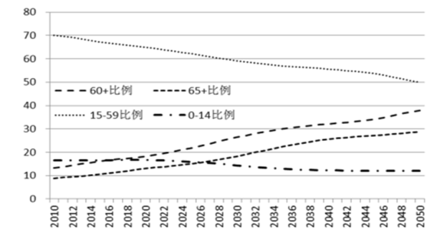
Forecast of Population Structure Change Trends
The number and the proportion of 15-59 years old working-age population remain downward trend throughout the forecast period. By 2050, the working-age population will be around 651 million, accounting for 50.05% of the total population
The number and the proportion of elderly population continue to grow: by 2050, the number of people aged 60 and above will be 492 million, accounting for a high proportion of the total population as up to 37.88%; the number of people aged 65 and above will be 375 million and the proportion will increase to 28.81 %

Slide 6
Forecast of Change Trends for the Ratio of People Aged 65 and above to
Working-age (15-64 years old) Population

Slide 7
Challenges of Rapidly Aging Population on Pension Insurance System
Distinct characteristics of China’s population aging is getting old before getting rich
--In 2010, among the 161 countries and regions where the degree of population aging and the national income per capita can be collected, China’s national income per capita ranked 81st (from high to low), but the proportion of population aged 60 and above ranked 55th (from high to low), the proportion of population aged 65 and above ranked 56th
China’s population is aging rapidly
--The world’s proportion of population aged 65 and above needs about 40 years to increase from 7% to 14%; while China’s may only need about 23 years
--The world’s proportion of population aged 65 and above needs about 50 years to increase from 14% to 21%; while China’s may only need about 11 years

Slide 8
The Number and the Proportion of Working-age Population

Slide 9
Economically Active Population and Labor Force Participation Rate

Slide 10
Employment Structure Changes: by Three Strata of Industry

Slide 11
Characteristics of Employment Structure Changes: Trends of Employees
 | Employed Persons in Urban and Rural Areas (10,000 persons) | Employed Persons in Urban Areas (10,000 persons) | Employees in Urban and Rural Areas |  | Employees in Urban Areas
 |  |  | Number (10,000 persons) | Proportion to Total Employed Persons in Urban and Rural Areas (%) | Number (10,000 persons) | Proportion to Total Employed Persons in Urban Areas (%)
2000 | 72085 | 23151 | 26811 | 37.2 | 12852 | 55.5
2001 | 73025 | 23940 | 26924 | 36.9 | 12651 | 52.8
2002 | 73740 | 24780 | 27568 | 37.4 | 12869 | 51.9
2003 | 74432 | 25639 | 28681 | 38.5 | 13354 | 52.1
2004 | 75200 | 26476 | 29821 | 39.7 | 13931 | 52.6
2005 | 74647 | 28389 | 31321 | 42.0 | 14684 | 51.7
2006 | 74978 | 29630 | 32752 | 43.7 | 15440 | 52.1
2007 | 75321 | 30953 | 34144 | 45.3 | 16382 | 52.9
2008 | 75564 | 32103 | 35327 | 46.8 | 17096 | 53.3
2009 | 75828 | 33322 | 36519 | 48.2 | 17868 | 53.6
2010 | 76105 | 34687 | 37910 | 49.8 | 18838 | 54.3
2011 | 76420 | 35914 | 40313 | 52.8 | 21006 | 58.5
2012 | 76704 | 37102 | 42163 | 55.0 | 22418 | 60.4
2013 | 76977 | 38240 | 46476 | 60.4 | 26049 | 68.1
2014 | 77253 | 39310 | 48533 | 62.8 | 27852 | 70.9

Slide 12
Trends of Employees in the Labor Market

Slide 13
The Number of Participants in Pension Insurance and the Number of Retirees

Slide 14
Pension Insurance Coverage Rate: Different Definitions

Slide 15
Contributions of Urban Employee Basic Pension Insurance and Growth of Fund Revenue and Expenditure (%)
Time Period | Fund Revenue | Fund Expenditure | Accumulated Balance | Contributions per capita | Expenditure per capita | Balance per capita
1995-2014 | 18.86 | 18.63 | 25.42 | 12.34 | 10.52 | 18.16
1995-2000 | 19.12 | 20.07 | 17.12 | 14.94 | 12.03 | 12.18
2000-2010 | 19.40 | 17.44 | 32.13 | 12.23 | 9.63 | 24.00
2010-2014 | 17.19 | 19.82 | 19.94 | 9.42 | 10.89 | 11.74

Slide 16
Revenue, Expenditure, and Balance of Pension Insurance Fund

Slide 17
Growth of Fund Revenue, Expenditure and Balance by Province (2001-2014)

Slide 18
Growth of Fund Accumulated Balance per capita by Province (2001-2014)

Slide 19
Growth Rate of Fund Accumulated Balance per capita by Region (2001-2014)

Slide 20
Supporting One Retiree: number of persons
Year | 15-59 years old | Employed Persons | Employed Non-farm Persons | Employees | Participants Made Contributions
1990 | 75.5 | 67.1 | 26.8 | 24.3 | 5.4
1991 | 67.3 | 60.3 | 24.3 | 22.4 | 5.2
1992 | 44.0 | 39.3 | 16.3 | 15.3 | 4.6
1993 | 40.8 | 36.3 | 15.8 | 15.0 | 4.4
1994 | 36.4 | 32.4 | 14.8 | 13.4 | 4.1
1995 | 34.1 | 30.4 | 14.5 | 13.0 | 3.9
1996 | 33.0 | 29.2 | 14.5 | 12.7 | 3.7
1997 | 31.4 | 27.6 | 13.8 | 11.6 | 3.4
1998 | 29.5 | 25.9 | 13.0 | 9.9 | 3.1
1999 | 27.3 | 23.9 | 11.9 | 9.0 | 3.2
2000 | 26.2 | 22.7 | 11.4 | 8.5 | 3.3
2001 | 24.9 | 21.5 | 10.8 | 8.0 | 3.2
2002 | 23.8 | 20.3 | 10.2 | 7.6 | 3.1
2003 | 22.6 | 19.1 | 9.7 | 7.4 | 3.0
2004 | 21.7 | 18.1 | 9.6 | 7.3 | 3.0
2005 | 20.2 | 17.1 | 9.4 | 7.2 | 3.0
2006 | 19.3 | 16.2 | 9.3 | 7.1 | 3.0
2007 | 18.3 | 15.2 | 9.0 | 6.9 | 3.1
2008 | 17.2 | 14.2 | 8.6 | 6.7 | 3.1
2009 | 15.8 | 13.1 | 8.1 | 6.3 | 3.1
2010 | 14.9 | 12.1 | 7.6 | 6.0 | 3.1
2011 | 13.8 | 11.2 | 7.3 | 5.9 | 3.2
2012 | 12.6 | 10.3 | 6.8 | 5.7 | 3.1
2013 | 11.6 | 9.6 | 6.6 | 5.8 | 3.0
2014 | 10.8 | 9.0 | 6.3 | 5.6 | 3.0

Slide 21
Pension Insurance Burden

Slide 22
Average Wage Level of waged workers and the level of pension
Year | Monthly Average Wage of All Employees (Yuan) | Monthly Average Wage of Employees in Urban Areas (Yuan) | Monthly Average Pensions Received by Retirees (Yuan) | Ratio of Pension to Average Wage of All Employees (%) | Ratio of Pension to Average Wage of Employees in Urban Areas (%)
1990 | 165 | 178 | 129 | 78% | 72%
1991 | 536 | 378 | 315 | 59% | 83%
1992 | 600 | 439 | 365 | 61% | 83%
1993 | 685 | 491 | 412 | 60% | 84%
1994 | 775 | 533 | 462 | 60% | 87%
1995 | 833 | 627 | 538 | 65% | 86%
1996 | 989 | 699 | 556 | 56% | 80%
1997 | 1093 | 788 | 572 | 52% | 73%
1998 | 1193 | 914 | 657 | 55% | 72%
1999 | 1261 | 1046 | 674 | 53% | 64%
2000 | 1342 | 1182 | 711 | 53% | 60%
2001 | 1451 | 1342 | 771 | 53% | 57%
2002 | 1575 | 1531 | 880 | 56% | 57%
2003 | 1793 | 1760 | 1003 | 56% | 57%
2004 | 2011 | 2081 | 1161 | 58% | 56%
2005 | 2130 | 2456 | 1276 | 60% | 52%
2006 | 2316 | 2724 | 1395 | 60% | 51%
2007 | 2519 | 3085 | 1631 | 65% | 53%
2008 | 2791 | 3545 | 1870 | 67% | 53%
2009 | 3312 | 3977 | 2054 | 62% | 52%
2010 | 3544 | 4353 | 2262 | 64% | 52%
2011 | 165 | 178 | 129 | 78% | 72%
2012 | 536 | 378 | 315 | 59% | 83%
2013 | 600 | 439 | 365 | 61% | 83%
2014 | 685 | 491 | 412 | 60% | 84%

Slide 23
Replacement rate of the pensions

Slide 24
Reform of Urban Employee Basic Pension Insurance System
The Urban Employee Basic Pension Insurance System: under the current situation that personal accounts are not real, the fund revenue and expenditure are basically balanced, and accumulated balance is more than 3 trillion yuan; however, the problem of imbalances among different regions is significant, and the growth rate of expenditure exceeds the growth rate of revenue in several provinces, respectively.
The system replacement rate has been lower than 50%, so that it would be a lot of social pressure to improve the benefits of pension insurance.
From the perspective of people who should be fully covered, only 52% of employees participated in this system. Considering the current ratio of employees in the Chinese labor market is only about 62%, this system still has large potential to expand.
Overall, if the reform can keep up, this system should be able to continue.

Slide 25
Suggestions for Reform
Further clarify the rules of the system: combine social integration with personal accounts: achieve a complete pay-as-you-go pension system under the nominal account
National Integration of basic pensions
Expand Coverage: still has large potential, but how to collect and contribute is a problem worthy of studying
Financial subsidies should clearly be resources of statutory revenue; should be studied to determine the proportion of financial investment funds
Consider an appropriate reduction in the contribution rate

Slide 26
Thank You!

