Slide 1

Study Visit on Employment policies and Social security systems
with special reference
to Migrant workers
Prague, 2 November, 2015
Ministry of Labour and Social Affairs, Prague, Czech Republic

Slide 2



Pension System in the
Czech Republic
Ministry of Labour and Social Affairs
Department of Social Insurance
2nd November 2015

Slide 3


Introduction
The pension system is a integral part of national economy.
The most important objective of the system is providing benefits in case of invalidity, old age and survivor.
With respect to long term character of the system changes have to run step by step (evolutionary not revolutionary) with wide consensus.

Slide 4
Czech pension system
Mandatory public PAYG system (I. pillar)
Quasi-mandatory FF system (II. pillar) – (since 2013 till 2015)
Voluntary supplementary FF scheme with state support (III. pillar) – (since 1994)
---------------------------------------------------------
Life insurance products

Slide 5
Public PAYG system (I. pillar)
  Providing old-age, disability and survivor’s pensions (2,5+0,47+0,1= 3 mil.)
  Dominant source of old-age income (~ 94-95 %)
  Providing average gross replacement rate of 42 % (2011), net replacement rate about 53 %
  Pension expenditure – cca 9 % GDP
  Contribution rate – 28 % (6,5+21,5)
  High solidarity/redistribution formula = low risk of poverty among pensioners
  Institutional roots: end of 19 century
  Uniform system (no special schemes)

Slide 6
Number of pensioners and pensions – 2015 (end of 2014)
Number of pensioners 2 863 000
Number of paid pensions 3 576 000
Old – age pensions 2 345 000
Disability pensions 428 000
Widow´s/widower´s pensions 658 000
Orphan´s pensions 43 500
Number of insured persons 5 300 000
Average old age pension is about 11.380CZK (400 €)
Average wage is about 26.000 CZK (920 €)

Slide 7
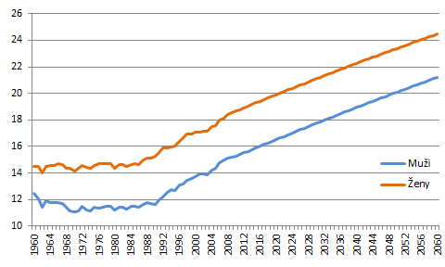
Life expectancy (at 65 years)
zdroj: EUROPOP 2011

Slide 8
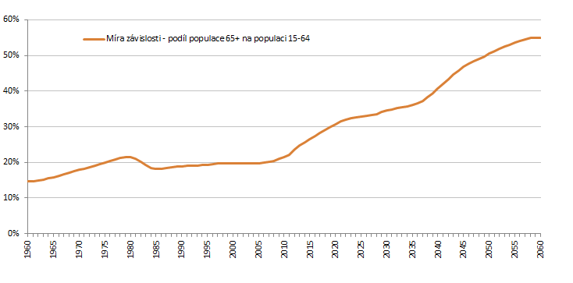
Dependency Ratio (65+/15-64)
TODAY
zdroj: EUROPOP 2011

Slide 9
Demography – population ageing
Life expectancy at the age of 60
  Born 1945………22-23 (22,7) years
  Born 1990………29-30 (29,2) years
Low fertility rate
  Current 1,2 – 1,4 (expected growth to a maximum of 1,7)
Increase in the share of people in older age groups
  especially in the group of 80+
+ 6,5
years

Slide 10
Demography (1950 - 2050)

Slide 11
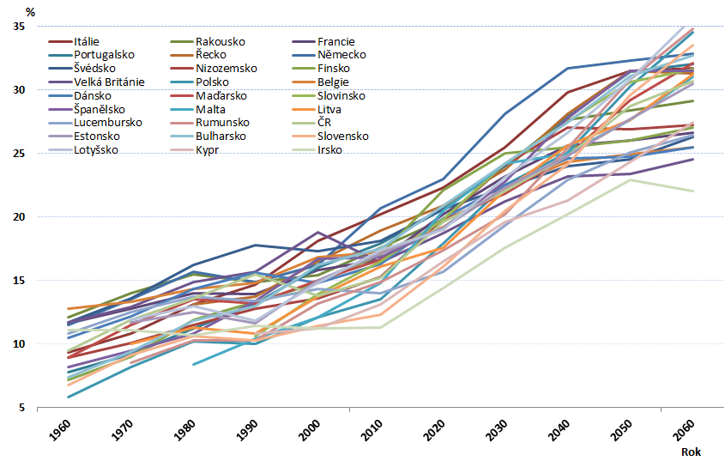
Share of 65+ on the total population

Slide 12
Pension Reform
A lot of parametric changes during last 20 years
  Increasing of the retirement age (4 times)
  Introducing of social contributions and changes in the level of contribution
  Increasing of minimum insurance period for entitlement
  Extension of reference period – to lifelong
  Introducing regular valorization of pensions
  Changes in the area of early pensions
  Redefinition of invalidity (three levels)
  Fully coordination with EU legislative (free movement, transfers of benefits)
  Introduction of III. fully funded voluntary pillar (1994)
  Introduction of II. fully funded pillar (2013)

Slide 13
Pensions
old-age (including the so-called early old-age pension),
disability (three levels of disability),
widow and widower,
orphan
  This system is based on several general principles:
  social solidarity, pay-as-you-go financing, mandatory participation of all economically individuals, defined benefit, universality - the legal regulation is the same for all the insured persons, there are no industry-specific schemes .

Slide 14
Pension insurance
The groups of pension insured persons
employes
Self-employed persons
Participants without economical activity in cases given in act – e. g. persons, who take care of child younger than 4 years of age or helpless persons, job applicants to a limited extent and others (non-contributory periods)

Slide 15
Pension Benefit Formula (old age)
Flat rate part (9 % of the average wage, 2440 CZK - 2016) + percentage amount, wage-linked (but with high income solidarity)
Entitlement:
Minimum insurance period: increasing (from 25 to 35(30) years - 2019)
Retirement age: increasing (60 (1995) - 67 (2044))
Decisive period: lifelong
all wages since 1986
Percentage part of pension
1,5 % of calculation base for each year of the insurance
Flat rate (fix amount)
9 % of average wage
2440 CZK - 2016

Slide 16
The statutory old-age pension
The conditions of entitelment
The insured person shall be entitled to the old-age pension, provided he/she has reached the necessary insured period and retirement age.
Currently, retirement age for men is 62 years and 10 months (2.11.1952-2.9.2015), for women without childern 62 years and and between 61 years – 58 years for women, who have raised one or more children.

Slide 17
The amount of the old-age pension
The amount of the pension consists of two components specifically a basic assessment and a percentage assessment.
The amount of the basic assessment of the pensions has been is set as a percentage of the average wage – 9 % of average wage (currently 2 440 CZK per month).
The percentage assessment is 1,5 % of the calculation base for each year of the insured period acquired before the entitlement to the pension arose.

Slide 18
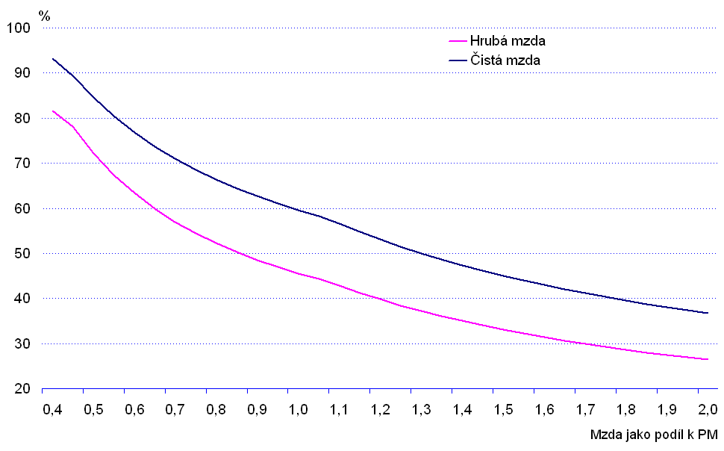
Replacement rate

Slide 19
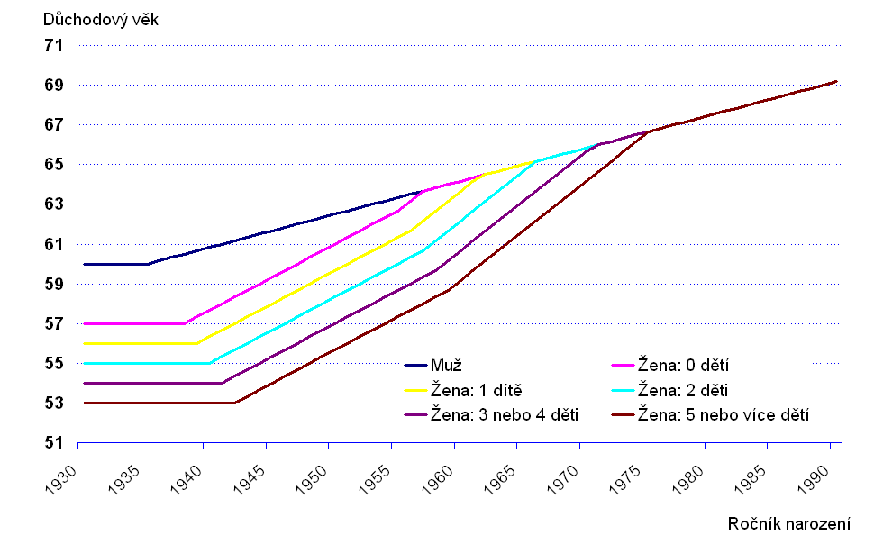
Retirement age – increasing and unification
year 2041, retirement age 66 years+8 months, born in 1975

Slide 20
Retirement age – increasing (men)

Slide 21
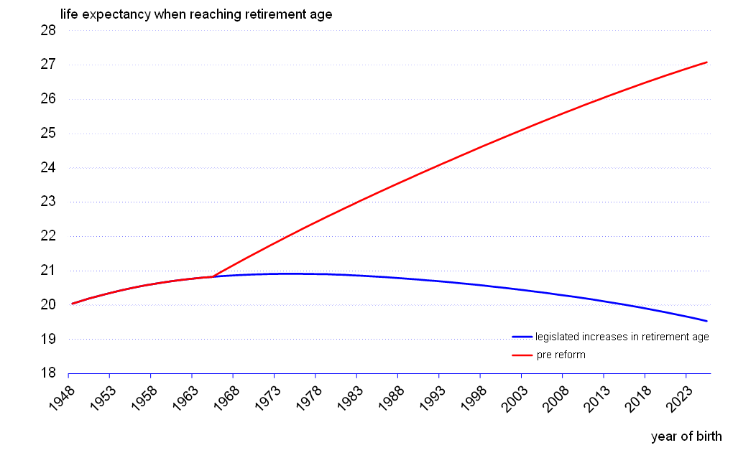
Life expectancy and retirement age
The increases in retirement age match life expectancy gains
Average years spent in retirement fixed at ~20 years
Future revisions of life expectancy and retirement age envisaged

Slide 22
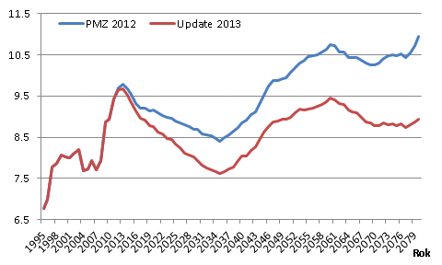
Pension expenditure projections (% of GDP)

Slide 23
Difference between revenues and expenditures (mld. CZK)

Slide 24
Risk of poverty rate (65+, 2011)
Eurostat

Slide 25
Conclusions
Demography trends are clear (low fertility rate, increasing life expectancy)
Statutory retirement age increasing is natural adaptation of pension systems
Importance of the flexible labour market without age discrimination
Pension system and labour market – mutual finding optimal balance

Slide 26
Thank you for your attention
Martin Štěpánek, Department of Social Insurance, martin.stepanek@mpsv.cz

