Slide 1
Prevention and fight against fraud in General treasury of the Social Security
财政部社会保障部门的预防和打击欺诈行为
Mr. José Luis Encinas, Head of Unit of Inspection and Prevention in the Sub Directorate General of Period Collection in voluntary
检测和防御单位志愿小组总局负责人
Madrid, 29th October 2015 马德里，2015年10月29日

Slide 2
General Treasury of the Social Security财政部社会保障部门
Business challenge业务挑战
How Analytics helped分析怎么发挥作用
High performance. Delivered高性能；交付
AGENDA
AGENDA

Slide 3
General Treasury of the Social Security财政部社会保障部门
Social Security General Treasury is the entity responsible for the collection and management of economic and financial resources of the Social Security.
财政部社会保障部门负责社会保障的经济和财政资源的收集和管理的实体。

Slide 4
The challenge挑战
Big deal with Big responsibilities大责任的大事件
The main challenge for TGSS is to deliver efficiency improvements and to do this, it is required to develop a strategy against fraud and irregular employment.
TGSS 最大的挑战是提高传送效率，为了提高效率，它要求发展一项策略来反对欺诈和不规律的招聘。
Lines of attack:
Integrate fighting fraud within all management procedures of the TGSS
Merge and debug all different available information sources.
Analysis techniques for focusing actions
Intensify Social Security inspection capacities
攻击线：
—在TGSS的整个管理流程中整合反对欺诈
—合并和调试全部不同的可用信息资源
—专注行动的分析技术
—加强社会保障审查能力

Slide 5
The challenge挑战
Priorities lines of attack for TGSS against fraud
对欺诈行优先攻击的TGSS
CONTROL OF PROCESSES控制过程
Employee identity员工身份
Inscription controls题记控制
Omitted and irregular info忽略的和不规则的信息
Exclusions and deductions排除和扣除
1
Inscription controls, deductions, …题记控制，扣费，...
Payment processes
付款流程
FICTICIOUS BUSINESS虚构公司
Fictitious business虚拟企业
Probability of risk evolution风险防范的可能性
Delay in payment prevention延迟付款的预防
2
Fraud Networks欺诈网络
Network Analysis网络分析
Insolvent companies破产公司
Fictitious companies虚拟企业
Delay in payment延迟付款
5
IRREGULAR EMPLOYMENT非正规就业
Workers not registered未注册工人
Part-time contracts兼职合同
Hide a higher activity隐藏较高的活动
3
4
HIDE PROPERTY IN
COMPANIES IN DEBT公司隐藏债务
Insolvent companies破产公司
Responsibilities derivation责任推导

Slide 6
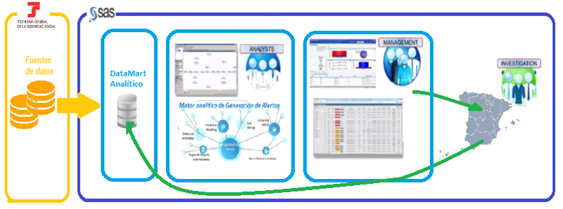
How Analytics Helped分析怎么发挥作用
Supported by powerful IT infrastructure强大的IT基础设施做支持

Slide 7
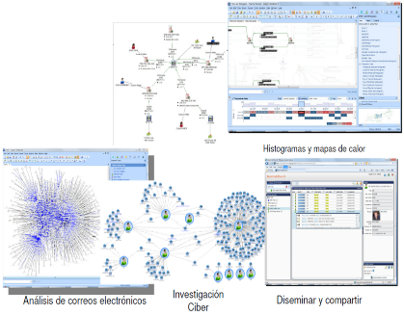
How Analytics Helped分析怎么发挥作用
Supported by powerful analytical tools
强大的分析工具做支持
Analytical techniques 分析技术
Known fraud / Unknown fraud
已知欺诈/未知欺诈
SAS Fraud Framework

Slide 8
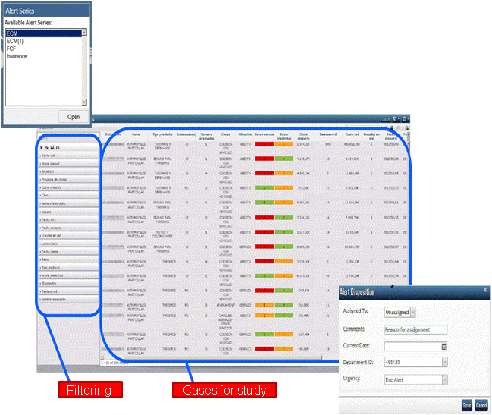
How Analytics Helped分析怎么发挥作用
Supported by powerful analytical tools (cont.)通过强大的分析工具支持（续）
The case manager (Social Network analysis) of the SAS Fraud Framework tool will, through its web access, meet the needs of performance in terms of information exchange在SAS反欺诈框架工具的情况下，经理（社交网络分析）将通过其网络接入，满足信息交流方面的性能需求

Slide 9
How Analytics Helped分析怎么发挥作用
Supported by powerful analytical techniques支持强大的分析技术
Integrating Analytics in Social Security General Treasury to identify potentially fraudulent cases and discover new patterns and behaviors, based on the analysis of existing information systems to deliver integrated fraud management, intensifying the process control management. 财政部社会保障部门的整合分析，以识别潜在的欺诈案件，并发现新的模式和行为，根据现有的信息系统提供集成欺诈管理，强化过程控制管理的分析。
Methodologies and algorithms
方法和算法

Slide 10
How Analytics Helped分析怎么发挥作用
Supported by powerful analytical techniques (cont.)通过强大的分析技术支持（续）
Capabilities provided
提供的能力
Results for Social Security General Treasury 财政部社会保障部门的结果
Definition and implementation of: automatic actions, performances case review, inspection activities , transfer to third parties. 定义和执行的：自动动作，表演案审查，检查活动，转移给第三方。
Alarms, automated controls or checks for integrated fraud management systems. 报警，自动化控制或支票欺诈的综合管理系统。
Protocols and case management协议和案件管理
-Identification of business rules业务规则识别
-Anomaly Detection 匿名检查
-Advanced Analytics 高级分析
Anomaly detection to identify unknown patterns of advanced analytics异常检测，以确定高级分析未知模式
Analytical techniques
分析技术
Big Data, Data Cleansing, Data Transformation, Natural Language Processing, Prospecting for information on the Internet大数据，数据清洗，数据转换，自然语言处理，展望为互联网上的信息
Datamart integrated with high reliability with multiple sources of information数据集市整合与多个信息源的高可靠性
Data sources
数据来源

Slide 11
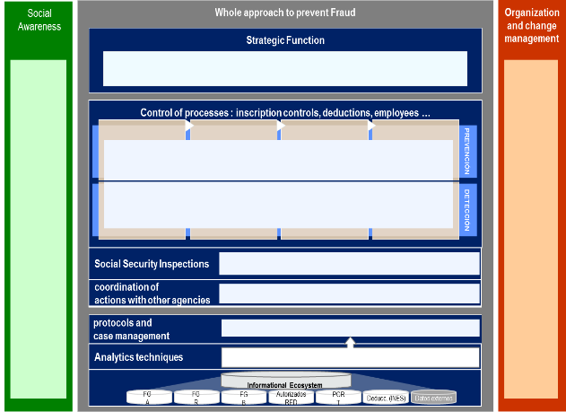
How Analytics Helped分析怎么发挥作用
Prevention and fight against fraud in TGSS - LEIF Operating Model预防和打击欺诈TGSS打 - LEIF运营模式
Multidisciplinary team of consultants with experience in analytics, big data, business and strategy to deal with a complex problem
与在分析的经验，大数据，业务和战略顾问多学科团队来处理复杂的问题。

Slide 12
How Analytics Helped分析怎么发挥作用
First assets一是资产
LEIF Datamart LEIF数据集市
Strategic plan战略计划
Phase I completed : LEIF Datamart第一阶段完成：LEIF数据集市
10 data sources10个数据源
Allows quick 360º perspective of workers and company’s behavior快速360度视角允许工人和企业的行为
Future Additions:将来扩展：
Collection, referrals, CRETA ...
EAT, SEPE, commercial register…收藏，推荐，CRETA...EAT，SEPE，商业登记
3 researching lines opened:3个研究线路开通：
Lower-contribution: Hiding computable salary items较低贡献：隐藏可计算的工资项目
Fictitious business: Construction and Household虚拟经营：建筑和家庭
Irregular employment: Self-employed quotes
非正规就业：自雇报价
Analytical capabilities分析能力
Social awareness社会意识
Developing analytical capabilities in order to identify, in advance, profiles and behavioural patters of fraudulent behavior:发展分析能力，以便提前确定型材和欺诈行为的行为模式：
Multidimensional clusters多维度集群
Networking analysis网络分析
Predictive models预测模型
Completing a survey of citizens’ perceptions of fraud:完成欺诈公民的看法的调查：
Knowledge of the institution and their functions知识的机构及其职能
Clarity and simplicity of procedures清晰度和程序简单
Perception of citizenship fraud公民身份欺诈的感知
Tolerance citizenship fraud宽容公民欺诈
Advanced indicators高级指标
Business Rules商业规则

Slide 13
How Analytics Helped分析怎么发挥作用
LEIF Datamart数据市场
First phase of the analytical environment complete with the addition of external and internal sources that allow a 360º perspective of the workers, the company and its historical behavior.分析环境的第一阶段完成，增加了外部和内部的来源，用360度的视角发现工人，公司和它的历史的行为。
Companies
Workers
Benefits
Information related benefits to temporary suspension of work activity
External sources 外部资源
Informal 信息
AET
SEPE
Registry of Commerce
List of members and their contracts have had activity at any time since January 2011
List of companies with activity at any time since January 2011
Quotes 报价
Collections 收集
Referrals 推介
Contribution basis (already included) 贡献的基础（已经包含）
Delinquency
CCC or workers that have generated debt since January 2011
从2011年1月份开始，把成员和合同及其活动列表
工人
犯罪
从2011年1月份开始，CCC或者工人欠账
益处
暂停工作活动的信息的益处
商业登记
Already included
已经包含
公司
从2011年1月份开始，把公司活动列表
Pending inclusion
待列入

Slide 14
How Analytics Helped分析怎么发挥作用
LEIF Datamart – Database enrichment充实数据库
250 variables have been developed for the enrichment of the analytical environment in order to improve the predictive capabilities of analytical techniques. The following variables were identified as relevant.为了提高分析技术的预测能力250变量已经开发了用于分析环境的富集。以下变量被确定为相关的。
Variables related to workers
和员工相关的变量
Variables related to debt
和债务相关的变量
Amount generated, pending and paid
Variables related to companies
和公司相关的变量
Recurrent economic activity in this type of fraud Anomalous distribution of workers by sex compared to economic sector Percentage of part-time workers Age of the company
Percentage of the amounts
Time evolution generated and paid amounts
在这种类型的诈骗中复发的经济活动
工人的性别异常分布相比经济部门
公司的年龄
兼职工人的百分比
Proportion of unemployed not collecting benefits at the time of recruitment
Proportion of non-EU workers in the company
Recruitment of women who are in an advanced state of pregnancy
Hiring workers close to retirement age
Proportion of workers on staff who have worked in different sectors
Existence of workers at risk of social exclusion
Existence of massive leaks
Repeated request of working life report
Province of different worker to CCC
·在招聘的时候失业、没有收益的人的百分比
在公司中，不是欧盟成员国的工人的百分比
招收在怀孕后期的孕妇
招收即将达到退休年龄的员工
在不同部门工作过的员工在全部职员中的百分比
有社会排斥风向的员工的存在
大量泄漏的存在
工作生活报告的反复要求
向CCC提供不同员工
产生的，悬而未决，支付的金额
金额的百分比
时间评估产生和支付的金额

Slide 15
How Analytics Helped分析怎么发挥作用
Irregular Employment. Self-employed quotes非正规就业。自雇报价
Business case
商业案例
With the self-employed flat rate, a new fraudulent practice has been detected: the Company forces employees to sign in RETA with the flat rate, whilst maintaining their original/normal activity in the Company. In this way, the amount due will be lower even when they still work for the Company.
随着个体户统一费率，一个新的欺诈行为已经被发现：公司迫使员工在签订区域技术援助与扁平率，同时保持其原有/正常活动的公司。这样一来，总量会降低，甚至当他们还在为公司工作的时候。
Hiding computable salary items隐藏可计算的工资项目
Business case
商业案例
On 22th of December 2013, a change was made to Article 109 of the Social Security law. 在2013年12月22日的一个变化是对社会保障法的109条款进行修改
This resulted in 10 of the 56 retributive concepts changed the basis on which they were calculated, however not all companies have implemented this correctly 这导致在56个观念中的10个观念改变上他们计算的基础，但并不是所有的企业都正确地实现这一点

Slide 16
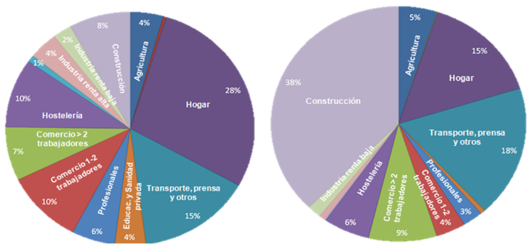
How Analytics Helped分析怎么发挥作用
Fictitious business. Construction & Households虚拟企业。建筑与家庭
Penetration of fictitious business in construction is very high. Therefore, we have prioritized the analysis of this segment.虚拟企业在建设普及率非常高。因此，我们优先考虑这部分的分析。
We have also begun to analyze the household segment due to the significant increase in the number of workers in the SSDE that have proved fictitious.
我们也开始来分析家庭分部由于已证明虚构的SSDE在工人的数量的显著增加。
Fictitious business distribution虚拟商业分配
Companies distribution公司分配

Slide 17
How Analytics Helped分析怎么发挥作用
Fictitious business. Construction & Households虚拟企业。建筑与家庭
Powerful analytical techniques were applied in order to identify fictitious business
实施强大的分析技术，以便确定虚构公司
Business rules 商业规则
Networking analysis 网络分析
Predictive models 预测模型
Developing predictive models (logistic regressions) to identify profiles and behavioral patters of fraudulent behavior 发展预测模型（回归）来检测诈骗行为的个人简历和行为模式
Advanced indicators 高级指标
Occupational and sociodemographic analysis of workers to estimate the potential risk in a fraudulent situation 在诈骗中估计潜在风险，对员工职业的和人口社会学的分析
Pairing companies with fake businesses identified in the past 在过去的确定用假的业务配对公司
Business rules and behavioral patterns 商业规则和行动模式

Slide 18
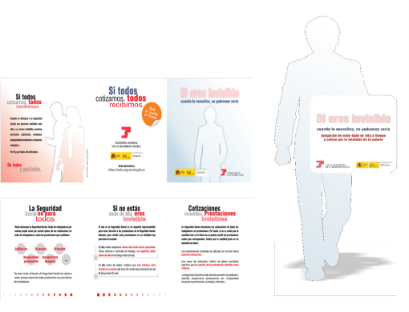
How Analytics Helped分析怎么发挥作用
Social awareness社会意识
The National Treasury is very interested in analyze society’s sensitivity related to fraud, with the objective of identifying existing fraudulent conduct (“Social Fraud Barometer”)国家财政部对于分析有关欺诈的社会的敏感度非常感兴趣，目标是识别现有的欺诈行为（“社会欺诈晴雨表”）
Therefore a survey was conducted in 2014.因此，一个调查是在2014年进行
The definition of a Strategic communication plan will be developed based on the results of the Fraud Survey 2014.战略沟通计划的定义将根据2014年欺诈调查的结果来制定。

Slide 19
How Analytics Helped分析怎么发挥作用
Social awareness社会意识
Definition, design and analysis of Fraud Survey 2014 in order to describe how citizens notice the fraud against the TGSS. 对于2014年欺诈调查的定义，设计和分析，为了描述形容公民如何发现对TGSS的欺诈行为。
Strategic communications plan will be developed based on the results of the Fraud Survey 2014.战略通信计划将根据2014年的欺诈调查的结果来制定。
Methodology:方法
Definition
(Jun 2014)
Qualitative phase
(Jul 2014)
Fieldwork
(Sept-Oct 2014)
Research and Analysis
(Nov-Dec 2014)
Fieldwork report
(Jan 2015)
Goals目标
Target意图
Methodology方法
Questionnaire design问卷设计
Proof of Concept概念验证
Training培训
Supervision监督
Gather survey results收集调查结果
Import survey results to database导入调查结果数据库
Weighing评价
Sociodemographic Analysis社会人口统计分析
Final Report最终报告

Slide 20
Thank you for your attention谢谢
SUBDIRECCIÓN GENERAL DE RECAUDACIÓN EN PERIODO VOLUNTARIO

