Slide 1
Prevention and fight against fraud in General treasury of the Social Security
Mr. José Luis Encinas, Head of Unit of Inspection and Prevention in the Sub Directorate General of Period Collection in voluntary
Madrid, 29th October 2015

Slide 2
General Treasury of the Social Security
Business challenge
How Analytics helped
High performance. Delivered
AGENDA
AGENDA

Slide 3
General Treasury of the Social Security
Social Security General Treasury is the entity responsible for the collection and management of economic and financial resources of the Social Security.

Slide 4
The challenge
Big deal with Big responsibilities
The main challenge for TGSS is to deliver efficiency improvements and to do this, it is required to develop a strategy against fraud and irregular employment.
Lines of attack:
Integrate fighting fraud within all management procedures of the TGSS
Merge and debug all different available information sources.
Analysis techniques for focusing actions
Intensify Social Security inspection capacities

Slide 5
The challenge
Priorities lines of attack for TGSS against fraud
CONTROL OF PROCESSES
Employee identity
Inscription controls
Omitted and irregular info
Exclusions and deductions
1
Inscription controls, deductions, …
Payment processes
FICTICIOUS BUSINESS
Fictitious business
Probability of risk evolution
Delay in payment prevention
2
Fraud Networks
Network Analysis
Insolvent companies
Fictitious companies
Delay in payment
5
IRREGULAR EMPLOYMENT
Workers not registered
Part-time contracts
Hide a higher activity
3
HIDE PROPERTY IN
COMPANIES IN DEBT
Insolvent companies
Responsibilities derivation
4

Slide 6
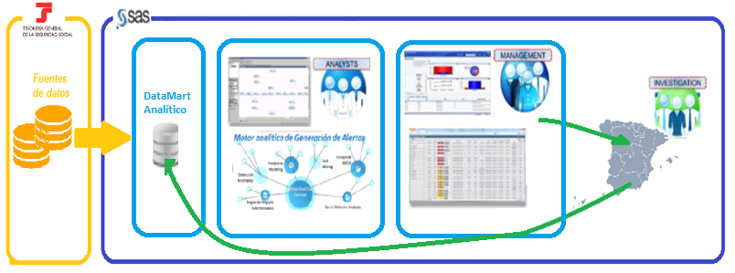
How Analytics Helped
Supported by powerful IT infrastructure

Slide 7
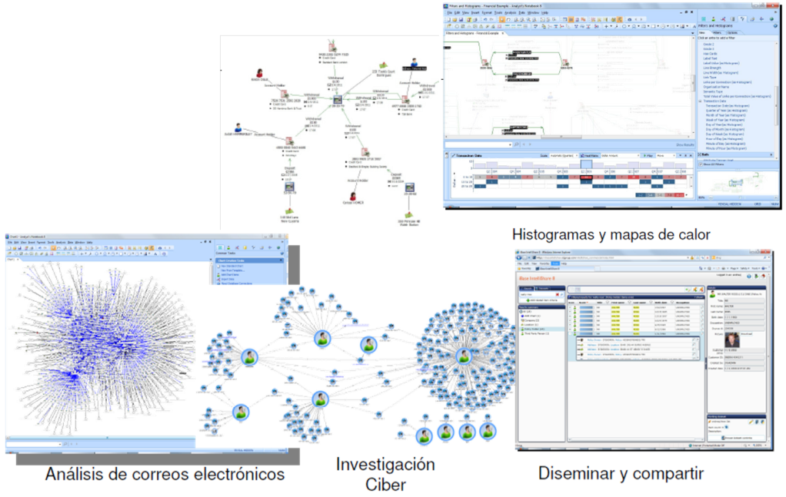
How Analytics Helped
Supported by powerful analytical tools
Analytical techniques
Known fraud / Unknown fraud
SAS Fraud Framework

Slide 8
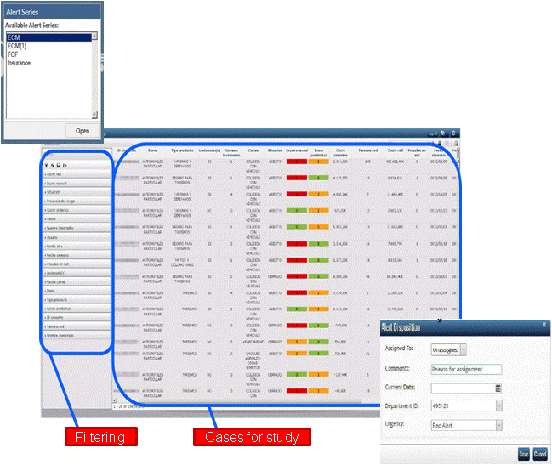
How Analytics Helped
Supported by powerful analytical tools (cont.)
The case manager (Social Network analysis) of the SAS Fraud Framework tool will, through its web access, meet the needs of performance in terms of information exchange

Slide 9
How Analytics Helped
Supported by powerful analytical techniques
Integrating Analytics in Social Security General Treasury to identify potentially fraudulent cases and discover new patterns and behaviors, based on the analysis of existing information systems to deliver integrated fraud management, intensifying the process control management.
Methodologies and algorithms

Slide 10
How Analytics Helped
Supported by powerful analytical techniques (cont.)
Capabilities provided
Results for Social Security General Treasury
Protocols and case management
Definition and implementation of: automatic actions, performances case review, inspection activities , transfer to third parties.
Alarms, automated controls or checks for integrated fraud management systems.
-Identification of business rules
-Anomaly Detection
-Advanced Analytics
Anomaly detection to identify unknown patterns of advanced analytics
Analytical techniques
Big Data, Data Cleansing, Data Transformation, Natural Language Processing, Prospecting for information on the Internet
Datamart integrated with high reliability with multiple sources of information
Data sources

Slide 11
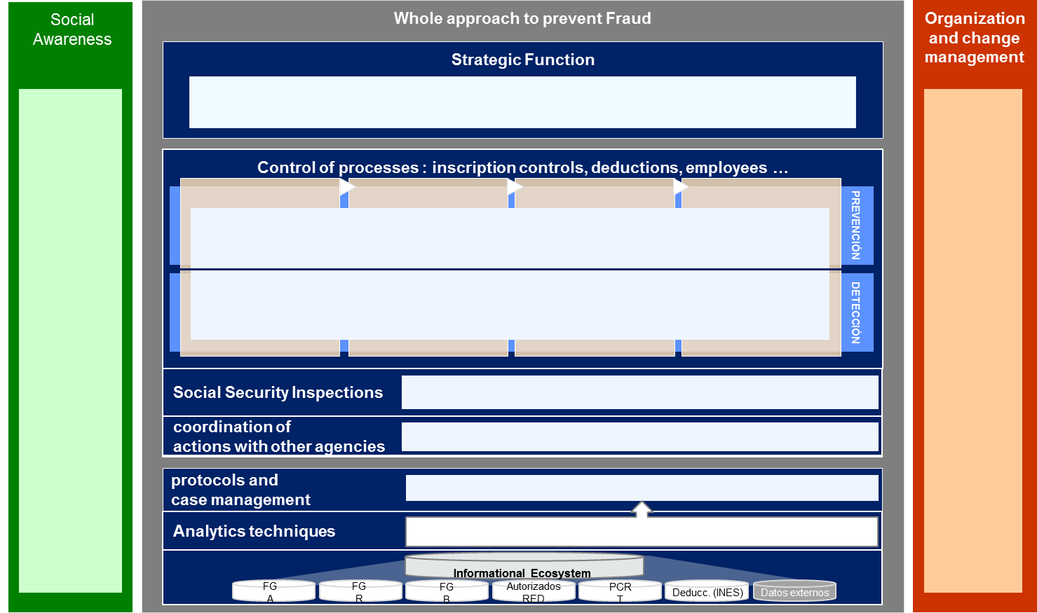
How Analytics Helped
Prevention and fight against fraud in TGSS - LEIF Operating Model
Multidisciplinary team of consultants with experience in analytics, big data, business and strategy to deal with a complex problem

Slide 12
How Analytics Helped
First assets
LEIF Datamart
Strategic plan
Phase I completed : LEIF Datamart
10 data sources
Allows quick 360º perspective of workers and company’s behavior
Future Additions:
Collection, referrals, CRETA ...
EAT, SEPE, commercial register…
3 researching lines opened:
Lower-contribution: Hiding computable salary items
Fictitious business: Construction and Household
Irregular employment: Self-employed quotes
Analytical capabilities
Social awareness
Completing a survey of citizens’ perceptions of fraud:
Knowledge of the institution and their functions
Clarity and simplicity of procedures
Perception of citizenship fraud
Tolerance citizenship fraud
Developing analytical capabilities in order to identify, in advance, profiles and behavioural patters of fraudulent behavior:
Multidimensional clusters
Networking analysis
Predictive models
Advanced indicators
Business Rules

Slide 13
How Analytics Helped
LEIF Datamart
First phase of the analytical environment complete with the addition of external and internal sources that allow a 360º perspective of the workers, the company and its historical behavior
Companies
Workers
Benefits
Information related benefits to temporary suspension of work activity
External sources
Informa
AET
SEPE
Registry of Commerce
List of members and their contracts have had activity at any time since January 2011
List of companies with activity at any time since January 2011
Quotes
Collections
Referrals
Contribution basis (already included)
Delinquency
CCC or workers that have generated debt since January 2011
Already included
Pending inclusion

Slide 14
How Analytics Helped
LEIF Datamart – Database enrichment
250 variables have been developed for the enrichment of the analytical environment in order to improve the predictive capabilities of analytical techniques. The following variables were identified as relevant.
Variables related to workers
Proportion of unemployed not collecting benefits at the time of recruitment
Variables related to debt
Amount generated, pending and paid
Variables related to companies
Recurrent economic activity in this type of fraud Anomalous distribution of workers by sex compared to economic sector Percentage of part-time workers Age of the company
Existence of workers at risk of social exclusion
Proportion of non-EU workers in the company
Recruitment of women who are in an advanced state of pregnancy
Hiring workers close to retirement age
Proportion of workers on staff who have worked in different sectors
Existence of massive leaks
Repeated request of working life report
Province of different worker to CCC
Percentage of the amounts
Time evolution generated and paid amounts

Slide 15
How Analytics Helped
Irregular Employment. Self-employed quotes
Business case
With the self-employed flat rate, a new fraudulent practice has been detected: the Company forces employees to sign in RETA with the flat rate, whilst maintaining their original/normal activity in the Company. In this way, the amount due will be lower even when they still work for the Company.
Hiding computable salary items
Business case
On 22th of December 2013, a change was made to Article 109 of the Social Security law.
This resulted in 10 of the 56 retributive concepts changed the basis on which they were calculated, however not all companies have implemented this correctly

Slide 16
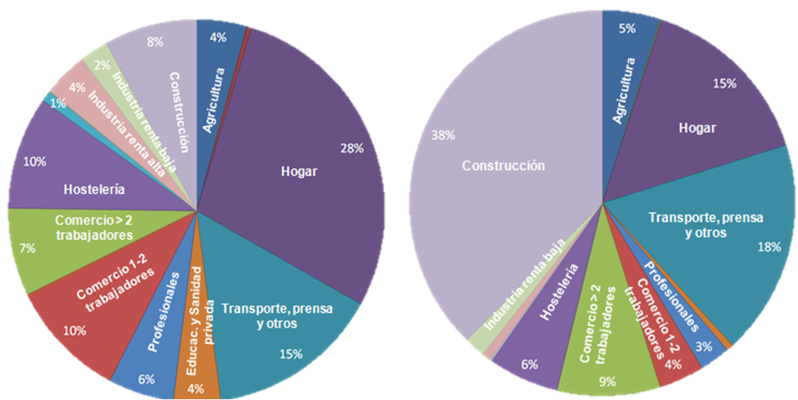
How Analytics Helped
Fictitious business. Construction & Households
Penetration of fictitious business in construction is very high. Therefore, we have prioritized the analysis of this segment.
We have also begun to analyze the household segment due to the significant increase in the number of workers in the SSDE that have proved fictitious.
Companies distribution
Fictitious business distribution

Slide 17
How Analytics Helped
Fictitious business. Construction & Households
Powerful analytical techniques were applied in order to identify fictitious business
Business rules
Business rules and behavioral patterns
Networking analysis
Predictive models
Developing predictive models (logistic regressions) to identify profiles and behavioral patters of fraudulent behavior
Advanced indicators
Occupational and sociodemographic analysis of workers to estimate the potential risk in a fraudulent situation
Pairing companies with fake businesses identified in the past

Slide 18
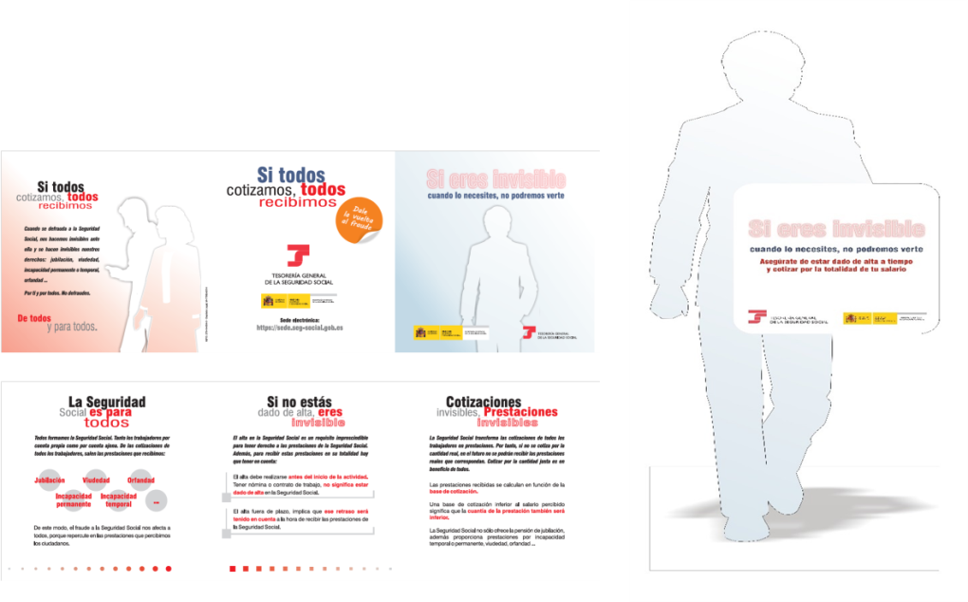
How Analytics Helped
Social awareness
The National Treasury is very interested in analyze society’s sensitivity related to fraud, with the objective of identifying existing fraudulent conduct (“Social Fraud Barometer”)
Therefore a survey was conducted in 2014
The definition of a Strategic communication plan will be developed based on the results of the Fraud Survey 2014.

Slide 19
How Analytics Helped
Social awareness
Definition, design and analysis of Fraud Survey 2014 in order to describe how citizens notice the fraud against the TGSS.
Strategic communications plan will be developed based on the results of the Fraud Survey 2014.
Methodology:
Definition
(Jun 2014)
Qualitative phase
(Jul 2014)
Fieldwork
(Sept-Oct 2014)
Research and Analysis
(Nov-Dec 2014)
Fieldwork report
(Jan 2015)
Goals
Target
Methodology
Questionnaire design
Proof of Concept
Training
Supervision
Gather survey results
Import survey results to database
Weighing
Sociodemographic Analysis
Final Report

Slide 20
Thank you for your attention
SUBDIRECCIÓN GENERAL DE RECAUDACIÓN EN PERIODO VOLUNTARIO

