Slide 1
MARINE HEALTH PROGRAMME 海事医疗制度
Madrid, October 30 2015

Slide 2
MARINE HEALTH PROGRAMME 海事医疗制度
Created in 1983, it includes the competences and functions of the ISM in relation to the healthcare attention for workers on board vessels abroad.
It is based on a comprehensive approach to the health of the mariners (WHO).
It is a practical model, based on comprehensive mechanisms for planned care and prevention.
The rest of the competences in healthcare have been transferred to the autonomous regions.
1983年实施，涵盖了海事社保署海外大型船舶工作者健康方面的管理职权与功能
主要为海上工作者提供全面的健康医疗渠道（世界卫生组织）
是一套实用的模型，主要为健康医疗与疾病预防提供综合性应对机制
其余健康医疗职权已经转入自治地区

Slide 3
PREVENTIVE LEVEL
预防性措施
ASSISTANCE LEVEL
救助性措施

Slide 4
PREVENTIVE LEVEL
Aimed at improving the state of health and reduce labour risk factors.
Medical check-ups on embarkation
´Mandatory healthcare training for mariners.
Inspection of medicine chests and health and hygiene conditions on vessels.
旨在改善健康状况并减少劳动风险因素
船上医疗检查
海上工作人员法定健康培训
船舶卫生条件、医药设施检查

Slide 5
PREVENTIVE LEVEL
4. Epidemiological studies.
5. Health awareness campaigns, health promotion and prevention.
6. Vaccination campaigns.
4. 流行病学习
5. 健康知识宣传、促进健康、防范疾病
6. 疫苗注射宣传

Slide 6
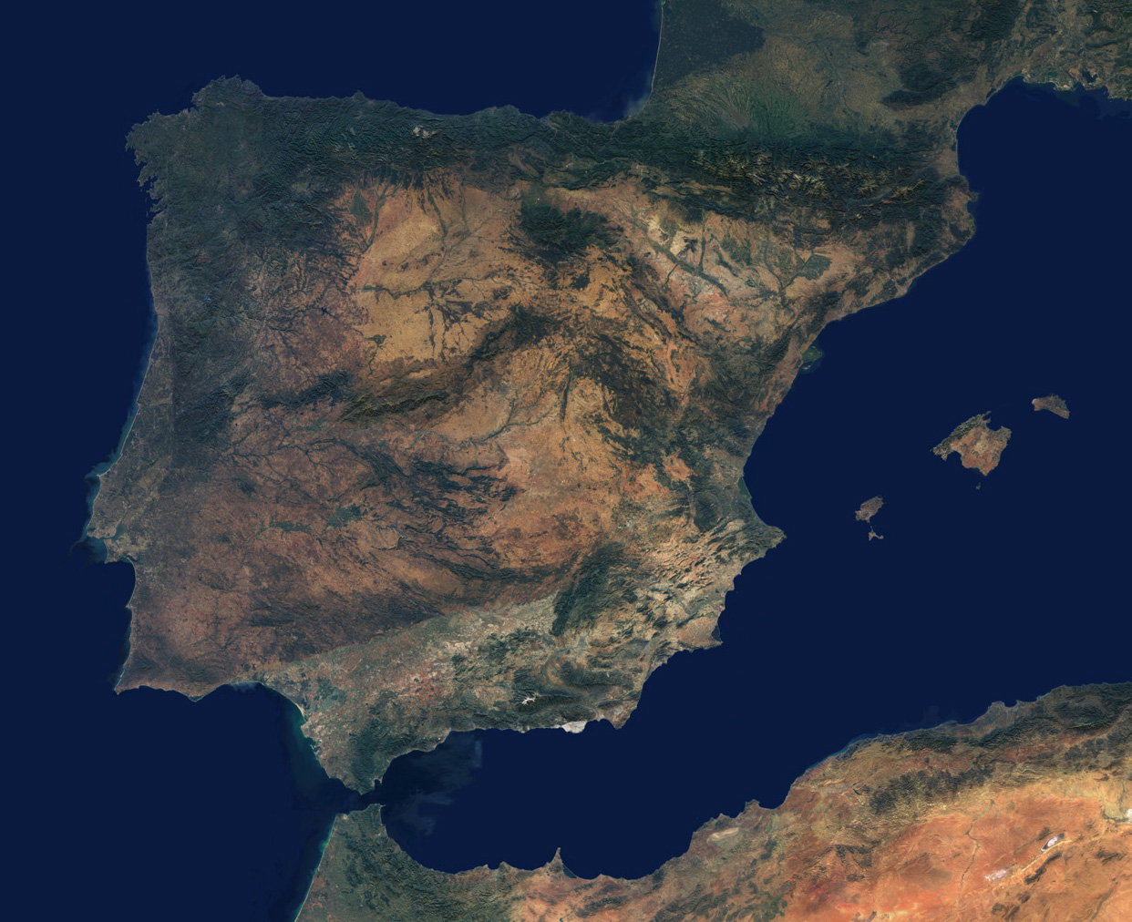

Slide 7
预防性措施
1. Medical check-ups on enbarkation
船上医疗检查

Slide 8
Medical check-ups on embarkation 船上医疗检查
Aimed at detecting any illness that the crew may suffer from and that may be aggravated by work at sea, or that may represent a risk for the health of others.
Guarantee access to the vessel in the best conditions.
Unified database that contains the clinical history of the medical check-ups.
旨在发现在海上工作期间可能患有或者可能加重的疾病，或者其他患病风险；
确保船舶拥有最佳卫生条件
统一数据库：包括了医疗检查病历

Slide 9
Medical check-ups on embarkation 海上医疗检查
Order of the Prime Minister's Office 1/3/1973 - ILO Conventions attributes responsibility for check-ups to the ISM
Act 31/1995 on employment risk prevention - health check-ups
Royal Decree 39/1997, passing the Regulation on Prevention Services for Occupational Risks - Sixth Additional Provision
Royal Decree 1696/2007, regulating Medical Check-ups on Embarkation.
Royal Decree 504/2011, on the structure and functions of the ISM
1973年3月1日《首相府令》：国际劳工组织为海事社保署医疗检查提供一定责任
1995年第31号工作健康检查与疾病预防法案
1997年第39号《皇诏》：通过了《职业疾病风险防范服务规定-第六号增修条款》
2007年第1696号《皇诏》：规定了“海上医疗检查”制度
2011年第504号《皇诏》：规定了海事社保署的架构与功能

Slide 10
Medical check-ups on embarkation 海上医疗检查
初期检查
定期检查
总计
5,595 | 51,111 | 56,706
6,208 | 46,853 | 53,061
6,657 | 47,702 | 54,361
7,581 | 44,580 | 52,161
7,657 | 46,656 | 54,313
33,698 | 236,902 | 270,602
总计

Slide 11
PREVENTIVE LEVEL 预防性措施
2. Mandatory Healthcare Training for workers at sea
海上工作者法定健康培训

Slide 12
Mandatory healthcare training 法定健康培训
Royal Decree 258/1999 establishes the minimum conditions for protection of health and medical assistance for workers at sea (transposes Decree 92/29/EEC of the Council of 31/3/92 to the Spanish legal system).
Order PRE/646/2004 establishes the minimum content of the programmes of specific healthcare training for workers at sea.
Resolution of 24 April 2013 of the Social Marine Institute on conditions that must be met by the training centres.
Resolution of 24 April 2013 of the Social Marine Institute on minimum contents of the healthcare training programmes.
1999年第258号《皇诏》建立了海上工作者健康保护与医疗救助最低标准条件（传达欧共体92/29法令（1992年3月31日），载入法律体系）
2004年第646号《首相令》：建立了海上工作者专项健康培训基本内容
201年4月24日《海事社会保障署关于培训中心必备条件的决议》
2013年4月24日《海事社会保障署关于健康培训必备内容的决议》

Slide 13
Mandatory healthcare training
Various levels of training:
Basic training: for all the workers on board.
Specific initial training: those responsible for healthcare on board and the control of the medicine chest in vessels with C medicine chests.
Specific advanced training: those responsible for healthcare on board and the control of the medicine chest in vessels with A/B medicine chests.
Other specific training according to the activity of the worker: diving, underwater activities.
培训的不同层次:
基础培训：对所有船上工作者
专项初级培训：拥有C级医疗设备的海上医疗与医药负责人
专项高级培训：拥有A/B级医疗设备的海上医疗与医药负责人
其他根据不同工作开展的专项培训：潜水、水下作业等

Slide 14
Mandatory healthcare training STUDENTS TRAINED 通过法定健康培训的学员
2011-2014 | course 课程 | students 学员
Basic training module for first aid 急救基础培训 | 318 | 5，922
Specific Initial Healthcare Training 专项初级健康培训 | 533 | 7，823
Specific advanced healthcare training 专项高级健康培训 | 238 | 3，485
Specific Initial Healthcare training (update) 专项初级健康培训（更进） | 344 | 5，381
Specific Advanced Healthcare training (update) 专项高级健康培训（更进） | 120 | 1，854
Healthcare training for underwater activities 水下作业健康培训 | 11 | 152
Specific healthcare training (online mode) 专项健康培训（在线模式） | 125 | 855
Total 总计 | 1685 | 25，472

Slide 15
PREVENTIVE LEVEL 预防性措施
3. Control of medicine chests and hygienic-healthcare conditions on vessels
船舶医药设备与卫生医疗条件管理

Slide 16
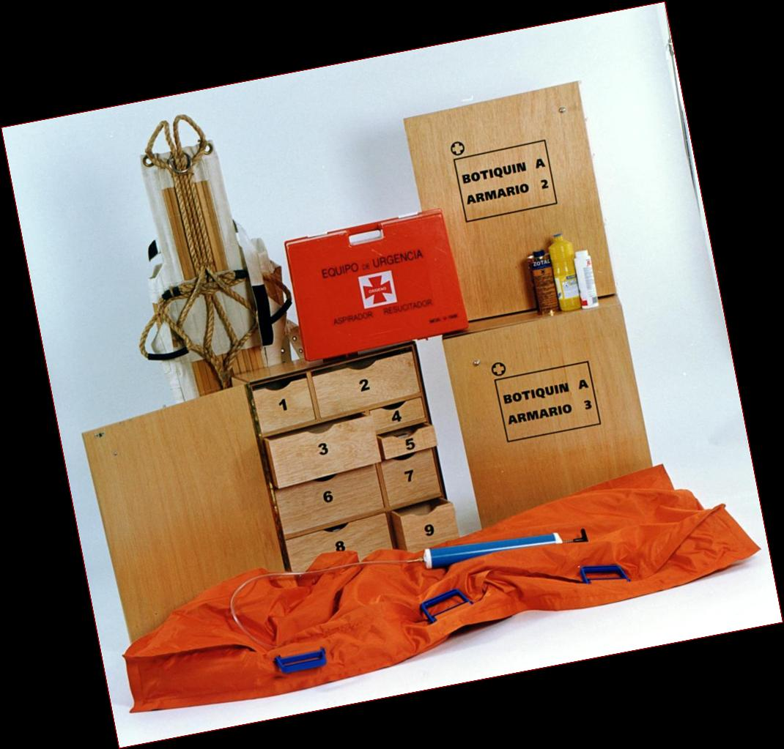
Inspection of medicine chests 医药设备监察
Medicine chests vary in size and contents according to the type of ship and the area of navigation.
- A: + 150 miles and/or trips of + 48 hours
- B: +60 and -150 miles and/or trips of 24-48 hours
- C: -60 miles and/or -24 hours, lifeboats (A and B)
- Antidotes
Health and sanitary conditions on vessels:
- Fishing vessels (SEGUMAR programme) 715 inspections between 2012 and 2014
- Merchant vessels (ILO MLC06 Convention): 141 inspections since its entry into force
医药设备根据船舶型号与航海区域不同而不同
A型:150公里以上及/或48小时以上航程
B型:60-150公里及/或24-48小时航程
C型: 60公里以下及/或24小时以下航程，救生船（A型与B）
- 药剂
船舶卫生医疗条件:
2012年与2014年间进行了715次渔船检查（保海计划）
制度生效以来（国际劳工组织MLC06次会议）进行了141次上传检查

Slide 17
Medicine chests inspected 医药设备监察
年份
A型
B型
C型
C型医药设备
药物
总计
254 | 389 | 4,837 | 395 | 56 | 5,931
259 | 346 | 4,636 | 349 | 74 | 5,990
224 | 273 | 5,303 | 321 | 66 | 6,187
239 | 264 | 5,595 | 291 | 65 | 6,454
245 | 260 | 6,879 | 270 | 72 | 7,726

Slide 18
Inspection of medicine chests 医药设备检查
- Royal Decree 258/1999, transposing an EU Directive: type of medicine chests and their content, models of containers, those responsible for periodic inspection.
Royal Decree 568/2011, modifying Royal Decree 258/1999
- Order ESS/2542/2014, of 5 December, establishing the basic amounts of the subsidies for provision of the medicine chests that are required on ships.
- Annual resolutions of the ISM management
- 1999年第258号《皇诏》转达《欧盟决议》：定期检查医药设备类型、内容、形式与容器
2011年第568号《皇诏》对1999年第258号《皇诏》进行了修正
- 2014年第2542号（12月5日）欧共体决议案：要求提供补助金以便在船上建立符合法规的医药设备
- 海事社保署年度决议管理

Slide 19
PREVENTIVE LEVEL 预防性措施
4. Epidemiological studies: information provided by the medical checks on embarkation.
5. Health awareness campaigns, promotion of health and prevention: AIDS, STDs, malaria, drug addiction, alcoholism, hearing protection.
6. Vaccination campaigns: tetanus, flu, hepatitis.
4. 流行病学习: 通过海上医疗检查的形式提供相关信息.
5. 健康知识宣传、疾病预防: 艾滋病, 性传播疾病, 疟疾, 吸毒, 酗酒, 听力保护等.
6. 疫苗注射宣传: 破伤风, 流感, 肝炎.

Slide 20
CARE LEVEL 看护措施
Aimed at bringing healthcare
to where the workers are
1. With own resources.
- Spanish Radio Medical Centre
- Medical Care and Logistical Ships
(“Esperanza del Mar” and “Juan de la Cosa”).
- Care Centres abroad.
目的是在工作地向工作者提供医疗
1. 利用自有资源
- 西班牙医疗广播中心
- 医疗救助与后勤补给船舶
(“海上希望号” 与 “胡安·德·拉·科萨号”).
- 海外医疗中心.

Slide 21
ASSISTANCE LEVEL 救助性措施
- Spanish Radio Medical Centre
Located at ISM Central Services in Madrid, opened in 1979.
Permanently staffed by medical personnel (24/7).
Provides free care for mariners on board who request it, regardless of nationality, area of navigation or fishery in which the vessels work.
- 西班牙医疗广播中心
位于马德里海事社保署服务中心, 成立于1979年.
由医护人员常年工作（一周7日，每日24小时）
为海上工作人员提供免费救护，无论其国籍、船舶航区或渔区

Slide 22
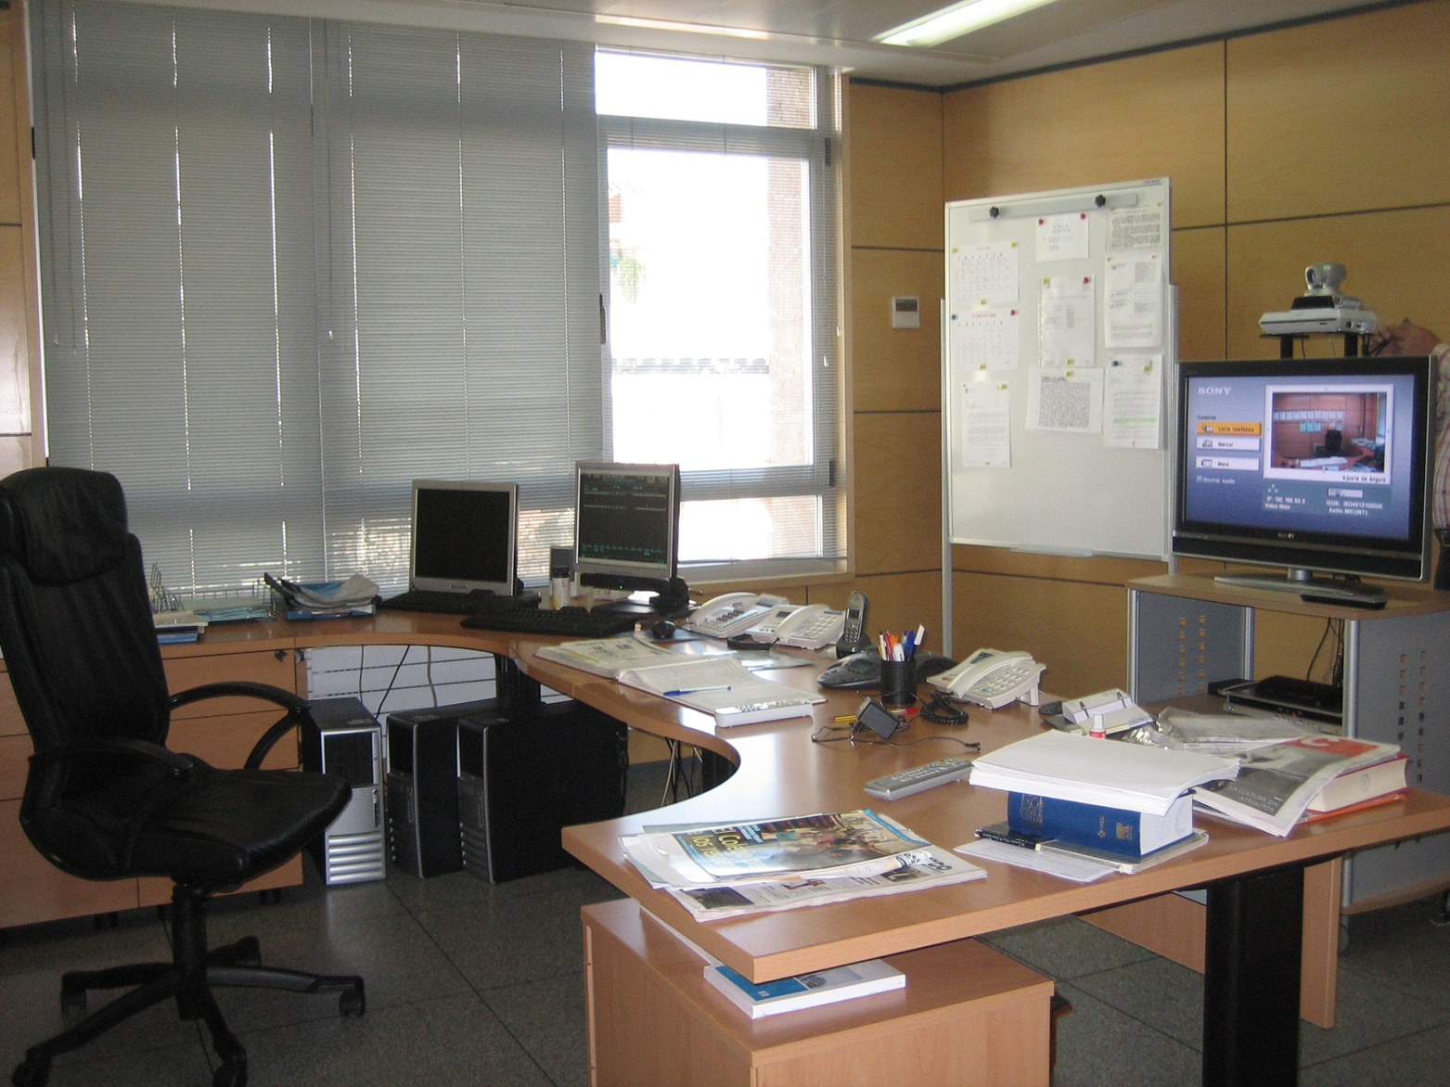

Slide 23
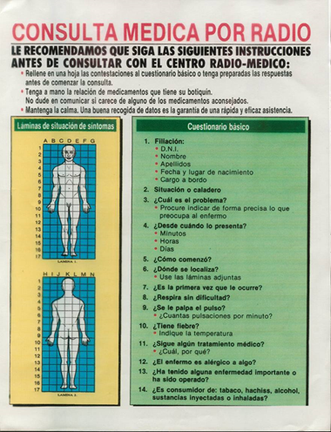
Spanish Radio Medical Centre
Medical radio consultation
Preparation of clinical history
Determination of medical advice
Monitoring and control of the case
西班牙医疗广播中心
医疗广播咨询
准备病历
提供医疗建议
监督与控制

Slide 24
Spanish Radio Medical Centre 西班牙医疗救助中心
Health database 健康数据库
Health training 健康培训
Appropriate medicine chests 适当医药设备
On-board medical guide 船上医疗指导

Slide 25
SANIMAR Databank 海医数据银行
Unified, automated and centralised databank containing all the clinical information on workers at sea. Contains data relating to different types of care:
- Medical check-ups prior to embarkation.
- Actions taken from:
. Spanish Radio Medical Centre
. Hospital ships
. Health Centres abroad
统一化、自动化与集中化的数据银行囊括了所有的海上工作者诊疗信息， 包括了不同类型救护的数据：
- 船上优先健康检查.
- 以下组织的活动数据:
. 西班牙医疗广播中心 . 医船
. 海外医疗中心

Slide 26
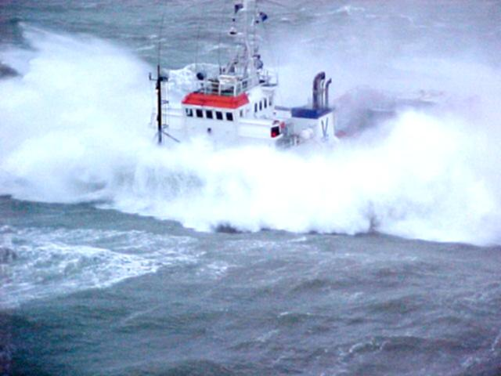
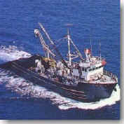
ASSISTANCE LEVEL 救助性措施
Assistance ships救援船舶
Health and logistical support 医疗与后勤支持
Introduction 介绍
Concept 概念
海上希望号医船
Hospital ship
“Esperanza del Mar”
Resources 资源
胡安·德·拉·科萨号医船
Hospital ship
“Juan de la Cosa”

Slide 27
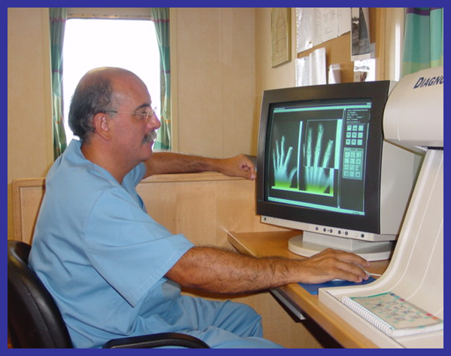
Assistance ships
人力资源：
2名医生
1名护士
1名医疗海员
医院技术资源
急救室
急救场
ICU
实验室、放射科、药房
住院区 （17/10床位）
隔离区（2床位）
附加资源
附加船舶
直升机升降坪
Juan de la Cosa
海上希望号医船
Esperanza del Mar
胡安·德·拉·科萨号医船

Slide 28
Navigation Areas 航海区域
“Juan de la Cosa” ship
胡安·德·拉·科萨号医船
North Atlantic 北大西洋
Peninsular shore 半岛海岸
Azores 亚速尔群岛
France 法国海域
Ireland 爱尔兰海域
Great Britain 不列颠海域
Can navigate in other areas than those assigned in the rest of the world except the American continent, Asia and Oceania.
除美洲大陆、亚洲与大洋洲以外亦可航行其他海域
Base port: Santander
基本港：桑坦德
"Esperanza del Mar" ship
海上希望号医船
Eastern North Atlantic, 东北大西洋
Between the Canary Island 加那利群岛之间
Archipielago and Ecuador, by the African coast.
阿吉皮也拉哥与厄瓜多尔，直到非洲海岸
Can navigate in other áreas than those assigned in the rest of the world except the American continent, Asia and Oceania.
除美洲大陆、亚洲与大洋洲以外亦可航行其他海域
Base port: Las Palmas de
Gran Canaria
基本港：大加纳利亚拉斯帕乐玛斯

Slide 29
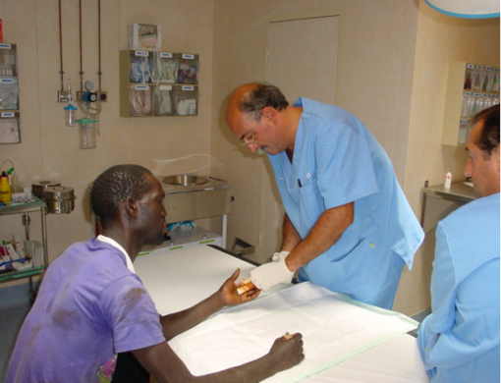
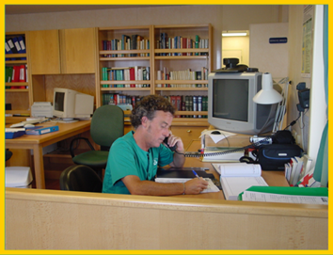
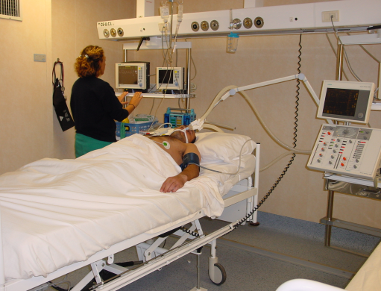
Assistance ships 救护船舶 Operational method 操作方法
医疗广播中心咨询
门诊咨询
住院
远程医疗
TELE-MEDICINE

Slide 30
Assistance ships 救护船舶
* Short-term in-patient stay: returns after a few days
to his ship where treatment continues
* Long-term in-patient stay: remains hospitalised until
he is returned to port
-On the hospital ship
- Other means
* Patient for urgent evacuation: is hospitalized
and stabilized until the evacuation can be carried out
- By air
- By other means
* 短期患病：数日后回到其本人工作船舶继续接受治疗
* 长期患病：住院到回港
- 在医船上进行
- 其他方式
* 紧急撤离: 在撤离可以执行前住院或就地治疗
- 通过飞机
- 通过其他渠道
Direct contact with CENTRE
FOR COORDINATION OF MARITIME
RESCUE 直接联系海事救护协调中心

Slide 31
Logistical support 后勤支持
Provide emergency logistical support
- Tugs
- Assistance for breakdowns
- Fuel supply
- Fresh water supply
- Electrical energy supply
- Anti-incendiary system
- Diver service
提供紧急后勤支持
拖船
抛锚救助
燃料供应
鲜水供应
电力供应
消防系统
潜水服务

Slide 32
Care Centres abroad 海外救护中心
Provide medical consultations, hospitalisations,repatriations, social care and information to workers.
Located in áreas where there is a significant presence of Spanish vessels.
Collaboration with the country´s heath services.
Located on the African coast:
向工作者提供医疗咨询、住院服务、归国运送、社会救助与信息
在西班牙籍船舶聚集地区设立
与所在国家卫生服务机构合作
在非洲海岸设立

Slide 33
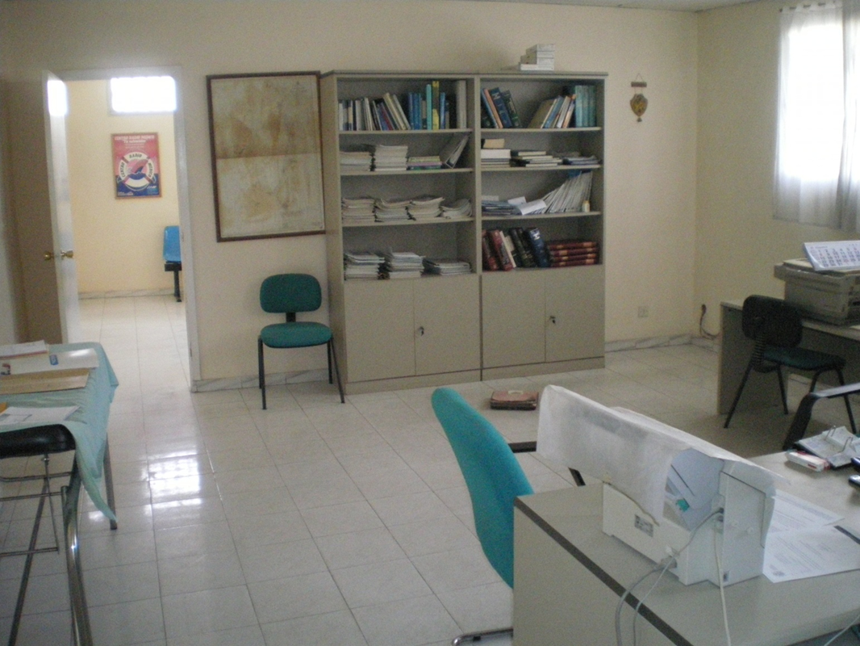
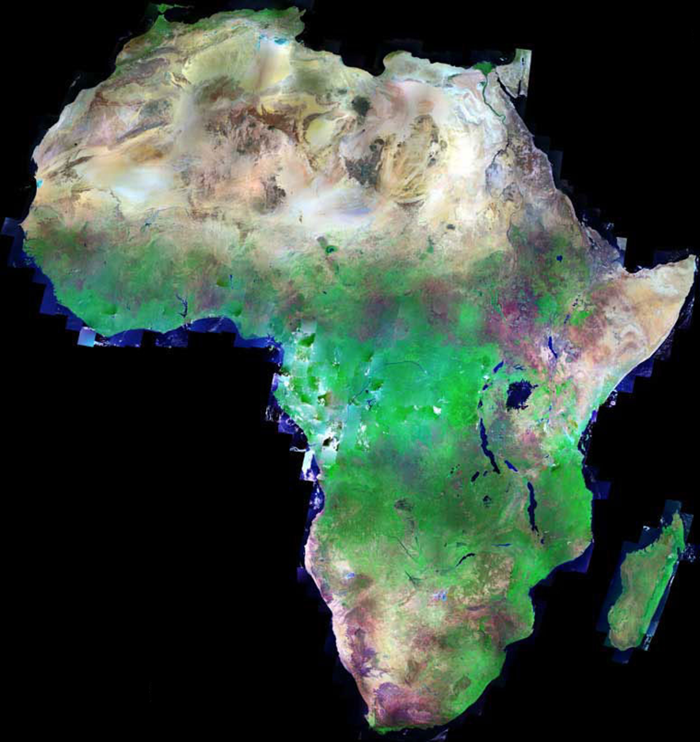
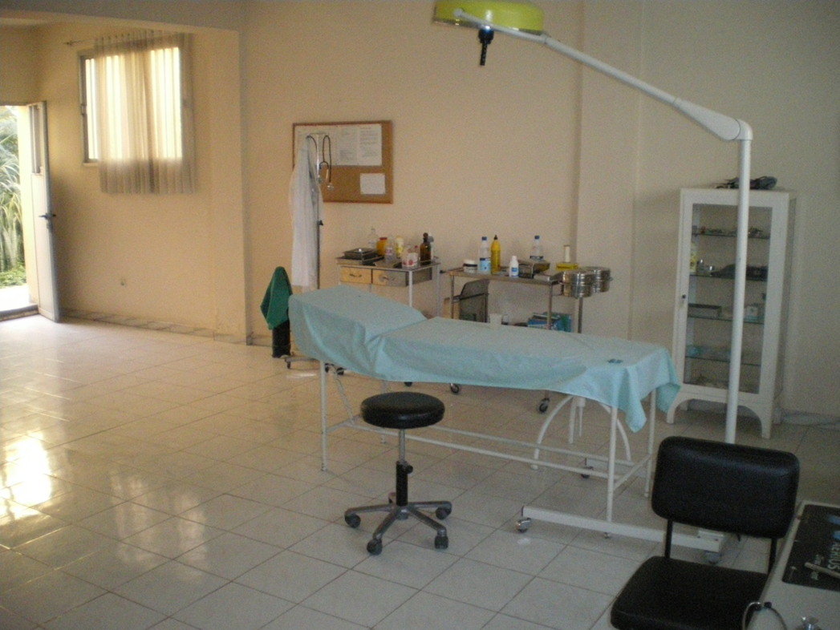
Care Centres abroad 海外救护中心

Slide 34
Care Level 救护性措施
Aimed at bringing healthcare
to where the workers are.
2. With third-party resources.
- The country‘s assistance resources + reimbursement of costs
-Healthcare repatriation
-Medical airplane
目的是向工人就地提供医疗服务
2. 运用第三方资源
- 当地国救助资源+费用报销
-归国治疗
-医用飞机

Slide 35
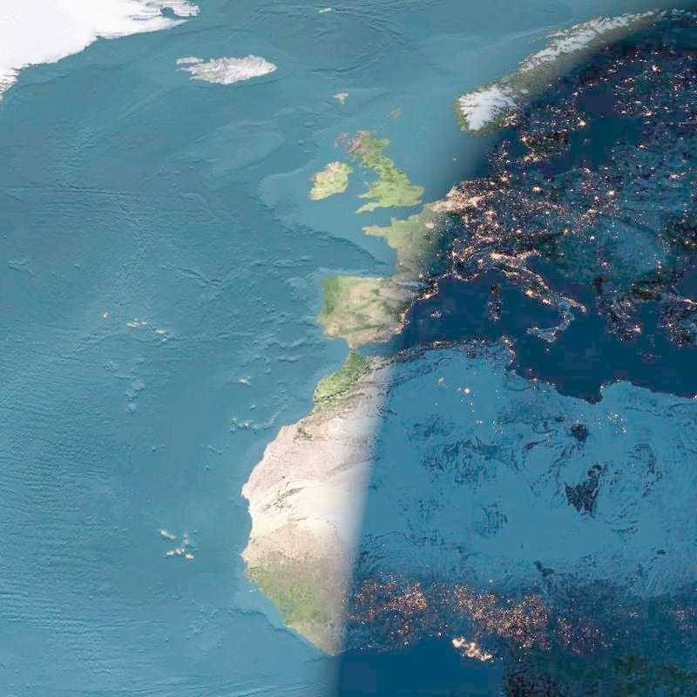
Thank you for your attention.
谢谢！

