Slide 1
MARINE HEALTH PROGRAMME
Madrid, October 30 2015

Slide 2
MARINE HEALTH PROGRAMME
Created in 1983, it includes the competences and functions of the ISM in relation to the healthcare attention for workers on board vessels abroad.
It is based on a comprehensive approach to the health of the mariners (WHO).
It is a practical model, based on comprehensive mechanisms for planned care and prevention.
The rest of the competences in healthcare have been transferred to the autonomous regions.

Slide 3
PREVENTIVE LEVEL
ASSISTANCE LEVEL

Slide 4
PREVENTIVE LEVEL
Aimed at improving the state of health and reduce labour risk factors.
Medical check-ups on embarkation
´Mandatory healthcare training for mariners.
Inspection of medicine chests and health
and hygiene conditions on vessels.

Slide 5
PREVENTIVE LEVEL
4. Epidemiological studies.
5. Health awareness campaigns, health promotion and prevention.
6. Vaccination campaigns.

Slide 6
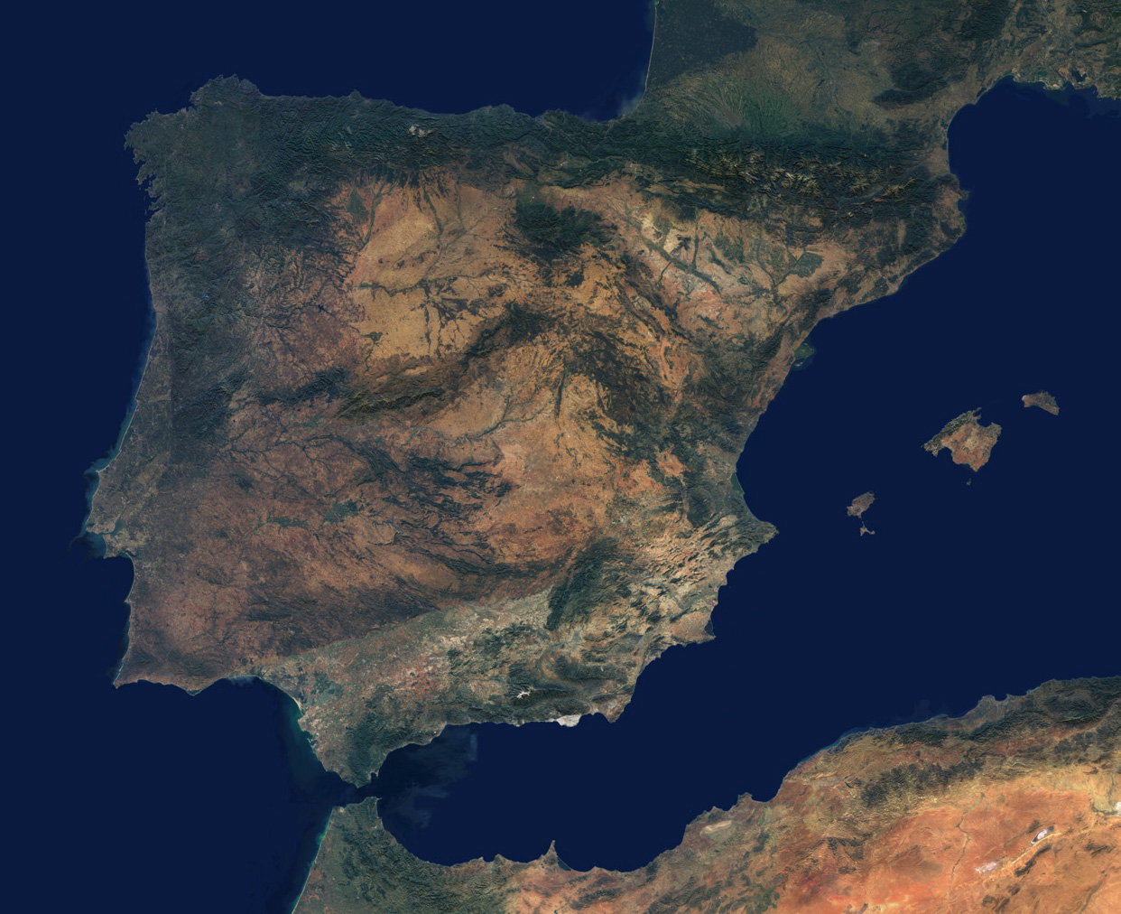

Slide 7
1. Medical check-ups
on enbarkation

Slide 8
Medical check-ups on embarkation
Aimed at detecting any illness that the crew may suffer from and that may be aggravated by work at sea, or that may represent a risk for the health of others.
Guarantee access to the vessel in the best conditions.
Unified database that contains the clinical history of the medical check-ups.

Slide 9
Medical check-ups on embarkation
Order of the Prime Minister's Office 1/3/1973 - ILO Conventions attributes responsibility for check-ups to the ISM
Act 31/1995 on employment risk prevention - health check-ups
Royal Decree 39/1997, passing the Regulation on Prevention Services for Occupational Risks - Sixth Additional Provision
Royal Decree 1696/2007, regulating Medical Check-ups on Embarkation.
Royal Decree 504/2011, on the structure and functions of the ISM

Slide 10
Medical check-ups on embarkation
5,595 | 51,111 | 56,706
6,208 | 46,853 | 53,061
6,657 | 47,702 | 54,361
7,581 | 44,580 | 52,161
7,657 | 46,656 | 54,313
33,698 | 236,902 | 270,602

Slide 11
PREVENTIVE LEVEL
2.

Slide 12
Mandatory healthcare training
Royal Decree 258/1999 establishes the minimum conditions for protection of health and medical assistance for workers at sea (transposes Decree 92/29/EEC of the Council of 31/3/92 to the Spanish legal system).
Order PRE/646/2004 establishes the minimum content of the programmes of specific healthcare training for workers at sea.
Resolution of 24 April 2013 of the Social Marine Institute on conditions that must be met by the training centres.
Resolution of 24 April 2013 of the Social Marine Institute on minimum contents of the healthcare training programmes.

Slide 13
Mandatory healthcare training
Various levels of training:
Basic training: for all the workers on board.
Specific initial training: those responsible for healthcare on board and the control of the medicine chest in vessels with C medicine chests.
Specific advanced training: those responsible for healthcare on board and the control of the medicine chest in vessels with A/B medicine chests.
Other specific training according to the activity of the worker: diving, underwater activities.

Slide 14
Mandatory healthcare training STUDENTS TRAINED
318 | 5,922
Basic training module for first aid
Specific Initial healthcare training | 533 | 7,823
Specific advanced healthcare training
238 | 3,485
Specific Initial Healthcare Training
(update)
344 | 5,381
Specific Advanced Healthcare training
(update)
120 | 1,854
Healthcare training for underwater activities
11 | 152
Specific healthcare training
(online mode)
125 | 855
TOTAL
1,689 | 25,472

Slide 15
PREVENTIVE LEVEL
3. Control of medicine chests
and hygienic-healthcare
conditions on vessels

Slide 16
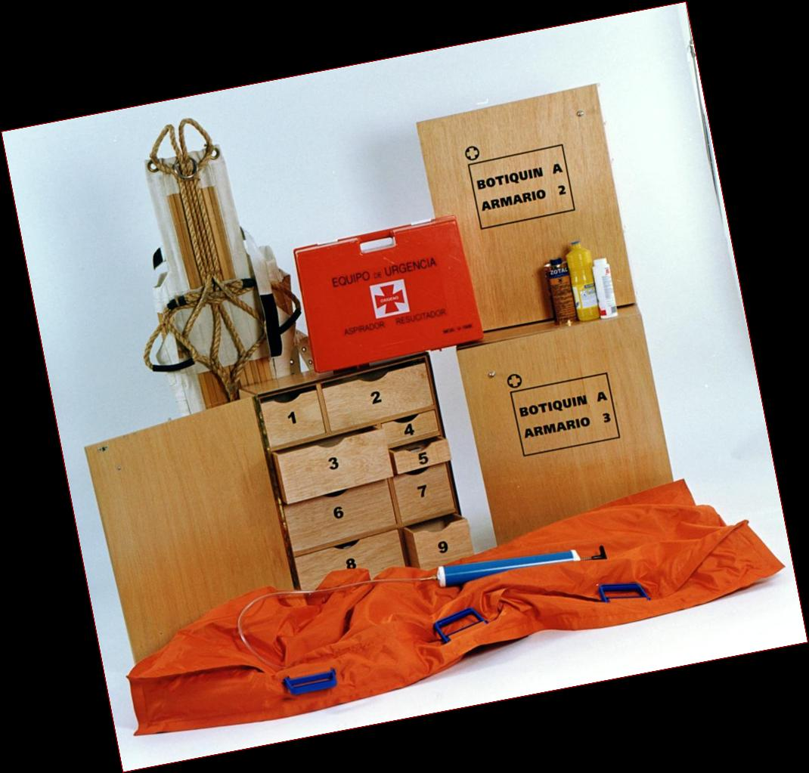
Inspection of medicine chests
Medicine chests vary in size and contents according to the type of ship and the area of navigation.
- A: + 150 miles and/or trips of + 48 hours
- B: +60 and -150 miles and/or trips of 24-48 hours
- C: -60 miles and/or -24 hours, lifeboats (A and B)
- Antidotes
Health and sanitary conditions on vessels:
- Fishing vessels (SEGUMAR programme) 715 inspections between 2012 and 2014
- Merchant vessels (ILO MLC06 Convention): 141 inspections since its entry into force

Slide 17
Medicine chests inspected
254 | 389 | 4,837 | 395 | 56 | 5,931
259 | 346 | 4,636 | 349 | 74 | 5,990
224 | 273 | 5,303 | 321 | 66 | 6,187
239 | 264 | 5,595 | 291 | 65 | 6,454
245 | 260 | 6,879 | 270 | 72 | 7,726

Slide 18
Inspection of medicine chests
- Royal Decree 258/1999, transposing an EU Directive: type of medicine chests and their content, models of containers, those responsible for periodic inspection.
Royal Decree 568/2011, modifying Royal Decree 258/1999
- Order ESS/2542/2014, of 5 December, establishing the basic amounts of the subsidies for provision of the medicine chests that are required on ships.
- Annual resolutions of the ISM management

Slide 19
PREVENTIVE LEVEL
4. Epidemiological studies: information provided by the medical checks on embarkation.
5. Health awareness campaigns, promotion of health and prevention: AIDS, STDs, malaria, drug addiction, alcoholism, hearing protection.
6. Vaccination campaigns: tetanus, flu, hepatitis.

Slide 20
CARE LEVEL
Aimed at bringing healthcare
to where the workers are
1. With own resources.
- Spanish Radio Medical Centre
- Medical Care and Logistical Ships
(“Esperanza del Mar” and “Juan de la Cosa”).
- Care Centres abroad.

Slide 21
ASSISTANCE LEVEL
- Spanish Radio Medical Centre
Located at ISM Central Services in Madrid, opened in 1979.
Permanently staffed by medical personnel (24/7).
Provides free care for mariners on board who request it, regardless of nationality, area of navigation or fishery in which the vessels work.

Slide 22
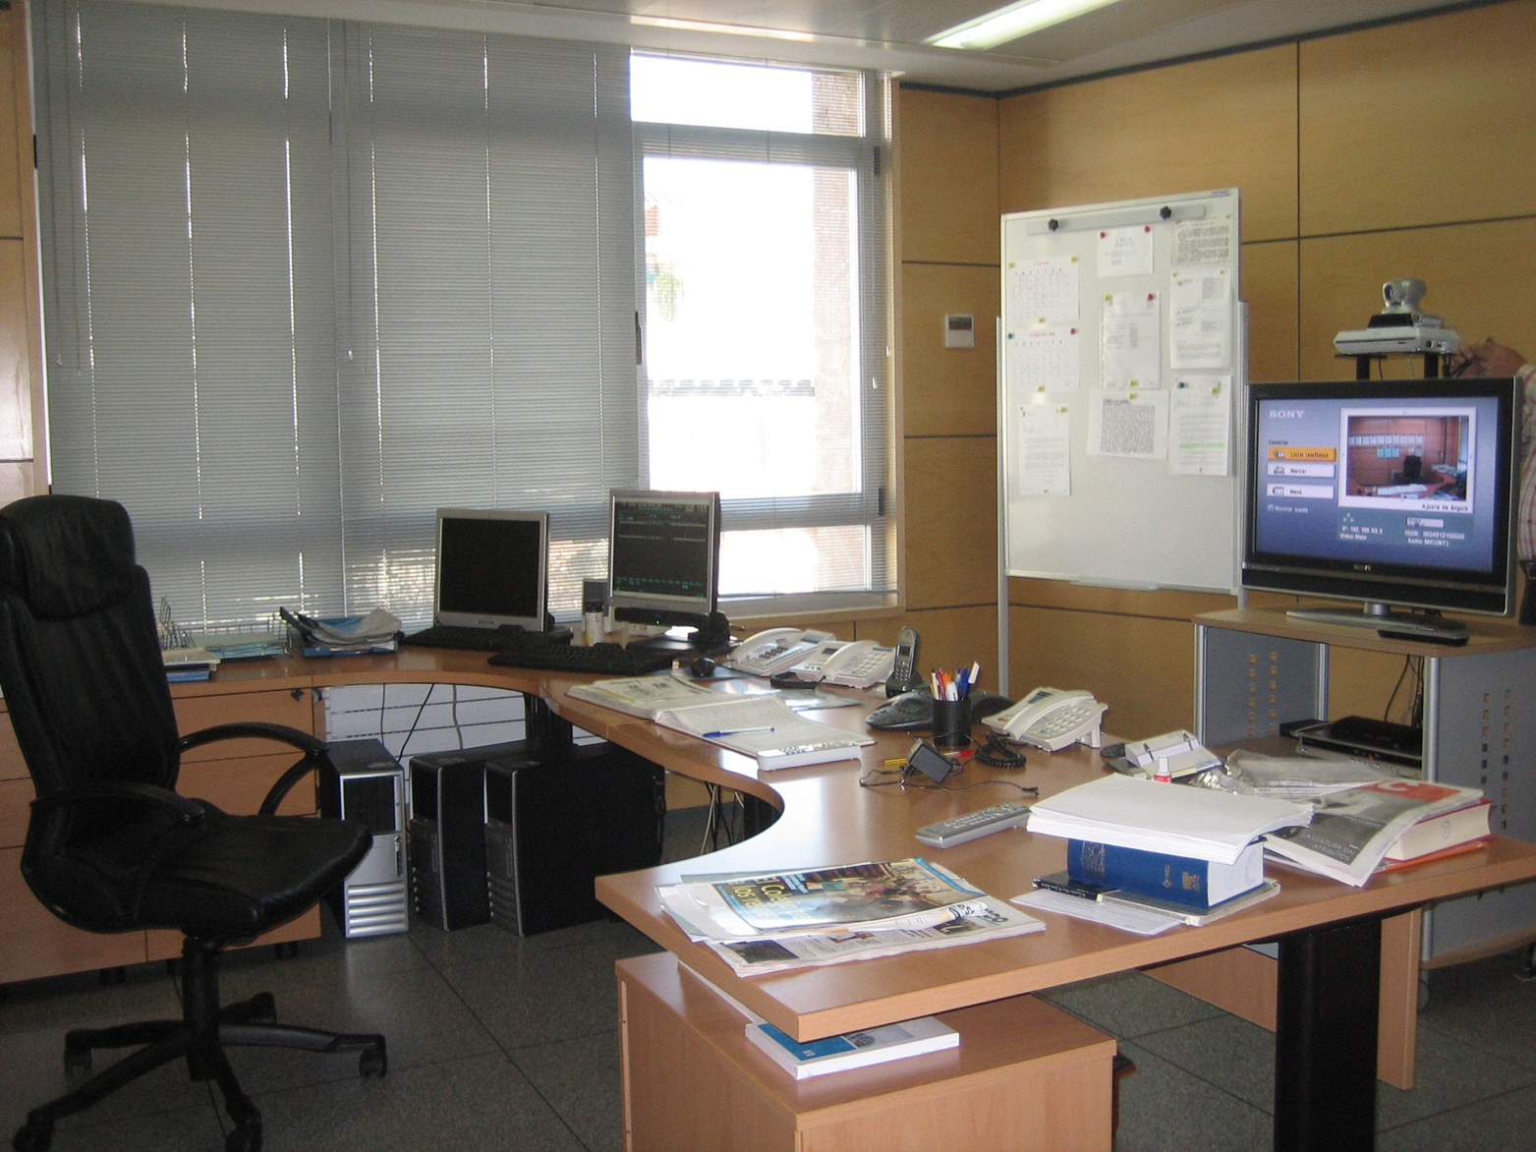

Slide 23
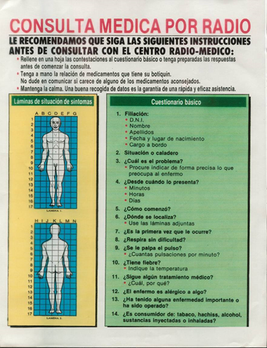
- Spanish Radio Medical Centre
- Medical radio consultation
- Preparation of clinical history
- Determination of medical advice
- Monitoring and control of the case

Slide 24
- Spanish Radio Medical Centre
Health database
Health training
Appropriate medicine chests
On-board medical guide

Slide 25
SANIMAR databank
Unified, automated and centralised
databank containing all the clinical
information on workers at sea. Contains
data relating to different types of care:
- Medical check-ups prior to embarkation.
- Actions taken from:
. Spanish Radio Medical Centre
. Hospital ships
. Health Centres abroad

Slide 26
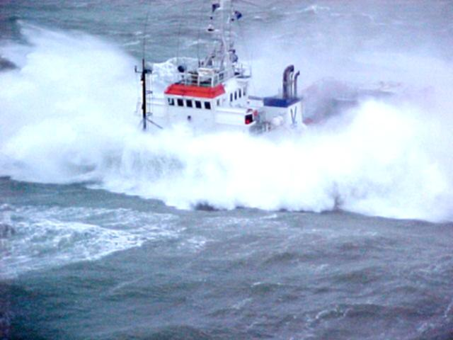
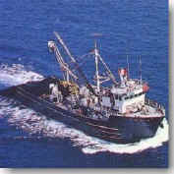
ASSISTANCE LEVEL
Assistance ships
Health and logistical support
Introduction
Concept
Hospital ship
“Esperanza del Mar”
Resources
Hospital ship
“Juan de la Cosa”

Slide 27
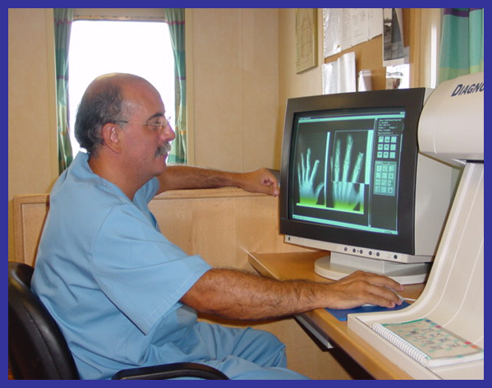
Assistance ships
Juan de la Cosa
Esperanza del Mar

Slide 28
Navigation areas
“Juan de la Cosa” ship
North Atlantic
Peninsular shore
Azores
France
Ireland
Great Britain
Can navigate in other areas than those assigned in the rest of the world except the American continent, Asia and Oceania.
Base port: Santander
"Esperanza del Mar" ship
Eastern North Atlantic,
Between the Canary Island
Archipielago and Ecuador,
by the African coast.
Can navigate in other áreas
than those assigned in the
rest of the world except the
American continent, Asia
and Oceania.
Base port: Las Palmas de
Gran Canaria

Slide 29
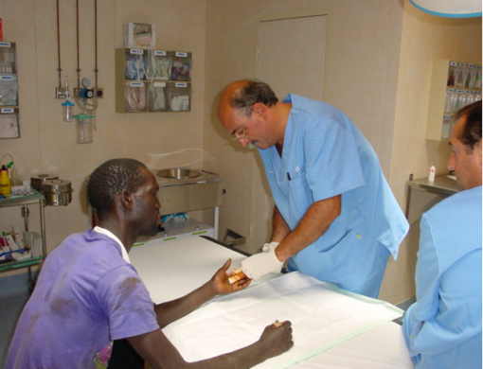
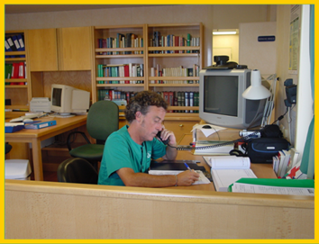
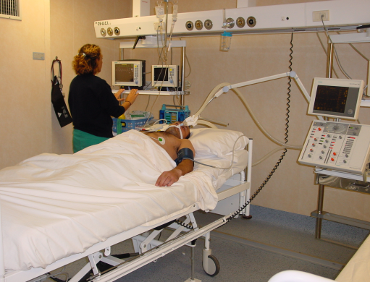
Assistance ships Operational method
TELE-MEDICINE

Slide 30
Assistance ships
* Short-term in-patient stay: returns after a few days
to his ship where treatment continues
* Long-term in-patient stay: remains hospitalised until
he is returned to port
-On the hospital ship
- Other means
* Patient for urgent evacuation: is hospitalized
and stabilized until the evacuation can be carried out
- By air
- By other means
Direct contact with CENTRE
FOR COORDINATION OF MARITIME
RESCUE

Slide 31
Logistical support
Provide emergency logistical support
- Tugs
- Assistance for breakdowns
- Fuel supply
- Fresh water supply
- Electrical energy supply
- Anti-incendiary system
- Diver service

Slide 32
Care Centres abroad
Provide medical consultations, hospitalisations,
repatriations, social care and information to workers.
Located in áreas where there is a significant
presence of Spanish vessels.
Collaboration with the country´s heath services.
Located on the African coast:

Slide 33
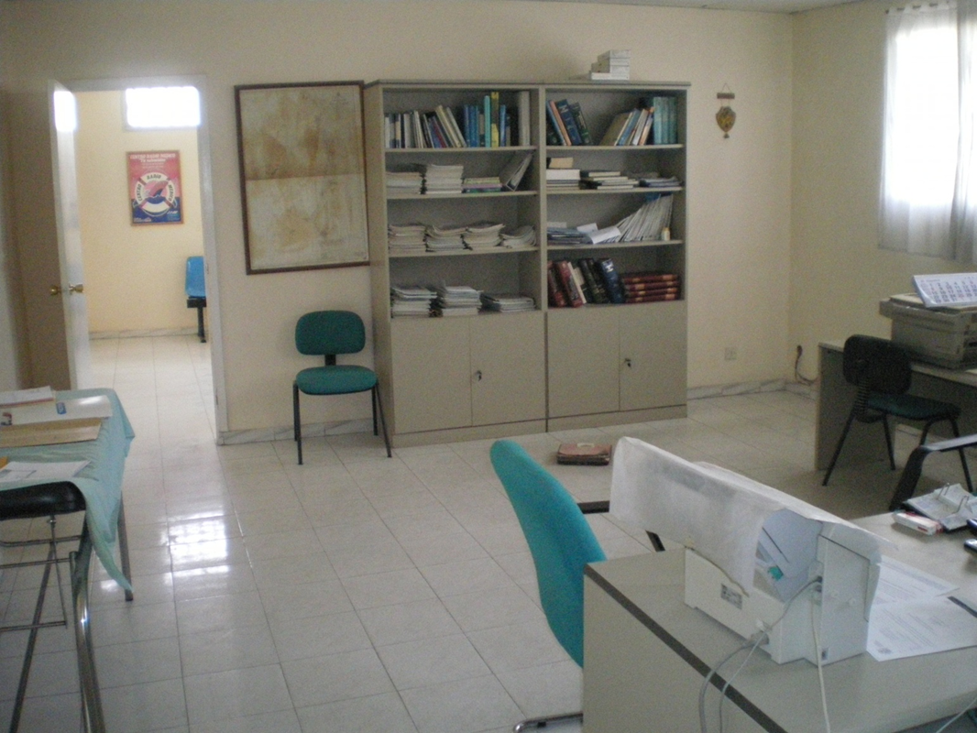
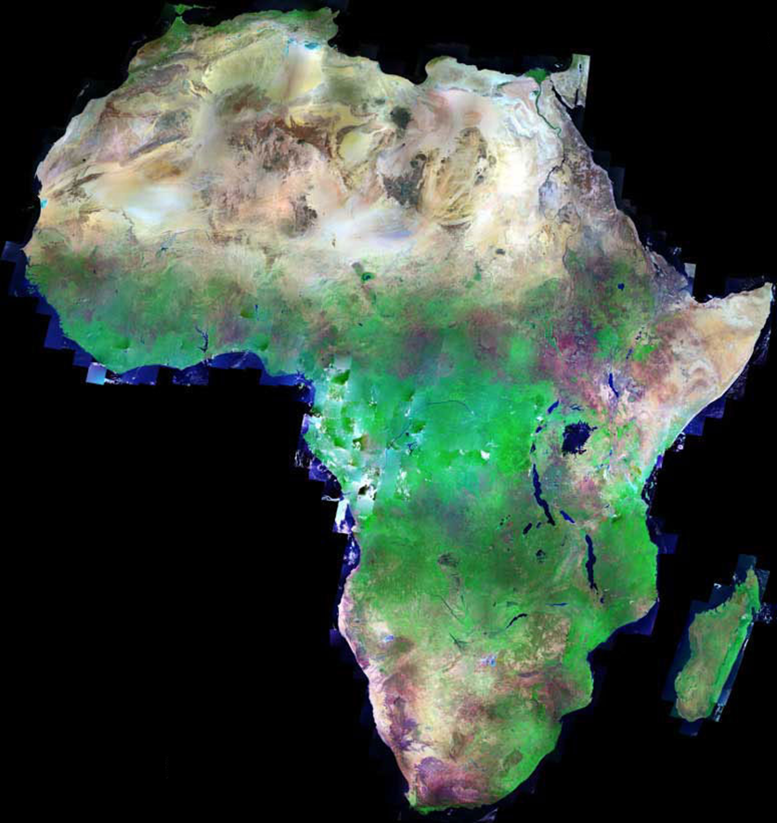
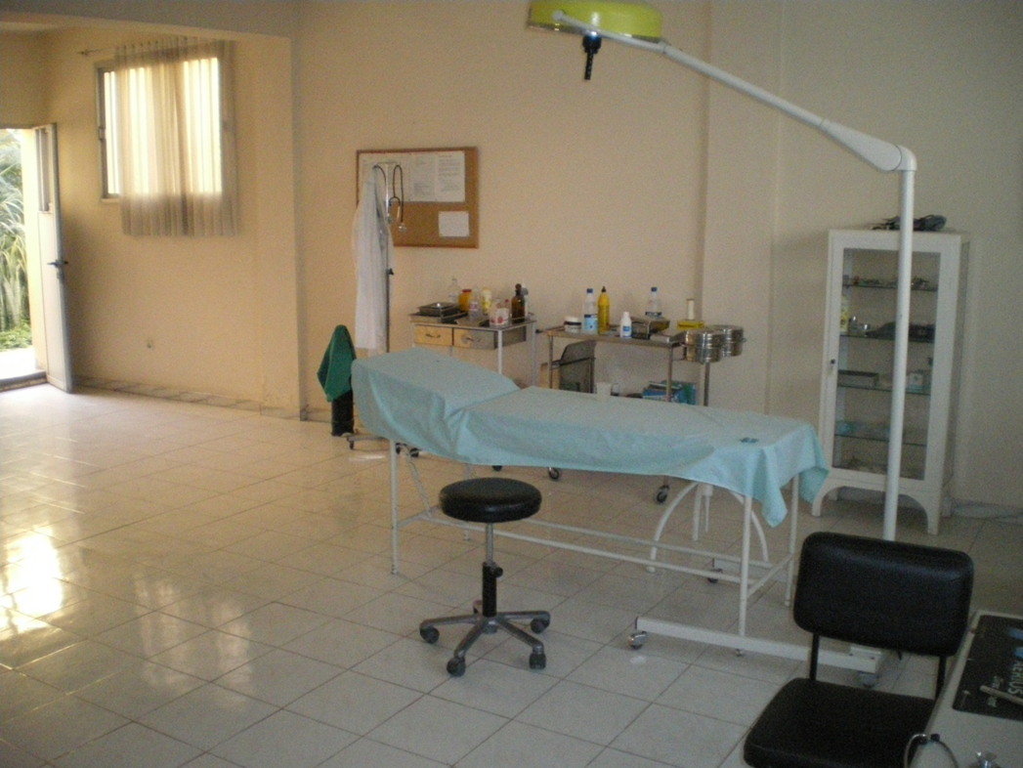
Care Centres abroad

Slide 34
Care Level
Aimed at bringing healthcare
to where the workers are.
2. With third-party resources.
- The country's assistance resources
+ reimbursement of costs
-Healthcare repatriation
-Medical airplane

Slide 35
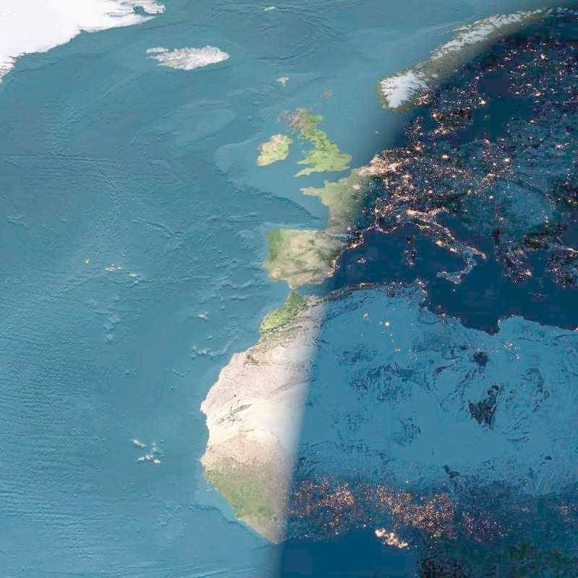
Thank you for your attention.

