Slide 1
DIRECT PAYMENT SYSTEM
直接支付系统
Madrid, 29th October 2015
2015年10月29日，马德里

Slide 2
Contents
内容
DIRECT PAYMENT SYSTEM
直接支付系统
DIRECT RED
电子数据直接提交系统
SLD
SlD系统

Slide 3
Contents
内容
DIRECT PAYMENT SYSTEM
直接支付系统
2. DIRECT RED
3. SLD

Slide 4
1. Direct Payment System 直接支付系统
Scope of management 管理范围
ACT 34/2014 OF 26 DECEMBER, ON MEASURES RELATED TO THE PAYMENT AND RECEIPT OF SOCIAL SECURITY PAYMENTS
2014年第34号（12月26日）社会保障支付款项计算及其收据管理法案
Social Security contributions payable jointly will be paid in accordance with this Act and in its implementing regulations, through one of the following systems
可联合支付的社保缴费应根据该法案及其执行规定，通过下列系统进行:
CONTRIBUTIONS/
COLLECTION
缴费/征缴
Self-assessment payment system by the person responsible for making the Social Security contributions and for joint collection. 自估支付系统：由社保征缴与联合征缴责任人实现
Direct payment system by the General Treasury of the Social Security system, for each worker, according to the data available on the persons obliged to make contributions and the data that must be submitted by the persons responsible for making contribution payments.
直接支付系统：由社保基金总会负责，根据个人有效数据对每一工作者进行征缴，且数据须由征缴责任人提交。

Slide 5
1. DIRECT PAYMENT SYSTEM 直接支付系统
CHARACTERISTICS OF THE NEW PROCEDURE 新程序特征
Current model
现行模式
New model
新模式
Calculations made with information submitted by the company in the FAN file.
根据企业在FAN文档中提供的信息进行缴费计算
Calculations at the level of Contribution Account Code (CCC) 通过缴费账户号码中进行缴费计算
Calculations made based on the information available in our databases and the minimum information submitted by the company.
根据数据库与企业提交的最低数据进行缴费计算
Calculations at the worker level. 根据职工个人情况进行计算
SELF-ASSESSMENT FORM
自我评估形式
INVOICING FORM
缴费凭据形式

Slide 6
Contents
内容
1. DIRECT PAYMENT SYSTEM
DIRECT RED 电子数据直接提交系统
3. SLD

Slide 7
2. Direct RED 电子数据直接提交系统
What is Direct RED? 何谓直接RED
It is a service that allows small companies to meet their Social Security obligations via a direct Internet connection with the TGSS in real time.
该服务可让小型企业直接通过互联网与社保基金总会进行实时互动，履行社保义务。
Aimed at companies with 15 or fewer workers at the time of requesting the authorisation, although the company may continue to be managed through Direct RED until the CCC includes 25 workers
目标在于具有15名或更少职工的企业，助其完成义务，在其缴费账户号码达到25名员工以前，仍通过直接RED系统处理社保事务。
In production since February 2008
2008年2月开始运行

Slide 8
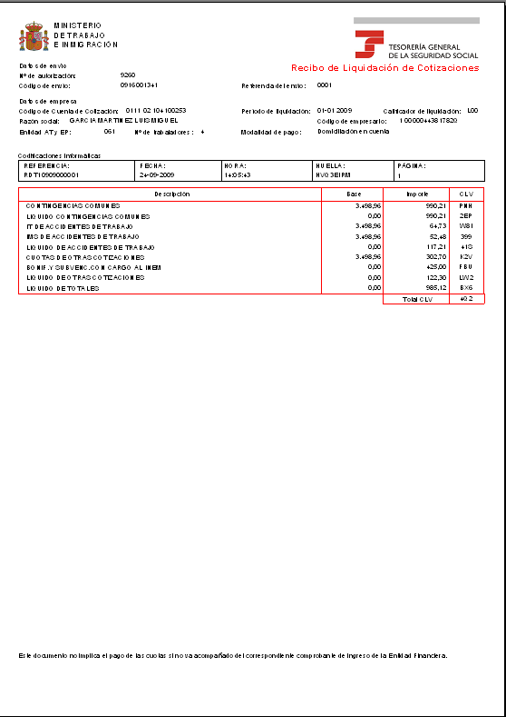
2. Direct RED 直接RED系统
How Direct RED works 直接RED系统如何运作
USERS
Direct RED Mailbox
直接RED邮箱
Professionals in Associations
协会专业人士
FGB
(contribution base file)
缴费基础文件
TC2
Payment receipt 支付收据
Decision on Membership
参保成员决定书
Companies
企业
Correct processing
Consolidation
Third Parties
第三方
Incorrect action/
error 错误
Does not allow submission with error
FGA
(Membership file)
参保成员文件
Internet
互联网
TGSS
社保基金总会
The user initiates the action of Membership or Contributions
用户开启参保人员事务或开始缴费
The TGSS requests data from the user
社保基金总会要求用户提供数据
SILCON certificate or electronic DNI (ID)
SILCON证书或电子DNI(身份证)
Checks 检查
Validations 效用
Calculations 计算

Slide 9
Contents
内容
1. DIRECT PAYMENT SYSTEM
2. DIRECT RED
SLD （SLD系统）
3.1. Contribution Payment procedure
缴费支付程序
3.2. Implementation
运行
3.3. Advantages
优点

Slide 10
3. SLD
What is SLD (Direct Payment System)?何谓SLD（直接支付系统）
A new procedure for exchanging information via the Internet, allowing companies and professionals to manage all the information needed for payment of contributions for their workers, without a limit to the number of workers.
是通过互联网交换信息的新程序，可让企业与专业机构管理所有与其员工缴费相关的必要信息，而不限制员工数量。
An application adapted to the Direct Payment System is required to send the different files and receive the answers.
直接支付系统所运用的程序必须能够发送不同文件并接受回应信息。

Slide 11
3. SLD 3.1. Contribution Payment procedure 缴费支付程序
CONTRIBUTION PAYMENT PROCEDURE 缴费支付程序
How does the new procedure work? 新程序如何运作？
TGSS INVOICE
社保发票
TOTAL PAYMENT
完全总额
AUTHORISED PERSON 管理方
AUTHORISED PERSON
管理方
AUTHORISED PERSON REQUESTS PAYMENT
管理房要求缴费
TOTAL PAYMENT
完全总额
NOTIFICATION OF ERRORS
错误通知
CORRECTION OF ERRORS 错误修复
COMMUNICATION OF DATA
(bases, part-time hours...)
信息交换 （基数、兼职、工时
CORRECTION OF TGSS DATABASE INFORMATION
修复社保基金总库数据库信息
ACCEPTS BASES OF THE PREVIOUS MONTH
(Workers without changes with respect to the previous month) 接受之前月份缴费基数
PARTIAL PAYMENT
部分总额
NOTIFICATION OF NEW DATA 新信息通知
POSSIBILITY OF RECEIPT FOR CORRECT WORKERS
无误员工可获取收据
CONSULTATION OF CALCULATIONS 计算咨询

Slide 12
3. SLD 3.1. Contribution Payment procedure 缴费支付程序
AUTHORISED PERSON 管理方
TGSS INVOICE
TOTAL PAYMENT
COMMUNICATION OF DATA
(bases, part-time hours...)
信息交换 （基数、兼职、工时
NOTIFICATION OF ERRORS
AUTHORISED PERSON
CORRECTION OF ERRORS
TOTAL PAYMENT
ACCEPTS BASES OF THE PREVIOUS MONTH
(Workers without changes with respect to the previous month) 接受之前月份缴费基数
POSSIBILITY OF RECEIPT FOR CORRECT WORKERS
PARTIAL PAYMENT
CONSULTATION OF CALCULATIONS
CHARACTERISTICS 特点
The authorised person requests the procedure for invoicing 管理方要求提供发票
The authorised person may request payment until the penultimate day of the month of collection.
管理方可要求在缴费月最后一日前缴费
Only the information not available in the TGSS is transmitted (bases by sections, part-time work coefficient...). 只有社保基金总会不可提供的资料才需传送（各行业基数、兼职工作系数…）
Only the data on workers affected by changes with respect to the previous month.
只有职工数据会因前期月份情况改变而受到影响
The effects of presentation are produced when it can be calculated.
演示效果在可进行计算时即生成

Slide 13
3. SLD 3.1. Contribution Payment procedure 缴费支付程序
TGSS INVOICE
社保发票
TOTAL PAYMENT
完全支付
AUTHORISED PERSON
AUTHORISED PERSON REQUESTS PAYMENT
AUTHORISED PERSON
NOTIFICATION OF ERRORS
CORRECTION OF ERRORS
TOTAL PAYMENT
POSSIBILITY OF RECEIPT FOR CORRECT WORKERS
PARTIAL PAYMENT
CONSULTATION OF CALCULATIONS
CHARACTERISTICS 特点
Calculation based on information of membership, and that provided by the INSS, SEPE and mutual societies. 缴费根据参保人员及国家社保署、SEPE和互助社的信息计算。
Before generating the receipt, a draft with the calculations is submitted to the employer. 在生成收据前，计算稿本会传送至雇佣企业。
On 24, 28 and every day after 29, the TGSS closes the drafts and submits the settlement receipts, although the employer may request them early. 在24号、28号及29号以后的每一日，社保基金总会都会停止稿本并传输确定收据，即使企业要求早发。
Update of the calculation at the close. 在缴费月结束前更新计算。

Slide 14
3. SLD 3.1. Contribution Payment procedure 缴费支付程序
TGSS INVOICE
AUTHORISED PERSON
AUTHORISED PERSON REQUESTS PAYMENT
NOTIFICATION OF ERRORS 错误提示
AUTHORISED PERSON
CORRECTION OF ERRORS
TOTAL PAYMENT
POSSIBILITY OF RECEIPT FOR CORRECT WORKERS
PARTIAL PAYMENT
CONSULTATION OF CALCULATIONS
CHARACTERISTICS 特点
The TGSS notifies the employer of any errors and the information needed to complete the calculation of the payment. 社保基金总会提醒雇佣方任何错误以及任何为完成缴费计数而必须的信息。
Although not all the correct workers are included, the TGSS allows consultation of the workers calculated. 即使未包括所有无误职工，社保基金总会也允许已获得计算的职工进行咨询。

Slide 15
3. SLD 3.1. Contribution Payment procedure 缴费支付程序
TGSS INVOICE
AUTHORISED PERSON
管理方
TOTAL PAYMENT
完全总额
AUTHORISED PERSON
CORRECTION OF ERRORS 错误修复
AUTHORISED PERSON REQUESTS PAYMENT
NOTIFICATION OF ERRORS
CORRECTION OF TGSS DATABASE INFORMATION
修复社保基金总库数据库信息
PARTIAL PAYMENT
部分总额
CONSULTATION OF CALCULATIONS
NOTIFICATION OF NEW DATA 新信息通知
POSSIBILITY OF RECEIPT FOR CORRECT WORKERS
无误员工可获取收据
CHARACTERISTICS 特点
The authorised person may correct the errors that prevent the calculation before the conclusion of the presentation period by procedures that are mainly electronic. 在演示结束前，管理方会修复为防止电子程序计算错误而出现的错误。
If it is not possible to correct the errors, starting on 24 the TGSS issues a partial payment receipt for the workers it has been able to calculate, if requested by the authorised person. 从每月24号开始，在社保基金总会在管理方要求下计算部分支付收据时，无法修复错误。

Slide 16
3. SLD 3.2. Implementation 运作
Implementation of the Direct Payment System 直接支付系统运作
Run-in period, initial authorisations
运行阶段，授权起步
JAN
2015年1月
FEB
2015年2月
MAY
2015年5月
…
OBLIGATION 义务
Start of notification of obligation
开始确认义务
1st transmission in real SLD (auth. Direct RED)
第1次传入真实SLD系统
（直接RED）
1st transmission in real SLD (auth. RED Internet)
第1次转入真实SLD系统
（在线RED）
8 JANUARY 2015: Approval of Resolution of 8 January 2015 by the SESS, which regulates the online notification of mandatory incorporation into the Direct Payment System.
2015年1月8日：《SESS系统批准决议》，规定了与直接支付系统的法定整合及其在线确认方式。

Slide 17
3. SLD 3.2. Implementation 运作
Implementation of the Direct Payment System 直接支付系统运作
Companies notified 通知企业
January
2015年1月
February
2015年2月
March
2015年3月
April
2015年3月
December
2015年12月
RED authorisations
管理部门
24
73
1,300
4,100
100%
285
1,400
20,000
43,000
100%
Companies
企业
Workers
职工
43,000
50,000
600,000
500,000
100%
CCCs:缴费账户号码
General Scheme (0111)
通用方案（0111）
Normal payment mode
正常支付模式
Public Administration No.
公共行政号码
Frequency of monthly payment without deferral
每月无点击支付频度
MOVE TO REAL 移至现实
May
2015年5月
June
2015年6月
July
2015年7月
August
2015年8月

Slide 18
3. SLD 3.3. Advantages 优点
MAIN ADVANTAGES 主要优点
SIMPLIFICATION OF COMPLIANCE WITH OBLIGATIONS
简化义务履行方式
Application by TGSS of the regulations governing contributions
通过社保基金总会执行缴费管理规则
Reduction of burdens on employers as less information has to be transmitted
减轻企业信息报告负担
FOR COMPANIES
对于企业
MORE INFORMATION
更多信息
Availability of information on contributions and details of calculation of the payment at worker level
对职工缴费计算细节有更多的了解
FOR WORKERS
对于职工
IMPROVED MONITORING AND CONTROL
改善监管
Improved control of the obligation to make contributions
改善对企业职工义务的监督，增加缴费
A priori control
系优先监管
FOR THE TGSS
对于社保基金总会

