Slide 1
DIRECT PAYMENT SYSTEM
Madrid, 29th October 2015

Slide 2
Contents
1. DIRECT PAYMENT SYSTEM
2. DIRECT RED
3. SLD

Slide 3
Contents
1. DIRECT PAYMENT SYSTEM
2. DIRECT RED
3. SLD

Slide 4
1. DIRECT PAYMENT SYSTEM
Scope of management
ACT 34/2014 OF 26 DECEMBER, ON MEASURES RELATED TO THE PAYMENT AND RECEIPT OF SOCIAL SECURITY PAYMENTS
Social Security contributions and joint payment contributions will be paid in accordance with this Act and in its regulatory implementation, through one of the following systems:
CONTRIBUTIONS/COLLECTION
Self-assessment payment by the person responsible for making the Social Security contributions and by joint collection items.
Direct payment system by the General Treasury of the Social Security system for each worker, according to the data available on the persons obliged to make contributions and the data that must be submitted by the persons responsible for making contribution payments.

Slide 5
1. DIRECT PAYMENT SYSTEM
CHARACTERISTICS OF THE NEW PROCEDURE
Current model
New model
Calculations made with information submitted by the company in the FAN file.
Calculations at the level of Contribution Account Code (CCC)
Calculations made based on the information available in our databases and the minimum information submitted by the company.
Calculations at the worker level.
SELF-ASSESSMENT FORM
INVOICING FORM

Slide 6
Contents
1. DIRECT PAYMENT SYSTEM
2. DIRECT RED
3. SLD

Slide 7
2. Direct RED
What is Direct RED?
It is a service that allows small companies to meet their Social Security obligations via a direct Internet connection with the TGSS in real time.
Aimed at companies with 15 or fewer workers at the time of requesting the authorisation, although the company may continue to be managed through Direct RED until the CCC includes 25 workers
In production since February 2008

Slide 8
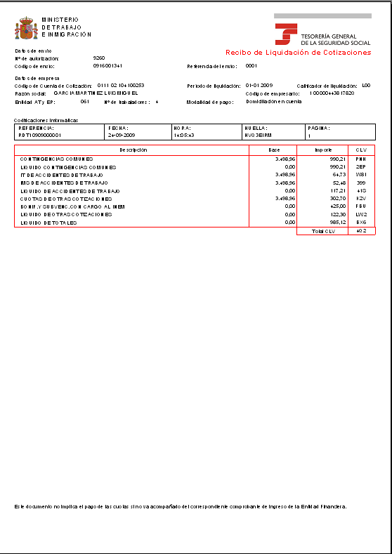
2. Direct RED
How Direct RED works
USERS
Direct RED Mailbox
Professionals in Associations
TC2
Payment receipt
Decision on Membership
FGB
(contribution base file)
Companies
Correct processing
Consolidation
Third Parties
Incorrect action/
error
Does not allow submission with error
FGA
(Membership file)
Internet
TGSS
The user initiates the action of Membership or Contributions
The TGSS requests data from the user
SILCON certificate or electronic DNI (ID)
Checks
Validations
Calculations

Slide 9
Contents
1. DIRECT PAYMENT SYSTEM
2. DIRECT RED
SLD
3.1. Contribution Payment procedure
3.2. Implementation
3.3. Advantages

Slide 10
3. SLD
What is SLD (Direct Payment System)?
A new procedure for exchanging information via the Internet, allowing companies and professionals to manage all the information needed for payment of contributions for their workers, without a limit to the number of workers.
An application adapted to the Direct Payment System is required to send the different files and receive the answers.

Slide 11
3. SLD 3.1. Contribution Payment procedure
CONTRIBUTION PAYMENT PROCEDURE
How does the new procedure work?
TGSS INVOICE
TOTAL PAYMENT
AUTHORISED PERSON
AUTHORISED PERSON REQUESTS PAYMENT
AUTHORISED PERSON
NOTIFICATION OF ERRORS
TOTAL PAYMENT
CORRECTION OF ERRORS
COMMUNICATION OF DATA
(bases, part-time hours...)
ACCEPTS BASES OF THE PREVIOUS MONTH
(Workers without changes with respect to the previous month)
CORRECTION OF TGSS DATABASE INFORMATION
NOTIFICATION OF NEW DATA
CONSULTATION OF CALCULATIONS
POSSIBILITY OF RECEIPT FOR CORRECT WORKERS
PARTIAL PAYMENT

Slide 12
3. SLD 3.1. Contribution Payment procedure
CONTRIBUTION PAYMENT PROCEDURE
TGSS INVOICE
TOTAL PAYMENT
AUTHORISED PERSON
AUTHORISED PERSON REQUESTS PAYMENT
AUTHORISED PERSON
NOTIFICATION OF ERRORS
CORRECTION OF ERRORS
TOTAL PAYMENT
COMMUNICATION OF DATA
(bases, part-time hours...)
ACCEPTS BASES OF THE PREVIOUS MONTH
(Workers without changes with respect to the previous month)
POSSIBILITY OF RECEIPT FOR CORRECT WORKERS
PARTIAL PAYMENT
CONSULTATION OF CALCULATIONS
CHARACTERISTICS
The authorised person requests the procedure for invoicing
The authorised person may request payment until the penultimate day of the month of collection.
Only the information not available in the TGSS is transmitted (bases by sections, part-time work coefficient...).
Only the data on workers affected by changes with respect to the previous month.
The effects of presentation are produced when it can be calculated.

Slide 13
3. SLD 3.1. Contribution Payment procedure
CONTRIBUTION PAYMENT PROCEDURE
TGSS INVOICE
TOTAL PAYMENT
AUTHORISED PERSON
AUTHORISED PERSON REQUESTS PAYMENT
AUTHORISED PERSON
NOTIFICATION OF ERRORS
CORRECTION OF ERRORS
TOTAL PAYMENT
POSSIBILITY OF RECEIPT FOR CORRECT WORKERS
PARTIAL PAYMENT
CONSULTATION OF CALCULATIONS
CHARACTERISTICS
Calculation based on information of membership, and that provided by the INSS, SEPE and mutual societies.
Before generating the receipt, a draft with the calculations is submitted to the employer.
On 24, 28 and every day after 29, the TGSS closes the drafts and submits the settlement receipts, although the employer may request them early.
Update of the calculation at the close.

Slide 14
3. SLD 3.1. Contribution Payment procedure
CONTRIBUTION PAYMENT PROCEDURE
TGSS INVOICE
AUTHORISED PERSON
AUTHORISED PERSON REQUESTS PAYMENT
NOTIFICATION OF ERRORS
AUTHORISED PERSON
CORRECTION OF ERRORS
TOTAL PAYMENT
POSSIBILITY OF RECEIPT FOR CORRECT WORKERS
PARTIAL PAYMENT
CONSULTATION OF CALCULATIONS
CHARACTERISTICS
The TGSS notifies the employer of any errors and the information needed to complete the calculation of the payment.
Although not all the correct workers are included, the TGSS allows consultation of the workers calculated.

Slide 15
3. SLD 3.1. Contribution Payment procedure
CONTRIBUTION PAYMENT PROCEDURE
TGSS INVOICE
AUTHORISED PERSON
AUTHORISED PERSON REQUESTS PAYMENT
CORRECTION OF ERRORS
TOTAL PAYMENT
NOTIFICATION OF ERRORS
CORRECTION OF TGSS DATABASE INFORMATION
NOTIFICATION OF NEW DATA
POSSIBILITY OF RECEIPT FOR CORRECT WORKERS
PARTIAL PAYMENT
CONSULTATION OF CALCULATIONS
CHARACTERISTICS
The authorised person may correct the errors that prevent the calculation before the conclusion of the presentation period by procedures that are mainly electronic.
If it is not possible to correct the errors, starting on 24 the TGSS issues a partial payment receipt for the workers it has been able to calculate, if requested by the authorised person.

Slide 16
3. SLD 3.2. Implementation
OBLIGATION
Implementation of the Direct Payment System
Run-in period, initial authorisations
JAN
2015
FEB
2015
MAY
2015
…
OBLIGATION
Start of notification of obligation
1st transmission in real SLD (auth. Direct RED)
1st transmission in real SLD (auth. RED Internet)
8 JANUARY 2015: Approval of Resolution of 8 January 2015 by the SESS, which regulates the online notification of mandatory incorporation into the Direct Payment System.

Slide 17
3. SLD 3.2. Implementation
Implementation of the Direct Payment System
Companies notified
January
2015
February
2015
March
2015
April
2015
December
2015
RED authorisations
24
73
1,300
4,100
100%
Companies
285
1,400
20,000
43,000
100%
Workers
43,000
50,000
600,000
500,000
100%
CCCs:
General Scheme (0111)
Normal payment mode
Public Administration No.
Frequency of monthly payment without deferral
MOVE TO REAL
May
2015
June
2015
July
2015
August
2015

Slide 18
3. SLD 3.3. Advantages
MAIN ADVANTAGES
SIMPLIFICATION OF COMPLIANCE WITH OBLIGATIONS
Application by TGSS of the regulations governing contributions
Reduction of burdens on employers as less information has to be transmitted
FOR COMPANIES
MORE INFORMATION
Availability of information on contributions and details of calculation of the payment at worker level
FOR WORKERS
IMPROVED MONITORING AND CONTROL
Improved control of the obligation to make contributions
A priori control
FOR THE TGSS

