Slide 1
Multi-tier social protection in healthcare The role of mutuals in health social protection
Thierry Weishaupt, Rome, May 27th, Rome

Slide 2
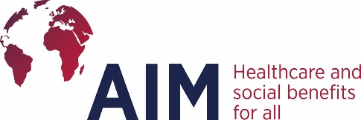
Who we are, what we do
AIM is the International representative body of health and social protection mutuals in the World
On 3 continents
In 30 countries
For mutuals and equivalent member based organizations covering 240 million people
AIM is working closely with ISSA (the International Social Security Association), WHO, ILO and other regional and international organizations (EU, Mercosur, UEMOA …)
AIM is promoting the role of mutuals in 3 fields :
Healthcare policy
Social policy
Development issues: UHC, development of social protection

Slide 3
MUTUALS AS THE MISSING LINK IN HEALTH COVERAGE
Notes:
Mutuals and other non for profit and member initiated insurers represent more than one quarter of the World insurance market. This significant position shows how important mutuals can be for the global balance of insurance markets.
Let’s look why it is so, zooming on health, and why it should remain that way through the example of a French mutual I represent, Groupe VYV.

Slide 4
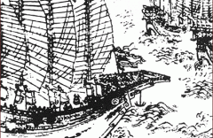
MUTUAL TO SHARE RISKS IN A COMMUNITY
Chinese merchants sharing their loads to avoid loosing everything
Notes:
One part of the story of mutuality actually starts right here in China. Thousands of years ago Chinese merchants came up with practical ways of protecting their cargo against the potential financial ruin caused by the treacherous river rapids along their trade routes.
This is at the root of mutualiste principles : a community protecting itself and sharing risks.
4

Slide 5
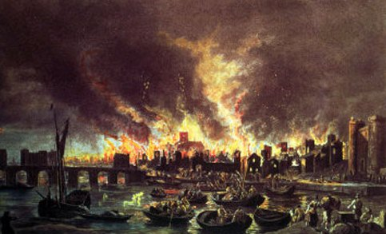
MUTUAL TO SHARE RISKS WHICH ARE TOO BIG FOR EACH INDIVIDUAL ACTORS
Great Fire of London in 1666
when 14,000 buildings were destroyed and
200,000 persons where left homeless
Notes:
But today we are here to discuss mutual insurance and that has a direct link with England in 1666 when London saw 14,000 buildings destroyed and 200 thousand people left homeless during the Great Fire of London. Following this event communities came together to find a way to ensure that risk could be shared, fairly. They did so because the burden of such a heavy and widespread risk could not be borne by individual actors.
5

Slide 6
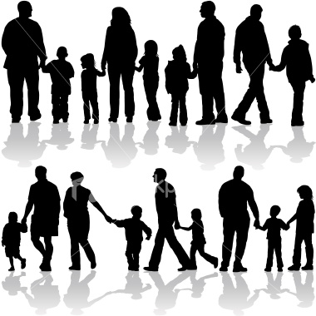
ILLNESS OR ACCIDENT CAN BE TOO BIG A RISK FOR A PERSON OR A FAMILY
PUBLIC AND PERSONAL HEALTH NEED SOLIDARITY !
In case of public health issue
For heavy illness or accident
For ageing and its consequences
Notes:
So mutuals are about communities covering risks for their members when these risks are too big and too important for them.
Thhis is of course the case for health. In French mutuals we use to say that health can’t be summarized by saying it is a market. It is also a central element of each person’s and family’s life. Risks for health can also be so high and vital that it is not possible for persons alone to cover them.
This is why health mutuals emerged in Europe but also in other regions of the World.
Let’s take specific situation to illustrate this :
Public health issues : ex. Of MGEN developing sanatoriums for members having tuberculosis
Heavy illness of accident: the reason why pyramid builders for a starter, but more recently many professional communities build mutuals : ex bikers in France
And now we have a new paradigm to tackle as human communities, which is the ageing. This can’t be only a market, it must be a common engagement.
Saying that, you can also see that health mutuals are private, but with a vision which is quite near to social security vision.
6

Slide 7
MUTUAL = HEALTH RISK COVERAGE ORGANIZATION
FOR AND BY A COMMUNITY
Solidarity
Member
responsibility
Non for profit
Notes:
Mutuals cover risks in another way than for profit insurers, through 3 principles :
- Solidarity : between ages, between revenues, between healthy and ill people, ands
- Non for profit
Members’ engagement to think over and take measures to cover their risks.
Thèse three principles are strongly interlinked and create a virtuous circle quite useful for communities. It does not mean this is the universal solution, but it is a kind of « missing link » between the for profit insurers market and the public schemes.

Slide 8
MUTUALITY AS A COMPLEMENTARY ELEMENT TO TACKLE HEALTH RISK COVERAGE CHALLENGE
互助共济性
非营利性
会员责任性
GOVERNMENT – SOCIAL SECURITY
FOR PROFIT INSURERS
MUTUALS
Member and community
oriented
Shareholder oriented
Profitability limit
Nation oriented
Fiscal space limit
A space for member based
initiatives
Notes:
Public schemes help cover the whole population and are necessary for the biggest risks (cf public health risks, epidemic …), they are nation oriented and government driven ; but their fiscal space does not allow to cover all needs and all population : they mainly concentrate on a floor and on tackling poverty and poor peoples’ basic needs
Private for profit insurers are shareholder oriented, hence looking for profitable markets where they can optimize their profit, hence they concentrate on higher end consumers and middle class and on manageable risks compatible with profitability
The mutuals are in between, insuring a level of solidarity in communities, including for lower class people (ex education community), and bringing adapted solutions to specific risks of these specific communities ; they can do this without looking for high profit return, as they don’t have to remunerate shareholders.
Even if this slide is a little bit caricatural, it shows how mutuals can be « the missing link » to cover health coverage needs !

Slide 9
HOW MUTUALS BRING VALUE IN HEALTH SOCIAL PROTECTION
As non for profit partners of public schemes – managing Social Security
As complementary health insurers – with a strong articulation with public schemes, and based on the same value of solidarity
As health care providers – to reinforce health care capabilities
As public and personal health and prevention actors – to reduce human, social and financial costs of health

Slide 10
aim.secretariat@aim-mutual.org

