Slide 1

Coordination of Social Security
Gabriela Pikorová, Head of Unit for Coordination of Social Security

Slide 2

Problems that coordination CAN SOLVE:
Migration between countries irrespecitve of the reason. Examples:
  Person lives in state A, but works in state B (commutes weekly) – where he pays contribution, who cover his health care costs, whis state is responsible for family benefits.
  Pensioner receiving a pension from state A moves to state B – will his pension be exported there? Which state will be responsible for health care cost and how the costs will be paid?
Movement between different schemes in one state (persons is for 20 years covered by scheme for policemen, than for 15 years by general scheme for pensions)

Slide 3
HOW Coordination solves the problems connected with migration :
Determination of one „competent state“ - state responsible to deduct contribution and also provide benefit to migrants and their families.
Competent state must treat migrants equally to own nationals (same rules, same befits, same personal scope).
In order to access benefits, even periods of participation (residence, insurance, employment) must be taken into account.
Acquired benefits are alwayz exported to the states that apply coordination rules.

Slide 4
Where coordination may be found?
Regulation of EU n. 883/04 a 987/09 (applicable to EU Member States, Island, Norway and Switzerland)
Bilateral agreements (Czech Republic currently has 16 agreements on social security in force - Australia, Bosnia and Hercegovina, Chilli, India, Israel, Japan, South Korea, Canada, Macedonia, Moldova, Québec, Rusia, Turkey, Ukrajine, USA)
Multilateral convention – Ibero-American convention on social security, ILO convention on social security

Slide 5
How competent state is determined?
Main rule – person is covered in the state of work
Exceptions
  Posting – up to 2 years in sending state
  Civil Servants
  Pesons employed on see vessels
  Simultaneous activities in several state – State of residence takes precedence.
  Agreement between institutions on exceptions.

Slide 6
What means equality of treatment?
Legislation on social scheme usually includes determination of persons covered, benefits provided, determination of contribution levels, payment conditions etc.)
NO DIFFERENCES may be applied when the person concerned is migrant, i.e.
  If legislation provides that only citizens or permanent residents are covered, such rules must be disregarded.
  If legislation provides different levels of benefits, i. e. for example – that benefits paid to other states are not regularly adjusted/top up according to inflation (eventough internally paid benefits are adjusted) such rule cannot be applied.

Slide 7
How aggregation of periods works?
Different states have different schemes based on different qualification conditions. It may be especially
  Periods of insruance/employment
  Periods of residence
All such periods are taken into account in all states concerned during determination of benefit. Every state pays a benefit corresponding to the lenght of periods acuired in their schemes.
Main aim: FAIR DISTRIBUTION OF COSTS between states especially in pension sector.

Slide 8
Short term cash benefits coordination
What are the benefits concerned:
Benefits paid in case of short term incapacity for work
Unemployment benefits
Family benefits
Normally paid out by the competent state only, but periods of insurance/residence/employment from other states are taken into account.
Special rules concern family benefits.

Slide 9
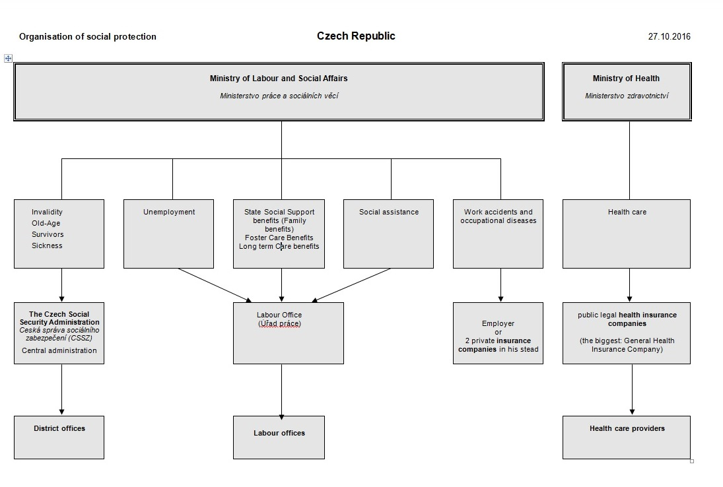

Slide 10
Information sources:
www.mpsv.cz
www.cssz.cz
www.kzp.cz
Questions?

