Slide 1
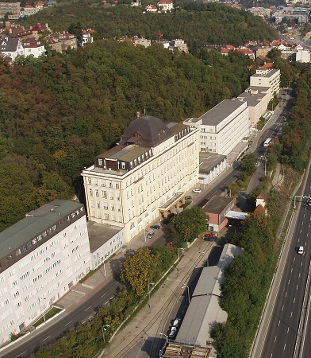
CZECH SOCIAL SECURITY ADMINISTRATION
PRESENTATION
CSSA
Name
position
location
date
(as of 31 December 2015)

Slide 2
CZECH SOCIAL SECURITY ADMINISTRATION
Profile
responsibility in the field of social security
=> pension and sickness insurance
and the Medical Assessment Service
liaison body for foreign institutions
collection of social security premiums
=> amount of premiums collected:
1/3 of the Czech state budget
revenues in the amount of CZK 395 billion and expenditures in the amount of CZK 416 billion in 2015
8.6 million clients
(number of inhabitants of the CR - 10.5 million)
approx. 8,600 employees
government body under the province of the MLSA

Slide 3
CZECH SOCIAL SECURITY ADMINISTRATION
The social system in the Czech Republic
The social system of the CR
State social support
Social assistance
Assistance in material poverty
Social insurance
Benefits for people with disabilities
Social services
(care allowance)
Non-tested social benefits
(income independent)
Tested social benefits
(income dependent)
Pension insurance
Sickness insurance
State employment policy

Slide 4
CZECH SOCIAL SECURITY ADMINISTRATION
Main activities of the CSSA
pension insurance (PI) implementation
determination of eligibility for a pension and the pension’s amount
payments of pensions
deciding on objections
sickness insurance (SI) implementation
payments of SI benefits
monitoring adherence to the treatment regime
collection of social security premiums
premiums collected in total => 1/3 of the Czech state budget
medical assessment service
liaison body for foreign institutions

Slide 5
CZECH SOCIAL SECURITY ADMINISTRATION
Social Security implemented by the CSSA
Competence of the
CSSA
Pension insurance
Sickness insurance
Collection of premiums
and administration of receivables
Medical assessment service
Administration of proceedings
involving clients with disabilities
Supervision
Distraints on pension and sickness insurance benefits
Indemnifications

Slide 6
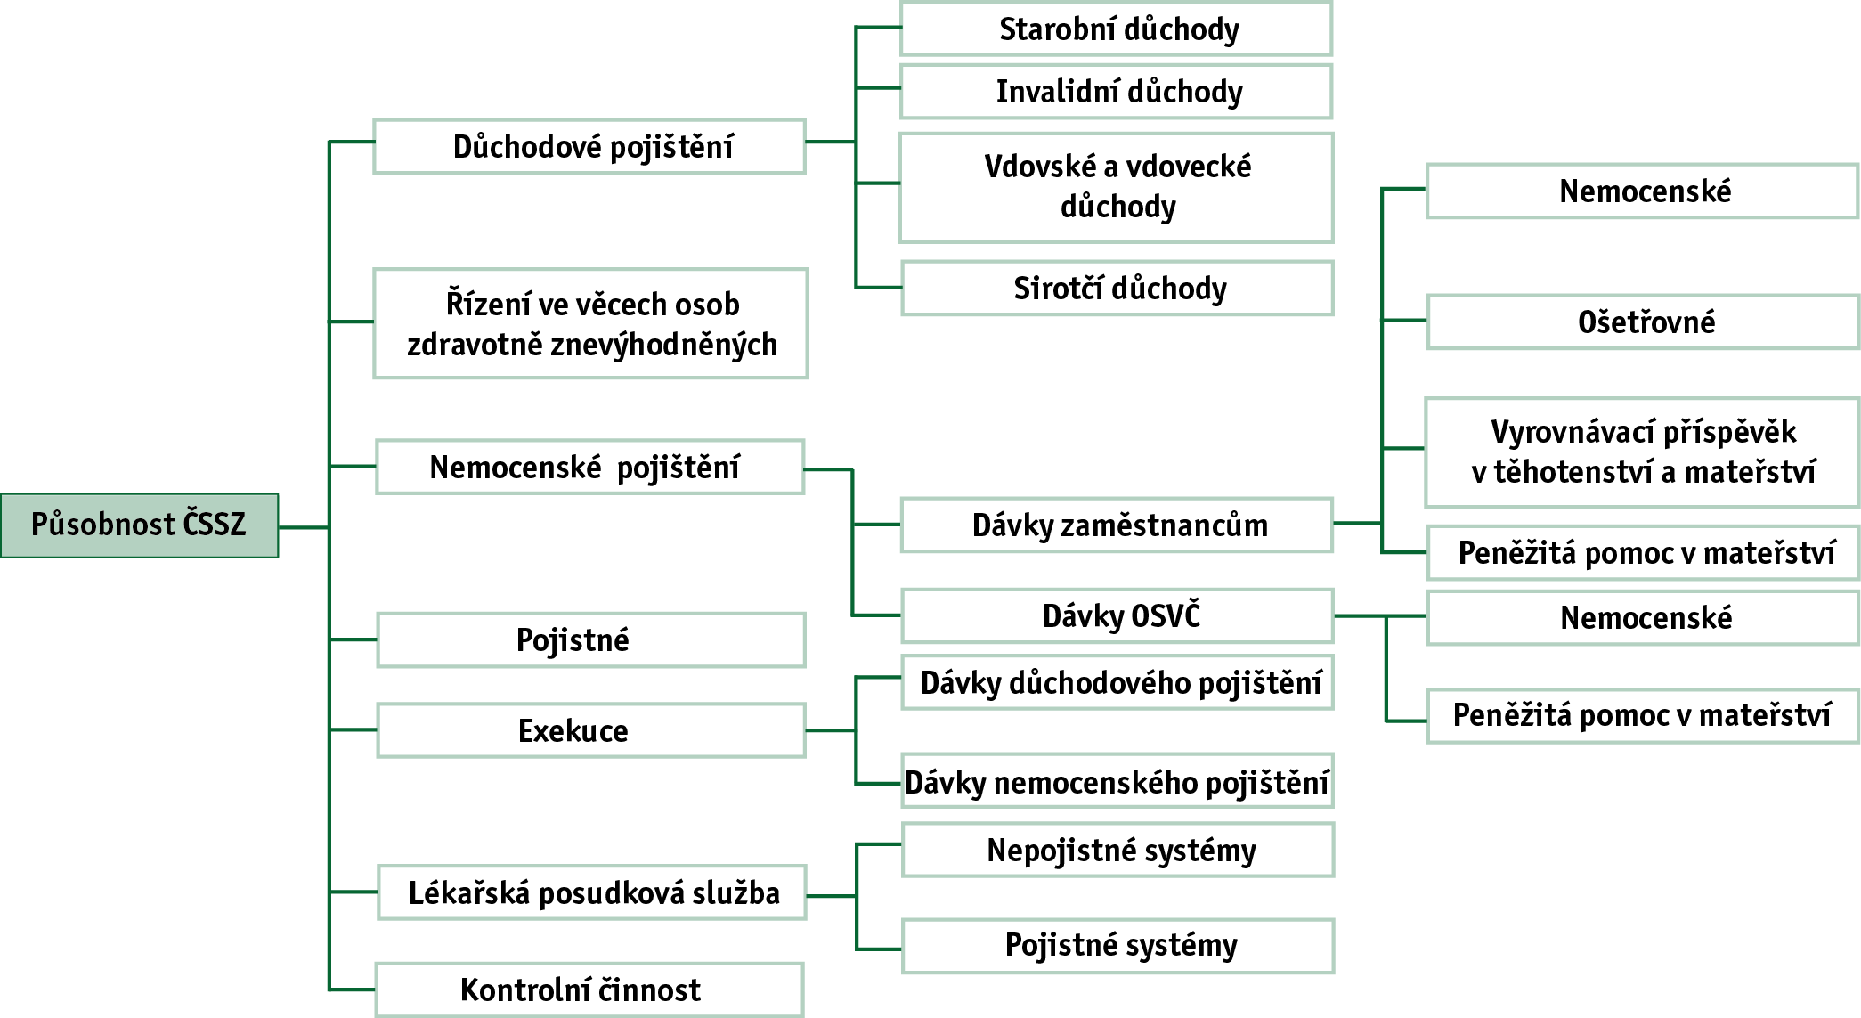
CZECH SOCIAL SECURITY ADMINISTRATION
Scope of CSSA’s authority in detail

Slide 7
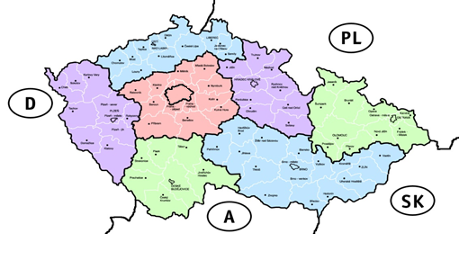
CZECH SOCIAL SECURITY ADMINISTRATION
Organizational structure
Central Director of the
CSSA
Headquarters
7 regional offices of the CSSA
77 social security district administrations
methodological guidance

Slide 8
CZECH SOCIAL SECURITY ADMINISTRATION
Main indicators - numbers of clients
 | 2010 | 2011 | 2012 | 2013 | 2014 | 2015
Population of the CR^{*)} | 10,532,770 | 10,505,445 | 10,516,125 | 10 512 419 | 10,538,275 | 10,553,843
Clients of the CSSA | 8,336,483 | 8,505,094 | 8,496,948 | 8,469,506 | 8,529,965 | 8,646,425
Clients working as employees | 4,272,541 | 4,292,672 | 4,284,307 | 4,275,544 | 4,328,561 | 4,421,888
Number of employers | 263,235 | 263,792 | 269,291 | 269,734 | 271,432 | 275,716
Total numbers of pensioners in the CR | 2,819,093 | 2,873,004 | 2,866,056 | 2,857,856 | 2,863,210 | 2,873,953
of which: old-age pensions | 2,260,032 | 2,340,147 | 2,341,220 | 2,340,321 | 2,355,144 | 2,376,883
: disability pension recipients | 466,329 | 445,033 | 438,509 | 433,414 | 428,298 | 421,655
: survivor pension recipients | 92,732 | 87,824 | 86,327 | 84,121 | 79,768 | 75,415
Persons with voluntary pension insurance | 4,545 | 5,071 | 5,550 | 5,717 | 6,357 | 6,889
Number of active self-employed clients | 977,069 | 1,001,764 | 994,088 | 977,228 | 972,356 | 975,952
Of which: Self-employed obliged to pay income tax advances | 734,711 | 742,235 | 719,490 | 692,753 | 676,188 | 675,700
: Self-employed voluntarily participating in sickness insurance | 151,881 | 115,115 | 98,579 | 92,525 | 91,854 | 91,065
8

Slide 9
CZECH SOCIAL SECURITY ADMINISTRATION
Main indicators
Revenues and expenditures of the CSSA (in CZK mil.)
in terms of the budgetary structure rules (Act No. 218/2000 Coll., On budgetary rules, as amended)
 | 2010 | 2011 | 2012 | 2013 | 2014 | 2015
Total revenues | 346,307 | 358,104 | 362,361 | 363,255 | 373,649 | 394,685
of which:
- from pension insurance premiums | 308,407 | 319,425 | 323,176 | 323,614 | 332,857 | 351,805
- from sickness insurance premiums and state employment policy | 37,016 | 38,025 | 38,569 | 38,754 | 40,001 | 42,259
Total expenditures | 369,279 | 387,120 | 398,443 | 399,748 | 404,613 | 415,894
Of which:
- for pension insurance benefits | 337,799 | 359,098 | 372,753 | 373,435 | 376,711 | 385,808
- for sickness insurance benefits | 22,789 | 21,505 | 19,377 | 20,143 | 22,077 | 24,110
Operating expenditures | 6,191 | 5,455 | 5,478 | 5,390 | 5,106 | 5,320
- asset replacement financing | 507 | 245 | 318 | 435 | 305 | 345
- administrative expenses | 5,684 | 5,210 | 5,160 | 4,955 | 4,801 | 4,975

Slide 10
CZECH SOCIAL SECURITY ADMINISTRATION
Collection of social security premiums
i.e. collection of pension insurance (PI) premiums, sickness insurance (SI) premiums, contribution to the state employment policy
Rates of social security (SS) premiums
employers - 25% of the total, of which:
PI - 21.5%, contribution to the state employment policy - 1.2%
SI - 2.3 %
employees:
PI - 6.5 %
SI - 0 %
Self-employed:
PI: 29.2%,
voluntary SI - 2.3 %
Collection of security premiums in 2010-2015
(in CZK bil.)
 | 2010 | 2011 | 2012 | 2013 | 2014 | 2015
Premiums and accessories written | 346.7 | 359.3 | 365.6 | 366.2 | 375.7 | 395.4
Collection of premiums and accessories | 346.1 | 357.9 | 362.1 | 362.8 | 373.3 | 394.5
In % | 99.83 | 99.61 | 99.04 | 99.07 | 99.36 | 99.77
revenues from premiums since 1993: CZK 6.3 tn.

Slide 11
CZECH SOCIAL SECURITY ADMINISTRATION
Implementation of pension insurance
3.5 million of pensions paid (old-age, disability, survivor)
216,230 new pension applications
of which 17,500 with the “international element”
indemnification agenda
administration of distraint deductions agenda
79,991 pensions with distraint deductions
1,084 mil. registered submissions regarding distraint deductions from pensions
call centre and Clients centre – official days are every working day

Slide 12
CZECH SOCIAL SECURITY ADMINISTRATION
Implementation of pension insurance
^{*)} Including substandard payments and payments abroad

Slide 13
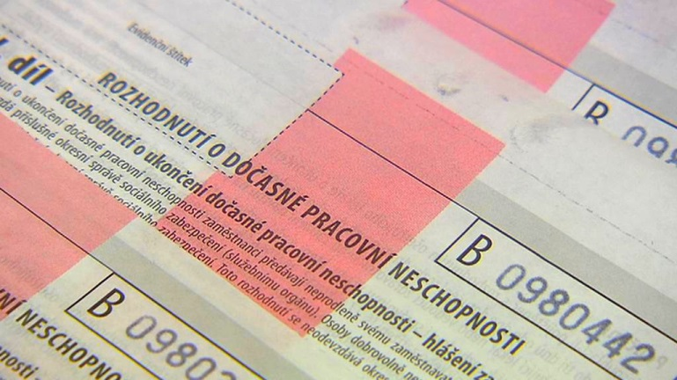
CZECH SOCIAL SECURITY ADMINISTRATION
Sickness insurance
processing and payments of sickness benefits, maternity benefits, nursing allowances and compensation allowances during pregnancy and motherhood
payments of “sickness benefits” - from the 15th day of incapacity; employer pays wage compensations for the first 2 weeks
administration of distraint deductions agenda
penalties for treatment regimen violations by the insured and for infringements of healthcare facilities
sickness insurance call centre

Slide 14
CZECH SOCIAL SECURITY ADMINISTRATION
Sickness insurance
 | 2010 | 2011 | 2012 | 2013 | 2014 | 2015
The number of benefits processed | 2,924,279 | 2,542,386 | 2,371,285 | 2,487,658 | 2,786,089 | 3,071,508
of which sickness benefits | 2,031,251 | 1,678,866 | 1,524,226 | 1,588,891 | 1,888,113 | 2,092,167
maternity benefits | 664,727 | 567,052 | 543,462 | 534,978 | 534,628 | 545,030
nursing allowances | 227,161 | 295,067 | 301,860 | 362,183 | 360,833 | 431,640
compensation allowance during pregnancy and motherhood | 1,140 | 1,401 | 1,737 | 1,606 | 2,515 | 2,671
The number of distraint deductions from sickness insurance benefits | Not available | 36,610 | 44,020 | 61,745 | 88,682 | 132,206
Terminated temporary incapacities to work (TIW) | 1,334,052 | 1,338,099 | 1,213,133 | 1,326,884 | 1,285,642 | 1,526,798
Days of sickness | 62,078,690 | 59,937,951 | 54,901,565 | 57,132,916 | 57,542,021 | 63,186,245
Average duration of a TIW (days) | 46.53 | 44.79 | 45.26 | 43.06 | 44.76 | 41.38
The number of checks on adherence to the TIW regime | 185,651 | 151,951 | 151,410 | 146,025 | 167,744 | 154,610
The number of penalties imposed | 3,468 | 3,004 | 2,977 | 2,609 | 3,391 | 3,650
The number of calls to the sickness insurance call centre | 71,970 | 71,854 | 48,191 | 56,249 | 122,790 | 180,287

Slide 15
CZECH SOCIAL SECURITY ADMINISTRATION
Distraint agenda
more than 1.08 million distraint-related submissions were received in 2015 (uptrend)
measures to significantly reduce the administrative burden:
electronic provision of data to distrainors since 2010 (2015 3.5 mil. requests for cooperation)
transfers of distraint orders in the form of data records since 2013 (“B2B” channel)

Slide 16
CZECH SOCIAL SECURITY ADMINISTRATION
Distraint agenda
80 thous. pensions with distraint deductions in 2015
uptrend
CZK 1.8 billion paid to creditors from pensions

Slide 17
CZECH SOCIAL SECURITY ADMINISTRATION
Distraint agenda
twofold increase in the number of deductions from SI benefits (uptrend) in 2013-2015
sickness benefits are of a short-term nature - i.e. the deductions are relatively low and the related administration is demanding
CZK 206 billion paid to creditors from the benefits
the agenda is performed in a decentralized way - by individual DSSAs

Slide 18
CZECH SOCIAL SECURITY ADMINISTRATION
Self-employed persons

Slide 19
CZECH SOCIAL SECURITY ADMINISTRATION
Medical assessment service
assessment activities on pension insurance
determination of disability - impact of diseases, injuries, or disabilities on work ability
inspections of temporary incapacities determined by physicians (for the purpose of sickness insurance)
assessment activities in the field of application of the EU social security law and bilateral treaties
assessment for purposes of provision of care allowance (Social Services Act) and allowances for persons with disabilities (mobility allowance, allowance for special aids and for the Severe Disability Card)

Slide 20
CZECH SOCIAL SECURITY ADMINISTRATION
Medical assessment service
^{*)} only the 1st instance opinions
Assessments for the CSSA agenda (contributory systems): approx. 40 %
Assessments for the Labour Office (non-contributory systems): approx. 60 %

Slide 21
CZECH SOCIAL SECURITY ADMINISTRATION
International relationships
liaison body and the competent institution for foreign institutions for sickness and maternity benefits and pensions and assessing the legislation applicable
application of regulations of the EU coordinating social security systems of 31 countries (EU, EEA, and Switzerland)
application of international (bilateral) agreements coordinating social security towards 31 countries
cooperation with foreign experts
international consulting days on pensions for the public
projects from the EU’s Structural Funds
twinning projects, Phare, Transition Facility, the EU grants

Slide 22
CZECH SOCIAL SECURITY ADMINISTRATION
Data base administration
Individual accounts of the insured
creation: 2006
content: digitized overviews of periods of insurance (employment) and alternative insurance periods recorded in the CSSA’s system
source: database of digitized documents of entitlement (150 million entitlement documents)
extract: Informative overviews of personal pension insurance (IOPPI) => at the client's request (max. once a year)
clients may ask for consultaion of their accounts at CSSA office
easier and faster communication with foreign institutions
Central registers
Master evidence: subject (natural and legal persons) and their identification data
Updates from Information Systems of registers of residents and foreigners and from the forms for reporting obligations
Registry of insurance relationships: insurance relationships (sickness and pension insurance) between subjects, registrations of subjects like employers, employees, self-employed, “voluntary pension insurance”
updates from the forms for reporting obligations

Slide 23
CZECH SOCIAL SECURITY ADMINISTRATION
Information and communication technologies
centralized data, decentralized operation of applications
e - Podání (e - Filing) = an alternative to paper forms
ePortál ČSSZ (ePortal of the CSSA) = web-based self-service portal
online services, interactive forms for citizens, employers, self-employed
communication with other public authorities via a B2B/G2G secure communication interface
online reservations of appointments via web
preparation for the international electronic data interchange (EESSI)

Slide 24
CZECH SOCIAL SECURITY ADMINISTRATION
CZECH SOCIAL SECURITY ADMINISTRATION
CZECH SOCIAL SECURITY ADMINISTRATION
Electronic communication
The number of electronically filed forms
The total number of forms received electronically as of 12/31/2015 (since the introduction in 2004): more than 95 million forms

Slide 25
CZECH SOCIAL SECURITY ADMINISTRATION
CZECH SOCIAL SECURITY ADMINISTRATION
CZECH SOCIAL SECURITY ADMINISTRATION
Electronic communication
Percentage electronically filled forms
on a voluntary basis
Overview of insurance premiums
Pension insurance registration sheets
eNeschopenka (eSick note)
89%
61 %
2 %
Notice of commencement of employment
76 %

Slide 26
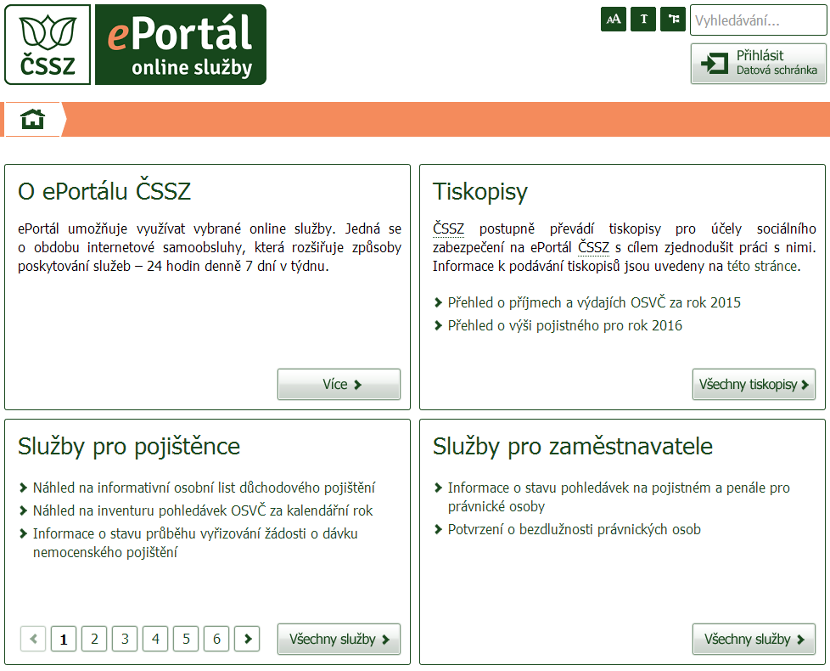
CZECH SOCIAL SECURITY ADMINISTRATION
CZECH SOCIAL SECURITY ADMINISTRATION
CZECH SOCIAL SECURITY ADMINISTRATION
ePortál ČSSZ
How does it taste...?
quick question or request
previews of selected data, e.g. insurance periods, amounts of benefits
check the benefit processing status
obtain a statement or ask for a confirmation
submit form – electronically received as “signed”
Are my insurance period and earnings recorded correctly?
Has my employer registered me to the insurance?
Do my payrolls correspond to the incomes registered by the CSSA?
Have I achieved the required length of the insurance period?
Has my sickness benefit application been processed?

Slide 27
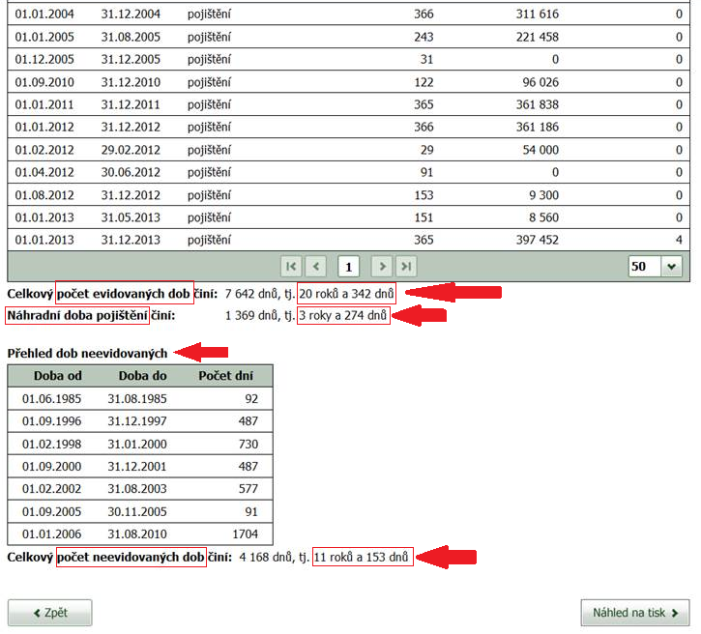
CZECH SOCIAL SECURITY ADMINISTRATION
CZECH SOCIAL SECURITY ADMINISTRATION
CZECH SOCIAL SECURITY ADMINISTRATION
Sending overviews of pension insurance periods
objective => familiarize citizens with the information registered by the CSSA
verify completeness of registered insurance periods in advance
actively address the deficiencies identified before applying for a pension
positive feedback
about 100 thous. overviews sent in total (since the commencement in 2015)
currently September 2016
men born in 1955 and women born in 1958

Slide 28
CZECH SOCIAL SECURITY ADMINISTRATION
Pension calculator
published on 11/05/2015
it joins the functions of the age calculator and the approximate calculation of the retirement pension,
both for the current time
and for the future, up to the horizon of 5 years
intended for the general public
available at the CSSA website
the citizen fills the data himself from their overview of pension insurance periods or from the informative overview of personal pension insurance
CZECH SOCIAL SECURITY ADMINISTRATION

Slide 29
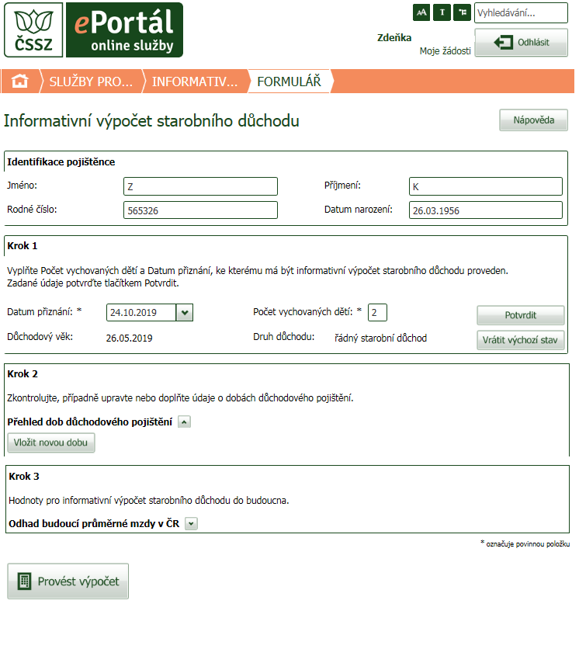
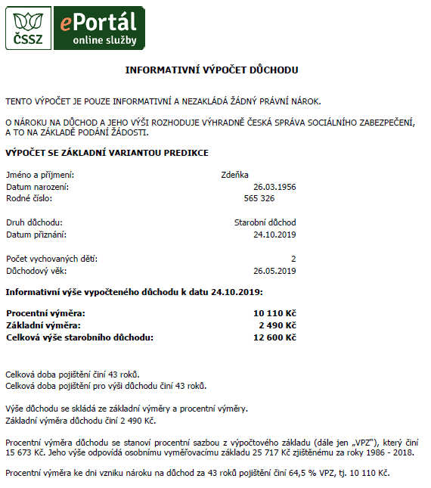
CZECH SOCIAL SECURITY ADMINISTRATION
Pension calculator
introduced in November 2016
a new service of ePortal of the CSSA
it automatically fills the data from the CSSA databases
CZECH SOCIAL SECURITY ADMINISTRATION

Slide 30
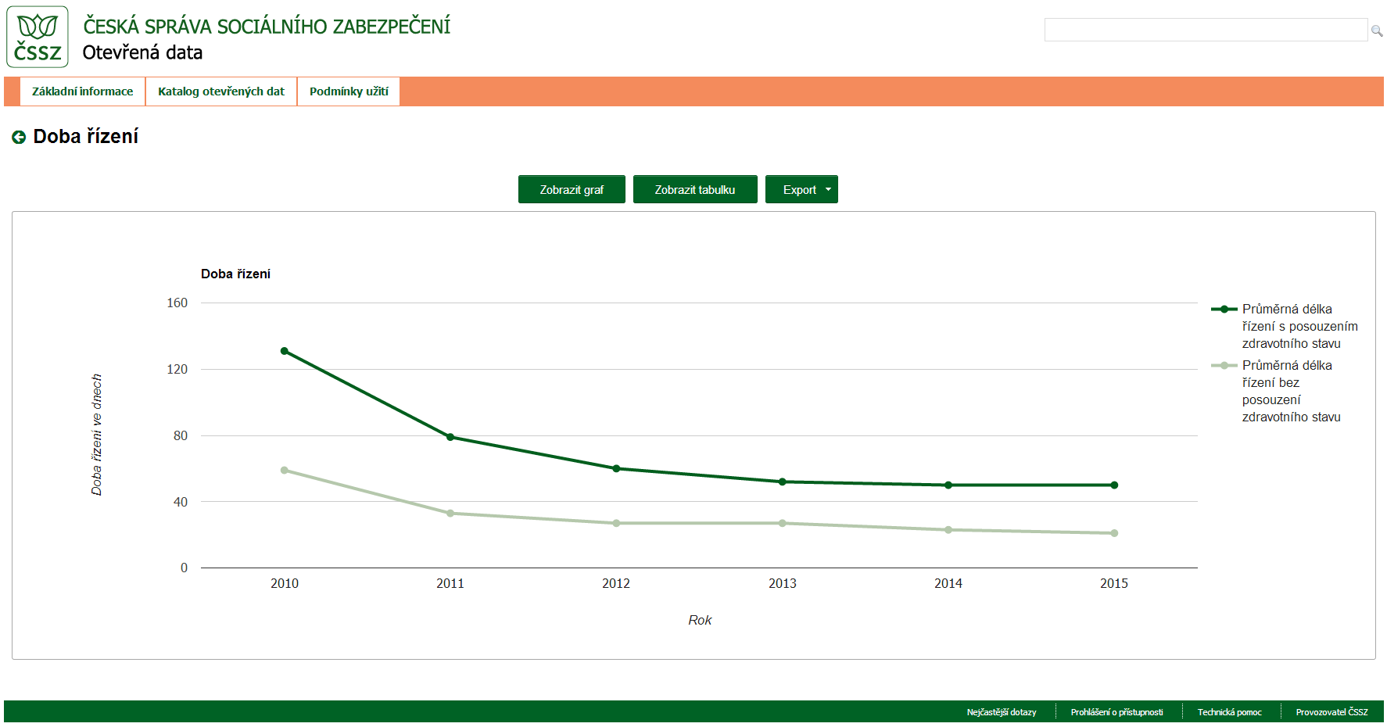
CZECH SOCIAL SECURITY ADMINISTRATION
Open data
portal launched on 11/02/2015
the CSSA as an example of a good practice
datasets of the CSSA are registered in the national catalogue of open data
the highest degree of openness, data stored in a machine-readable form (RDF, CSV, SPARQL)
clear charts and tables - visualization as an extension for users
CZECH SOCIAL SECURITY ADMINISTRATION

Slide 31
CZECH SOCIAL SECURITY ADMINISTRATION
Communication and information activities
informative materials
publications Manual of Future Pensioners and Handbook for Self-employed
a series of informative leaflets
Statistical Yearbook of Pension Insurance
facebook, twitter
Národní pojištění (National Insurance) (monthly magazine)
www.cssz.cz
portal.cssz.cz
CZECH SOCIAL SECURITY ADMINISTRATION

Slide 32
CZECH SOCIAL SECURITY ADMINISTRATION
in conclusion:

Slide 33
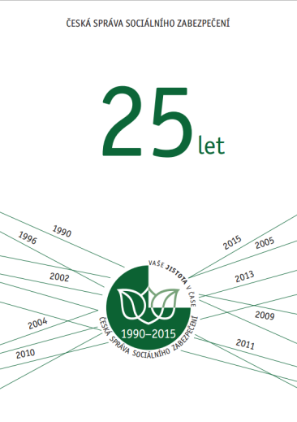
CZECH SOCIAL SECURITY ADMINISTRATION
The jubilee year of 2015
In 2015, the CSSA celebrated 25 years since its creation and 90 years of social insurance in the Czech Republic
a series of events to celebrate the anniversary
two-day international conference on social security at the premises of Charles University in Prague
academic panel at the Faculty of Law of Charles University in Prague focused on historical aspects and the international context of social insurance
strengthening of cooperation with colleges and universities
informal regional meetings with journalists aimed at promotion of awareness of this area
internal activities for employees
publication “25 Years of CSSA”
CSSA employees created a commemorative logo of the CSSA

Slide 34
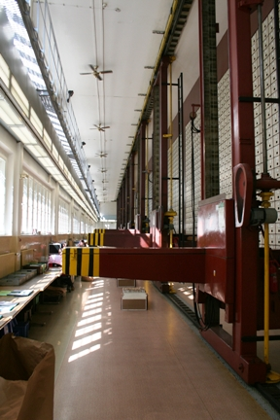
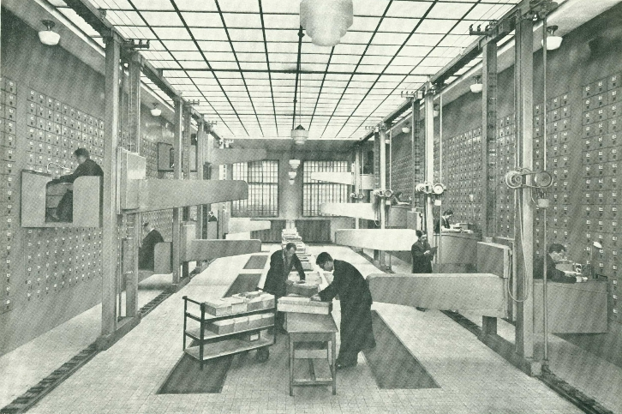
CZECH SOCIAL SECURITY ADMINISTRATION
Machine card file
from 1935-1936
declared a technical monument in 2004
the machine is fully functional
social security has nearly a hundred-year tradition in the Czech Republic
Vintage photo of the workplace.

Slide 35
CZECH SOCIAL SECURITY ADMINISTRATION
Thank you for your attention.

