Slide 1
The labour market in the Czech Republic Public Employment Services Prague, MLSA, 10/27/2016
Prepared by: Department of Employment DG LO CR

Slide 2
Basic data of the CR
(As of 9/30/2016)
Number of inhabitants: 10.5 million
Area: 78,866 km²
Average wage: CZK 26,480 (EUR 981)
Minimum wage: CZK 9,900 (EUR 367)
Unemployment: 5.2 % (September 2016)

Slide 3
Introductory information on the Labour Office of the Czech Republic
The Labour Office of the Czech Republic is a state organization acting as an administrative authority with a nationwide competence. It was established by Act No. 73/2011 Coll., On the Labour Office of the Czech Republic and amending related acts.
The Labour Office consists of the General Directorate which coordinates activities of regional branches and the branch for the city of Prague. Regional branches administer individual contact offices.
General Directorate
Regional branches
Contact offices

Slide 4
Regional distribution of branches of the Labour Office of the Czech Republic

Slide 5
History of PES in the CR
Public employment services in the CR 1990 – 2015 (25 years).
Long history of mediation of employment in the Czech Republic
12/10/1918 Act No. 63 On supporting the unemployed (T.G. Masaryk).
1989: Transition from a centrally planned model to a market economy – a number of structural changes, significant shifts in the structure of employment.

Slide 6
History of PES in the CR
At the beginning of 1991, the institutional and legal framework for the labour market was created.
A nationwide network of district labour offices began to operate gradual extensions by establishing branches in micro-regions.
Act No. 1/1991 Coll., On employment:
Act No. 9/1991 Coll., On employment and institutions in the field of employment.
Act No. 435/2004, On Employment, i.e. Employment Act (in force)

Slide 7
Other milestones of PES
Since 4/1/2004, information, mediating and counselling agendas and agendas related to the active employment policy and payments of unemployment benefits were supplemented with the tasks related of the State social support (non-contributory social benefits scheme).

Slide 8
Other milestones of PES
On 4/1/2011, Act No. 73 of 2/9/2011 created the Labour Office of the Czech Republic (DG and regional offices with contact offices).
Since 1/1/2012, the scope of activities of the Labour Office was extended over other social agendas transferred from municipalities (benefits in material need, allowances for persons with disabilities and foster parents. Together with the SSS, this area of ​​activities is called non-contributory social benefits (NSB).

Slide 9
State employment policy
State employment policy is developed by the State in cooperation with other institutions active in the labour market, in particular:
employers,
trade unions,
local government units,
professional organisations,
associations of people with disabilities,
employers' organisations.

Slide 10
State employment policy
The Czech State employment policy includes in particular:
Securing the right to employment,
Monitoring and evaluation of the situation on the labour market, processing of employment-related forecasts and policies,

Slide 11
State employment policy
implementation of active employment policy
creation and participation in international programmes aimed at development of employment and human resources in the labour market,
management of employment policy funds (PEP, AEP)
provision of the labour market-related information, counselling and placement services, etc.

Slide 12
Current situation on the labour market
Numbers of registered unemployed, job vacancies, and shares of the unemployed in the population (PUP)^{*)} by the end of month
 |  | measure | January | February | March | April | May | June | July | August | September | October | November | December
 |  | unit
2014 | unemployment | thous. persons | 629.3 | 625.4 | 608.3 | 574.9 | 550.0 | 537.2 | 541.4 | 535.2 | 529.1 | 519.6 | 517.5 | 541.9
 | PUP | % | 8.6 | 8.6 | 8.3 | 7.9 | 7.5 | 7.4 | 7.4 | 7.4 | 7.3 | 7.1 | 7.1 | 7.5
 | job vacancies | thous. of jobs | 36.4 | 38.3 | 40.8 | 44.2 | 48.0 | 49.5 | 51.1 | 54.7 | 56.6 | 58.2 | 59.4 | 58.7
2015 | unemployment | thous. persons | 556.2 | 548.1 | 525.3 | 491.6 | 465.7 | 451.4 | 456.3 | 450.7 | 441.9 | 430.4 | 431.4 | 453.1
 | PUP | % | 7.7 | 7.5 | 7.2 | 6.7 | 6.4 | 6.2 | 6.3 | 6.2 | 6.0 | 5.9 | 5.9 | 6.2
 | job vacancies | thous. of jobs | 62.3 | 69.0 | 76.1 | 83.7 | 92.7 | 97.0 | 98.1 | 103.8 | 108.6 | 107.3 | 105.0 | 102.5
2016 | unemployment | thous. persons | 467.4 | 461.3 | 443.1 | 415.0 | 394.8 | 384.3 | 392.7 | 388.5 | 378.3
 | PUP | % | 6.4 | 6.3 | 6.1 | 5.7 | 5.4 | 5.2 | 5.4 | 5.3 | 5.2
 | job vacancies | thous. of jobs | 107.8 | 114.8 | 117.3 | 124.3 | 129.1 | 133.9 | 135.8 | 139.3 | 141.0
^{*)} the proportion of unemployed persons is calculated as a ratio of unemployed job applicants aged 15 – 64 to the entire population of the same age

Slide 13
Current situation on the labour market

Slide 14
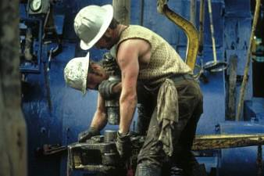
Current situation on the labour market
The number of reported job vacancies 140,993

Slide 15
Current situation on the labour market

Slide 16
Districts with the highest unemployment rates
Currently, the following districts have the highest unemployment rate:
Most – 10.6 % unemployment,
Karviná – 10.6 % unemployment,
Ostrava – město – 9.4 % unemployment,
Ústí nad Labem – 9.3 % unemployment.

Slide 17
Current situation on the labour market
According to the latest data available, in August, the unemployment rate of the CR (not seasonally adjusted), as published by the Eurostat for the purpose of international comparison, was 3.8%, in the EU28 it was 8.2%.
The seasonally adjusted unemployment rate was 3.9% in the CR and 8.6% in the EU28.

Slide 18
Comparison of the Czech labour market and the EU, as presented by the EUROSTAT

Slide 19
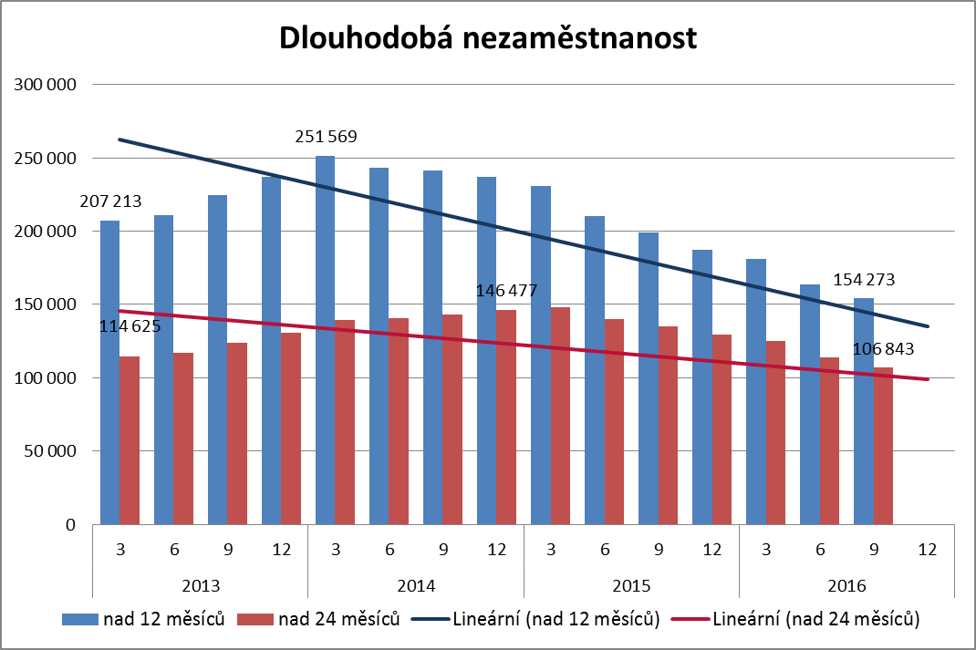
Challenges for the state employment policy

Slide 20
Challenges for the state employment policy

Slide 21
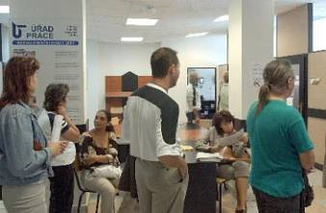
Challenges for the state employment policy
To remind:
The aim of the state employment policy is to achieve full employment and secure protection against unemployment (see the Employment act).
Job mediation for job seekers and job applicants - the “core” process of public employment services carried out by the LO CR. This is a specific functional area which stands in the “front line” in terms of fulfilment of the mission of the LO CR!

Slide 22
Challenges for the state employment policy
Efficient proactive orientation on mediation, counselling, and education of job seekers in accordance with the requirements of employers (active matching)!
It is necessary to strive to shorten the length of unemployment, allow job seekers to return to work, speed up workforce turnaround – reduce demands on the passive employment policy systems!

Slide 23
Challenges for the state employment policy
Contacts with employers restored – positive feedback from employers on personal monitoring visits.
The current priority is a quality preparation for each meeting and a proper choice of services for each employer – in order to maintain and develop the cooperation.

Slide 24
Unemployment benefits
A job seeker is entitled to unemployment benefits (“UB”) if:
was employed or performed other gainful activity during the decisive period (2 years before applying for UB) and paid their pension insurance for at least 12 months - also any substitute employments are taken into account,
applied for UB at the contact office where he is registered as a job seeker, and
does not draw old age pension to the date on which UB shall be granted.

Slide 25
Unemployment benefits
For example, the following job seekers are not entitled to UB:
with whom an employment was terminated due to the violation of obligations resulting from statutory provisions regarding the performed work in a particularly gross way; the decisive period are the last 6 months before the job seeker’s inclusion into the LO’s register,
who are entitled to a service pension while the service pension is higher than the prospective UB,
who are in a non-colliding employment legal relationship on the date on which UB are to be granted.

Slide 26
Unemployment benefits
Duration of provision of UB (support period) - depending on the job seeker’s age:
up to 50 years 5 months,
more than 50 but less than 55 years 8 months,
more than 55 years 11 months.
The decisive factor for the support period’ duration is the job seeker’s age on the day when the application for UB was submitted.

Slide 27
Unemployment benefits
UB amounts are:
65 % of the average monthly net earnings for the first 2 months,
50% for the following 2 months,
45 % for the rest of the period.
If the job seeker terminated their last employment by themselves or by agreement with the employer and there was no serious reason for the termination.
The maximum amount of UB is 0.58 times the average wage in the national economy (about CZK 15 000/month – approx. EUR 560).
Notes:
Or from the last assessment base (self-employed).
In case the job seeker met the condition of the length of previous period of employment by offsetting a substitute employment, or if they cannot certify the amount of their average net monthly income or the assessment base (not due to their fault) - multiples of the average wage.

Slide 28
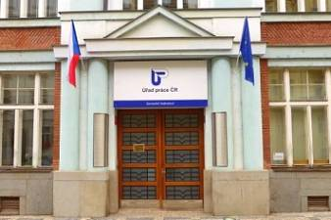
Thank you for your attention...
Jan Buba
jan.buba@uradprace.cz

