Slide 1



Pension System in the
Czech Republic
Ministry of Labour and Social Affairs
Department of Social Insurance
26th October 2016

Slide 2


Introduction
The pension system is a integral part of national economy.
The most important objective of the system is providing benefits in case of invalidity, old age and survivor.
With respect to long term character of the system changes have to run step by step (evolutionary not revolutionary) with wide consensus.

Slide 3
Czech pension system
Mandatory public PAYG system (I. pillar)
Voluntary supplementary FF scheme with state support (III. pillar) – (since 1994)
---------------------------------------------------------
Life insurance products + other

Slide 4
Public PAYG system (I. pillar)
  Providing old-age, disability and survivor’s pensions (2,5+0,47+0,1= 3 mil.)
  Dominant source of old-age income (~ 94-95 %)
  Providing average gross replacement rate of 42 % (2011), net replacement rate about 53 %
  Pension expenditure – cca 9 % GDP
  Contribution rate – 28 % (6,5+21,5)
  High solidarity/redistribution formula = low risk of poverty among pensioners
  Institutional roots: end of 19 century
  Uniform system (no special schemes)

Slide 5
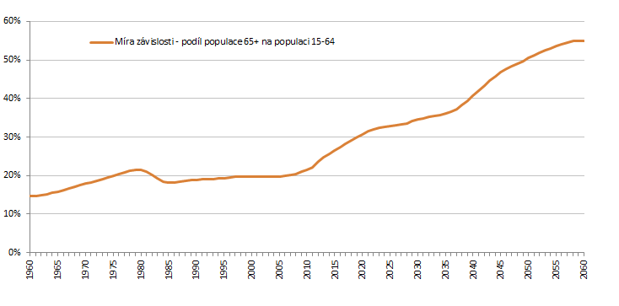
Dependency Ratio (65+/15-64)
Dependency ratio (65+/15-64)
TODAY
zdroj: EUROPOP 2011

Slide 6
Dependency ratio - increasing

Slide 7
Demography – population ageing
Life expectancy at the age of 60
  Born 1945………22-23 (22,7) years
  Born 1990………29-30 (29,2) years
Low fertility rate
  Current 1,2 – 1,4 (expected growth to a maximum of 1,7)
Increase in the share of people in older age groups
  especially in the group of 80+
+ 6,5
years

Slide 8
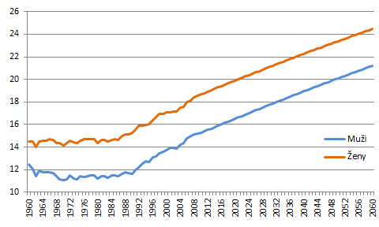
Life expectancy (at 65 years)
Males
Females
zdroj: EUROPOP 2011

Slide 9
Demography situation - development (1950 - 2050)

Slide 10
Number of pensioners and pensions – 2016 (July 2016)
Number of pensioners ..............................2,88 mil.
Number of paid pensions..........................3,5 mil.
Old – age pensions....................................2,37 mil.
Disability pensions.....................................0,43 mil.
Widow´s/widower´s pensions..0,03 mil. (0,65 mil.)
Orphan´s pensions.....................................0,04 mil.
Number of insured persons.......................5,3 mil.
Average old age pension is about 11.400 CZK (400 €)
Average wage is about 26.000 CZK (920 €)

Slide 11
Pension Reform
A lot of parametric changes during last 20 years
  Increasing of the retirement age (4 times)
  Introducing of social contributions and changes in the level of contribution
  Increasing of minimum insurance period for entitlement
  Extension of reference period – to lifelong
  Introducing regular valorization of pensions
  Changes in the area of early pensions
  Redefinition of invalidity (three levels)
  Fully coordination with EU legislative (free movement, transfers of benefits)
  Introduction of III. fully funded voluntary pillar (1994)

Slide 12
Pension insurance
  The pension system provides a compensation of income in the event of
  old age (including so called early pensions)
  disability (three level of disability)
  death of the breadwinner (widow/er, orphan)
  This system is based on several general principles:
  social solidarity, pay-as-you-go financing, mandatory participation of all economically individuals, defined benefit, universality - the legal regulation is the same for all the insured persons, there are no industry-specific schemes .

Slide 13
Pension insurance
The groups of pension insured persons
Employes
Self-employed persons
Participants without economical activity in cases given in act – e. g. persons, who take care of child younger than 4 years of age or helpless persons, job applicants to a limited extent and others (non-contributory periods)

Slide 14
Pension Benefit Formula (old age)
Flat rate part (9 % of the average wage, 2440 CZK - 2016) + percentage amount, wage-linked (but with high income solidarity)
Entitlement:
Minimum insurance period: increasing (from 25 to 35(30) years - 2019)
Retirement age: increasing (60 (1995) - 67 (2044))
Decisive period: lifelong
all wages since 1986
Percentage part of pension
1,5 % of calculation base for each year of the insurance
Flat rate (fix amount)
9 % of average wage
2440 CZK - 2016

Slide 15
The statutory old-age pension
The conditions of entitelment
The insured person shall be entitled to the old-age pension, provided he/she has reached the necessary insured period and retirement age.

Slide 16
The amount of the old-age pension
The amount of the pension consists of two components specifically a basic assessment and a percentage assessment.
The amount of the basic assessment of the pensions has been is set as a percentage of the average wage – 9 % of average wage (currently 2 440 CZK per month).
The percentage assessment is 1,5 % of the calculation base for each year of the insured period acquired before the entitlement to the pension arose.

Slide 17
Early old-age pension
The insured person shall be entitled to the early permanently reduced old-age pension, provided he/she
has reached the required insured period, and
will reach the retirement age in less than
  3 years if the retirement age is lower than 63 years
  5 years if the retirement age is higher than 63 years and the person is over 60 years of age
Notes:
17

Slide 18
The disability pension
The conditions of the entitelment:
The insured person is entitled to the disability pension, provided he/she has not reached 65 years of age and became
disabled and has reached the sufficient insured period, as long he/she does not meet the conditions for the entitlement to the regular old-age pension as at the day on which his/her disability arises, or if he/she was granted the early permanently reduced old-age pension before reaching the retirement age, or
disabled as a result of an occupational injury.
The insured person has to achieve necessary insured period.

Slide 19
The insurance time required for the entitlement to the disability pension
The required insurance period of the insured person is at the age:
younger than 20 less than one year
between 20 and 22 one year
between 22 and 24 two years
between 24 and 26 three years
between 26 and 28 four years
over 28 five years

Slide 20
The required insurance period
The required insurance period is being assessed before the occurence of invalidity, and in cases of insured persons of over 28 years of age in the last 10 years before the occurence of invalidity. For an insured over 38 years of age the condition is deemed fulfilled also in cases when the insured period was acquired in the last 20 years before the occurence of invalidity and the required minimum is 10 years. The condition of required minimum period is fulfilled if the insured period was acquired in the 10 years following the occurence of invalidity. The insured period condition is deemed fulfilled if the invalidity arose as a consequence of a work injury or occupational disease.

Slide 21
Disability
The insured person shall be considered disabled if, due to his/her long-term impaired health condition his/her ability to work has been reduced by at least 35 %. Provided the ability of an insured person to work has been reduced
at least by 35 %, however by 49 % at most, he/she shall be considered disabled in the first degree,
at least by 50 %, however by 69 % at most, he/she shall be considered disabled in the second degree,
at least by 70 %, he/she shall be considered disabled in the third degree.

Slide 22
The amount of the disability pension
The basic assessment - 2440 CZK (without regard to degree of disability).
The percentage assessment for each whole year of the insurance time is:
0.5 % of the calculation base per month, in case of a disability pension granted for disability of the first degree,
0.75 % of the calculation base per month, in case of a disability pension granted for disability of the second degree,
1.5 % of the calculation base per month, in case of a disability pension granted for disability of the third degree.
In case of a change in the disability degree the amount of the pension will be reassessed, starting from the date on which the disability degree changes.

Slide 23
Survivor´s pensions
Widow and widower pension
Conditions of entitlement
A widow shall be entitled to the widow pension after her deceased husband, who
was a beneficiary of an old-age or disability pension or
met by the date of his death the conditions of the required insurance time to be entitled to a disability pension or conditions to be entitled to an old-age pension or died as a result of an occupational injury (occupational disease).
A widower shall be entitled to the widower pension under the same conditions as a widow entitled to the widow pension

Slide 24
The widow/widower pension
The widow/widower pension shall be granted for a period of one year after the spouse’s death. After this period expires the widow (widower) shall continue to be entitled to the widow pension, if she/he fulfils any of the conditions set in act, e. g.
she/he takes care of a dependent child,
she/he takes care of a child dependent on the care provided by another person in levels II through IV,
she/he takes care of her/his parent or parent of the deceased husband/wife, who share the household with her/his and is dependent on the care provided by another person in levels II through IV.

Slide 25
The amount of widow/widower pension
The amount of the pension consists of two components, specifically a basic assessment and a percentage assessment.
The basic assessment - 2 440 CZK a month
The percentage assessment is 50 % of the percentage assessment for the old-age or disability pension for the third-degree disability to which the deceased spouse was or would have been entitled at the time of his/her death.

Slide 26
Orphan pension
Orphan pension
A dependent child shall be entitled to the orphan pension, provided either of the following persons has died
parent (adoptive parent), or
person, who took the child in foster care replacing the care of the parents
provided the parent (adopted parent ) or the person identified under the second bullet point were beneficiaries of the old-age or disability pension or conditions for the entitlement to the old-age pension or died as a result of an occupational injury (occupational disease). An orphaned child who lost both parents shall be entitled to the orphan pension after either the deceased parents.

Slide 27
The amount of the orphan pension
The basic assessment - 2 440 CZK per month
The percentage assessment is 40 % of the percentage assessment of the pension for which the deceased person would have been entitled at the time of his/her death.

Slide 28
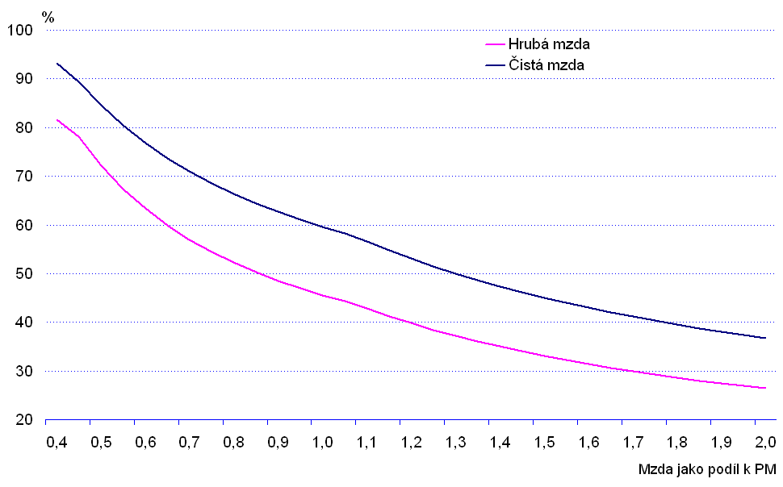
Replacement rate
Gross wage
Net wage

Slide 29
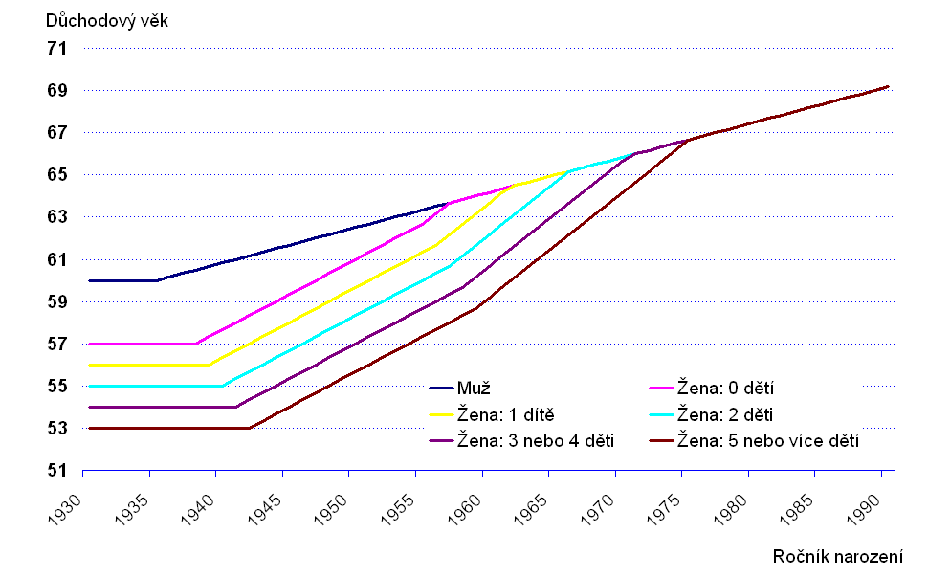
Retirement age – increasing and unification
Retirement age
year 2041, retirement age 66 years+8 months, born in 1975
Men
Women: no children
Women: 1 child
Women: 2 children
Women: 3 or 4 children
Women: 5 or more children
Year of bitrh

Slide 30
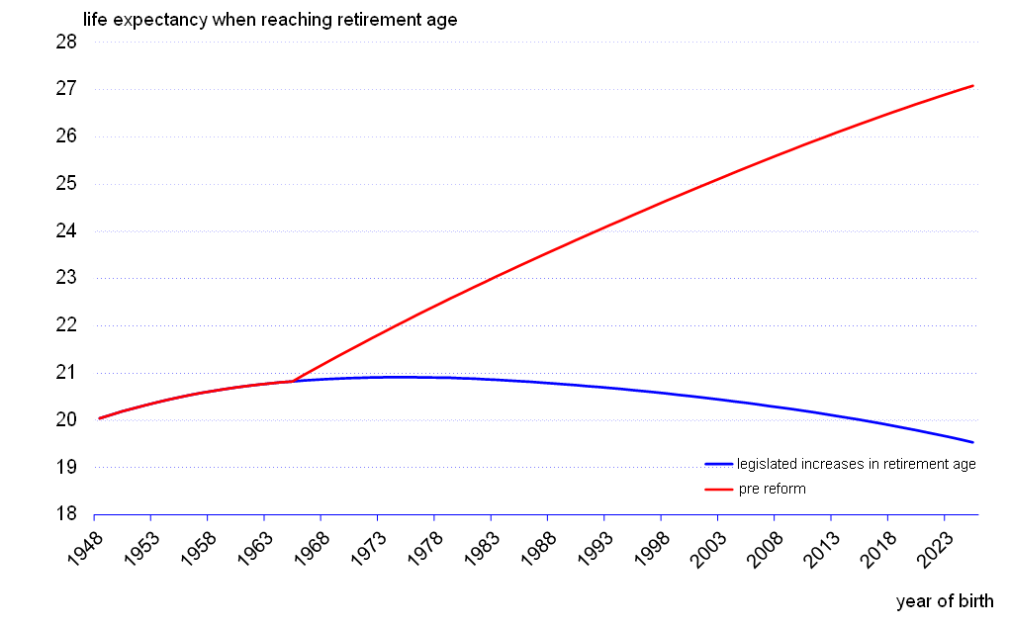
Life expectancy and retirement age
The increases in retirement age match life expectancy gains
Average years spent in retirement fixed at ~20 years
Future revisions of life expectancy and retirement age envisaged

Slide 31
Retirement age – increasing (men)

Slide 32
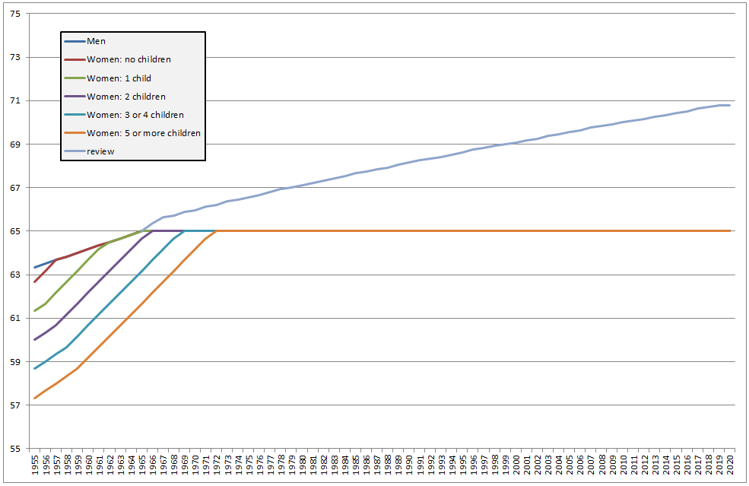
Retirement age and review

Slide 33

Valorisation/indexation – basic principle
minimum level fixed in law
reaction on price growth/inflation ...100%
reaction on (real) wage growth..........33%
anually – each year, fixed term – January
room for government decision
ensuring „adequate“ living standard for pensioners in relation to other population
extra valorisation in case of non-standard economy development

Slide 34
Risk of poverty rate (65+, 2014)
Eurostat

Slide 35
Income and expenditure
(bil. CZK)

Slide 36
Conclusions
Demography trends are clear (low fertility rate, increasing life expectancy)
Statutory retirement age increasing is natural adaptation of pension systems
Importance of the flexible labour market without age discrimination
Pension system and labour market – mutual finding optimal balance

Slide 37
Thank you for your attention
Martin Štěpánek, Department of Social Insurance, martin.stepanek@mpsv.cz

