Slide 1
中国-欧盟就业和社保政策对话与研讨会
China-EU Employment and Social Security Policy Dialogue &Workshop
2016年4月26日 ·北京 Beijing, April 26, 2016

Slide 2
Global Situation of Employment and Job Creation in Europe
(bilingual version)
Jordi Curell
Director for Labour Mobility
European Commission, DG EMPL
(EN-CN bilingual version)
（Email）

Slide 3
Unemployment rates in the EU, US, the G7, and China
Source: Labour Market and Wage Developments in Europe 2015 (European Commission) and World Bank

Slide 4
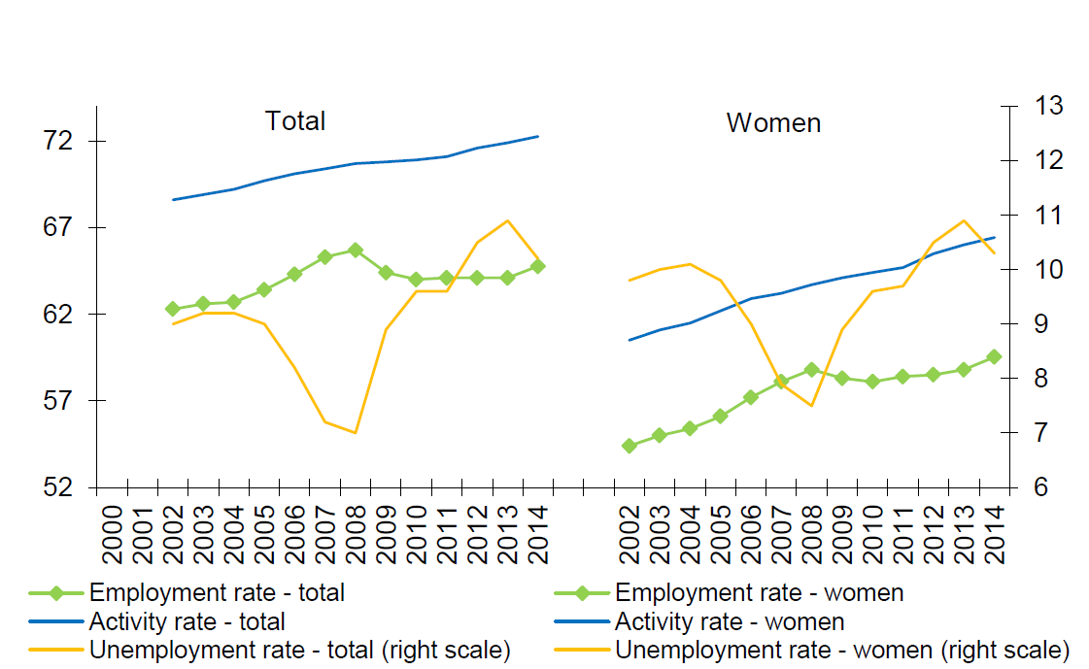
Employment, unemployment and activity rates in the EU
Source: Labour Market and Wage Developments in Europe 2015 (European Commission)

Slide 5
Employment level and changes by sectors in the EU
Source: Employment and Social Developments in Europe 2015 (European Commission)

