Slide 1
Functionality of Social Security from a Labour Market Perspective
Dr. Koen Vleminckx - 弗莱明 科恩
Beijing, April, 2016

Slide 2
INTRODUCTION

Slide 3
Social Security
… mitigates the loss of earnings associated with a set of recognized risks, such
as unemployment and conditions that negatively affect a person’s earnings
capacity, such ill health, disability, work-related injury and the real or assumed
loss of earnings capacity due to old age.
… provides benefits that replace to a certain extent the income from earnings and/or that to a certain extent compensate the partial loss of earnings.
… is financed by contributions paid by the employed and/or his/her employer, who withholds contributions on the payments of wages.

Slide 4
Social Insurance regulates the professional career throughout
the various fases of the life-course…
Professional career
Childhood and education
Old age retirement

Slide 5
Functions of social security from a labour market perspective
Employability: Income replacement helps beneficiaries to maintain their employability.
Job matching: Income replacement allows them time to find a job that matches their skills
Job retention: As social security rights are acquired and built up by the regular payment
of contributions it promotes job retention.
Job retention allows allowers to invest in training and lifelong learning.
Social insurance smoothens the functioning of the labour market

Slide 6
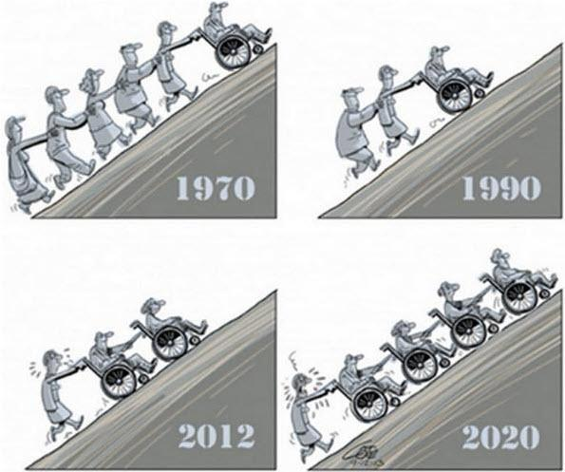
Social insurance requires a balanced labour market, foremost a balance between the number of active contributors to the system and the number of beneficiaries.
Volume and Cost Control

Slide 7
Social SECURITY in labour market - social welfare nexus

Slide 8
Social insurance is part of a broader set of policies in
the labour market - social welfare nexus
Education
Labour market regulation
Labour market services
Care & leave policies
Fiscal policies
…

Slide 9
Different European countries have a different vision on the role
of social insurance within this policy nexus.

Slide 10
Different visions on the role of social insurance within this labour market – social welfare nexus.
Scandinavian: Strong link between social insurance and labour market policies.
Social benefit are generous and access is universal. Strong emphasis on labour market
Reintegration (activation, with very developed labour market services and programs
facilitating a dynamic labour market.
Conservative: Developed social insurance systems, but linked to labour
market performance and focused on compensation, while labour market regulation protects
those already ‘inside’ the labour market.
Mediteranean: Social insurance strongly linked to labor market performance. Social
Provisions for those outside the labour market are more residual. Strong labour market
regulation, protecting those already ‘inside’ the labour market.
Liberal: Social insurance has a residual focus, while labour markets are more
deregulated.
Central European (East Asia?): Combines liberal and conservative features.

Slide 11
DESIGN OF SOCIAL INSURANCE FROM A LABOUR MARKET PERSPECTIVE

Slide 12
Policy chain
Prevention
of risks
Restoring situation
before risk occurred
Compensation
if risk occurs
1
2
3
Regulation
Education & lifelong learning
Health prevention
Safety at work
…
Health-care
Labour market services
…
Income replacement
Poverty prevention
…

Slide 13
Designing benefit system
1
Short-term:
Reasonable income replacement is important to compensate loss of
purchasing power and protect employability.
Expectancy to participate in reintegration efforts, including training
Obligation to be available for suitable work
2
Long-term
Preventing poverty and social exclusion
Avoid poverty trap (benefit levels, integration stimuli, sanctions)
Expectancy to participate in reintegration efforts, including training
Obligation to be available for work offered

Slide 14
Accompanying labour market services
Employment services to facilitate job matching
Specific services for target groups
Lifelong learning and (re) training

Slide 15
Labour market challenges

Slide 16
Main labour Market Challenges, both in Europe and China
Economic crisis and labour market restructuring
Population ageing

Slide 17
Economic Crisis
During the economic crisis of the eighties:
Strong increases in unemployment due to labour market restructuring
Governments prefered ‘exit’ strategies for less productive workers, such as early retirement to facilitate restructuring (reduce social conflict, limit poverty, …)
As a result, benefit dependency and cost of social insurance system increased

Slide 18
Economic Crisis
Recent financial and currency crisis:
Temporary unemployment schemes, allowed employers to retain workers (labour hoarding) to bridge crisis
Reliance on services aimed at retraining and reintegrating redundant workers

Slide 19
Population ageing
Longer and more intensive careers:
Increasing retirement age
Other measures to lengthen labour market careers, to maintain productivity and finacial equilibrium of social insurance system
Shorten duration of unemployment, sickness and invalidity

Slide 20
Population ageing
Phasing in and Phasing-out:
Introduction of part-time disability to facilitate labour market reintegration
Introduction of part-time retirement to allow older workers to retire gradually
Allow retired workers to supplement income with income from employment

Slide 21
Population ageing
Measures to make longer and more intensive professional careers acceptable:
Leave policies for parents, care for sick relatives, …
Leave policies to facilitate lifelong learning
Time-credits and life-course accounts

Slide 22
THANK YOU

