Slide 1
Round table meeting on active labour market policies
EU / China dialogue and cooperation
Rom, 30 November 2017
ACTIVE LABOUR MARKET POLICIES AT THE INTERNATIONAL LEVEL
Kristine Langenbucher
Directorate for Employment, Labour and Social Affairs
OECD

Slide 2
Content
Recent labour market developments
Faces of joblessness
OECD reviews of active labour market policies

Slide 3
Recent labour market developments

Slide 4
Employment rates in the OECD and beyond have evolved very differently since 2007
Employment rates, working-age population, 2007 and 2015
Source: OECD Employment Database, national labour force surveys and census data (China).

Slide 5
The unemployment rate is now below 5% in several countries, but remains very high in a few others
Unemployment rate, 2007, 2014 and 2015
Source: OECD Employment Database, national labour force surveys and census data (China).

Slide 6
The NEET rate shows no common trend and remains very high in many OECD countries and beyond
NEETs (Neither in Employment, nor in Education or Training)
as percentage of young population aged 15/16-29, 2007, 2014 and 2015
Source: OECD calculations based on national labour force surveys and OECD Education Database.

Slide 7
Gender employment gaps persist across the OECD and beyond, but are there is huge variation
Percentage-point difference of participation rates between
men and women of working-age, 2015
Source: OECD Employment Database, national labour force surveys and census data (China).
*: 2012 for China and 2011-12 for India.

Slide 8
Faces of Joblessness

Slide 9

Faces of Joblessness
Who is disadvantaged?
What employment barriers do they face?
jobless individuals
+ others with weak labour-market attachment
High-level social and labour-market indicators exist…
… but contain little information on relevant employment barriers
Powerful profiling systems exist
in several countries / PES…
… but may not capture circumstances relevant for key social-policy areas

Slide 10
Main steps
1
2
Indicators of employment barriers
→ 3 categories: (i) employability, (ii) motivation, (iii) opportunities
3
Identify policy-relevant groups
→ individuals with similar sets of barriers
→ using statistical clustering methods
Select population of interest
→ jobless or marginal / unstable employment
→ household micro-data (EU-SILC, HILDA)
Policy inventory & gap analysis
→ for selected groups
→ country dialogue missions organised with EC
4
5
Connecting People with Jobs
→ OECD reviews of active labour market policies
→ Completed: United Kingdom, Slovenia, Australia, and Korea
→ Ongoing: Italy and Latvia

Slide 11
Step 1: “individuals with potential employment difficulties in Italy” (target population)
Out of work
32% of working-age individuals
Weak labour-market attachment
7% of working-age individuals
Unstable jobs
Restricted hours
Near-zero earnings
Notes: Population aged 18-64, excluding students and those in military service
Source: EU SILC 2014

Slide 12
Step 2: Typology of employment barriers
Employability
Motivation
Opportunities
Education / skills;
Work experience
Health problems
Care responsibilities
Earnings replacements:
out-of-work benefits
Tax burdens on in-work earnings
Non-labour incomes
Incomes of other household members
Cyclical labour-market weakness
Limited hiring in relevant labour-market segment
(eg, region, education)
Adapted from Immervoll and Scarpetta, 2012

Slide 13
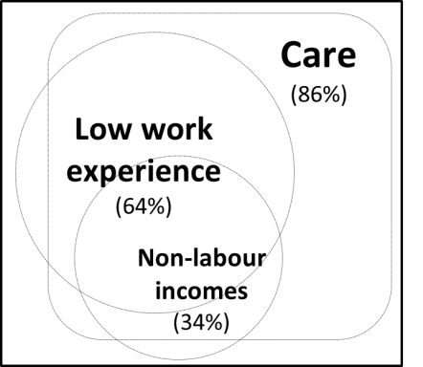
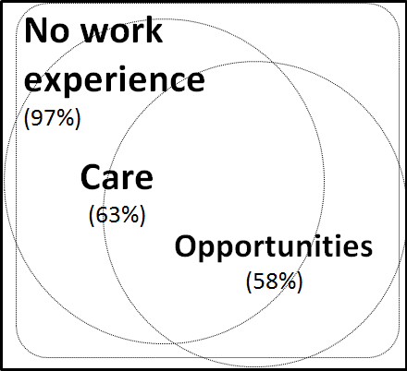
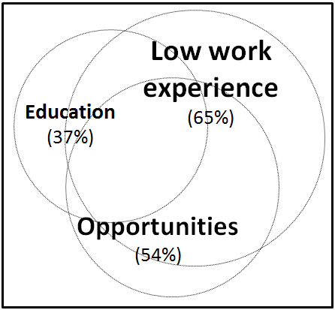
Step 3: Anatomy of employment barriers for three selected groups in Italy
LM inactive mothers with limited work experience
(Group B)
LM inactive mothers, no past work experience (Group C)
Discouraged younger adults
(Group A)

Slide 14
Step 4: Policy inventory & gap analysis
Which groups are a priority for activation and employment support? Large and diverse groups of people without stable employment imply an important role for identifying priority groups to ensure policy impact (e.g. based on size, “distance” from labour market, poverty risks and social situation).
A need to link up & coordinate across institutions.
Large majority of people with labour-market problems face multiple barriers. They likely require multiple types of support, which requires coordination and sequencing.

Slide 15
Step 5:
OECD reviews of active labour market policies

Slide 16
Key building blocks for fostering more inclusive Labour Markets
Addressing demand-side barriers and expanding employment opportunities for jobseekers
INSTITUTIONS AND POLICIES
Opportunities
Inclusive and resilient labour markets
Intensive case management, placement services and participation in measures to increase employability
Ensuring that jobseekers have the motivation to seek work
Motivation
Employability

Slide 17



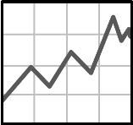
Challenges for Public Employment Services (PES)
Which role can PPPs and contracted out services play?
Outcome-based payment systems
Performance management
How to address the challenges of decentralised systems?
Defining key procedures
Comparative benchmarking of local offices.
Questions addressed in previous reviews
How to manage performance and ensure continuous improvement and learning?
Performance & quality management, operational processes, etc.
How can the PES achieve more with less?
Transition to
e-services

Slide 18





For further information
Contact: Kristine Langenbucher (Kristine.Langenbucher@oecd.org)
OECD Directorate for Employment, Labour and Social Affairs: www.oecd.org/els
More on active labour market policies and activation strategies: www.oecd.org/els/employment/activation.htm
More on Faces of joblessness: www.oecd.org/els/soc/faces-of-joblessness.htm
OECD Employment Outlook: www.oecd.org/employment

