Slide 1
Trends, causes and remedies to income inequality in OECD countries 经合组织国家的收入不平等趋势、原因及应对措施
Céline Thévenot – Economist Céline Thévenot——经济学家 Jobs and Incomes division 就业及收入司
CHINA / EU INTERNATIONAL WORKSHOP AND DIALOGUE 中欧国际对话与研讨会 Lyon, September 2017 里昂，2017年9月

Slide 2
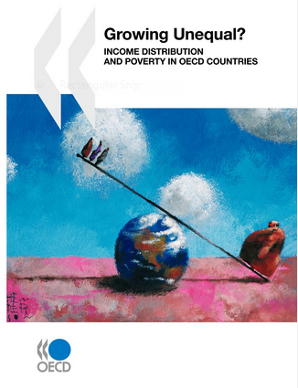

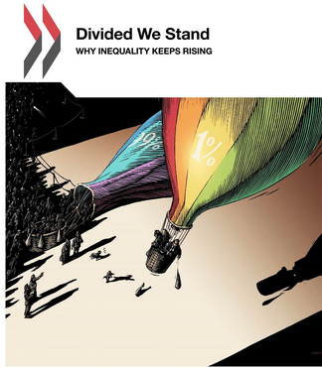
Inequality – in the heart of international policy discourse and policy debate
收入不平等——国际政策对话及讨论的核心问题
  “Inequality can no longer be treated as an afterthought. We need to focus the debate on how the benefits of growth are distributed” (A. Gurría, OECD)
  “This is the first time that the World Bank Group has set a target for income inequality” (Jim Yong Kim, World Bank)
  “Reducing excessive inequality is not just morally and politically correct, but it is good economics” (C. Lagarde, IMF)
  “The crisis has added to the long-term trend of rising inequalities” (J-C. Juncker, European Commission)
  "不平等不能再被视为事后再思考的问题。我们需要重点讨论关于如何分配增长红利的相关问题” (A. Gurría，经合组织)
  "这是世行集团第一次为收入不平等设定目标" (Jim Yong Kim, 世界银行)
  “减少过度的不平等不仅在道义和政治上是正确的, 并且具有良好的经济性” (拉加德，国际货币基金组织)
  “危机加剧了不平等现象的长期发展趋势” (J-C. Juncker，欧洲委员会)
2008
2011
2015

Slide 3
Large country differences in levels of income inequality
各国在收入不平等程度上的巨大差异
Source: OECD Income Distribution Database (www.oecd.org/social/income-distribution-database.htm), as at 1-September-2017
Note: the Gini coefficient ranges from 0 (perfect equality) to 1 (perfect inequality). Income refers to cash disposable income adjusted for household size. Data refer to 2015 or latest year available.
资料来源：世界经合组织国家收入分配数据库（www.oecd.org/social/income-distribution-database.htm），2017年9月1日访问。
备注：基尼系数的范围是从0（完全平等）到1（完全不平等）。收入指根据家庭规模调整后的可支配的现金收入。可获知2015年或最近年份的数据。

Slide 4
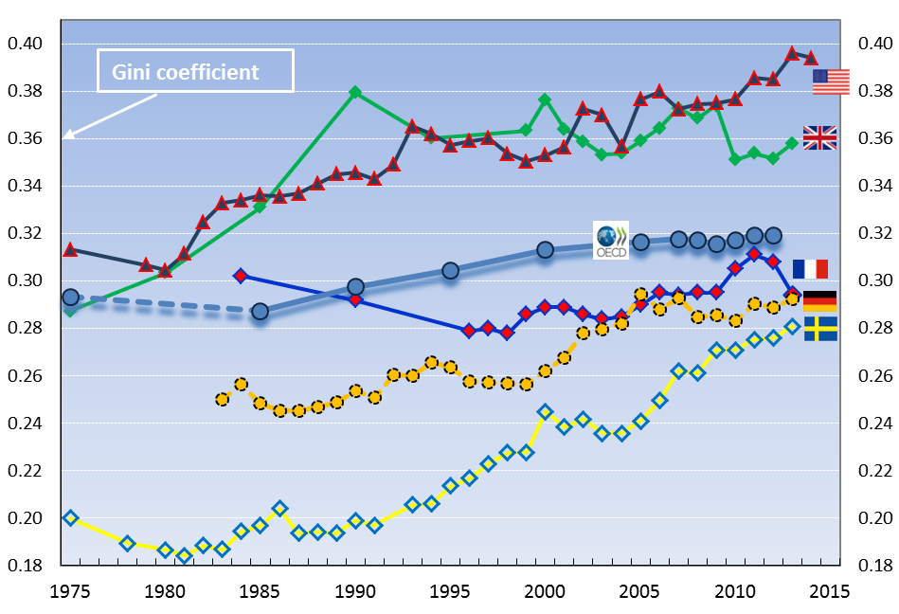
Rather than continuous long-term trends, “episodes” of inequality increases收入不平等水平并非长期持续上升，而是呈现阶段性地上升
Long-term trends in inequality of disposable income (Gini coefficient)
可支配收入不平等的长期趋势（基尼系数）
Source: OECD (2016), “Income inequality remains high in the face of weak recovery”, http://www.oecd.org/social/OECD2016-Income-Inequality-Update.pdf OECD Income Distribution Database, www.oecd.org/social/income-distribution-database.htm.
Note: Income refers to disposable income adjusted for household size.
资料来源：世界经合组织（2016年），“经济复苏疲软的背景下，收入不平等仍然处于高水平” , http://www.oecd.org/social/OECD2016-Income-Inequality-Update.pdf 。世界经合组织国家收入分配数据库（www.oecd.org/social/income-distribution-database.htm）。
备注：收入指根据家庭规模调整后的可支配的现金收入。

Slide 5
But the rise of income inequality is, not only, about the top of the distribution 然而，收入不平等的增长不仅仅存在于分配金字塔的顶端
  → When looking at the long run, lower and lowest incomes were increasingly left behind 从长期看，较低及最低收入群体越发被忽视
Trends in real household incomes at the bottom, the middle and the top,1985 = 1
实际低、中、高水平家庭收入的发展趋势，1985年为1
17个经合组织国家
美国
法国
Source: OECD (2015), “In It Together”, http://www.oecd.org/social/in-it-together-why-less-inequality-benefits-all-9789264235120-en.htm; OECD Income Distribution Database, www.oecd.org/social/income-distribution-database.htm
数据来源（2015），“In It Together”, http://www.oecd.org/social/in-it-together-why-less-inequality-benefits-all-9789264235120-en.htm
OECD收入分配数据库，www.oecd.org/social/income-distribution-database.htm

Slide 6
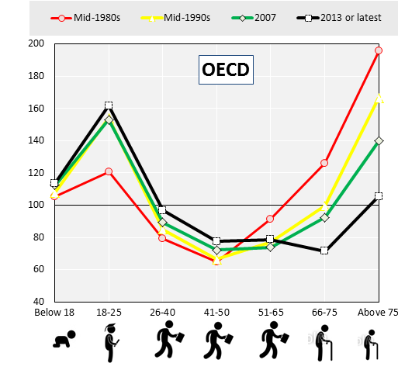
In most countries, the income poverty risk has shifted from the elderly to younger age groups
在多数国家，收入贫困风险从老年人转移到年轻群体
Relative income poverty risk, by age groups (total population = 100),
mid-1980s to 2013
不同年龄群体的收入贫困风险比较（总人口=100）1980年代中期-2013年
Note: OECD unweighted average for 18 OECD countries for which data are available from the mid-1980s: Canada, Denmark, Finland, France, Germany, Greece, Israel, Italy, Japan, Luxembourg, Mexico, the Netherlands, New Zealand, Norway, Sweden, Turkey, the United Kingdom, the United States.
Relative income poverty:: having incomes below 50% of the country’s median disposable income.
备注：世界经合组织18个国家的未加权平均数，其数据可从1980年代中期开始统计：加拿大、丹麦、芬兰、法国、德国、希腊、以色列、意大利、日本、卢森堡、墨西哥、荷兰、新西兰、挪威、瑞典、土耳其、英国、美国。
相对收入贫穷：收入低于国家可支配收入中位数的50%。
Source: OECD Income Distribution Database (via www.oecd.org/social/income-distribution-database.htm)
数据来源：OECD收入分配数据库（通过www.oecd.org/social/income-distribution-database.htm访问）

Slide 7
Poverty rates by age groups, OECD and China
不同年龄群体的贫困率，经合组织国家及中国
总计 儿童（0-17岁） 工作适龄群体（18-65） 老年人（65+）
Source: OECD Income Distribution Database (www.oecd.org/social/income-distribution-database.htm), as at 1-September-2017
资料来源：世界经合组织国家收入分配数据库（www.oecd.org/social/income-distribution-database.htm），2017年9月1日访问。

Slide 8
Consequences of high inequality
高度不平等的后果
Social concerns 社会问题
Political concerns 政治问题
Ethical concerns 道德问题
Economic concerns 经济问题

Slide 9
Inequality and growth: main findings from the recent OECD study 不平等及增长：从近期对经合组织国家的研究中得出的主要结论
  1. Higher income inequality lowers subsequent economic growth in the long-term
  1. 收入不平等水平增加导致后续的长期经济增长放缓
    Increasing income inequality by 1 Gini point lowers the growth rate of GDP per capita by ~0.12 %-points per year
    收入不平等水平每增加一个基尼系数点，人均GDP增长率下降0.12%/年
  2. This is driven by disparities at the lower end of the distribution, incl. lower middle classes, not just the poor
  这是由分配低层的分化导致的，不仅是贫困群体导致的，还包括中产阶级中的较底层群体
  3. Redistribution through taxes and transfers does not necessarily lead to bad growth outcomes
  通过税收和社会流动进行的收入再分配不一定会导致不良的增长结果

Slide 10
Higher inequality hinders skills investment by the lower middle class and lowers social mobility更高的不平等阻碍了中下阶层的技能投资, 降低了社会流动性
Average years of schooling by parental educational background (PEB) and inequality 不同的父母教育背景（PEB）和不平等情况下的学龄群体平均教育年限
Average numeracy score by parental educational background (PEB) and inequality 不同的父母教育背景（PEB）和不平等情况下的平均算数得分
平均教育年限
平均算数得分
Source: OECD (2015), “In It Together”
不平等情况（基尼系数）
不平等情况（基尼系数）
Increasing inequality by ~5-6 Gini pts. (the current differential between Denmark and Germany) means less average schooling of low PEB individuals by ~half a year 收入不平等水平每增加5-6个点的基尼系数（目前丹麦和德国之间的差距）在父母教育背景下的学龄群体个人平均受教育年限就会降低半年
Note: Low PEB: neither parent has attained upper secondary education; Medium PEB: at least one parent has attained secondary and post-secondary, non-tertiary education; High PEB: at least one parent has attained tertiary education. The bars indicate 95% confidence intervals.
备注：低 PEB： 父母均未接受高中教育；中等 PEB：至少有一方家长已获得中学和大专等非高等教育；高 PEB：至少有一方家长接受了大专教育。上图显示了95% 置信区间。

Slide 11





Causes of growing inequalities
不平等现象加剧的原因
Main culprits 主要原因
Changes in employment patterns and working conditions
改变原有就业模式与工作条件
Weaker redistribution via the tax/benefit system
通过税收/福利制度的再分能力配较弱
Skill-biased technological change
技术偏好型技术变革
Ambiguous effects模糊影响
Changes in labour market
regulations and institutions
劳动力市场的规则与制度的改变
Lesser culprit 次要原因
Changing family structures
家庭结构的改变
Indirect effects
Globalisation (trade, FDI)
间接影响
全球化（贸易、外国直接投资）
Off-setting factors抵消性因素
Increase in education
Female employment participation
教育水平提高
女性就业者参与就业程度的增加

Slide 12
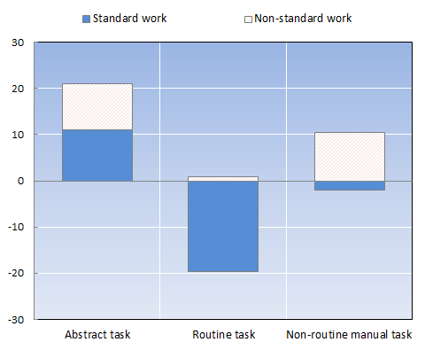
Non-standard work contributed to job polarisation into high- and low-skill jobs, away from routine jobs 非标准的工作导致就业分化为高技能型和低技能型工作，常规性工作逐渐减少
Percentage change in employment shares by task category, 1995/98-latest available year
不同工作类别就业比例的变化， 1995、1998年为最近有数据可查的年份
标准工作
非标准工作
Source: OECD (2015), “In It Together”, http://www.oecd.org/social/in-it-together-why-less-inequality-benefits-all-9789264235120-en.htm
Note: Abstract occupations (ISCO88: 12-34); Routine (ISCO88: 41-42, 52, 71-74, 81-82 and 93); Non-routine manual (ISCO88: 51 83 and 91). The overall sample restricted to workers aged 15-64, excluding employers as well as students working part-time.
数据来源（2015），“In It Together”, http://www.oecd.org/social/in-it-together-why-less-inequality-benefits-all-9789264235120-en.htm
备注：抽象职业 (ISCO88: 12-34)；常规职业 (ISCO88: 41-42、52、71-74、81-82 和 93)；非常规职业 (ISCO88:51 83 和 91)。整个样本仅限于15-64 岁的劳动者, 不包括雇主和兼职的学生。

Slide 13
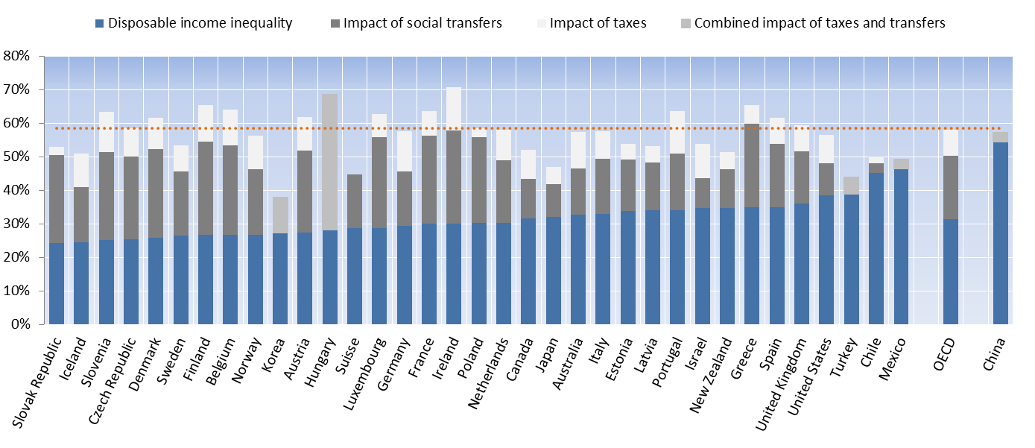
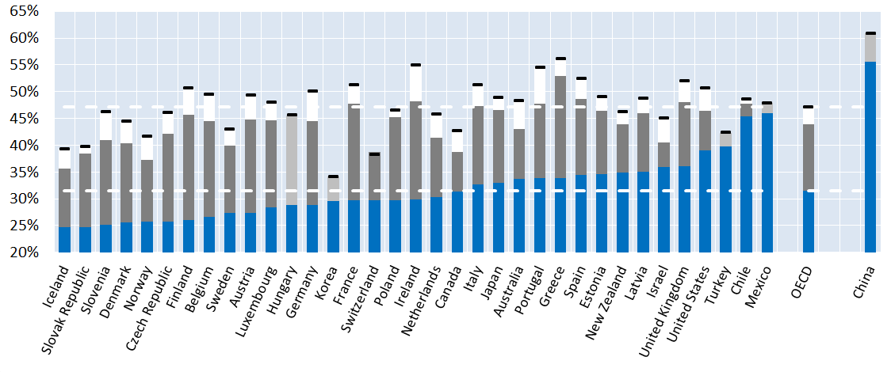
Redistribution via taxes and benefits plays an important role in (almost) all OECD countries
通过税收和福利再分配在（几乎）所有经合组织国家中起到重要作用
Inequality of market and disposable income,
working-age population, 2015 or latest
市场及可支配收入的不平等
劳动适龄人口，2015年至最新
可支配收入的不平等 社会转移的影响 税收的影响 税收及转移综合影响

Slide 14
Designing policy packages to tackle high inequality and promote social cohesion 设计组合政策，解决高度不平等，加强社会凝聚力。
Promote employment and good-quality jobs
促进就业及高质量工作岗位
1
Foster women’s participation in economic life
促使女性参与经济生产、生活中
2
3
Strengthen quality education and skills development
强化高质量的教育及技能发展
4
Improve the design of tax and benefit systems for a more efficient redistribution
改善税收及福利体系设计，实现更高效的收入再分配

Slide 15

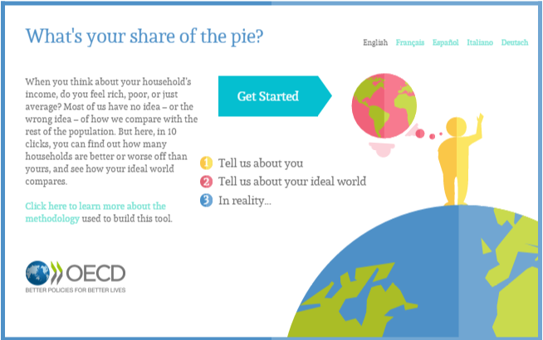

Thank you for your attention!
感谢！
celine.thevenot@oecd.org
www.oecd.org/social/inequality-and-poverty.htm
Includes: "COMPARE YOUR INCOME" WEB TOOL →
包括：“比较您的收入”网络工具→
@OECD_Social

