Slide 1

统筹推进养老保险改革
实现制度更加公平更可持续
中国国家发展改革委
就业和收入分配司
李亢
法国巴黎，2017.9.14

Slide 2
Promoting Comprehensive Reform
for A Pension System More Fair and Sustainable
Department of Employment and Income Distribution, NDRC, China
Li Kang
Paris，France, 2017.9.14

Slide 3
目 录
一、国家发展改革委及其就业和收入分配司职能
二、中国养老金体系现状
三、中国养老金制度面临的困难挑战
四、改革中国养老金体系的基本思路

Slide 4
Contents
Function of NDRC, China, and its Department of Employment and Income Distribution
Pension System in China Today
Challenges to China’s Pension System
Basic Ideas for China’s Pension Reform

Slide 5
一、国家发展改革委及其就业和收入分配司职能
二、中国养老金体系现状
三、中国养老金制度面临的困难挑战
四、改革中国养老金体系的基本思路

Slide 6
Function of NDRC, China, and Its Department of Employment and Income Distribution
Pension System in China Today
Challenges to China’s Pension System
Basic Ideas for China’s Pension Reform

Slide 7
国家发展改革委职能
拟订并组织实施国民经济和社会发展战略、中长期规划和年度计划
统筹协调经济社会发展，研究分析国内外经济形势
提出国民经济发展、价格总水平调控和优化重大经济结构的目标、政策
监测宏观经济和社会发展态势
提出综合运用各种经济手段和政策的建议
协调解决经济运行中的重大问题

Slide 8
Function of NDRC, China
making strategic plan, mid and long term plan, and annual plan on national economic and social development, and organizing the implementation
Coordinating socio-economic development and analyzing domestic and international economic situation
Proposing objective and policy for national economic development, overall control of price and optimization of strategic economic structure
Monitoring macro economy and trends of social development
Making proposal on comprehensive economic approaches and policies
Coordinating the solution of important problems in the economic development

Slide 9
就业和收入分配司职能
提出就业促进及职业、技能培训等政策，指导和推进就业服务体系及人力资源市场建设
统筹开展收入分配制度改革，组织收入分配体制改革
推进完善社会保障制度，组织和参与社会保障体制改革

Slide 10
Function of Department of Employment and Income Distribution
proposing policies on employment promotion, professional & skill training; guiding and promoting the development of employment service system and HR market
Coordinating and organizing the reform on income distribution system
promoting the perfection of social security system; organizing and participating in social security reform

Slide 11
就业司近年来主要工作
劳动者能力建设：建设了近百个公共实训基地。
就业创业：编制并推动落实《“十三五”促进就业规划；开展农民工返乡创业试点。
收入分配：牵头制定深化收入分配制度改革和促进城乡居民增收文件。
社会保障：推进养老保险制度改革顶层设计和医疗保险人口全覆盖。

Slide 12
Work of The DEID in Recent Years
Capacity Building of Labour Force：setting up about 100 public training base。
Employment & Start-up: producing and promoting the implementation of the Employment Promotion Plan of the 13th Five-Year Plan, and conducting pilot on Migrant Worker Start-up in Original City
Income Distribution：issuing policy documents for deepening the reform on income distribution system and stimulating the increase of income of urban and rural residents
Social Protection：promoting the top-level political design of pension reform and promoting the coverage of medical insurance on the whole Chinese population.

Slide 13
一、国家发展改革委及其就业和收入分配司职能
二、中国养老金体系现状
三、中国养老金制度面临的困难挑战
四、改革中国养老金体系的基本思路

Slide 14
Function of NDRC, China, and Its Department of Employment and Income Distribution
Pension System in China Today
Challenges to China’s Pension System
Basic Ideas for China’s Pension Reform

Slide 15
政策体系框架
第一层次：基本养老金
社会统筹 + 个人账户
  国家强制实施
  空账
国家强制实施
地区统筹
第二层次： 职业养老金
（企业年金、职业年金）
企业年金已经实施，由企业自愿建立，政府税收优惠（企业职工）
职业年金即将开始实施，准强制建立（机关事业单位）
第三层次：
个人税延养老保险
  支持政策即将出台

Slide 16
Framework of
Policy System
1st Tier：Basic Pension
Social Pooling + Individual Income
compulsory
regional pooling
  compulsory
  not fully funded
2nd Tier： Occupational Pension
（Enterprise Annuity、Occupational Annuity）
Enterprise Annuity system is started, with voluntary establishment by enterprises and tax incentive from government (for enterprise employees)
Occupational Annuity is to be started, as quasi-mandatory system (for public organ and institutions)
3rd Tier： Tax-deferred Individual Old-Age Insurance
  Supporting policy is going to be issued

Slide 17
养老金制度覆盖人数
单位：万人

Slide 18
Covered Population of Pension
Unit：10,000
employees
residents
total

Slide 19
养老金待遇
单位：元/人.月

Slide 20
Pension Benefit
Unit：RMB/Person/Month

Slide 21
一、国家发展改革委及其就业和收入分配司职能
二、中国养老金体系现状
三、中国养老金制度面临的困难挑战
四、改革中国养老金体系的基本思路

Slide 22
Function of NDRC, China, and Its Department of Employment and Income Distribution
Pension System in China Today
Challenges to China’s Pension System
Basic Ideas for China’s Pension Reform

Slide 23
经济增速趋缓
新常态下，中国经济增速由高速转为中高速。一方面影响了企业和个人的缴费能力；另一方面影响财政对养老金制度的补贴能力

Slide 24
Economic Growth Slows Down
In the New Normal, China’s economic growth turns from high speed to mid-high speed, impacting on the contributory capacity of enterprise and employees, and the subsidiary of public finance to the pension system.

Slide 25
人口老龄化加剧

Slide 26
Ageing Speeds Up

Slide 27
人口老龄化加剧
65岁及以上人口占总人口比例

Slide 28
Ageing Speeds Up
65+ People in the Whole Population
World
Developed Countries
Developing Countries
China

Slide 29
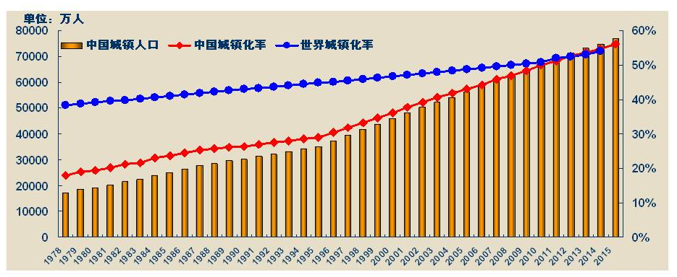
城镇化进程加快

Slide 30
Urbanization Accelerates
Unit: 10000 p
CN Urban Population
Urbanization Rate, CN
Urbanization Rate, World

Slide 31
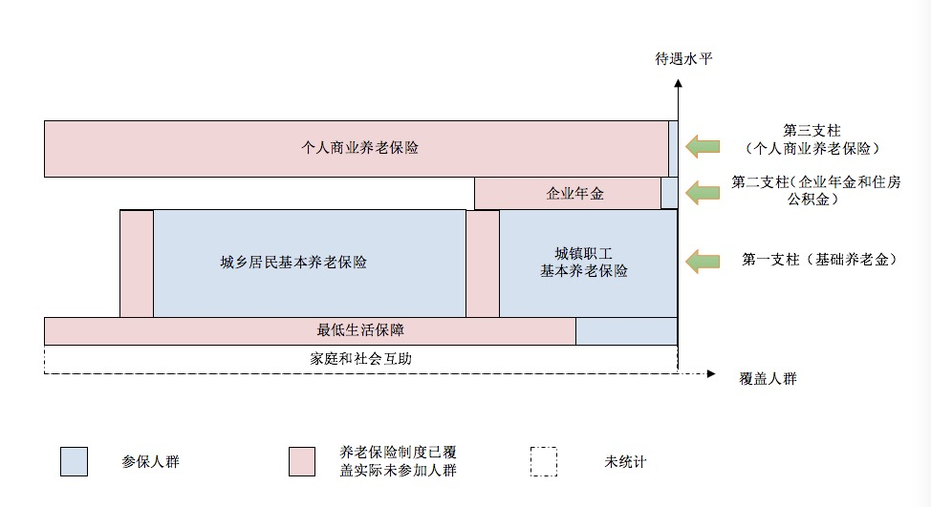
多层次养老体系不健全
基本养老保险承担了绝大多数保障职能

Slide 32
imperfect multi-tier pension system
The Basic Pension bares most social protection functions
benefit
3rd Pillar
(Individual Commercial Old-Age insurance)
individual commercial old-age insurance
2nd Pillar
(Enterprise Annuity & Housing Credit)
enterprise annuity
old-age insurance for urban and rural residents
old-age insurance for urban employees
1st Pillar
(Basic Pension)
minimum livelihood guarantee
Coverage
Covered but not Real Participants
Participants
Outside
Statistics

Slide 33
多层次社保体系不健全
部分国家养老保障第二、三支柱占GDP比重

Slide 34
imperfect multi-tier pension system
GDP shares of 2nd & 3rd pillars in some countries
Greek
Luxembourg
Hungary
Slovenia
Turkey
Belgium
China
Korean
Italy
Germany
Czech Rep.
Norway
Spain
Estonia
Portugal
Sweden
Slovakia
Mexico
New Zealand
Poland
Japan
Denmark
Israel
Chili
Canada
US
Weighted Ave.
France
Australia
UK
Switzerland
Iceland
Netherland

Slide 35
部分重要参数不合理
退休年龄偏低
实际退休年龄不足55岁

Slide 36
Some Important Parameters are not reasonable
Legal Retirement Age are relative low, and the real retirement age is less than 55
Female
UK
Ireland
Czech Rep.
US
Slovakia
Poland
Norway
Netherland
Italy
Israel
Iceland
Denmark
Canada
Australia
Portugal
OECD
Argentine
Turkey
Switzerland
Sweden
Spain
New Zealand
Mexico
Korea
Japan
Hungary
Germany
Finland
Estonia
Chili
Belgium
Austria
France
Greece
S. Africa
Russia
China
Slovenia
Luxembourg
India
Indonesia
Brazil

Slide 37
统筹层次和人群覆盖
制度在省级以下统筹。不同省份基金不能互济，地区之间收支状况差异大
人群全覆盖要进一步推进。约1亿人需要通过制度完善纳入覆盖范围

Slide 38
Pooling Level &
Covered Population
Pooling is under the provincial level. Funds of different provinces cannot be used for mutual help, and the balances are of large difference among regions.
It is necessary to promote full coverage over the whole population. About 100 million people are to be covered under an improved pension system.

Slide 39
一、国家发展改革委及其就业和收入分配司职能
二、中国养老金体系现状
三、中国养老金制度面临的困难挑战
四、改革中国养老金体系的基本思路

Slide 40
Function of NDRC, China, and Its Department of Employment and Income Distribution
Pension System in China Today
Challenges to China’s Pension System
Basic Ideas for China’s Pension Reform

Slide 41
养老金制度全民覆盖
实施全民参保计划
将农民工和灵活就业人员更多纳入职工养老制度
加快落实机关事业单位养老保险制度改革

Slide 42
Covering the whole population
universal participation plan
covering more migrant and flexible workers into the pension system for employees
accelerating the pension reform for public organs and institutions

Slide 43
降成本和保发放政策平衡
适当降低养老金费率
多渠道筹集养老基金
建立基本养老保险中央调剂金

Slide 44
balancing costs reduction and benefit guarantee
Appropriately reducing contribution rate
pooling pension funds through multiple channels
Establish funds at the central level for adjusting the balance of the basic pension system

Slide 45
适应新就业形态发展
放宽参保资格（取消户籍限制）
对部分人员实施社保费减免
提高参保缴费便利性

Slide 46
Adapting to new employment forms
reducing restriction on pension participation (deleting the restriction related to residency, Hukou)
reducing contribution for certain groups
increasing conveniences for contribution payment

Slide 47
完善多层次养老金体系
合理确定基本养老保险政府、企业和个人责任
进一步完善落实企业年金税收优惠政策
尽快制定出台税收递延型养老保险政策

Slide 48
Perfecting the multi-tier pension system
reasonable distribution of responsibilities among government, enterprises and individuals
improving tax incentive policy for enterprise annuity
issuing policy for tax-deferred old-age insurance as soon as possible

Slide 49
谢谢大家！
Thank You!

