Slide 1



National pension schemes reforms in Poland between 2007 and 2016
2007-2016年波兰国家养老金制度改革
Dr. Andrzej Szybkie
Andrzej Szybkie博士
ZUS Poland, Social Insurance Institution
波兰社会保险服务局
Paris, September 2017
2017年9月，巴黎

Slide 2
Poland 波兰概览
Area of Republic of Poland – 312 679 km²
^{波兰国土面积—— 312 679 km2}
Population in 2017 – 38 634 007
^{2017年人口——38 634 007}
GDP (PPP) | 2017 estimate
• Total | $1.114 trillion^{[4]} (21st)
• Per capita | $29,349
GDP (购买力平价) | 2017年预计
总计 | 1.114万亿美金 (第21)
人均 | 2.9349万美金
GDP (nominal) | 2017 estimate
• Total | $482.920 billion^{[4]} (23rd)
• Per capita | $12,722
GDP (名义) | 2017年预计
总计 | 4829.2亿美金 (第23)
人均 | 1.2722万美金

Slide 3
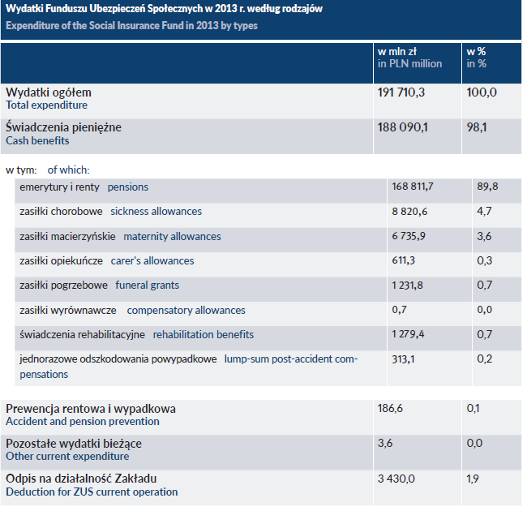

Slide 4
ZUS (Zaklad Ubezpieczen Spolecznych) is responsible for administration of pension system in Poland
波兰社会保险服务局负责管理波兰养老金制度。
ZUS is a public institution performing public tasks in social insurance area
在社会保险领域，波兰社会保险服务局是履行公共职能的公共机构。
ZUS has headquarter and 43 territorial branches in Poland
波兰社会保险服务局的总部位于波兰，境内有43个分支机构。

Slide 5
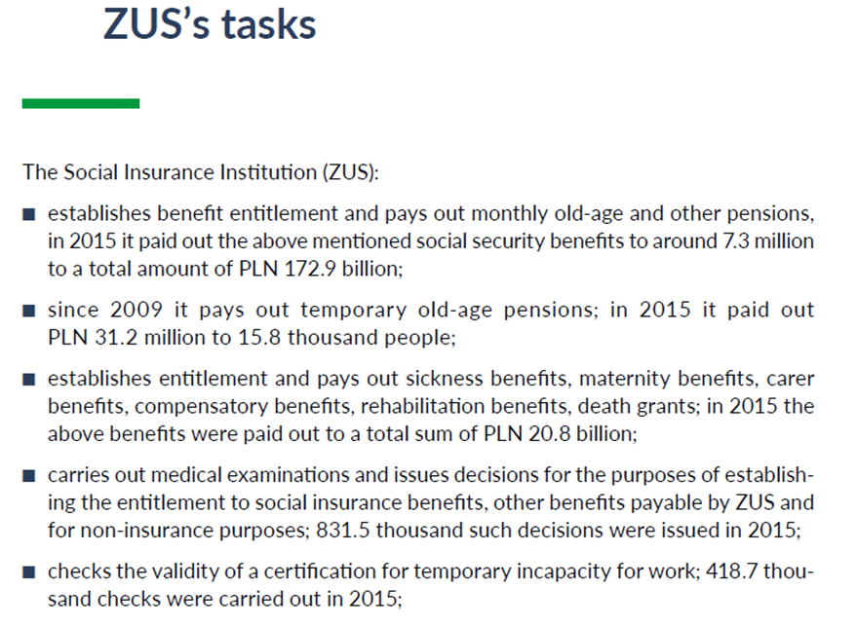

Slide 6
社会保险服务局的职责
社会保险服务局：
建立相关福利待遇，并每月支付养老金和其他抚恤金。2015年，社会保险服务局向730万人支付了共计1729亿兹罗提的上述社会保障福利；
自2009年起，社会保险服务局开始支付临时养老金。2015年向1.58万人支付了3120万兹罗提；
建立相关权利，并支付疾病津贴、生育津贴、照料者津贴、补偿性福利、康复津贴、死亡补助金。 2015年共支付上述津贴208亿兹罗提；
开展医疗检查，并对建立社会保险福利权利、获得其他通过社会保险服务局支付的福利的权利以及非保险福利权利等进行决策。2015年共发布83.15万项相关决策。
审核临时丧失工作能力证明的有效性，2015年开展了41.87万次审核。

Slide 7
Agenda of presentation
主要内容
  BACKGROUNDS AND REFORMS背景和改革
  BENEFIT FORMULA福利计算公式
  CREDIT PERIODS记分期
  BASIS FOR CONTRIBUTIONS缴费基数
  MINIMUM PENSIONS最低养老金
  RETIREMENT AGE退休年龄
  CONDITIONS FOR EARLY RETIREMENT提前退休的条件
  BONUSES FOR DEFERRED RETIREMENT对延期退休的奖励
  FRINGE BENEFITS附加福利
  EXPERIMENT WITH CAPITAL PENSIONS资本化养老金试行情况
  INDEXATION OF PENSION养老金指数化
  CONTRIBUTIONS FOR SOCIAL INSURANCE RISKS/BENEFITS社会保险缴费风险/收益
  FINAL CONCLUSIONS结语

Slide 8
BACKGROUNDS AND REFORMS
背景和改革
Pension system before 1999
1999年前的养老金制度
Reform from 1999
从1999年开始的改革
Further changes in years 2007 – 2016
2007–2016年期间的进一步变革
Legal changes from October 2017
从2017年10月开始的法律变化

Slide 9
  BENEFIT FORMULA
  待遇计算公式
Current pension system (new pension system) is NDC system. Right to pension does not depend on length of insurance periods.
现行的养老金制度（新的养老金制度）是NDC制度。领取养老金的权利不取决于参保期限长短。
Amount of pension results from dividing of registered amount of contributions (indexed) by average life expectancy.
养老金的数额等于记录的缴款额（指数化后的）除以平均预期寿命。
First old-age pensions from new pension system were awarded in 2009.
新养老金制度的第一份养老金是在2009年给付的。
In December 2016 there were 1 654 500 benefits being paid out monthly from new pension system by the Polish Social Insurance Institution ZUS.
2016年12月，波兰社会保险局按照新养老金制度支付了1654500份养老金。

Slide 10
CREDIT PERIODS
记分期
Pension rights are based on insurance periods. In a new pension system only contribution has influence on the future pension rights and the amount of pension.
养老金权利是以参保期限为基础的。在新养老金制度中，只有缴款对未来的养老金权利和养老金总额有影响。
Non-contributory periods are taken into account only for meeting the condition of sufficient periods qualifying for minimum guarantee pension amount.
为满足最低养老金保障，满足充分期限的条件，非缴款期可纳入考虑。
A pension contribution of 19.52% is paid for pension insurance. Contributory basis is the taxable income, like gross salaries.
19.52% 的养老金缴款是为养老保险支付的。缴款基数是应纳税收入，如工资总额。

Slide 11
BASIS FOR CONTRIBUTIONS
缴费基数
gross salary,
工资总额，
taxable income from employment, self-employment (fixed amount),
就业、自营职业 （固定数额）群体的应纳税收入，
other legal titles like child-raising, some of the civil contracts, maternity allowances
其他法定名目，如养育子女、部分民事合同、生育津贴。

Slide 12
MINIMUM PENSIONS
最低养老金
In a new pension system there is provided a minimum old-age pension amount, if amount of pension from 1st and 2nd pillar does not exceed legal pension minimum amount stipulated by Pension Act (and adjusted each year since March).
新养老金制度规定了养老金最低限额，前提是第一和第二支柱的养老金总额不超过养老金法案规定的法定养老金最低额（每年三月起开始调整）。
Supplement to minimum is awarded to pensioners who meet condition of 20 years of insurance periods (contributory and non-contributory) for women and 25 for men and reach pensionable age.
最低养老金还将补充养老金提供给养老金领取者。领取者需满足以下条件：达到可领取养老金的年龄，女性参保期为20年（缴费及非缴费），男性参保期为25年。
Current amount of guaranteed minimum pension from March 2017 is monthly 1000 PLN, (equals about 233 EUR per month).
从2017年3月起，最低养老金保障为每月1000兹罗提（约合每月233欧元）。

Slide 13
So called “penny pensions”
“微水平养老金”
Recently there have been a big increase of number of pensioners who do not meet these conditions and receive pension amounts lower than guaranteed minimum pension.
In December 2016 there were 95 400 of pensioners with pension amount below guaranteed minimum pension, which was 5,7% of pensioners of new pension system. The lowest pension amount in December 2016 was 0,04 PLN.
The total amount of pensions paid in December 2016 lower than guaranteed minimum pension to PLN 65.5 million (approximately EUR 15.2 million).
最近，不满足这些条件且领取的养老金低于最低保障金的退休人数大幅增加。
2016年12月，95400名退休人员领取的养老金数额低于最低保障金，占新养老金制度总人数的5.7%。2016年12月，最低的养老金数量仅为 0.04兹罗提。
2016年12月支付的养老金总额与最低保障养老金的差距是6550万兹罗提（约合1520万欧元）。

Slide 14
RETIREMENT AGE
Date | Regular pensionable age | Retirement before regular age | Other systems
Before 1999 | 60y women 65y men | For many different groups, like miners, teachers, railwaymen, public service workers, special systems. | Different systems for different groups of workers, self-employed, working on civil contracts, self-employed farmers, military services, prosecutors and judges
Since 01.1999 | 60y women 65y men | Restricted to those who meet conditions for early retirement before 2009 or certain groups who meet conditions concerning periods on 01.01.1999. Still early retirement for miners. Still in special systems for military services. | Universal system for all the workers and self-employed except self-employed farmers. Different systems for self-employed farmers, military services, prosecutors and judges.
Since 01.2009 | 60y women 65y men | Restricted to those who meet conditions for early retirement before 2009 or certain groups who meet conditions concerning periods on 01.01.1999. Still early retirement for miners. Still in special systems for military services. Since 01.2009 special provisions on so called “bridge pensions” for certain workers working in harmful conditions. | Universal system for all the workers and self-employed except self-employed farmers. Different systems for self-employed farmers, military services, prosecutors and judges.
Since 01.2013 | 60y women increasing up to 67 – for months after each quarter, so 67y in 2040 65y men increasing up to 67 – for months after each quarter, so 67y in 2020 | Restricted to certain groups who meet conditions concerning periods on 01.01.1999. Still early retirement for miners. Still in special systems for military services. Special provisions on so called “bridge pensions” for certain workers working in harmful conditions. | Universal system for all workers and self-employed except self-employed farmers. Different systems for self-employed farmers, military services, prosecutors and judges
Since 10.2017 | 60y women 65y men | Restricted to certain groups who meet conditions concerning periods on 01.01.1999. Still early retirement for miners. Still in special systems for military services. Special provisions on so called “bridge pensions” for certain workers working in harmful conditions. | Universal system for all the workers and self-employed except self-employed farmers. Different systems for self-employed farmers, military services, prosecutors and judges

Slide 15
退休年龄
时间 | 常规领取养老金年龄 | 常规年龄前退休 | 其他制度
1999年以前 | 女性：60岁 男性：65岁 | 对于不同的群体，如矿工、教师、铁路工人、公共服务人员有专门的制度 | 不同的劳动者群体、签订民事合同的自营职业者、自营农业劳动者、军队服役人员、检察官和法官采用不同的制度。
1999年1月之后 | 女性：60岁 男性：65岁 | 仅限于2009年之前提前退休满足条件的群体，或者1999年1月1日期间满足条件的特定群体。对矿工而言仍然有效。军队服役人员仍享受特殊制度。 | 所有劳动者和自营职业者都采用统一制度，除了自营农业劳动者。自营农业劳动者、军队服役人员、检察官和法官采用不同的制度。
2009年1月之后 | 女性：60岁 男性：65岁 | 仅限于2009年之前提前退休满足条件的群体，或者1999年1月1日期间满足条件的特定群体。对矿工而言仍然有效。军队服役人员仍享受特殊制度。从2009年1月开始，针对特定在艰苦工作条件下工作的劳动者推出了特殊规定，“过渡养老金”。 | 所有劳动者和自营职业者都采用统一制度，除了自营农业劳动者。自营农业劳动者、军队服役人员、检察官和法官采用不同的制度。
2013年1月之后 | 女性：60岁延长到67岁，每个季度增加，2040年达到67岁 男性：65岁延长到67岁，每个季度增加，2020年达到67岁 | 仅限于2009年之前提前退休满足条件的群体，或者1999年1月1日期间满足条件的特定群体。对矿工而言仍然有效。军队服役人员仍享受特殊制度。从2009年1月开始，针对特定在艰苦工作条件下工作的劳动者推出了特殊规定，“过渡养老金”。 | 所有劳动者和自营职业者都采用统一制度，除了自营农业劳动者。自营农业劳动者、军队服役人员、检察官和法官采用不同的制度。
2017年10月之后 | 女性：60岁 男性：65岁 | 仅限于2009年之前提前退休满足条件的群体，或者1999年1月1日期间满足条件的特定群体。对矿工而言仍然有效。军队服役人员仍享受特殊制度。从2009年1月开始，针对特定在艰苦工作条件下工作的劳动者推出了特殊规定，“过渡养老金”。 | 所有劳动者和自营职业者都采用统一制度，除了自营农业劳动者。自营农业劳动者、军队服役人员、检察官和法官采用不同的制度。

Slide 16
CONDITIONS FOR EARLY RETIREMENT
提前退休的条件
  Pensions for miners (special provisions, stipulating on special pensions)
  矿工养老保险制度（特别条款，明确对养特殊老金进行规定）
  So called “bridge pensions” (for several categories of workers working in conditions harmful for health).
  所谓的“过渡养老金”（用于在有害健康的条件下工作的几类劳动者）
  Expiring early retirement for some categories of employees born before 1969, like teachers, railways workers, others.
  在1969年之前出生的特定类型的劳动者可以提前退休，如教师、铁路职员等。

Slide 17
BONUSES FOR DEFERRED RETIREMENT
对延期退休的奖励
In the Polish pension system there is no special bonus for deferred retirement, but the method of calculation of old-age pension encourages a longer stay in the labor market and contributing to the system, since the postponement of the retirement decision allows for an increase in benefits.
在波兰养老金制度中，延期退休没有特别奖励。但是，延期退休的待遇水平更高，实际上这种计算方法就是在鼓励劳动者在劳动力市场待更长的时间，并向养老金体系缴费。
The pension system is calculated on the basis of the quotient of the amount of eligible contributions (and for those who started work before 1999 – so called “initial capital”) and the average life expectancy at retirement years, common for men and women.
养老金制度是根据合格缴款额（对于1999年以前开始工作的人，这是所谓的“初始资本”）除以退休年份的平均预期寿命计算而来的，这对男性和女性都是通用的。
The life expectancy is shorter if you are elder, and at the same time contributions paid to the system after reaching pensionable age increase basis of calculation of pension amount.
如果年龄较大，预期寿命较短，同时，达到应计养老金年龄后仍向系统缴款，养老金数量计算的基数也相应加大。

Slide 18
FRINGE BENEFITS
附加待遇
Health care for pensioners is provided basis on health contribution deducted from pension amount, each month, and transferred to Health Insurance Fund (9% of income).
为养老金领取者提供的医疗保健每月从养老金总额中扣除，并转入健康保险基金（收入的 9%）。
Pension is subject to personal income tax.
养老金须缴纳个人所得税。
A pensioner who has reached the age of 75 or is unable to live independently gets a care supplement to pension (this is not treated as Long Term Care under EU Regulation 883/2004).
年龄达到75岁或无法独立生活领取养老金的人, 在养老金之外可获得护理补贴（这一项不应计入欧盟条例 883/2004规定的长期护理）
Pension is paid each month, on bank account of beneficiary or by post.
养老金按月支付到受益人的银行帐户或通过电邮支付。

Slide 19
EXPERIMENT WITH CAPITAL PENSIONS
资本化养老金试行情况
The Act of 2008 stipulated that a capital pension is awarded as two types:
  a periodic pension, which can be charged from the 60th year of retirement age (transitional status) – so called EOK benefit, and
  a life-long retirement pension paid at the age of retirement.
2008年的法令规定, 资本化养老金的给付有两种情况：
  定期养老金，可从第六十年即退休年龄（过渡性）开始给付，即所谓的 EOK 待遇；
  退休时支付的终生年金。
Due to the above mentioned periodical capital pension (EOK) is a benefit addressed exclusively to insured / members of OFE-women.
上述定期资本化养老金 (EOK) 是专门针对被保险人/开放式养老基金成员-女性。

Slide 20
According to amending Act of December 2013 big changes in the 2nd pillar pension system were introduced:
  changing the rules for setting a periodic capital retirement pension (EOK)
  The law and the amount of the periodic retirement pension are determined by ZUS on the basis of the funds deposited on the sub-account (Article 14 (4) of the Pensions Act amended by the amending act).
  liquidation of lifetime capital pension from OFE
    The law eliminates life-long retirement pensions at the regular retirement age for men. Therefore, the law determines the use of these funds. These funds will be used to determine the EOK or be taken into account when determining the retirement pension under art. 24 of Pension Act in pensionable age from the 1st pillar. The principle of determining the basis of the pension measure from the Social Insurance Fund is changing accordingly.
根据2013年12月的修订法案，第二支柱系统发生了巨大变化：
- 改变设定定期资本化退休金（EOK）的规则；
- 定期资本退休金的法律和数量是由社会保险局基于储存在子账户上的资金为基数的（《养老金法案》修正案第 14 (4) 条）；
- 开放养老基金中的终生资本养老金的清算。
该法律取消了正常年龄退休的男性的终生退休养老金。因此，法律确定了这些资金的使用方式。这些资金将用于确定定期资本退休金，或在确定第一支柱中养老金法案第24条规定的不可领取退休金的年龄时作为参考。确定来自社会保险局的养老金措施的基础的原则也相应改变。

Slide 21
The pension from the 1st pillar will consist of 3 parts:
− the amount of premiums credited to the insured's account,
− the amount of initialed capital,
− amount of funds deposited on the sub-account.
第一支柱的退休金由三部分组成：
−被保险人账户的保险费金额；
−首批资金的数量；
−储存在子账户上的资金额。

Slide 22
INDEXATION OF PENSION
养老金指数化
Indexation in 2006 and in 2007
2006年和2007年的指数化情况
Basis on legal changes in Pension Act price-salary indexation was run. According to Pension Act in 2007 no indexation was made.
价格工资指数根据养老金法案的变化而运行。根据2007年的《养老金法》, 没有进行指数化。

Slide 23
Indexation in years 2008 – 2011, 2013-2014 and 2016
2008-2011年、2013-2014年以及2016年的指数化情况
As a consequence of the next change in the pension law, the annual pension indexation has been introduced back to 1 March.
由于养老金法的下一项变动, 年度养老金指数化可追溯到3月1日。
This was connected with special separate regulations for the indexation of benefits in March 2008.
这与2008年3月的收益指数化的特别单独规定有关。
Indexation rate is the average annual price index of consumer goods and services in the previous calendar year increased by at least 20% of the real increase of the average remuneration in the previous calendar year.
指数化率是上一日历年消费品和服务的平均年价格指数, 在上一个历年的平均薪酬实际增长中至少增加了20%。

Slide 24
Indexation in 2012
2012年的指数化情况
In 2012, the legislator implemented a quota indexation mechanism.
Indexation in 2012 was made by adding to the benefits of amount PLN 71 equal to everybody.
The above regulation was subject to evaluation by the Constitutional Court, which did not declared inconsistency with the Constitution
2012年，立法机构实行了配额指数化机制。
2012年实行指数化措施是，每人的收益增加71兹罗提。
上述条例获得宪法法院的审阅，宪法法院未宣布该措施与《宪法》存在不一致。

Slide 25
Indexation in 2015
2015年的指数化情况
In 2015 r. it was again introduced separate mechanism of indexation of benefits so called mixed, quote/amount-percentage.
As a result of the indexation, the amount of the benefit was increased as at 28.02.2015 with the indexation rate of 100.68%, the amount of the increase could not be lower than:
  36 PLN – as for old-age pensions, total disability pensions and survivors pensions,
  27 PLN – as for partial disability pensions. ustawa z dnia 23.10.2014 r. o zmianie ustawy o emeryturach i rentach z FUS oraz niektórych innych ustaw
2015年，再次采用了区别性的待遇指数化机制，所谓的混合型，配额/金额-比例。
指数化之后，待遇水平有所增加，是2015年2月28日水平的100.68%，增加的金额不能低于：
  针对养老金、完全残疾群体的养老金及抚恤金—36兹罗提;
  针对部分残疾群体的养老金—27兹罗提.

Slide 26
Indexation in 2017
2017年的指数化情况
In 2017 a special indexation mechanism was introduced.
As a result of the indexation, the value of the benefit was increased as at 28 February 2017 with a rate index of 100.44%, with an increase not lower than:
  10 PLN - as for old-age pensions, total disability pensions and survivors pensions,
  7,50 zł – as for partial disability pensions.
An increase of PLN 10 or more was not covered by pensions which, on February 28, 2017, amounted to PLN 882.56, to which the increase guarantee was not applied for the lowest benefit.
2017年采用了特别指数化机制。
指数化之后，待遇水平有所增加，是2017年2月28日水平的100.44%，增加的金额不能低于：
  针对养老金、完全残疾群体的养老金及抚恤金—10兹罗提;
  针对部分残疾群体的养老金—7.5兹罗提.
增加10兹罗提或更多，不包括在养老金中，2017年2月28日总额为882.56兹罗提，保障的增加不适用于最低待遇。

Slide 27
CONTRIBUTIONS FOR SOCIAL INSURANCE RISKS/BENEFITS
Contributions for social insurance risks/benefits (percentage of basis o assessment) |  | 1999 | 2017
For retirement pension: |  | 19,52% | 19,52%
 | from above: to chosen open pension fund (OFE) | 7,3% (mandatory) | 2.92% (voluntary)
 | from above: on pension account in ZUS | 12,22% | 12,22%
 | from above: on pension sub-account in ZUS | ---------- | 4,38% if a person has chosen to pay on open pension fund (OFE) 7,3% if person has chosen only pay to ZUS
For invalidity/survivors pensions |  | 13 % | 8,00%
For sickness/maternity/paternity allowances |  | 2,45% | 2,45%
For accidents at work and occupational diseases benefits |  | 1,62 % | 0,40% - 3,60%

Slide 28
社会保险缴费风险/收益
社会保险缴费风险/收益 （基数比例评估） |  | 1999 | 2017
退休养老金 |  | 19.52% | 19.52%
 | （1）以上：转移到开放式养老基金 | 7.3%（强制性） | 2.92%（强制性）
 | （2）以上：登记在社会保险局养老金账户 | 12.22% | 12.22%
 | （3）以上：登记在社会保险局子账户 | ---------- | 4.38%，如果选择向开放式养老基金缴费。 7.3%，如果选择向社会保险局缴费。
残疾/遗属抚恤金 |  | 13 % | 8.00%
病假/产假/生育津贴 |  | 2.45% | 2.45%
工伤事故和职业病津贴 |  | 1.62 % | 0.40% - 3.60%

Slide 29
FINAL CONCLUSIONS
结语
The Polish pension system reformed in 1999 is still under changes the recent changes include:
  Implementation and liquidation of capital pensions
  Changes in 2nd pillar, in percentage of contribution and implementation of voluntary participation in 2nd pillar.
  Increase and decrease of pensionable age
  Changes in indexation formula.
1999年改革的波兰养老金制度仍在变化之中, 最近的变化包括:
  资本化养老金的执行和清算；
  第二支柱中，缴费比例及自愿参与的推行方面的变化；
  提高及减少养老金年龄；
  指数化公式的变化。

Slide 30
Thank you
谢谢
contact: andrzej.szybkie@zus.pl
联系方式：andrzej.szybkie@zus.pl
ZUS Poland
波兰社会保险服务局

