Slide 1
The Swedish Pension Reform – Karl Birkholz
瑞典养老金改革- 博克豪兹·卡尔
Paris 14 September 2017
2017年9月14日 巴黎

Slide 2
Contents 目录
The Old System
Reasons for the Reform
Process of the Reform
Principles of the Reform
The New System
Earnings Related Old Age Pension
Guaranteed pension
Summary
Current Issues
原有制度
改革缘起
改革进程
改革原则
新制度
与收入相关的养老金
保证养老金
概述
当前的问题

Slide 3
The Old System 原有制度
Universal Minimum Pension (Folkpension)
通用最低养老金（国民养老金）
Earnings related supplementary pension (ATP) –
Defined benefit (DB)
与收入相关的补充养老金(ATP)-固定受益(DB)
Introduced in 1960
于1960年推出
15/30 year rule
15/30 年规则
Trust fund (substantial assets)
信托基金（实质资产）
Also included early retirement
还包括提前退休

Slide 4
Reasons for the Reform 改革缘起
Financial crisis
财政危机
Financially unstable (especially in long-term)
财政不稳定（特别是就长期而言）
Weak link between contributions and benefits
缴费与收益之间的联系薄弱
Increase in life expectancy
预期寿命增加

Slide 5
Process of the Reform 改革进程
Financial crisis (Ability to make tough decisions)
财政危机（决断力）
Pension group (Fairly few people involved and those were high profile politicians)
养老金组织（仅有少数人或者高调的政客参与其中）
Broad political agreement
广泛的政治协商
Influence from social partners and pensioner interest groups was limited
社会合作方和养老金利益集团的影响有限
Partition of premiums divided between PAYG and fully funded scheme
(Political compromise rather than ”Optimal design”)
现收现付与完全筹资计划的福利受益分配 (属于政治妥协而非“最佳设计”)

Slide 6
Principles of the Reform 改革原则
Long-term financial stability
Mandatory
Largely PAYG scheme
Separation of old age pension and disability pension
Life time earnings
Clear link between contributions and benefits
Adjustment to changes in life expectancy
Redistribution should be explicit
长期财政稳定
强制性
主要现收现付制度
养老金和伤残抚恤金分离
终生收益
缴费与收益之间的明确联系
根据预计寿命的变化做出相应调整
应当明确再分配

Slide 7
The New System 新制度
Autonomous From State Budget
脱离国家预算的自主制度
Inkomstpension
名义账户
Premium pension
额外投保养老金
State Budget国家预算
Guaranteed pension (Universal)
担保养老金（通用）
Housing supplement
(Means tested)
住房补贴（平均值）
Disability insurance
残障保险

Slide 8
Earnings Related Old Age Pension 与收入相关的养老金
Personal account
Universal
Premiums 18.5% of pensionable income
Pension-qualifying amounts (a form of income redistribution)
Contribution ceiling
Inheritance gains
Indexing of (notional and funded） capital
Annuity divisor (Flexible retirement age 61+)
Transition cohorts (1938-1953)
个人账户
通用
保费为应计养恤金收入的18.5％
养老金资格数量 (一种收入再分配形式)
缴费上限
继承收益
（名义和资金）资本指标挂钩
年金除数(灵活退休年龄61岁+)
过渡年龄段（1938-1953）

Slide 9
Earnings Related Old Age Pension 与收入相关的养老金
Inkomstpension (NDC)
名义账户
Premium Pension (FDC)
额外投保养老金
Premiums (86,5 % of total premiums)
保费（占总保费的86.5％）
Notional capital 名义资本
Annuity divisor (Observed)
年金除数（观察）
Income index 收入指标
Buffer fund 缓冲基金
Premiums (13,5 % of total premiums)
保费（占总保费的86.5％）
Fully funded 资金充足
Annuity divisor (Prognostic)
年金除数（预测）
Rate of return on financial market 金融市场回报率
Individual choice (up to 5 funds)
个人选择（最多5个基金）

Slide 10
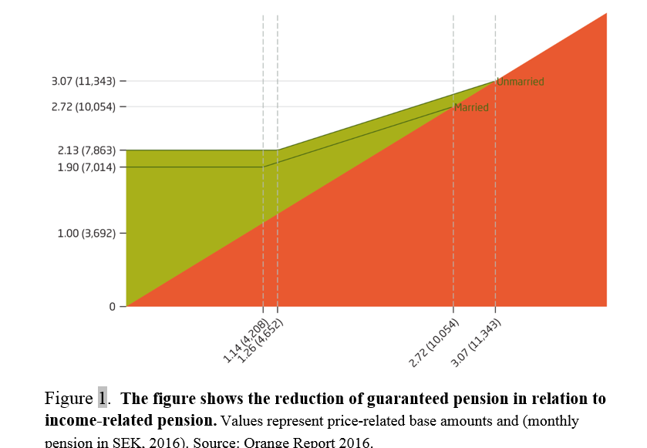
Autonomous System and State Budget 自主机制和国家预算
这一数据显示了保证养老金的减少和与收入相关的养老金之间的关系。

Slide 11
Summary 概述
Earnings related old age pension (Automatic, Fairly straight forward)
与收入挂钩的养老金(自动、相当直接)
With inclusion of guaranteed pension, housing supplement and taxation (Net pension is more complex)
包括担保养老金，住房补贴和税收（净养老金更复杂）

Slide 12
Current Issues 当前的问题
Pension withdrawal age (Adequacy)
养老金支取年龄（充足）
Premium pension (Fraud, Complexity)
额外投保养老金（诈骗、复杂性）
Minimum pension
最低养老金

