Slide 1
The Political Economy of
Pensions and Redistribution Effects in Europe
Pieter Vanhuysse, PhD (LSE)
Professor of Comparative Welfare State Research
Danish Centre for Welfare Studies
University of Southern Denmark
vanhuysse@sam.sdu.dk
www.sdu.dk/staff/vanhuysse
www.sdu.dk/staff/vanhuysse

Slide 2
Outline
Redistributive effects of policy design within/between generations
Political economy effects on redistribution: population aging, pension generosity cutbacks and pro-elderly policy bias
Beyond policy transfers: Shining a wider light on resource (re)allocations between generations in Europe

Slide 3
Redistributive effects of policy design, 1
Pension design (almost) always has powerful redistributive effects within and between generations – whether intended or not
Within: unless there is complete reliance on tax-financed minimum incomes for the elderly, virtually all pension systems have rich-to-poor redistribution as an objective
Between: any system with less than full funding makes choices on this; and so does a move toward funding that increases national saving
Source: Barr & Diamond (2008)

Slide 4
Within generations
General aim is often to raise retirement income of those who enter retirement with low pension rights
Eg. Means-tested minimum income guarantee for all or for those with long enough contributions record (or residence, cf NL)
→ Use of general tax revenues entails redistribution to higher earners in low coverage systems (where tax incidence > benefit coverage)
Source: Barr & Diamond (2008)

Slide 5
Redistributive effects of policy design, 2
Pension design also (almost) always has powerful other redistributive effects. E.g:
Using general tax revenue to finance a system covering a small proportion of workers transfers income from many taxpayers to few covered workers
Many DB plans favor workers whose major pay raises were at end of career compared to earlier
System that provides annuities on uniform terms favors the longer lived over shorter lived – i.e. typically both rich over poor and women over men
Source: Barr & Diamond (2008)

Slide 6
Between generations
Decision to introduce PAYG: transfers from later to early cohorts of pensioners
Decision to introduce full funding: early generations receive very small pensions
Decision to move from PAYG to funding that involves an increase in saving: redistribute from earlier to later generations
Source: Barr & Diamond (2008)

Slide 7
Political economy rules
What design is feasible depends on positive political economy: relative voting power of generations; institutional constraints
What design is optimal depends on normative political economy: relative weighting of objectives (e.g. poverty relief vs consumption smoothing); willingness to trade off distortionary effects
→ Key factor in Europe : population aging
Source: Barr & Diamond (2008)

Slide 8
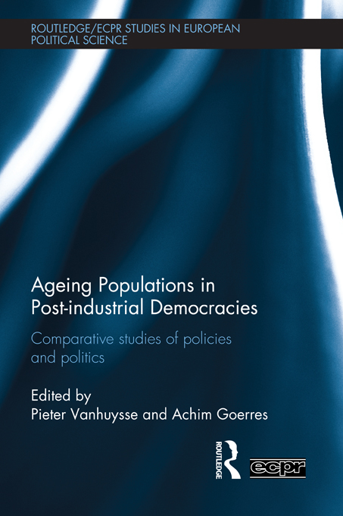
Causal mechanisms, institutional mediators, and empirical variance behind age-group politics and policies
Editorial intro, ‘Mapping the Field’: http://papers.ssrn.com/sol3/papers.cfm?abstract_id=1799348
Oxford blog summary: http://www.openpop.org/?p=403
Tepe, Markus & Vanhuysse, Pieter (2009), 'Are Aging OECD Welfare States on the Path to Gerontocracy? Evidence from 18 Democracies, 1980-2002,' Journal of Public Policy, 29 (1): 1-28. http://papers.ssrn.com/sol3/papers.cfm?abstract_id=1225672
wwwC.sdu.dk/staff/vanhuysse

Slide 9
A growing sense of alarmism about aging ➔gerontocratic democracies
Roman Herzog (2008): ‘we are seeing a foretaste of a pensioner democracy… It could end up in a situation where older generations plunder the younger ones’
Sinn (2005): ‘Europe’s fun society is aging…fast. …. Hordes of pensioners, using the income received from the European PAYG systems, cruise the seven seas on luxury liners and jet off to the remotest beaches of our planet. The PAYG systems have made Europeans world champions in tourism and created a breathtaking infrastructure with seaside resorts and leisure centres from the Canaries to the Maldives and the beautiful Pacific Islands.’
www.sdu.dk/staff/vanhuysse

Slide 10
How has population aging constrained the implementation of pension generosity cutbacks?
Tepe, M. & Vanhuysse, P. (2012), ‘Accelerating Smaller Cutbacks to Delay Larger Ones? The Politics of Timing and Alarm Bells in OECD Pension Generosity Retrenchment ,’ in AGEING POPULATIONS IN POSTINDUSTRIAL DEMOCRACIES, Pieter Vanhuysse, Achim Goerres, eds., Abingdon: Routledge/ECPR European Political Science Series.
https://ssrn.com/abstract=1673366
Tepe & Vanhuysse (2012)

Slide 11
Scruggs and Allan’s (2006) annual pension generosity scores
3 components - average minimum and standard pension replacement rates, number of years needed to qualify for public pensions receipt, take-up rates.
Event history analysis
18 countries, 1981-1999
Tepe & Vanhuysse (2012)

Slide 12
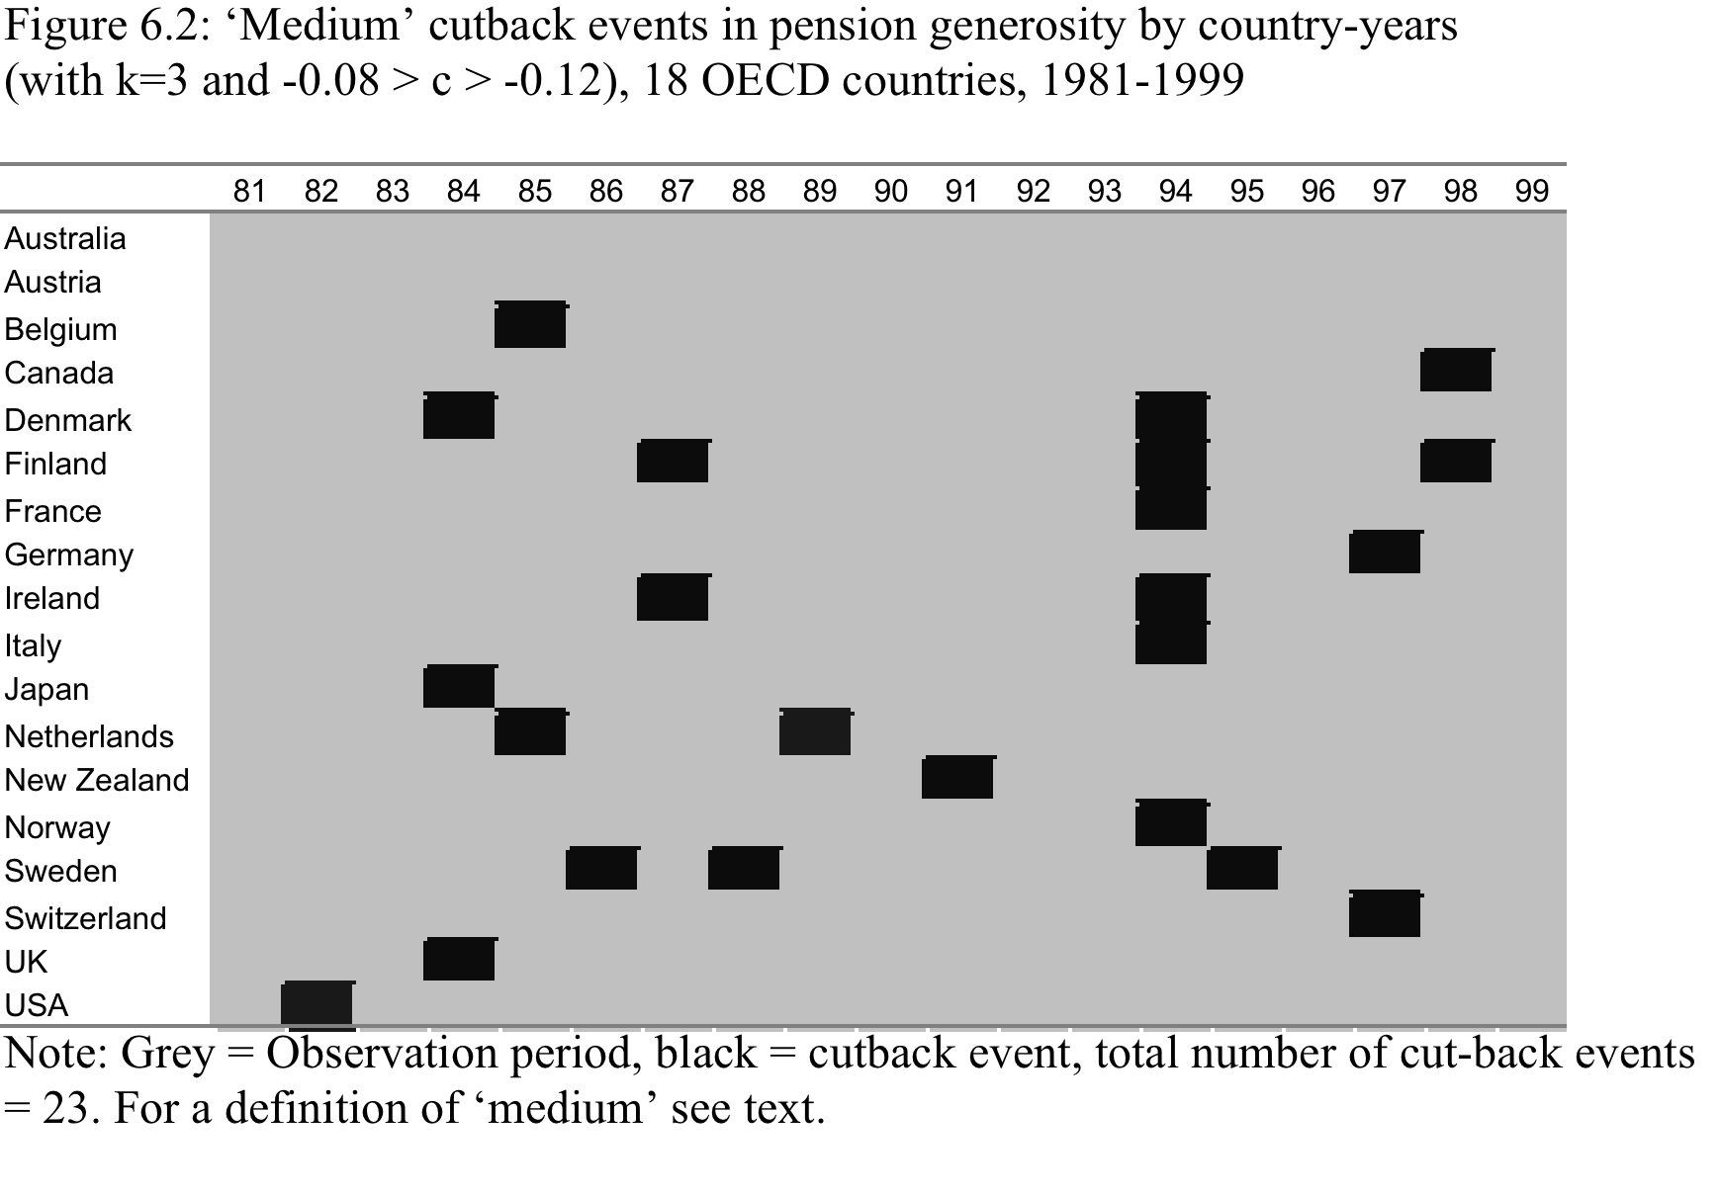
All but 2 countries implemented a medium cut already in 1980s-90s (23)…
Tepe & Vanhuysse (2012)

Slide 13
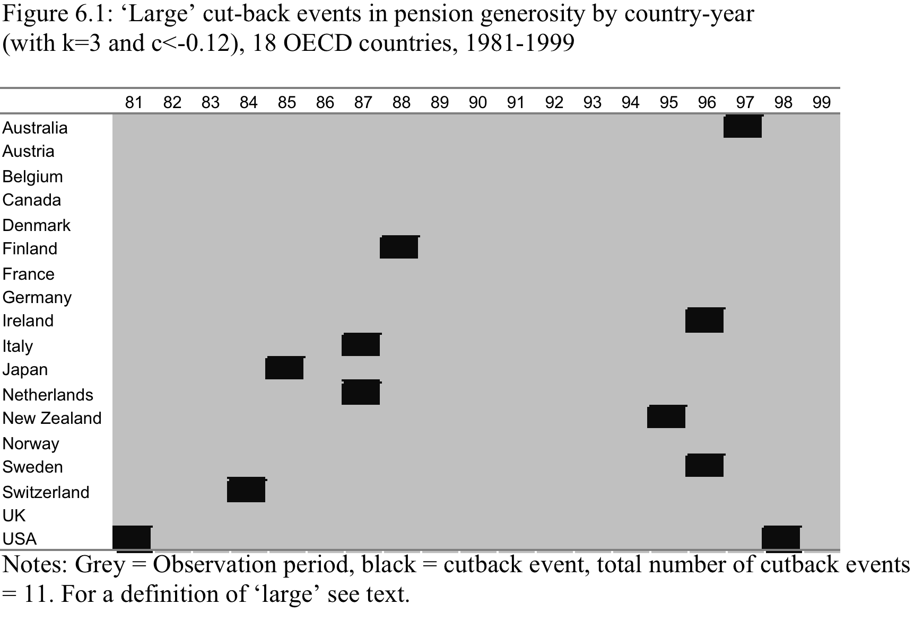
… but only half as many had large cutbacks (11)
Tepe & Vanhuysse (2012)

Slide 14
Alarm bells tolling for incremental cuts
Tepe & Vanhuysse (2012): Aging populations both function as powerful ‘alarm bell signals’ urging pension policymakers to take the small risk of incremental retrenchment, but also as electoral constraints -- they do so in order to better be able to delay more radical retrenchment
Politicians jump to bite relatively small bullets only in order to delay biting large bullets
Tepe & Vanhuysse (2012)

Slide 15
Pro-elderly policy bias: political economy of intergenerational redistribution
Lynch (2001, 2006): ENSR; Tepe & Vanhuysse (2010): ENSS
Southern welfare regimes (and JA) very pro-elderly biased; Nordic regimes more age-balanced
Tepe, Markus & Vanhuysse, Pieter (2010), 'Elderly Bias, New Social Risks, and Social Spending: Change and Timing in Eight Programs across Four Worlds of Welfare, 1980-2003', Journal of European Social Policy 20 (3): 218-234.
https://papers.ssrn.com/sol3/papers.cfm?abstract_id=1370004
wwwC.sdu.dk/staff/vanhuysse

Slide 16
EBiSS
An Elderly-Bias Social Spending indicator
Overall elderly-oriented state spending, per person 65+
/
Overall non-elderly state spending, per person 15-64
Vanhuysse, P. (2013),
Intergenerational Justice in Aging Societies
www.sdu.dk/staff/vanhuysse

Slide 17
EBiSS: numerator
Spending on the ELDERLY:
All old age related benefits in cash (pensions) and in kind (residential care/home-help services)
All survivors benefits in cash (pensions) and in kind (funeral expenses)
All disability pensions
All occupational injury and disease related pensions
All early retirement for labor market reasons
Vanhuysse, P. (2013),
Intergenerational Justice in Aging Societies
www.sdu.dk/staff/vanhuysse

Slide 18
EBiSS: denominator
Spending on the NON-elderly:
All family benefits in cash (family allowances, maternity/parental leave) and in kind (day care/home-help services)
All ALMPs (employment services and administration, LM training, youth measures, subsidized employment, employment measures for disabled)
All income maintenance cash benefits
All unemployment compensation/severance pay
All education spending
Vanhuysse, P. (2013),
Intergenerational Justice in Aging Societies
www.sdu.dk/staff/vanhuysse

Slide 19
The EBiSS 2007-2008
PL, GR, IT, SK, CZ, PT, SL, AT
Demography is not destiny
IT
Legitimate & sustainable
rolling contract differences ?
JA
IE, BE, EST, NL, Nordics
GE
SE
EBiSS-OASR R=-0.18
Vanhuysse, P. (2013),
Intergenerational Justice in Aging Societies
www.sdu.dk/staff/vanhuysse

Slide 20
The EBiSS 2009-2010 or latest
PL…. GRE, IT, SK, CZ, SL, JA
‘Spartan-childhood-for-luxury-old-age’ tradeoffs agreed to by successive cohorts?
IT
NZ, KO, CA, IE, DK, NL, BE, NO, UK, SE
JA
SE
GE
www.sdu.dk/staff/vanhuysse

Slide 21

Vanhuysse, Pieter (2013), Intergenerational Justice in Aging Societies: A Cross-national Comparison of 29 OECD Countries, Gütersloh: Bertelsmann Stiftung.
Full report: http://papers.ssrn.com/sol3/papers.cfm?abstract_id=2309278
Blog summary at Oxford: http://www.openpop.org/?p=583

Slide 22
But…
What if the focus widens to what societies redistribute between generations?
Gal, R.I., Vanhuysse, P. and Vargha, L. (2018), ‘Pro-elderly welfare states within child-oriented societies,’ forthcoming, Journal of European Public Policy
Available at:
https://papers.ssrn.com/sol3/papers.cfm?abstract_id=2979171
www.sdu.dk/staff/vanhuysse

Slide 23
Policy data give very partial picture
Biased, since limited to the “visible world” of public transfers
Largely ignores intra-familial transfers (cash) & the household economy (time - care)
Once we use more complete data on the value of all forms of resources transferred across generations, a radically different picture emerges on what generations redistribute to each other
Gal, Vanhuysse, Vargha (2017)

Slide 24
Two key asymmetries: 1
Asymmetric socialization of care:
working-age people pay taxes and social security contributions to care for the elderly as a generation -- but they privately contribute cash & time to raise their own children
Resource transfers flowing upward from the currently active to the elderly are socialized to a much larger extent than those flowing downward to children
Gal, Vanhuysse, Vargha (2017)

Slide 25
Two key asymmetries: 2
Asymmetric statistical visibility:
resources flowing to the elderly are near-fully observed in National Accounts, but inter- and intra-household transfers are not (or barely) registered
→ Lion’s share of resources transferred to children is just not visible in NA statistics
≈ looking for lost car key only where the street light shines
Gal, Vanhuysse, Vargha (2017)

Slide 26
Empirical contributions: 1
We apply NTA (Lee & Mason 2011) to look not just at allocation of primary income and secondary distribution (taxes and benefits) but also at tertiary redistribution of after-tax revenues within households (e.g. parents paying consumption of their children) and between households (e.g. retired parents supporting non-cohabiting adult children)
NTA brings age into NA by breaking down the various quantities by age: introduces info on the relation between age of individuals and their economic activities
Gal, Vanhuysse, Vargha (2017)

Slide 27
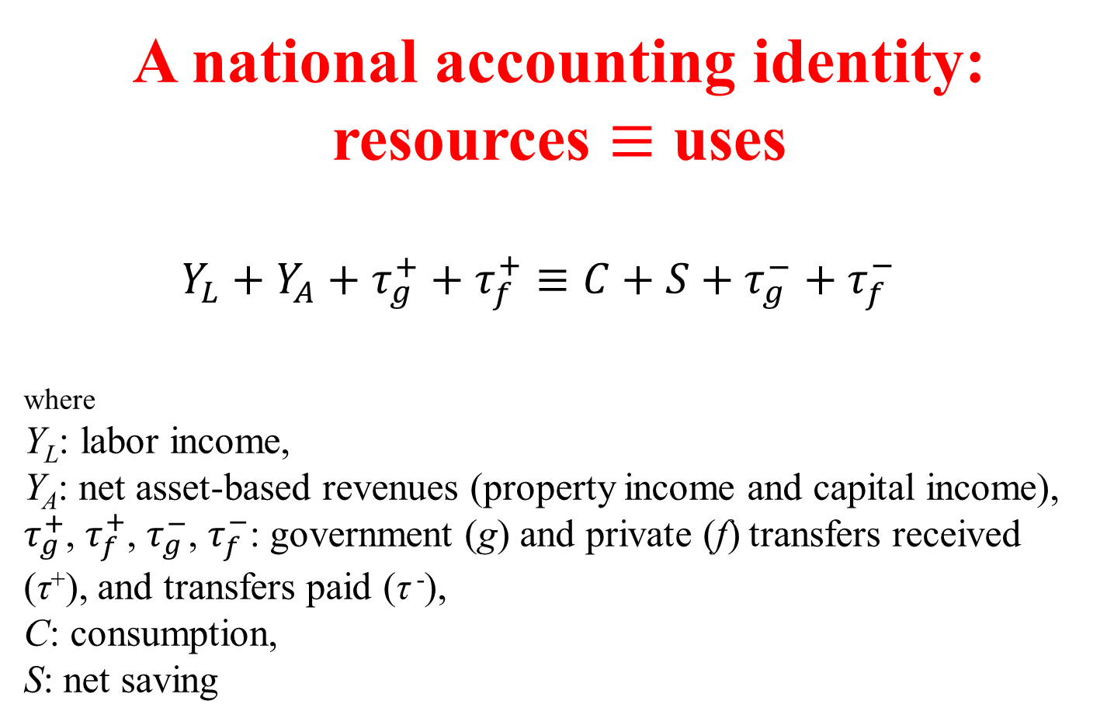
A national accounting identity:
resources $≡$ uses
$Y_{L}+Y_{A}+τ_{g}^{+}+τ_{f}^{+}≡C+S+τ_{g}^{−}+τ_{f}^{−}$
where
Y_{L}: labor income,
Y_{A}: net asset-based revenues (property income and capital income),
$τ_{g}^{+}$, $τ_{f}^{+}$, $τ_{g}^{−}$, $τ_{f}^{−}$: government (g) and private (f) transfers received (τ⁺), and transfers paid (τ ⁻),
C: consumption,
S: net saving
Gal, Vanhuysse, Vargha (2017)

Slide 28
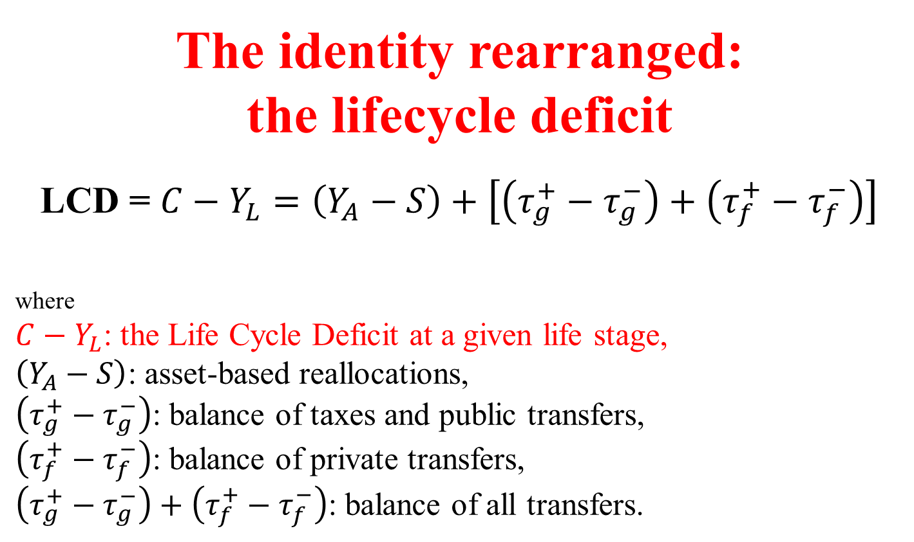
The identity rearranged:
the lifecycle deficit
LCD = $C−Y_{L}=\left(Y_{A}−S\right)+\left[\left(τ_{g}^{+}−τ_{g}^{−}\right)+\left(τ_{f}^{+}−τ_{f}^{−}\right)\right]$
where
$C−Y_{L}$: the Life Cycle Deficit at a given life stage,
$\left(Y_{A}−S\right)$: asset-based reallocations,
$\left(τ_{g}^{+}−τ_{g}^{−}\right)$: balance of taxes and public transfers,
$\left(τ_{f}^{+}−τ_{f}^{−}\right)$: balance of private transfers,
$\left(τ_{g}^{+}−τ_{g}^{−}\right)+\left(τ_{f}^{+}−τ_{f}^{−}\right)$: balance of all transfers.
Gal, Vanhuysse, Vargha (2017)

Slide 29
Data
NTA data can be downloaded from www.ntaccounts.org
Country teams: Reijo Vanne, Risto Vaittinen (FI), Bernhard Hammer (AT), Marina Zannelli (IT), Katharina Lisenkova (UK), Fanny Kluge (GE), Joze Sambt (SL), Thomas Lindh et al. (SE), Ció Patxot et al. (ES), Róbert I. Gál, Endre Szabó, Lili Vargha (HU)
Gal, Vanhuysse, Vargha (2017)

Slide 30
Empirical contributions: 2
We provide calculations for a key variable mostly missing from studies of intergenerational transfers: unpaid household labor
Based on time use survey data we estimate the value of production and consumption of unpaid household labor and the resulting transfers : National Time Transfer Accounts (henceforth NTTA)
Gal, Vanhuysse, Vargha (2017)

Slide 31
NTTA
1. Identify from HETUS the average time spent on various household production activities on an average day, by age and per country. Activities are deemed unpaid household labor if they can be done by someone else (third person principle)
2. Assign home production to household members; equally in case of most activities, but exclusively to children in case of child care activities.
3. Assign wages to impute the value of time spent on unpaid household activities by using the Eurostat SES regular market wage of the person whose job is done (specialist replacement wage approach).
Gal, Vanhuysse, Vargha (2017)

Slide 32
Intergenerational resource transfers in Europe
10 countries, 5 welfare state regime models, 70% of EU population, around 2005
FR, AT, GE (Continental regime)
IT, ES (Southern regime)
HU, SL (Post-Communist regime)
FI, SE (Nordic regime)
UK (Anglo-Saxon regime)
Gal, Vanhuysse, Vargha (2017)

Slide 33
Preview 1
European welfare states, as welfare states, indeed devote significantly more resources per capita to the currently elderly than to the currently young – mainly because of public pension outlays (then healthcare and LTC)
Gal, Vanhuysse, Vargha (2017)

Slide 34
Preview 2
(2) But: once we take into account private transfers and unpaid household labor (time), the picture changes radically
All European societies, as societies, transfer more per capita resources to children than to the elderly
Gal, Vanhuysse, Vargha (2017)

Slide 35
1. Defining lifecycle stages according to NTA resource dependency
LCD Time TLCD
• NTA childhood lasts from birth until age 25; old age from age 58
• LCD of elderly is on the whole higher than that of children.
• By age 80: 70%, by age 90: 79%
all values normalized on the per capita labor market income of persons aged 30-49 in the respective country
Gal, Vanhuysse, Vargha (2017)

Slide 36
2. Defining lifecycle stages according to time resource dependency
LCD Time TLCD
• Net time transfers remain large throughout childhood and teenage years: 60% at age 5, 33% at age 10, 20% at age 15.
• Transfers negative from age 24 to 80: adulthood lasts significantly longer in terms of unpaid household labor
Gal, Vanhuysse, Vargha (2017)

Slide 37
3. Defining lifecycle stages according to total resource dependency
LCD Time TLCD
• Europe is an idle continent: long periods of childhood and of old age; a short productive life stage
• TLCD childhood lasts until 25; old age starts at 60
Gal, Vanhuysse, Vargha (2017)

Slide 38
Europe is a child-oriented continent
Children 0-9 receive between 129 and 92%: more than even the very oldest old – those 90+
Young Europeans still receive on average more than 70% right until they reach age 17
Elderly Europeans start receiving the same 70% share only after 80
Gal, Vanhuysse, Vargha (2017)

Slide 39
Completing the picture stepwise: from public to private and time transfers
Net public transfers TLCD
• European welfare states are pro-elderly oriented
• Highest net public transfer in childhood around age 12-13, but is less than 1/4 of prime-age earnings. All Europeans aged 65+ receive more
• Welfare state dependency adulthood only betw. ages 21 - 61
Gal, Vanhuysse, Vargha (2017)

Slide 40
Private transfers: from (older) working-age adults to children (esp teenagers)
Net private transfers TLCD
• Mostly a 2-generation affair: children - up to age 27! – are net receivers; people in active age, but not elderly, net providers
• At age 60 net private transfers become marginal, and they remain so through all older age groups.
• Private transfers more important in childhood than public transfers, exceeding them in every stage of childhood.
Gal, Vanhuysse, Vargha (2017)

Slide 41
Time transfers: from (younger) working-age adults to (esp younger) children -- only more so
Net time transfers TLCD
• Children cost more time when small and more cash as they grow older
• Time transfers are more important than cash / public
• Grandparenting… elderly very modest net time providers until 80
Gal, Vanhuysse, Vargha (2017)

Slide 42
The visibility asymmetry
Gal, Vanhuysse, Vargha (2017)

Slide 43
Thanks
Pieter Vanhuysse, PhD (LSE)
Professor of Comparative Welfare State Research
Danish Centre for Welfare Studies
University of Southern Denmark
vanhuysse@sam.sdu.dk
www.sdu.dk/staff/vanhuysse
Papers available at:
https://papers.ssrn.com/sol3/cf_dev/AbsByAuth.cfm?per_id=876624
www.sdu.dk/staff/vanhuysse

