Slide 1
十四五时期中国社会保障重大问题
Major Issues of Social Security
in China’s 14th Five-Year Period
报告人：关博
Presenter: Guan Bo
Associate Research Fellow， Chinese Academy of Macroeconomic Reasearch
2019.05

Slide 2
1
中国社会保障的现状，挑战和风险
Current，Challenges and Risk Factors
2
养老保险全国统筹
National overall plan in Basic Endowment Insurance
3
延迟退休年龄
Delayed Retirement Age
Contents
目录
4
多层次社会保障体系建设
Multi-pillar social security system

Slide 3
5
老年康养体系
Health Care Service System for the Elderly
6
儿童福利
Child Welfare
7
住房公积金
Housing Provident Fund
Contents
目录

Slide 4
现状，挑战和风险
Current, Challenges and risk factors
1.1 Great progress has been made
Reformation 改革:
Transferring state-owned capital to enhance social security system
划转国有资本充实社保
Market-oriented investment of pension funds
完善基本养老基金管理政策
Basic medical insurance playing in strategic purchaser
医保发挥战略购买者地位
launched a pilot in long term care insurance
试点长期护理保险
Expansion 扩面：Coverage expanding steady
制度覆盖人数稳步增长

Slide 5
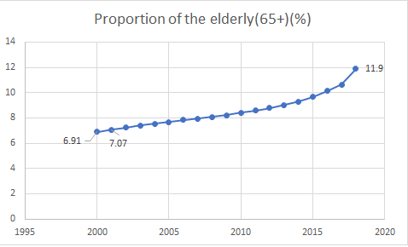
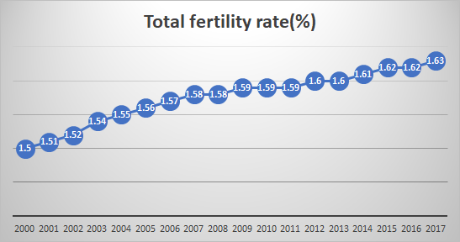
现状，挑战和风险
Current, Challenges and risk factors
1.2 Aging of population
——Deep aging society in 2026
——Deterioration of Support Structure
人口老化形势更加严峻，恶化社保制度赡养结构
1.3 Risk of "low fertility trap"
——Total fertility rate stay low rate after
adjustment of fertility policy in 2015
全面两孩政策实施后，总和生育率没有明显提高

Slide 6
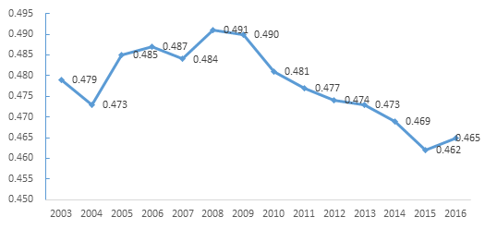
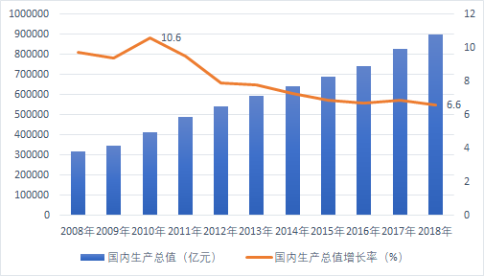
现状，挑战和风险
Current, Challenges and risk factors
1.4 Income distributtion inequality
——Gini coefficient hovering at high leavel
基尼系数高位徘徊
1.5 Economic downward pressure
——financial subsidy capacity
——unemployment risk
经济下行和结构调整影响社保财力和筹资稳健

Slide 7


现状，挑战和风险
Current, Challenges and risk factors
1.6 New forms of employment increasing informality
Sharing economy
Tens of millions of new jobs
Informal employment
共享经济依托互联网平台，衍生出了数以千万万计的工作岗位 就业非正规化趋势
Retail ecosystem of Alibaba.com created 36.81 million employment
opportunities in 2017.
阿里巴巴系零售生态在2017年创造3681万个就业机会。
Non-standard production
生产活动非标准化
Platform based value exchange
价值交换平台化
Diversified participation
多样化参与
Non-fixed workplace
劳动场所灵活化
DiDi created 21.08 millions employment
opportunities from June 2016 to June 2017 .
2016.6-2017.6，滴滴创造就业和增收机会达到2108万个

Slide 8
2. 养老保险全国统筹
National Overall Plan in Basic Endowment Insurance
support structure not balanced but fund lack of redistributive capacities（6.71:1 in Guangdong VS. 1.26:1 in Heilongjiang）
地区间赡养结构不平衡，地方基金没有调剂
Measures taken
Central adjustment funds
proportion:3.5%,scale:600 bn
中央调剂金
B. Unified contribution rate and wage base
统一费率费基
C. Unified policies at provincial level by 2020
2020年前实现省级统筹
Current:
Fragmentation
现状：制度碎片化
Policy are not unified in most provinces
大部分省域范围内政策政策不统一
Financial subsidy dependence (18.48%) Fund expenditure exceeds income from contribution from 2014.
财政补助责任压力持续加大（18.48%），2014年以来，支出大于征缴收入
Ambiguity of responsibility between central and regional
中央地方权责关系模糊

Slide 9
2. 养老保险全国统筹
National Overall Plan in Basic Endowment Insurance
Reform motive force
A. Unified labor market
建立统一劳动要素市场
B. Fair competition environment
公平的国内竞争环境
C. Actively address population
aging of pension system
提高养老金制度积极应对老龄化能力
Key points of national overall plan
Shock Therapy Reform
“断崖式”过渡
B. Unified system such as contribution scheme, benefit scheme, fund payment, budget and management services.
统一制度结构，包括缴费筹资、待遇、基金使用、预算和经办服务政策
C. Define responsibility between central and regional
明晰央地权责关系
Consensus on Reform
改革共识
Technical support：
taxation system
Transformation
技术支撑

Slide 10
3. 延迟退休年龄
Delayed Retirement Age
Retirement age(pension age) lower than the average leave
中国法定退休年龄（领取养老金年龄）低于大部分国家
Country | Pension age | Life expectancy
Japan | 65 | 84
France | 60(65 for full pension) | 83
Germany | 60(65 for full pension) | 81
Britain | Male 65; female 60 | 81
America | 62(67 for full pension) | 79
Brazil | Male 53 (65 for full pension); female 48(60 for full pension) | 76
Russia | Male: 60 65 Female: 55 63 | 72
China | Male: 60 Female: 55(public sector); 50(enterprise) | 76
Dependency Ratio fallen off a cliff in the
past several years although expending coverage for younger employees.
抚养比断崖式下滑，“扩面”红利消耗殆尽

Slide 11

3. 延迟退休年龄
Delayed Retirement Age
——Solution：Raise the retirement age in progressive steps
渐进式延迟退休年龄是中国养老保险制度改革的“必选项”
Adjust retirement step by step
分步推进
Special policy for hardship posts
艰苦工作制定特殊照顾政策
Social propaganda and public opinion guide 社会宣教和舆情引导
Full pension age
建立全额领取养老金年龄政策

Slide 12
4. 多层次社会保障体系建设
Multi-pillar Social Security System
——Structure：Basic endowment insurance is dominant in coverage，financing, benefit and social expectation
基本养老保险在覆盖率、筹资、保障水平和社会预期方面都呈现出“一支独大”的局面
First
Pillar
Second
Pillar
Third
Pillar
DB+NDC
Coverage:
418.84M
Fund income:
5014.48Bn
Benefit:
66% in Premium Wage
Enterprise annuity：DC
Coverage:
2.3M
Fund:
132.6Bn
Benefit:
5% in average wage
Tax deferred old age security: Based in individual account ;
Pilot in three areas; link up to fund industry
Enterprise annuity get into platform period：企业年金陷入平台期

Slide 13
4.多层次社会保障体系建设
Multi-pillar Social Security System
——Solution：Coordinated develop multi-pillar social security system
Compulsory implementation；Structural reform
强制覆盖；结构性改革
Compulsory implementation in partial ；market operation；government regulation.部分强制；市场运营；政府规制
Voluntary participation；market-oriented；自愿参与；市场主导
First
Pillar: optimization
一支柱：
优化
Second
Pillar: Promotion
二支柱：
提升
Third
Pillar: Construction三支柱：
建制

Slide 14
5. 老年康养服务体系
Health Care Service System for the Elderly
——Key points
——Home based, Community support, Institutions supplement, Combination of Medical Care and Old-age Care
居家为基础，社区为依托，机构为补充，医养相结合
——No more than 50% of Beds in old-age service Institutions operated by government, 30% of Bed in old-age service Institutions are nursing beds.
政府运营床位不超过50%，30%护理床位。
——Internet plus elderly care
互联网+养老服务
elderly care | 2011 | 2013 | 2015 | 2017
old-age service facilities（thousand） | 41 | 42 | 116 | 155
：old-age service institutions（thousand） | － | － | 28 | 29
old-age service institutions in community （thousand） | － | － | 26 | 43
Beds for old-age service （thousand） | 3532 | 4937 | 6727 | 7448
：Beds for old-age service in community （thousand） | － | 641 | 2981 | 3385
Number of beds for old-age service in 1000 senior citizens | 19.1 | 24.4 | 30.3 | 30.9

Slide 15
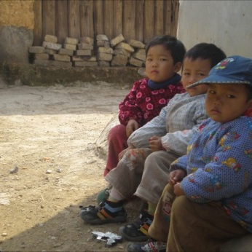
6. 儿童福利
Child Welfare
——Background: Changes in family structure; Adjustment of fertility policy; Increased population mobility
背景：家庭结构转变；生育政策调整；人口流动性加剧
——Responsibility: Government； Social forces；Family dominant
权责：政府搭建政策框架，社会力量参与，家庭主体责任
——Key points
Focus group：left-behind children，Migrant children，Children in low-income families.
目标群体：留守儿童，随迁儿童，城市低收入儿童
Responsibility：Increasing Government Investment；
Encouraging Participating in Charity
责任：增加政府投入，扩大慈善参与
Policies: Establishment of child allowances;
improve urban MAF systems;
putting in place the management system
政策：建立儿童津贴；完善大病救助，规范管理体系。

Slide 16

7. 住房公积金制度
Housing Provident Fund
Disadvantages of current policies:
Inequity in coverage; Reverse redistribution; Wage squeeze causing low recognition; Ambiguity of responsibility
现行政策存在问题：覆盖不均衡；
逆向再分配；挤压工资导致扩面难；
管理主体关系模糊
Reform target：Housing Security Bank
改革目标：政策性住房保障银行
Key points: Sources and proportions of financing;
Housing construction investment;
Expanding coverage;
Governance structure
改革要点：调整筹资来源和比例，强化住宅投资
职能；扩大受惠对象；完善治理结构

Slide 17
谢谢大家
Thank you

