Slide 1


就业促进规划:“十三五” 评估与“十四五”建议
Employment Promotion Plan: Evaluation of “The 13th Five-Year” and Proposal for “The 14th Five-Year”
中国人民大学劳动人事学院课题组
School of Labor and Human Resources
Renmin University of China
May, 2019

Slide 2
Three questions will be answered in this report
How did we carry out this evaluation?
What have been done?
What have to do next?

Slide 3
Executive summary
Research design
Outline
Report schedule
Methods
Data and materials sources
Main achievement
Main Suggestion for next Five-year plan

Slide 4
《规划》是在新时代全面深化改革的重大背景下制定并实施的，是中国政府全面深化改革指导思想与总体思路在就业促进领域的一次集中体现
It was made and implemented in the background of comprehensively deepening reform in China. And of course it was designed to serve this reform.
What makes difference in the new plan?

Slide 5
4 Main Highlights In This Plan
更高的定位：“最大的民生”、“经济发展最基本的支撑”
Employment is regarded as the biggest livelihood of the people and most fundamental support for economic development
市场与政府关系：市场“决定性”、政府“服务型”（环境、监督、协调）
Market will play a decisive role in human resources allocation
Government turn to service-oriented
创新与创业对就业的拉动作用(demand driven)
Employment promotion depends more on entrepreneurship and innovation
就业质量与劳动力素质(supply optimized)
Employment promotion devotes more to improvement of quality in both employment and labor force

Slide 6
Report Schedule
Market
How Many?
Entrepreneurship
&
innovation
Demand
Supply
Human Resource
Market & Services industry
High-quality
Labor force
Environment
How Better?
Government

Slide 7
Report Schedule
上篇（十三五《规划》评估 Comprehensive and Thematic evaluation）
1、综合评估（Comprehensive Evaluation）
1.1 就业规模与质量（Employment Scale and Quality）
1.2 人力资源结构与劳动力素质（Human Resource Structure and Labor Force Quality）
1.3 创业创新环境（Environment for Entrepreneurship & Innovation）
2、专题评估（Thematic Evaluation）
2.1 新经济与就业促进（Newly Economy and Job Creation） D
2.2 人力资源市场效率与服务能力（ Market Efficiency for Human Resource ）M
2.3 劳动力素质提升（Labor Force Quality Improvement）S
2.4 重点就业人群保障（Employment Security for Focus Groups）

Slide 8
Report Schedule
下篇（十四五《规划》建议 Suggestion）
1、总结（Conclusion）- 十四五规划建议的基础
1.1 主要问题与不足（Main problems and deficiency）
1.2 国内就业新趋势（New domestic trend ）
1.3 国际就业新经验（International experience）
1.4 中长期规划衔接（Connection with medium and long-term planning）
2、十四五《规划》建议（Suggestion for next five-year plan）
2.1 框架建议（Suggestion for outline）
2.2 内容建议（Suggestion for content）
2.3 执行与保障建议（Suggestion for implementation）

Slide 9
Research methods
比较研究（Comparative Studies）
目标导向（Goal-index- oriented）
- 12th Five-year （2011-2015）VS 13th Five-year （2016-2019）
政策工具（Policy Instruments and Textual Analysis）
过程导向（Progress-content- oriented）
- 200+ central policies and 3000+ local policies
- transformation of governmental function and attitude（政府职能的转变）

Slide 10
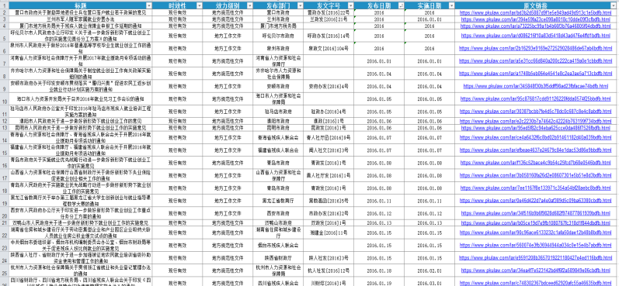
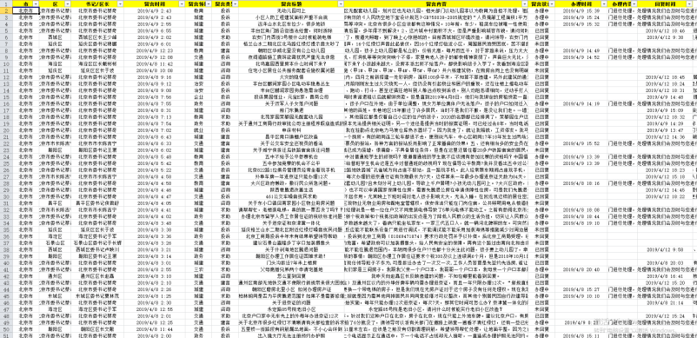
Data and Reference Source
统计与调查数据
World bank datasets
NBS National Bureau of Statistics
China Labor-force Dynamic Survey（CLDS）
智库及国际组织的研究报告
China institute for employment research
China center for human capital and labor market research
政策数据库
北大法宝(PKULAW.CN)

Slide 11
Executive summary
Research design
Main achievement
Employment Scale and Quality
Human Resources and Labor Quality
Entrepreneurship & Innovation
Human resources industry
Employment Security for Focus Groups
Suggestion

Slide 12
Employment Scale and Quality
就业规模稳步增长 （Employment scale grows steadily）
  城镇累计新增就业4061万（目标值5000万，80.5%）
  Accumulative newly-increased urban employment reaches 40.61 million
就业结构持续优化（ Employment structure continues to optimize）
  第三产业从业人员比重稳步上升，2018年前三季度达44.6%
  Proportion of service sectors employees is up to 44.6% in first 3Q 2018
  b. 城镇就业人员占比不断提高，2018年达56%
  Proportion of urban employees up to 56% of total in 2018
就业质量进一步改善（Employment quality keep improved）
a. 劳动合同签订率保持在90%以上（high rate of signed contracts）
b. 劳动收入与权益保障水平稳步提升（wage \ security improves）

Slide 13
Employment Scale and Quality
Figure 1. Newly increased urban employment and its grow rates
(Source: NBS)

Slide 14
Employment Scale and Quality
Figure 2. The proportion and amount of employees in three industries
(Source: NBS; note: 2018 shows the first 3 quarters statistics)

Slide 15
Human Resources and Labor Quality
人力资源结构持续优化（ human resource structure keep optimizing ）
  2018年，中国技能劳动者1.65亿（目标1.7亿），高技能人才4791万（目标5500万），占技能劳动者总数29%（目标32%）（人社部）
  China has 0.16 billion skilled labor，of which high-tech labor is 47.9 million, accounts for 29%
劳动者素质不断提升（ labor quality improves continuously）
  劳动人口平均受教育年限有所提升
  Average years of schooling is more than 10
  b. 人力资本指数评分67.72，全球130个国家里排名34
  Human capital scale is 67.72, ranking 34th among 130 countries (The Global Human Capital Report 2017)

Slide 16
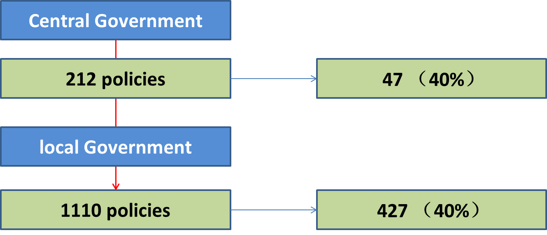
Entrepreneurship & Innovation
政府高度重视创新创业对就业的促进作用，大力推动优化创新创业环境（财税、产业、公共服务等）
Much more attention has paid to empowering the job-creation capability of Entrepreneurship & innovation by providing series of policy supports

Slide 17
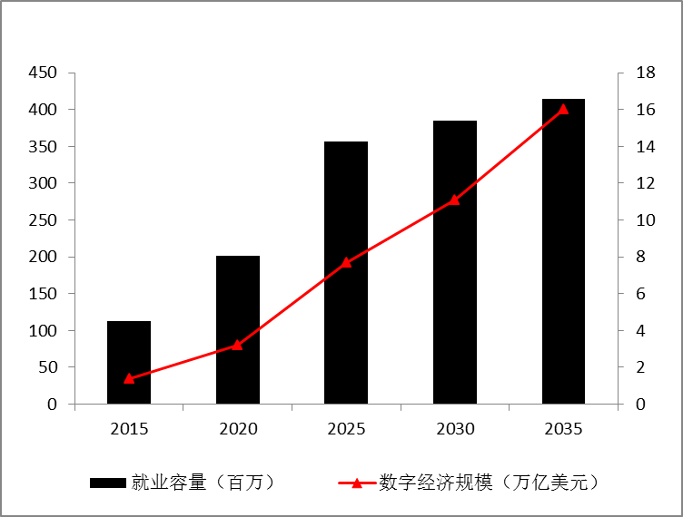



Entrepreneurship & Innovation
“网络零售” 与“平台经济” 成为创造就业的重要增长极
Digital economy grows rather dramatically
network retail and platform economy serves as new engine of employment growth
16 trillion dollars
0.41 billion jobs
270万 （2018）
2.7 million
Takeout
2108万（2016-2017）
21.08 million
Car-hailing
4082 万
40.82 million
Network retail
Figure 4. Market size of digital economy and its employment capacity
(source: BCG, 2017)

Slide 18
Human Resource Industry
市场规范化程度不断提升 （Market regulation）
  a. series of policies have been designed to promote the degree of market regulation and free flow of human resources
产业规模不断扩大（Industrial scale expands dramatically）
  2017年人力资源服务产业市场规模达到3436亿元，年复合增长率21.9%，从业人员规模达到58.4万（目标 60万人）
  Estimated the total market for human resource service has reached 343.6 billion Yuan in 2017 with compound annual growth rate as high as 21.9%. And the number of employment is over 580 thousand in 2017

Slide 19
Human Resource Industry
842.7 billion yuan
Over 300 thousand enterprises
Figure 5. market size of industry
Figure 6. Enterprise number and growth rate
(collected by research group)

Slide 20
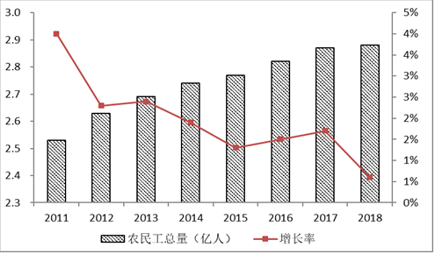
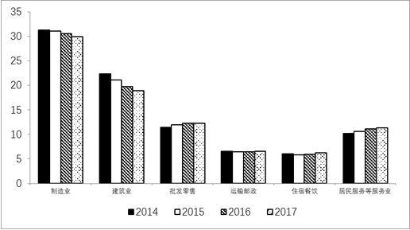
Focus Groups- Rural workers
农村劳动力（Rural workers）
总量增长（2.88亿）、增速下降；新生代主力（50%）、结构老化（39.7）；二产为主（51.5%）、三产上升（48%）
Up to 0.29 billion and slow growth; 80s account for 50% and average age is 39.7;
Decreasing employment in secondary industry employment while increasing in service sector
Figure 7. Migrant workers’ growth
Figure 8. Employment structure of migrant workers

Slide 21
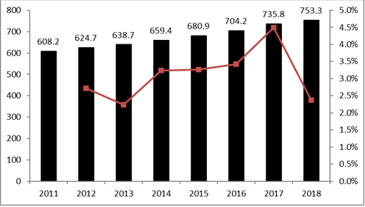
Focus Groups- College graduate
大学毕业生（College graduate）
总量增长（753.3万）、增速下降；就业稳定（91.6%）；全职（80%）、创业（3%）、深造（10%）；中西部吸引力增长；教育（14%）与数字经济（10.3%）
Up to 7.53 million and slow growth; Employment is stable(91.6%); 80% full-time\3% start business\10% study further or abroad; more and more chose to work in middle and west region ;and education and digital economy absorb increasing employment.
Figure 9. College graduate amount and growth

Slide 22
Focus Groups- Job placement
过剩产能职工安置（Job placement）
2016年，全国去产能涉及职工83.1万人，实际分流职工72.6万人，其中转岗安置和内部退养合计占55.8%。About 726 thousand workers from backward production enterprises were reassigned by government
预计到2020年将直接影响180万名职工就业，其中钢铁行业约50万人，煤炭行业约130万人。There are estimated around 180 million workers need to re-employ in 2020 and most of them are from steel and coal industry
去产能重点地区地方政府通过内部安置、鼓励创业、内退托底等多种途径解决去产能企业职工的安置问题. Numerous policies were made by Local government to solve workers’ employment from enterprises excess production capacity
国家发改委等六部门《关于做好2018年重点领域化解过剩产能工作的通知》（发改运行〔2018〕554号））

Slide 23
Executive summary
Research design
Main achievements
Main Suggestion for next five year plan
1) Main foundation of suggestion
Main problems
New trend and experience
Connection with medium and long-term plan
2) Main Suggestion
schedule
content
implementation

Slide 24
Structural contradiction still prominent
就业难、招工难并存的结构性矛盾仍然突出.
Structural contradiction in employment is still prominent on both demand and supply sides.
一方面，劳动力市场供需缺口在2016年以后明显扩大，2017年达到107万，高技术人才供给不足，高级工程师、技师求人倍率超过2.0
Labor demand gap has sharply expanded since 2016 and peaked in 2017 (107 million). High Tech talent is in short and its demand ratio（求人倍率） is above 2.0.
另一方面，失业问题不容乐观，2019年一季度，城镇调查失业率超过5%（要求控制在5.5%）。
Unemployment problem remains acute although registered unemployment rate far below 5% (3.8%) and keep decreasing

Slide 25
Structural contradiction still prominent
Figure 10. Position requirement gap is widening sharply
(source: ministry of human resources and social security)

Slide 26
Structural contradiction still prominent
Figure 11. Demand ratio for high-tech talent remains high
(source: ministry of human resources and social security)

Slide 27
Structural contradiction still prominent
Figure 12. Unemployment rate estimated by ILO
（Source: International Labour Organization, ILOSTAT database）

Slide 28
Digital economy and new employment pattern
数字经济挑战着传统的劳动关系以及建立在其上的用工及保障制度
Digital economy, platforms in particular, is challenging the classical definition of employment relationship and even the whole employment security system on which it built.
在不断强化平台经济创造更多就业岗位能力的同时，更要重视对“新型就业形态”的规范与保护
Rather than simply emphasizing the job-creation of platform economy, much more attention should be paid on institutional adjustment to protect these platform workers and regulate platform operators

Slide 29
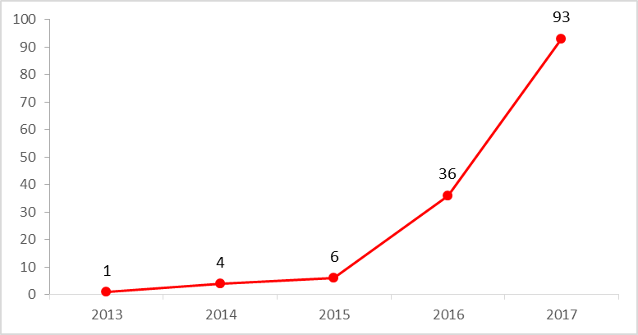
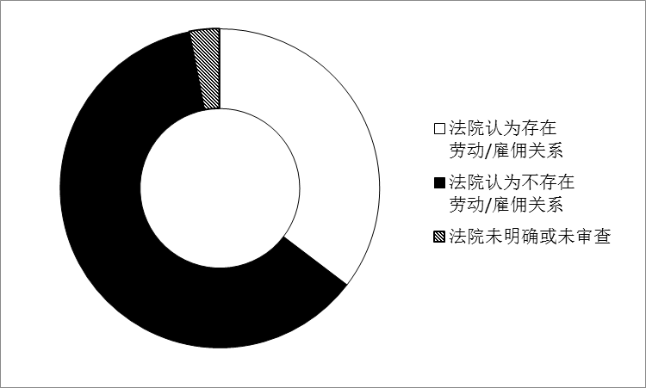
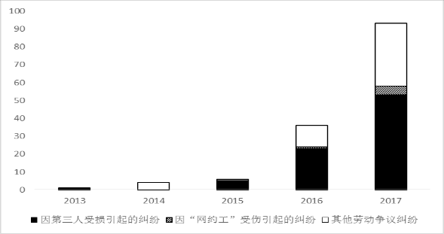
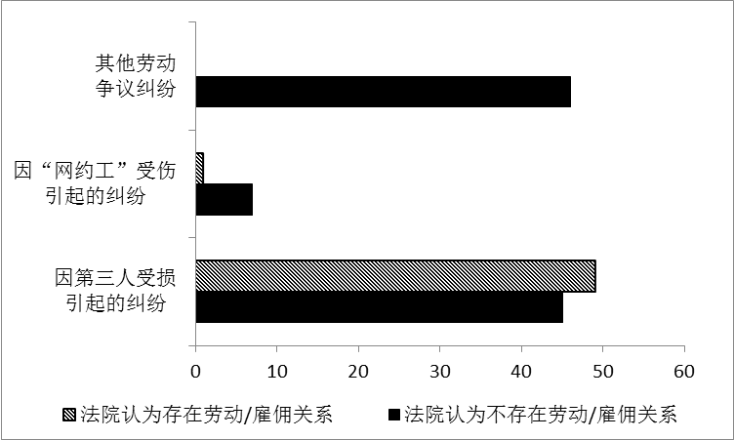
Digital economy and new employment pattern
基于158个司法案例的初步分析（preliminary analyses on 158 cases）
More disputes
a
c
Judges tend not to confirm
b
d
Platform workers injured
caused by damage the interests of a third parties

Slide 30
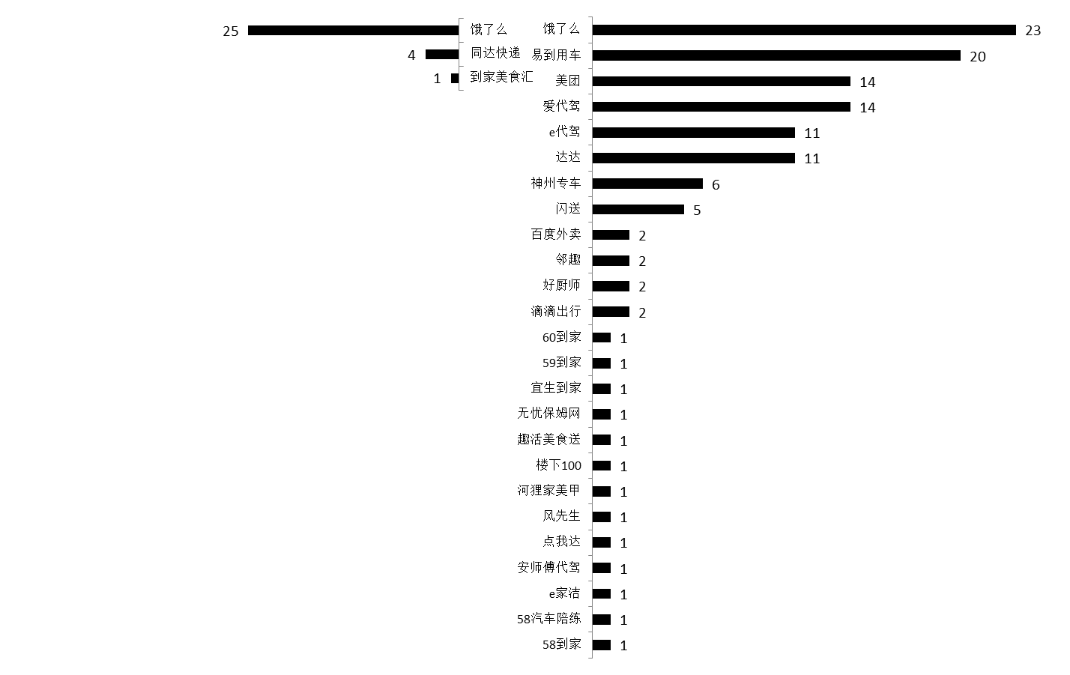
Digital economy and new employment pattern
Most platforms acclaim that they are “partners” other than employment relationship
e

Slide 31
Skilled Labor are insufficient and uneven distribution
中国劳动力素质仍然有较大的提升空间，高技术人才的缺乏不利于为经济转型升级提供持续动力。Labor quality is still at a relative low level, poor educated workers are majority and only 10%-20% receive vocational training
43%
High-tech talent
11.9%
97/130
8.5%
Figure 13. poorly educated workers are majority
(source: China labour statistical yearbook)

Slide 32
Skilled Labor are insufficient and uneven distribution
Per capita human capital stock (1,000 yuan)
High school degree or above (%)
College degree or above(%)
Average schooling years
Figure 14. Enlarging urban-rural distance in labor quality
(source: China human capital index report)

Slide 33
Public employment service supply is still in short
公共就业服务规模呈下降趋势。
Down trend for public employment services scale
公共就业培训仍以短期培训（六个月以下）与初中级资格培训为主。
Short-term employment training and Preliminary and intermediate qualification training
Figure 15. public employment service and training

Slide 34
New trend and experience
“一个背景”：数字技术兴起下数字经济蓬勃发展的新背景
One essential background：Fast growth of digital economy (Digital China)
“三个趋势”
就业政策定位从具体领域的社会政策向服务宏观调控升级。
Employment policies re-definition: from social polices to macro control
就业主导产业从劳动密集型制造、建筑业向劳动密集型服务业转变
Employment engine: from construction\manufacture to services
人口结构转型加速“人口红利”消退：劳动力供给下降、老化、低参与
Demographic transition: labor supply decline; aging labor force; low labor participation

Slide 35
New trend and experience
“一个背景”：数字技术兴起下数字经济蓬勃发展的新背景
One essential background：Fast growth of digital economy (Digital China)
“三个趋势”
就业政策定位从具体领域的社会政策向服务宏观调控升级。
Employment policies re-definition: from social polices to macro control
就业主导产业从劳动密集型制造、建筑业向劳动密集型服务业转变
Employment engine: from construction\manufacture to services
人口结构转型加速“人口红利”消退：劳动力供给下降、老化、低参与
Demographic transition: labor supply decline; aging labor force; low labor participation

Slide 36
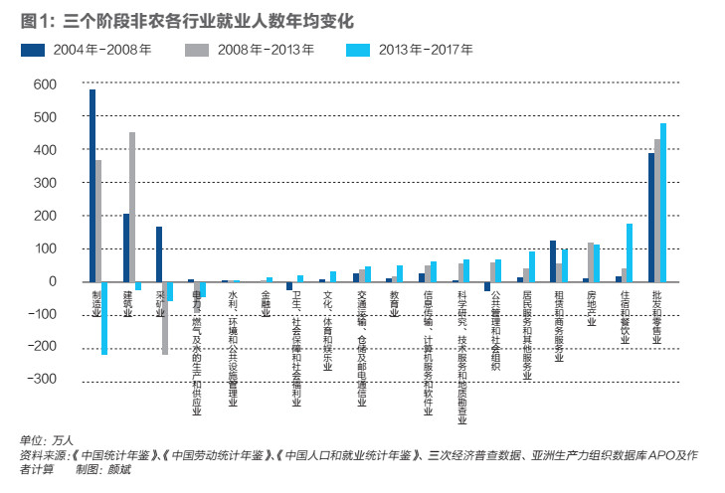
New trend and experience
Figure 16. Employment structure from 2004-2017

Slide 37
New trend and experience
人口结构转型使得劳动力供给能力持续弱化。New round of demographic transition triggered by population aging will weaken China’s labor supply continuously, till 2049 amount of working age population will shrink to 0.8 billion.
Figure 17. working age population and dependency ratio
( source: world bank group)

Slide 38
New trend and experience
劳动年龄结构老化。working age population aged 45-64 will account for more than 45% in 2045
Figure 18. age structure of working age population
( source: world bank group)

Slide 39
New trend and experience
劳动参与率持续下降。Labor participation decreases dramatically from nearly 85% to 75%, especially for women even reach to 65%.
Figure 19. Labor force participation rate
( source: world bank group)

Slide 40
New trend and experience
国际组织关切的主要就业议题（EU\OECD\ILO\WORLD BANK）
数字经济对就业的正（促进就业）反（非标准工作挑战雇佣关系、加剧就业极化）效应 Both positive and negative effect of digital economy on employment
2. 工资增长乏力与不平等加剧（中等工资和中等技能工作的逐渐消失）
Inadequate wage growth and wage inequality\polarization
3.“老龄化对劳动力供给及劳动力市场的挑战”
population aging challenges
4.“加强就业领域的社会安全网建设”Social safety nets
5. “就业中的性别不平等”Gender inequality in employment

Slide 41
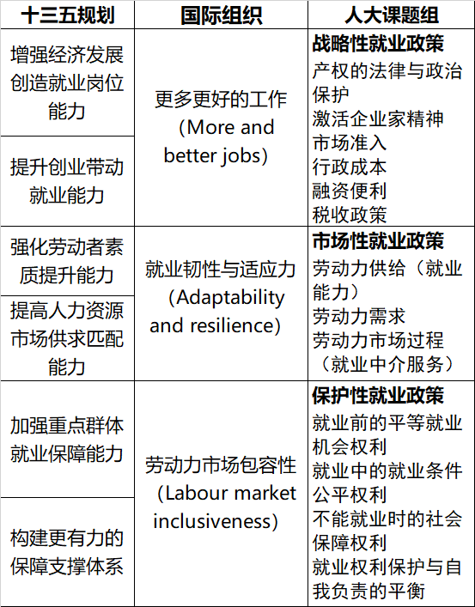
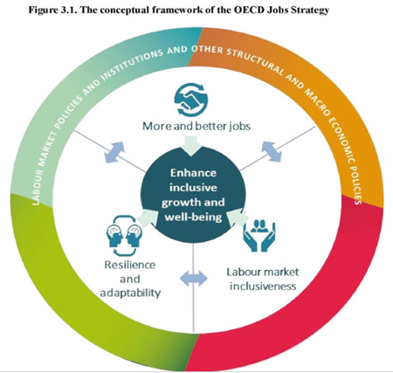
New trend and experience
三个维度：国际就业促进政策设计与评估框架

Slide 42
Connection with medium and long-term plan
注重与国家中长期战略规划的衔接，不仅对明确十四五规划的基本方向与内容有着重要的意义，同时也是建立就业促进长效机制的根本依据。
方向 | 主要内容 | 规划文件
提升劳动力素质 Labor quality | 1）劳动年龄人口平均受教育年限从2015年的10.23上升至2020年的10.8及2030年的11.8 2）新增劳动力平均受教育年限达到13.5年以上，高等教育毛入学率达到50%以上。 3）健全多层次人才培养体系--加强制造业人才发展统筹规划和分类指导，组织实施制造业人才培养计划，加大专业技术人才、经营管理人才和技能人才的培养力度 | 2015.05.19-国务院-关于印发《中国制造2025》的通知（国发〔2015〕28号） 2017.01.25-国务院-《人口发展规划（2016—2030年）的通知》国发〔2016〕87号 2019-中共中央、国务院-《中国教育现代化2035》
提升服务业就业 Service sector | 2025：服务业体系更加完备、产品更加丰富，供需协调性显著增强，服务业增加值占GDP比重提高到60%，就业人口占全社会就业人口比重提高到55%。 | 2017.06.13-发改委《服务业创新发展大纲（2017—2025年）》

Slide 43
Suggestion
总体框架建议
基本原则：除了强调“质与量”、“供与需”及“政府与市场”之外，建议注重“兼顾短期就业平衡与劳动力市场长期发展之间的关系”
Employment balance in short term and labor market development in long term
2. 规划结构：建议在围绕“供给、需求及市场”三个基本维度进一步明确规划内容布局的基础上，增加“就业保护”（就业权益保障）部分的内容。
Strengthening employment protection
3. 规划侧重：在规划对新形势与新趋势的反映与预判上，建议重视从各个方面体现对“数字经济”就业促进（培育新经济、新业态）、保障（新就业形态-非标准工作）以及人才培养（数字技术人才）内容的重视。
More attention should be paid on the connection between employment and digital economy

Slide 44
Suggestion
规划内容建议
明确失业性质，强化分类管理 （Classified management of unemployment）
结构性-人力资本投资；摩擦性-市场配置；周期性-宏观调控
Structural- human capital investment; frictional- market allocation; cyclical-macro control
提升劳动力质量（improvement of labor quality）
挖掘劳动者工作潜能，提升就业能力，推动农村劳动力转型
Tap working potential and promote transformation of rural labor force
促进劳动者人力资本投资与积累
Human capital investment and accumulation
有效利用国际人才资源，实施更积极开放有效的国际人才培养和引进政策
International talent introduction
3. 推动劳动力市场充分流动，提高劳动力资源的市场匹配效率

Slide 45
Suggestion
规划内容建议
3. 加强新就业形态群体的权益保障（Social security for nonstandard employment）
建立适合灵活就业者的参保和缴费机制
Establishing a mechanism for flexible participation in insurance and payment
强化对平台企业的监管与责任
Strengthen the supervision of platform enterprises
4. 提升就业服务与培训供给水平与均等化程度（improve the service supply and equalization level）
5.建设与老龄社会相适应的就业促进政策体系（aging-friendly employment environment）
完善养老保障体系，开发老年人力资源
Developing human resources for the elderly
6.以家庭为对象的就业促进与保障体系建设（family-oriented employment protection and promotion policies）

Slide 46
Suggestion
政策执行（组织保障部分）建议
协同性（coordination）建议突出完善就业促进协同机制的重要性
  劳动力市场综合数据采集与指标监测机制
  Promote labor market data collection and monitoring
  理顺宏观经济综合管理部门与劳动力市场运行与管理部门之间关系
  Government coordination
  发挥就业促进政策制定与实施过程中的协同效应
  Governance/policies coordination
精准性（accuracy）：完善政策实施效果科学评估机制，不断提高精准性
  公共财政支出的绩效评估
  Performance evaluation of public expenditure
  分类管理与精准干预
  Classified management and Precision intervention

Slide 47
Many thanks!

