Slide 1
100 years of social protection with the ILO: the road to universal social protection systems and floors
Valerie Schmitt, ILO
International workshop on multi-tier social protection systems in Europe and China, Rome, 27 May 2019

Slide 2
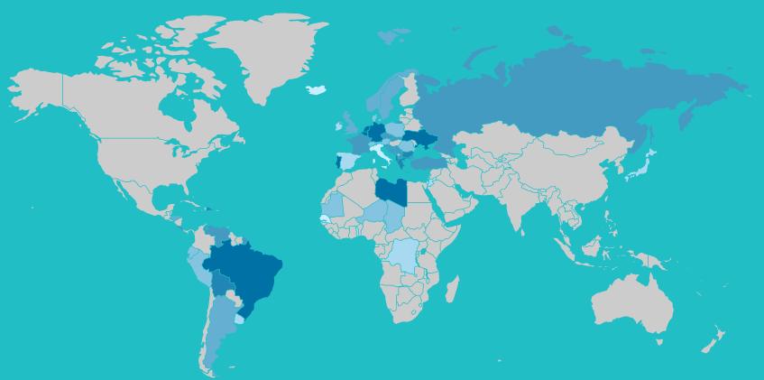
Ratification of ILO C102 – work in progress In grey: countries that have not yet ratified

Slide 3
ILO social security standards: key principles
Principle 1: Progressive realization of universal coverage
Principle 2: Social solidarity and collective financing
Principle 3: Adequacy and predictability of benefits
Principle 4: Overall and primary responsibility of the State
Principle 5: Non-discrimination, gender equality and responsiveness to special needs
Principle 6: Financial, fiscal and economic sustainability
Principle 7: Transparent management and administration
Principle 8: Involvement of social partners and consultations with other stakeholders
Principle 9: Periodic review of pensions to match evolution of cost of living and level of earnings

Slide 4
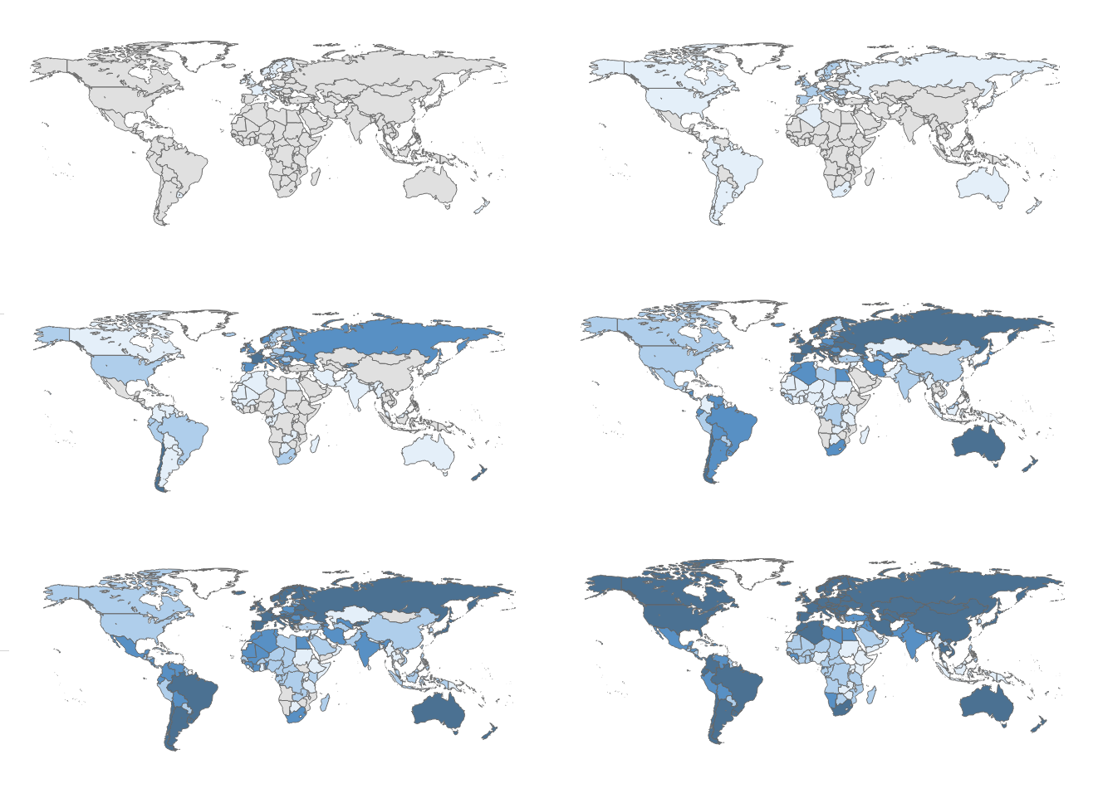
Development of social security over 100 years
1900
1920
1940
1960
1980
2015

Slide 5
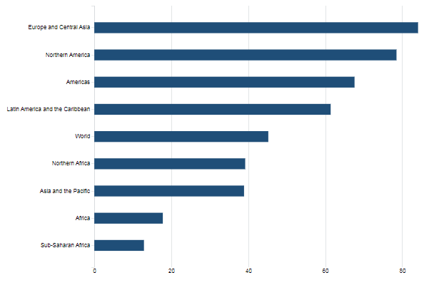
Globally 45% of the world population is covered for at least one social protection benefit (SDG 1.3.1)
84%
Which means that 55% of the world’s population is excluded from social protection
45%
39% (China 63%)

Slide 6
Globally 68% of eldery population receives an old age pensions (SDG 1.3.1)
Which means that 32% of older persons do not receive any pension
Notes:
Note: Proportion of older persons receiving a pension: ratio of persons above statutory retirement age receiving an old-age pension to the persons above statutory retirement age. Regional and global estimates weighted by population of retirement age.

Slide 7
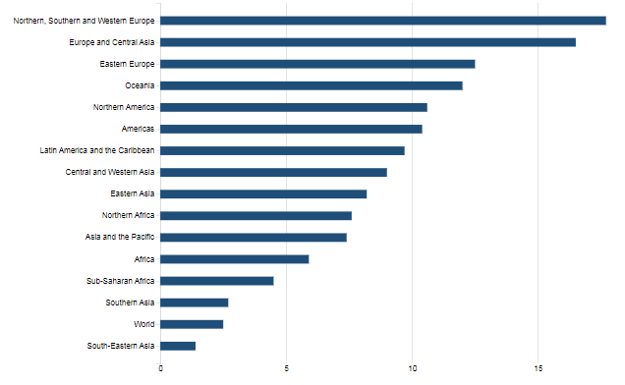
Public social protection expenditure, excluding health (percentage of GDP)
16.5% GDP
On average, countries invest only 2.5% of their GDP on public social protection.
In Europe & central Asia, average is at 16.5%. In China at 5.6%.
7.4% GDP (China 5.6%)
2.5% GDP

Slide 8
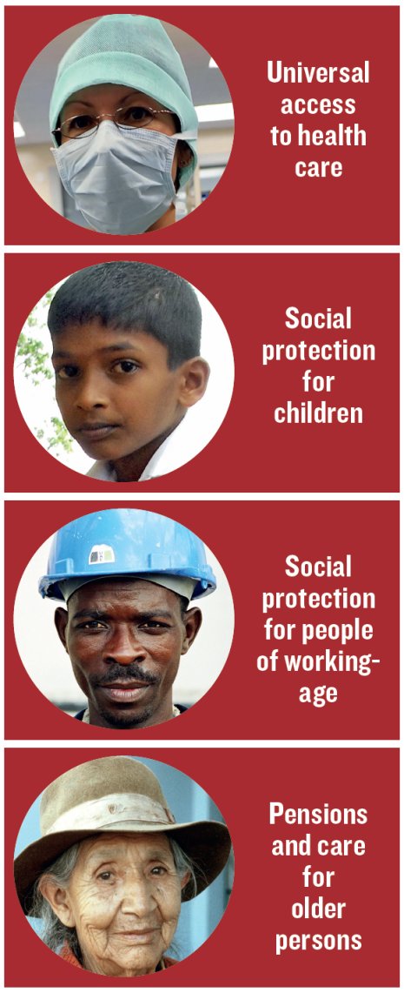
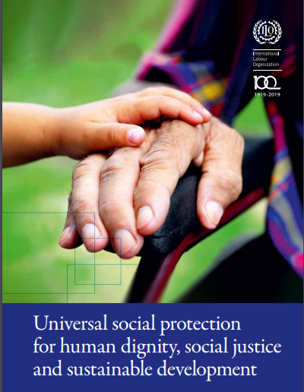
The extension of social protection: Recommendation No 202
All residents have access to essential health care, including maternity care
All children enjoy basic income security, providing access to nutrition, education, care, and any other necessary goods and services
Four basic guarantees
All persons in active age who cannot earn sufficient income, enjoy basic income security, particularly in cases of sickness, unemployment, maternity, disability
All older persons have basic income security

Slide 9
Closing the coverage gaps: horizontal and vertical extension
Level of protection
❶
Extend through non contributory schemes
❷
Extend through adapted social insurance
❸
Extend the number of branches and levels of benefits
❸
Social protection floor
❶
❷
Poor
Rest of informal sector
Formal sector
Population

Slide 10
Multi-tier social protection: pension systems
Benefits levels
Voluntary savings
Complementary (mandatory/voluntary)
Mandatory Social Insurance
Universal Old-Age Pension
Low income
Coverage of the population
High income

Slide 11
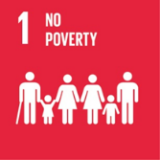
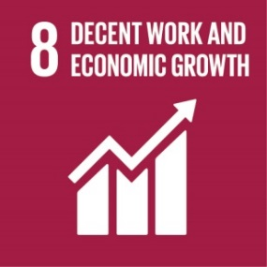
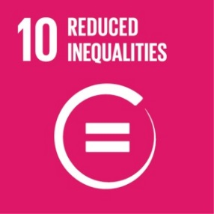
Agenda 2030: leaving no one behind
Support achievement of SDG 1.3 «Implement nationally appropriate social protection systems and measures for all, including floors, and by 2030 achieve substantial coverage of the poor and the vulnerable».

Slide 12
Decrease in replacement rates of public pension schemes (2013-2060)

Slide 13
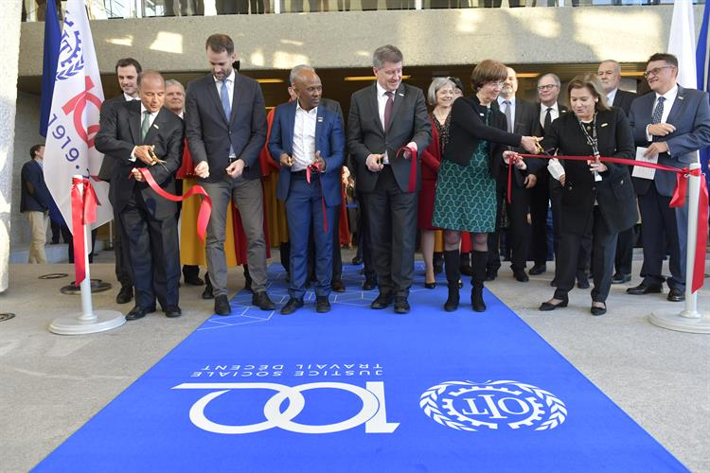
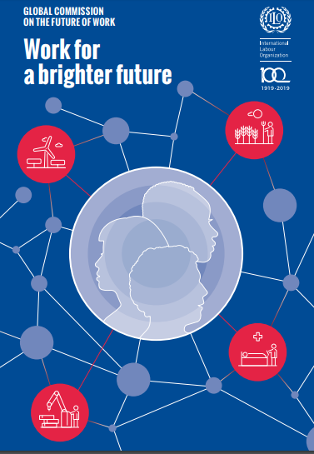
Working for a brighter future
Social protection has a key role to play to facilitate the demographic, green and digital transitions
We call for guaranteed universal social protection from birth to death
www.ilo.org
The global commission for the future of work

Slide 14
Working for a brighter social protection
Informal economy
New forms of employment
Demographic shifts
Climate change
Globalization
Protection
Adaptation
Solidarity
Sustainability

Slide 15
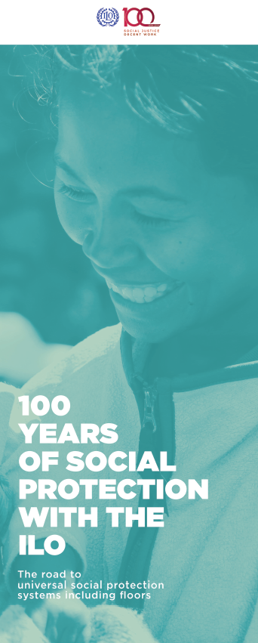
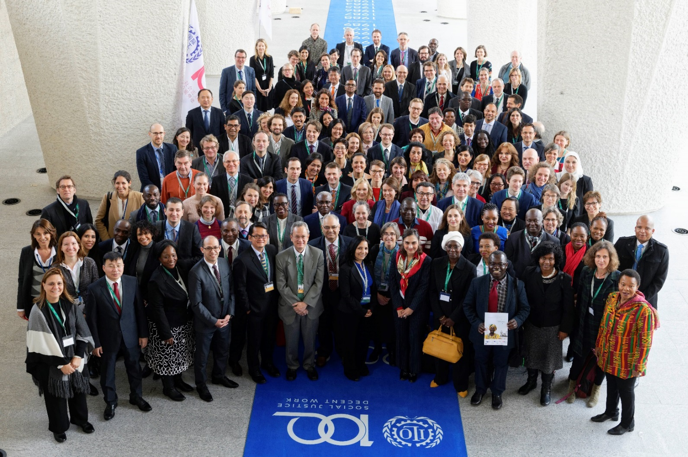
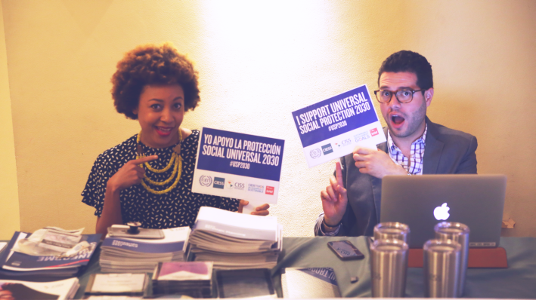
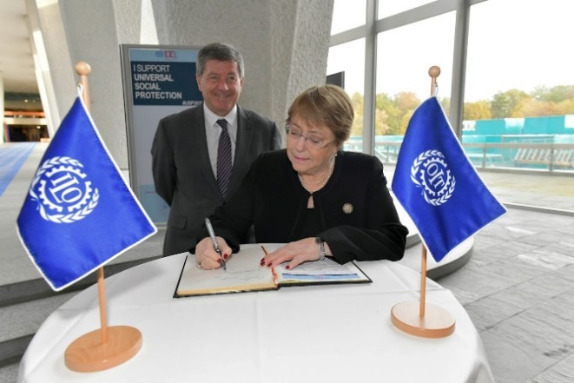
Global social protection week 25-29 November 2019, ILO Geneva
http://ilo100.social-protection.org

