Slide 1
Challenges of multi-tier social protection for social security institutions
Simon Brimblecombe, Head, Policy Analysis & Research
International Social Security Association, Geneva

Slide 2
The importance of multipillar systems
A retirement system has multiple objectives – unlikely that one benefit structure can meet all of them
These objectives change with age and vary by population profile as well as being influenced by external trends
Diversification of risk in multi pillar benefit structure AND financing
Secondary objectives of retirement systems can be important

Slide 3
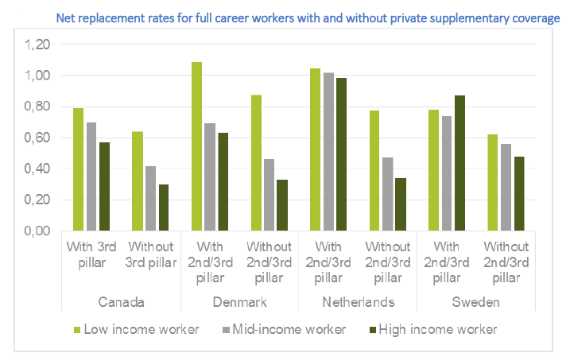
Are these replacement rates comparable ?

Slide 4
Why adequacy is so important.. and difficult to define
An adequate benefit meets the specific needs of the beneficiary & their family... and the wider needs of society
Adequate benefits increase public confidence in social security, create incentives, support other policy aims and positive economic feedbacks
The individual is interested in system adequacy not individual scheme adequacy
RR important but varies by income, career etc
Other elements of adequacy include:
  Security of benefits
  Interaction with other provision
  Coverage
  Intergenerational equity
  Labour market consistency
  Administrative adequacy

Slide 5
What are the challenges ?
Providing an (overall) adequate benefit
Coordination and consistency between pillars
Ensuring incentives are correct
Supporting the labour market
Can we administer and manage it ?
Communication: does the population understand the system ?
Sustainability and intergenerational equity

Slide 6
Responsibilities of social security policymakers and administrations in a multipillar system
Policymakers
Overall strategy
Benefit structure
Financing mechanisms and structures
Social security administrations
Scheme and system information
Communication
Compliance (contributions, payments, roll-up)
Oversight of second & third pillar

Slide 7
Examples of key integration issues
Policy
  Retirement ages
  Contribution salary
  Pensionable salary
  Tax treatment
  Form of benefits (lump sum, annuity, spouse’s benefits etc)
Administration & governance
  Provide overall benefit projections
  Affiliation – made simpler across schemes
  Communication includes explanation of second pillar & relevant links
  Managing second pillar provision ?
  Regulation on types of benefits from second/third pillar

Slide 8

Switzerland: Three Pillar system
Pillar III: Individual voluntary
Tax incentivised provision with maximum cap
Pillar II: Employer sponsored provision
Defined Benefit or Defined Contribution*
Pillar I: Social Security
Fixed rate pension based on service requirement
Contributions on all salary
Pensionable salary has offset for social security
Government regulates (minimum return, conversion rates, funding etc.)
Funded; employer pays at least half the cost
Pay as you go with a small buffer fund
In some professions, financed bridging pension exists

Slide 9

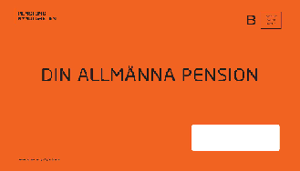
Sweden
Pillar I:
-Income Pension (NDC)
-Premium Pension (individual funded account)
(income tested top-up ‘Guaranteed Pension’ for those with low levels of Income Pension)
Pillar II:
Quasi mandatory employer provided (DB and DC basis)
Window of retirement ages
Automatic Adjustment Mechanisms

Slide 10
Is there a checklist of what makes a good multipillar system ?
Compulsory first and second pillar ?
Tax incentives ?
Funded or not ?
Some flat rate, some salary related (makes transition easier )
Transition to an older population profile
Direct / indirect integration of other pillars with social security

Slide 11
Looking forward
What are the key challenges and what measures can be taken ?
Change in labour market structure: do traditional second pillars still work?
Dealing with increased inequality
The role of social security as
  Membership of employer sponsored schemes reduces
  Pressure on disposable income threatening third pillar affiliation & contribution rates
Issue of prevention – should be considered a pillar
Other pillars (e.g. housing status and support)

