Slide 1
Universal Pensions – An EU Perspective
普惠养老金——欧洲视角
JV Gruat
圭亚
CASS Seminar, 12 June 2019
中国社会科学院研讨会，2019年6月12日

Slide 2
Index
内容
System typology
系统分类
Benchmarks and standards
指标及基准
Current situation, and challenges
现状及挑战

Slide 3
System typology – 1
系统分类
DUAL PURPOSE OF PENSION SYSTEMS
养老金制度的双重目标
ADDITIONAL FEATURES
其他特征
For all 全民覆盖
Collective financing 集体筹资
Guaranteed 待遇保障
Predictable 待遇可预期
Affordable 缴费可支付
Democratic / transparent management
民主/透明的管理
Non profit 非营利
Keep out of poverty
消除贫困
Replace past income
替代原有收入

Slide 4
System typology – 2
系统分类
TWO FUNDAMENTAL SYSTEMS 两种体制原型
- BISMARCKIAN (OCCUPATIONAL)
俾斯麦模式（职业养老金）
- BEVERIDGIAN (CITIZENSHIP/RESIDENCE)
贝弗里奇模式（国民/居民养老金）
PROGRESSIVE CONVERGENCE 两种模式渐进融合
UNTIL NEW TYPE EMERGES 产生新形式
(universal pensions)
（普惠型养老金）

Slide 5
System typology – 3
系统分类
Out of 192 countries: （192个国家中）
  186 have some type of periodic benefits in old-age
  有186个国家具有某种形式的养老金福利
    72 have contributory schemes only 72个国家采用缴费制
    13 have non contributory only 13个国家采用非缴费制
      2 means-tested 2个按收入调查结果进行支付
      1 pensions-tested 1个按养老金进行支付
      10 universal 10个全覆盖
    101 have both contributory and non contributory 101个国家为两种制度相结合
      64 contributory + non contributory means tested 64个缴费制+非缴费制 收入挂钩
      23 contributory and non contributory pension-tested 23个缴费制与非缴费制 养老金挂钩
      14 contributory and universal 14个缴费制与普惠制
      ILO World Social Protection Report
      国际劳工组织《全球社会保障报告》

Slide 6
In Europe
欧洲的情况
Practically all countries have non contributory pension schemes
基本上所有国家都有非缴费制养老金制度
  NON means-tested a minority – Denmark, Estonia, Finland, Latvia, Lithuania, Malta, Netherlands, Switzerland, Cyprus
  少数国家（丹麦、爱沙尼亚、芬兰、拉脱维亚、立陶宛、马耳他、荷兰、瑞士、塞浦路斯）不进行收入调查
  Representing between 8% (Latvia) and 75% (Netherlands) of minimum wage
  待遇相当于最低工资的8%（拉脱维亚）到75%（荷兰）
  Benefitting between 2% (Estonia) and 100% of the population above 65 years of age
  65岁以上人口覆盖率：2%（爱沙尼亚）- 100%
  Costed between 0.n % (Estonai, France, Germany …) and 5-6% of GDP (Denmark, Netherlands, Norway)
  GDP占比：0.n%（爱沙尼亚、法国、德国等）- 5-6% （丹麦、荷兰、挪威）

Slide 7
International standards: Benchmarks, rules, principles
国际标准：指标、规则、原则
Historically: 历史沿革
  ILO Income security recommendation (n. 67), 1944 《国际劳工组织收入保障建议》（n. 67），1944
  ILO Convention on social security (minimum standards) (n. 102), 1952 《国际劳工组织社会保障公约（最低标准）》 (n.102)，1952
  ILO Recommendation on Social protection floors (n.202), 2012 《国际劳工组织关于社会保障标准的建议》 (n.202), 2012
  United Nations and WB: SDG 1.3 联合国及世界银行：可持续发展目标 1.3
  “Implement nationally appropriate
  social protection systems and measures
  for all, including floors, and by 2030
  achieve substantial coverage
  of the poor and the vulnerable”
“根据国情实施相适宜的社会保障制度和措施，以保障所有阶层的民众，至2030年，实现对贫困和弱势群体的全面覆盖。”

Slide 8
Principles for basic income security (R.202)
基本收入保障的原则（R.202）
Objective: Basic income security at least at a nationally defined income level, for older persons
目标：确定一个全国统一标准，为老年人提供基本收入保障
  Key principles: 关键原则：
    Universality of protection 普惠性
    Adequacy and predictability of benefits 待遇的充足和可预期
    Non discrimination, gender equality and responsiveness to special needs 无歧视、性别平等、照顾特殊需求
    Respect for the right and dignity of people covered by the social security guarantees
    尊重人权和个体尊严
    Social dialogue and participation 社会对话、社会参与

Slide 9
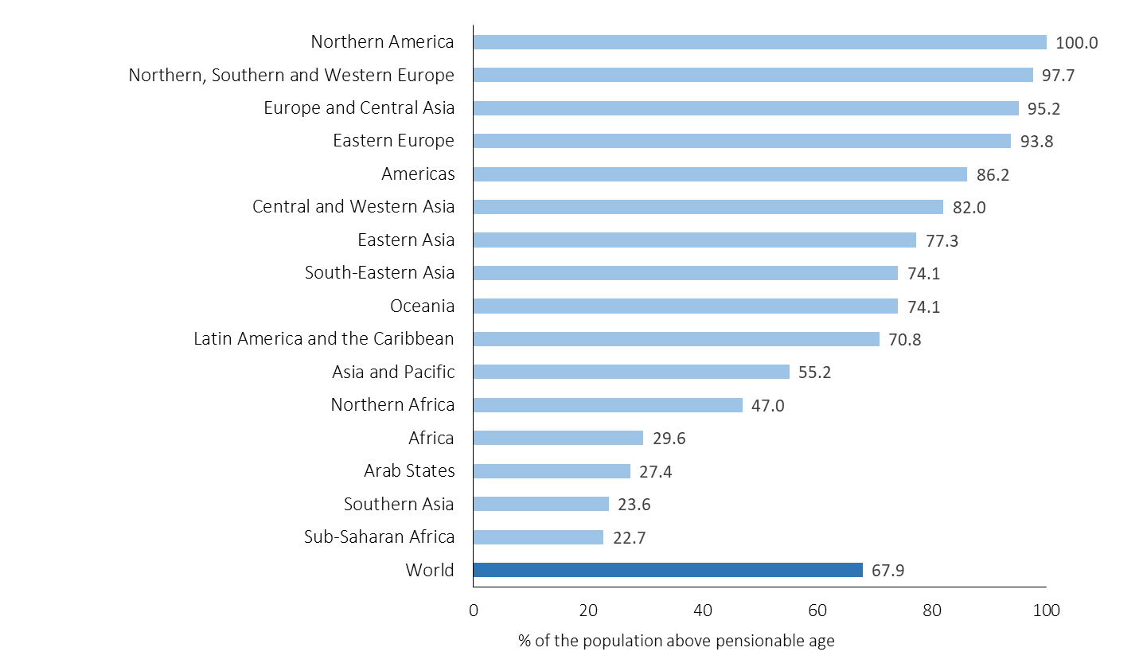
Current situation in Europe – 1
欧洲现状
High share of the elderly receiving old-age pension 领取养老金的老年人口比例较高

Slide 10
Current situation in Europe – 2
欧洲现状
Poverty rate of elderly close to that of the overall population
老年人口贫困率与整体人口贫困率的差异

Slide 11
Risks for the future
未来风险
Decrease in replacement rates of public pension schemes (2013-2060)
公共养老金替代率呈下降趋势（2013-2060）

Slide 12
Is universal pension protection not affordable any more ?
养老金全覆盖不可负担了吗？
Cost of universal pension in % GDP 全民覆盖养老金制度支出占GDP比重

Slide 13
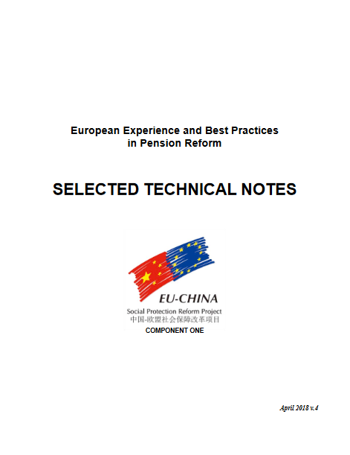
Further readings
参考资料

