Slide 1
DC Pension Reforms in Latin America since 2007
20160122
Institute of
Latin America Studies
CASS
Gao Qingbo
gaoqb@cass.org.cn

Slide 2
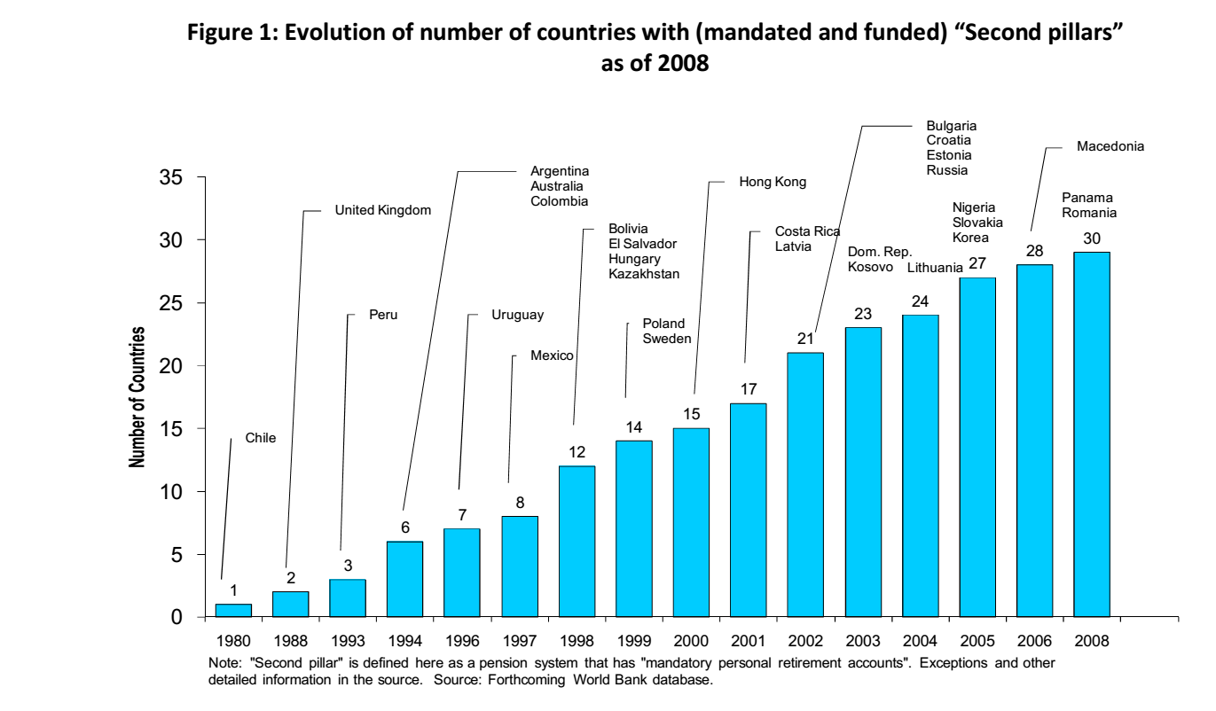
Chile1980, Peru1993, Argentina,Columbia1994, Uruguay1996, Mexico1997, Bolivia, El Salvador1998, Costa Rica2001, Dominican Republic2003, Panama2006

Slide 3
Contents
1
Pension reforms in Argentina
2
Pension reforms in Bolivia
3
Pension reforms in Chile & Mexico
4
Prospects

Slide 4
1.Pension reform in Argentina
2008 Sistema Integrado Previsional Argentino,26425
SIPA
1993 Sistema Integrado de Jubilaciones y Pensiones ,24241
SIJP
Before
PAYG

Slide 5
Argentina
Integrated system of Retirements and Pensions (SIJP)
Pay as you go
Fully funded
PBU
PBU
CA
IA
AP

Slide 6
Diagram
Universal Basic Benefit，Benefit adjusts according to contribution time.
2.5MOPREs for one year...... (max 45 years).
PBU
Compensatory allowance，comprising 1.5 per cent of the reference income for each year of
contributions (max 35 years).
CA
Additional Pension, comprising 0.85 per cent of the reference income for each year of
contributions (max 35 years).
AP

Slide 7
Return on investment of Argentina

Slide 8
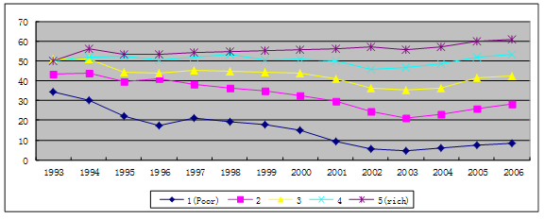
Coverage (Argentina)

Slide 9
Salary growth rate :Argentina
年份 | Private Sector registered | Private sector unregistered | Public sector | Average | Growth rate
2005 | 189.20 | 130.88 | 125.06 | 158.39 | 20.31
2006 | 225.98 | 157.89 | 145.44 | 188.32 | 18.89
2007 | 271.28 | 195.99 | 186.78 | 231.00 | 22.66
2008 | 321.61 | 269.54 | 226.33 | 282.73 | 22.40
2009 | 377.22 | 327.56 | 252.23 | 329.94 | 16.70
数据来源：INDEC，http://www.indec.gov.ar/
Data resource: http://www.indec.mecon.ar/nuevaweb/cuadros/4/h030319.xls

Slide 10
Constraints:
g
r
n
Salary growth
rate
Revenue
rate,
inflation
rate
labor
population
increasing
rate

Slide 11
2 Pension reform in Bolivia
2011-- , del Sistema Integral de Pensiones, Ley Nº 065 de Pensiones de 10 Diciembre de 2010.(Individual accounts)
1997-2010 ,LEY Nº 1732，LEY DE 29 DE NOVIEMBRE DE 1996，DECRETA: LEY DE PENSIONES(Individual account).
1949-1996, Pensiones Básicas(PAYG & additional pension )

Slide 12
2 Pension reform in Bolivia
SIP
PAYG
IA
C:7/8.5%*
IA
C:12.5%
Fondo de Sol.
B:30%
B:2.8t%
NCP
Note:
C:contribution ratio;
B:Benefit,that is replacement ratio;
t:contribution time
*:government provide 1.5% of salary for his staff

Slide 13
2 Pension reform in Bolivia
DC:
    individual account:10%
    Insurance:2%(injured and death)
    Fee:0.5%
    Qualification: Accumulate assets can afford more than 70% of salary, age 65(etc)。
SIP:
  DC:
  Fondo de sol.
    3%(employer),0.5%(employee), injured and death(20%)
    Qualification: Accumulate assets can afford more than 60% of salary, age 58(etc)。

Slide 14
3. Pension reforms in Chile
2011
  Measures in favor of low-income and middle-class pensioners
  Survivors and disability insurance premium to be paid by employers
  Integration of poor elderly into the Solidarity Pension System
  Pension funds' limit on foreign investment raised
2009
  Implementation of pension reform provisions
2008
  Creation of a basic old-age pension(NCP,65+)

Slide 15
3. Pension reforms in Mexico
2013
  New non-contributory pension for the elderly(65+)
2012
  Towards more competition between pension funds
2011
  A guideline for hiring asset managers
  Tax exemptions for low-income pensioners
2007
  New programme for the provision of care to old people in rural areas(70+)

Slide 16
4.Prospects:
Benefit
Coverage
Finance

Slide 17
4.Prospects:
  Argentina
    PAYG:
      C:17%+11%; B:PBU+AP or CA;
        CA：1.5t%; AP :0.85t%
    IA:
    Constraints :
      Salary growth rate & return on investment
    Deficit unavoidable.

Slide 18
4.Prospects:
  Bolivia
    PAYG:
      Cost：7.5%*30；
      Benefit：30%*20（PAYG）
      Real pension system:7.5%*3-30%=-7.5%
      During 1993～1996, the government provide more than 1% of GDP to the pension system.
    DC
    SIP
      1. Replacement：60%（55/50）
      2. Fondo Solidario
      3. NCP

Slide 19
Thanks!
Gao qingbo
gaoqb@cass.org.cn

