Slide 1
危机后OECD国家养老金改革措施
房连泉
2016年1月21日

Slide 2
● 改革主要集中两方面：
改善财务可持续性
提高养老金充足性
14 OECD国家通过延长工作和参保时间，增强财务能力
14 countries the focus has been on increasing financial sustainability often through a longer working life. .
● 11个国家采取措施提高养老金收入
Improving income adequacy was also common as 11 OECD countries introduced measures that will improve pension benefits at least for some groups of people.
● 一些国家采取混合措施In several countries measures with mixed outcomes were implemented.
●14个国家改革是普遍的，9个国家中幅改革，3个国家改革较小
The scope of the reforms is expected to be broad in 14 countries, medium in nine and narrow in three.

Slide 3
Improving financial sustainability（提高可持续性）
● The most popular measure was to strengthen the incentives to work by increasing the minimum retirement age and/or the main retirement age.（提高退休年龄）
● Almost no country resorted to direct nominal benefit cuts. （一般不消减名义待遇）
● A much larger number of countries changed the indexation of pension benefits to less generous uprating mechanisms（改变待遇指数化方式）.
● Many countries raised revenues by increasing taxes or contribution rates in defined-benefit systems（提高费率）.
● Measures to curb pension administration costs were quite common（降低管理成本）.

Slide 4
Increasing retirement-income adequacy（提高养老金充足性）
● Several countries have taken measures to increase the coverage of voluntary private pension schemes（扩展自愿性计划覆盖）.
● Some countries awarded retroactive pension credits or reduced the impact of missing years of contributions on pension levels（待遇追溯记分）.
● In some defined-contribution schemes, contribution rates have been increased, while some countries chose to reduce the effective taxation of pensioners’ income（DC计划提高费率）.
● The countries that did not make any change were Estonia, Hungary, Iceland, Mexico, Slovenia, Turkey and the United States（一些国家改革未有改革）.

Slide 5
Table Overview of pension measures, September 2013-September 2015（各国改革措施 ）
Countries: | Income adequacy | Financial sustainability | Impact | Scope
Australia | + | + | major | broad
Austria |  | + | minor | medium
Belgium |  | + | major | broad
Canada | + | + | moderate | medium
Chile | + |  | minor | narrow
Czech Republic | - | - | minor | narrow
Denmark |  | + | moderate | medium
Estonia | no new measures
Finland | - | + | moderate | broad
France |  | + | moderate | broad
Germany | + | - | moderate | medium
Greece | no new measures
Hungary | no new measures
Iceland | no new measures
Ireland | +/- |  | minor | medium
Israel | + |  | moderate | broad
Italy | +/- | -/+ | moderate | medium
Japan | + | - | minor | medium
Korea | + | - | minor | medium
Luxembourg | + | - | minor | broad
Mexico | no new measures
Netherlands | +/- | + | moderate | broad
New Zealand | + | + | minor | broad
Norway | + |  | moderate | broad
Poland |  | + | moderate | broad
Portugal | - | + | major | broad
Slovak Republic | - | + | moderate | broad
Slovenia | no new measures
Spain | - | + | moderate | broad
Sweden | +/- |  | minor | medium
Switzerland |  | + | minor | narrow
Turkey | no new measures
United Kingdom | + | +/- | moderate | broad
United States | no new measures

Slide 6
Figure Current and future retirement ages for a man entering the labour market at age 20
各国20岁男性劳动力将来的退休年龄

Slide 7
Figure Current and future retirement-age gap between men and women entering the labour market at age 20（20岁男性和女性劳动力未来退休年龄差别）

Slide 8
Figure Theoretical long-term net replacement rates（各国理论上的长期替代率）

Slide 9
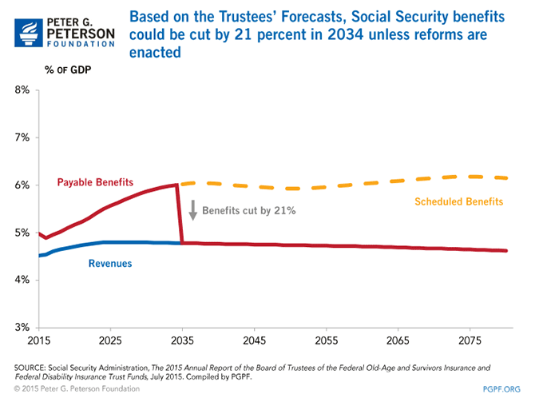
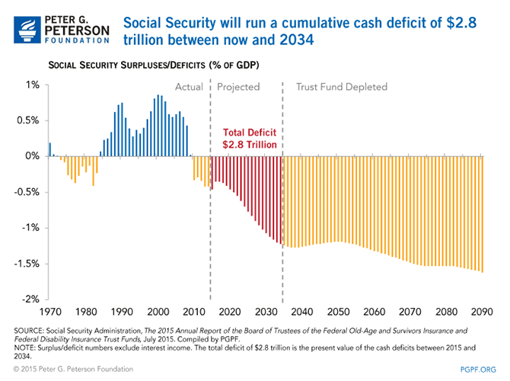
美国社保改革形势

Slide 11
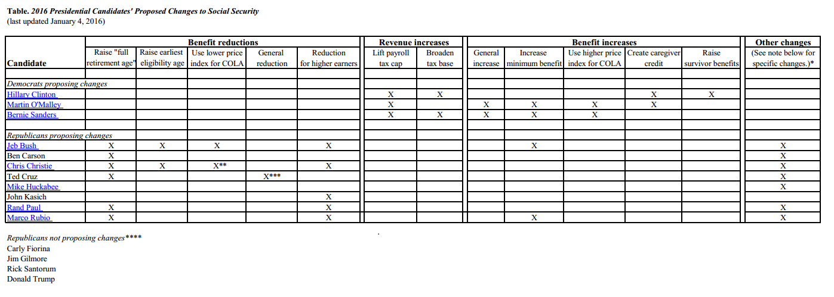
2015年美国各总统候选人提出的社保改革建议

Slide 12
谢谢！

