Slide 1

  THE CHALLENGE OF SOCIAL SECURITY SCHEME DURING THE CRISIS
María Teresa Quílez Félez
Deputy Director General of Planning and Financial Analysis of Social Security
Madrid, 28 th October 2015

Slide 2

Overview
Focus areas of EU co-operation in social field & supported by Europe 2020 Strategy:
  Social inclusion (combating poverty & social exclusion; child poverty & wellbeing; homelessness & housing exclusion)
  Social protection (pensions, healthcare, long-term care)
  Each includes: shared objectives, agreed indicators, monitoring, mutual learning, peer review

Slide 3
EU approach: Major challenges to EU social protection systems
Short-term challenge: The economic crisis and its aftermaths
  Financial, economic and public budget crises aggravate the situation for social protection schemes (fiscal constraints and employment impacts)
Medium and Long-term challenge: Demographic ageing
  Ageing of the 'baby-boomers' generation
  Increasing longevity amid persistently low birth rates
  Shrinking EU working age population
  Future generations: strengthening intergenerational solidarity

Slide 4
Over two years creating NET EMPLOYMENT
Y₁= 240.328.629,767195 - 0,0164877429804076 x
Y₂= -159.851.953,43 + 0,0129557147861302 x

Slide 5
Over two years creating NET EMPLOYMENT
3,17
-4,57

Slide 6
TAX WEDGE
(AVERAGE WAGE)
2.655 €
TAX WEDGE
(WAGE 1.000 €)
1.321 €
TAX WEDGE
(WAGE 1.000 €)
EXEMPTION 1os 500 €
1.321 €
Employer
Employee
Employer
Employee
Employer
Employee
2.070 €
1.620 €
1.000 €
936,5 €
15 €
1.000 €
936,5 €
149,5 €
149,5 €
570 €
570 €
321 €
321 €
171,5 €
171,5 €
126 €
63,5 €
63,5 €
324 €
38,6%
20,1%
29,1%
38,9%

Slide 7
SOCIAL PROTECTION REVENUES
% GDP

Slide 8
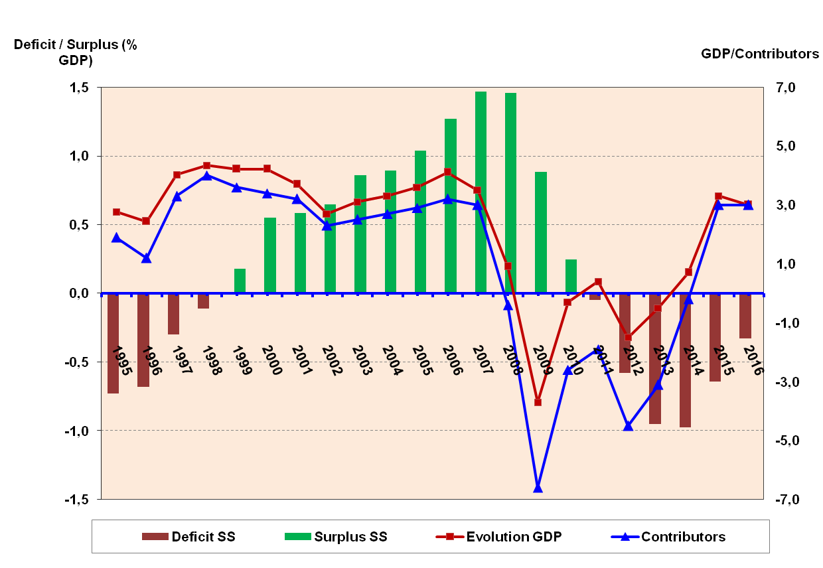
Spanish Social Security is nowadays deeply hit by the crisis and in the future by the aging population.

Slide 9

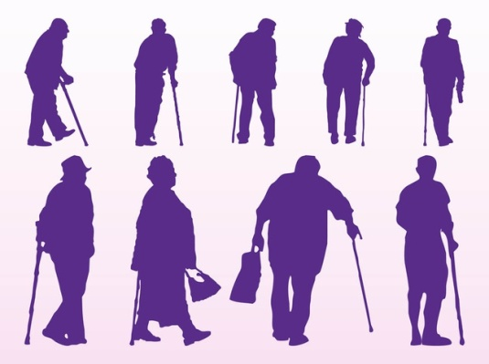

CHALLENGES
Guarantee a public pension system that anticipates to the economic and demographic challenges
The prevention of the risk of poverty

Slide 10
Bringing social & economic objectives together
Should address social consequences of crisis:
Social inclusion
Combating poverty & social exclusion:
– first target in Europe 2020 Strategy
– adequate income support, inclusive labour markets and access to quality services all important
– current focus on minimum income schemes + developing reference budgets for adequacy
– support into secure work key for long-term outcomes
– services should be accessible & of good quality

Slide 11
Social protection
The poverty for people 65+ in the EU is comparable to those in working age.
  At risk of poverty rate 2013 for Total Population: 16.6%
  At risk of poverty rate 2013 for 65 years or over: 13.8%
Strengths and weaknesses of the system
• A guaranteed minimum pension with «high» replacement rates
• Low poverty rate (also after age 65)
• Several levels of competence operating simultaneously
• 3 pillar-system:
  public pension system (pay-as-you go)
  occupational benefit plans (funded)
  individual provident measures (funded)

Slide 12
Public Spanish Social Security System /Modalities
Basic non contributory
Contributory and profesional
Financed by State
Financed by employers and employees

Slide 13
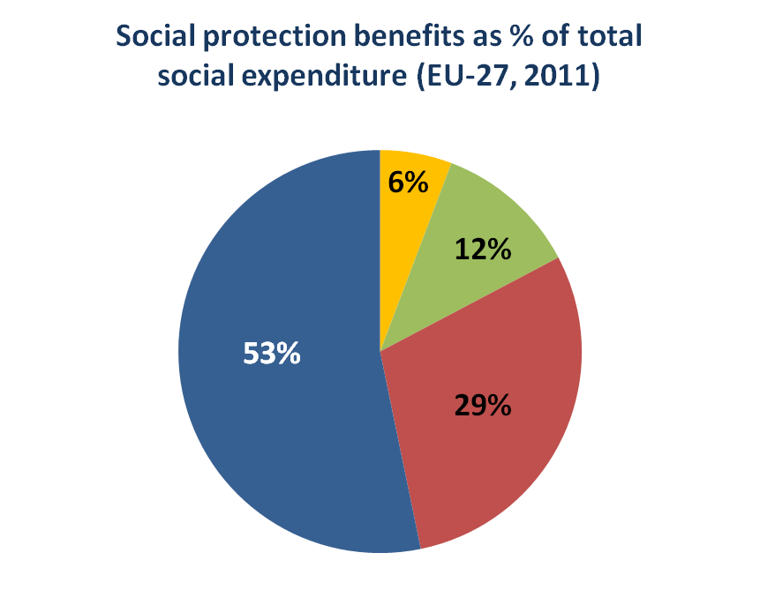
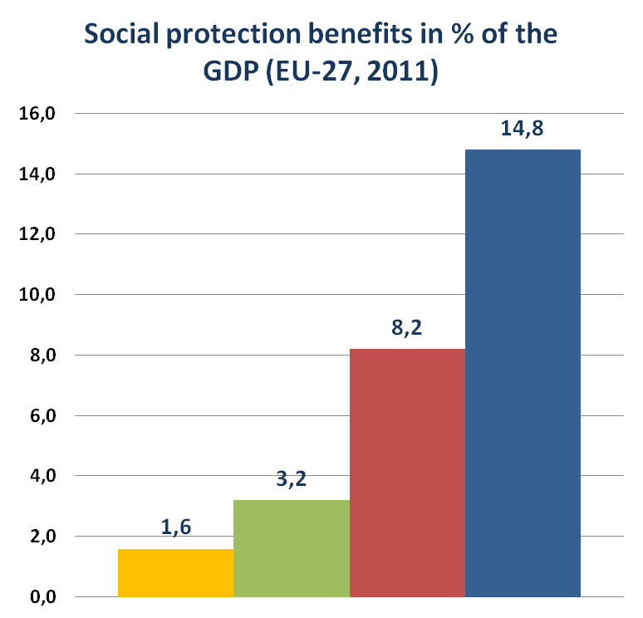
EU approach: Expenses in the EU dedicated for social protection benefits

Slide 14
On-going pension reform
Harmonization of retirement age with life expectancy
More flexibility in the transition to retirement
Harmonization of retirement age between women and men
The focus is on sustainability in order to ensure adequacy

Slide 15
Older workers
Progress was made in terms of employability of older persons
  Weak flexibility of the market
  Potential in terms of training
Incentives to continue working are to further develop
  Positive attitudes of senior workers and retirees
Barriers to staying on job or returning to work should be removed
  No legislation against age discrimination at work
  Innovative age management in companies promote a quality employment for women and men in order to increase the opportunities at the end of the career

Slide 16
Gender differences
Women in the EU are at higher risk of poverty than men (gender gap also in pensions)
Gender gap in terms of insurance coverage
Reflects pay inequalities
…and patterns of women’s employment
Part time workers are mostly women
Women’s careers are often fragmented
Women are overrepresented in the lowest income group (70%)
Lower salaries

Slide 17
Key aims
Highlight the importance of adequacy and examine what makes up an adequate income in old-age
Adoption of policies to deliver longer working lives and higher pension ages could potential provide win-win scenario in terms of enhancing adequacy and sustainability
Public pension systems should contain minimum income provision mechanisms and redistributive features in order to protect people who were unable to build adequate entitlements
Analyze the impact of recent pension reforms
Assess the risks to future adequacy, bearing in mind that financial sustainability and adequacy must always be analysed together
Need for safer and more transparent schemes

Slide 18
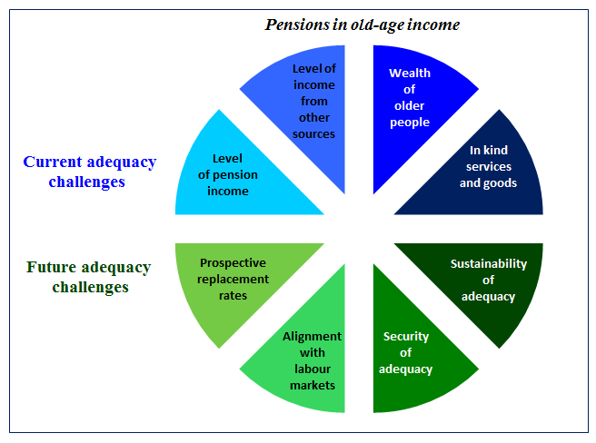
Concept of adequacy

Slide 19
National Reform Plan
1.Sustainability and adequacy PENSION SYSTEM
3.EFFICIENCY IN THE MANAGEMENT OF SOCIAL SECURITY
2.COMBATING FRAUD

Slide 20

The 2011-2013 reforms of the social security pension system
Legal retirement age is “increasing”
2015
2027
65 years
(with 35 years and 9 months of contributions)
Or
65 years and 3 month
(with less contributions)
65 years
(with 38 years and 6 months of contributions)
Or
67 years (with less contributions)
The requirements for early retirement are being tightened gradually

Slide 21
…Promoting active aging. Late retirement
Late retirement
An increase in the accrual rate will be applied for each year of contributions after the legal retirement age:
For careers lengths
          below 25 years …………………………+ 2%
          between 25 and 37 years………….+ 2.75 %
          over 37 years…………………………….+ 4%
Active retirement: compatibility between retirement pension and active life.
Old age pensions are compatible with paid-employment and self-employment, regardless whether the work is on full-time or part-time basis, provided that the pensioner has reached the statutory retirement age. The pension benefit will be equivalent to half of the amount the pensioner would be entitled to, excluding minimum top-ups. (19,522 pensioners)

Slide 22
…Sustainability factor
The Sustainability Factor (FS) is an automatic link between the amount of retirement pension benefits and developments in life expectancy of pensioners. The mathematical formulation of the Sustainability Factor:
Pension = Regulatory Base *% years contribution * FS ≤ Maximum Pension
Being:
t = the year of the factor, taking values from the year 2019 onwards.
is the annual change in a five year period life expectancy at age 67, acording to the mortality tables
of the population covered by Social Security, calculated using the following formula
Fixed value applicable for the calculation of FS in the years 2019 to 2023 = 0.9953
Fixed value applicable for the calculation of FS in the years 2024 to 2028 = 0.9960
2012
Link benefits to life expectancy
2017

Slide 23
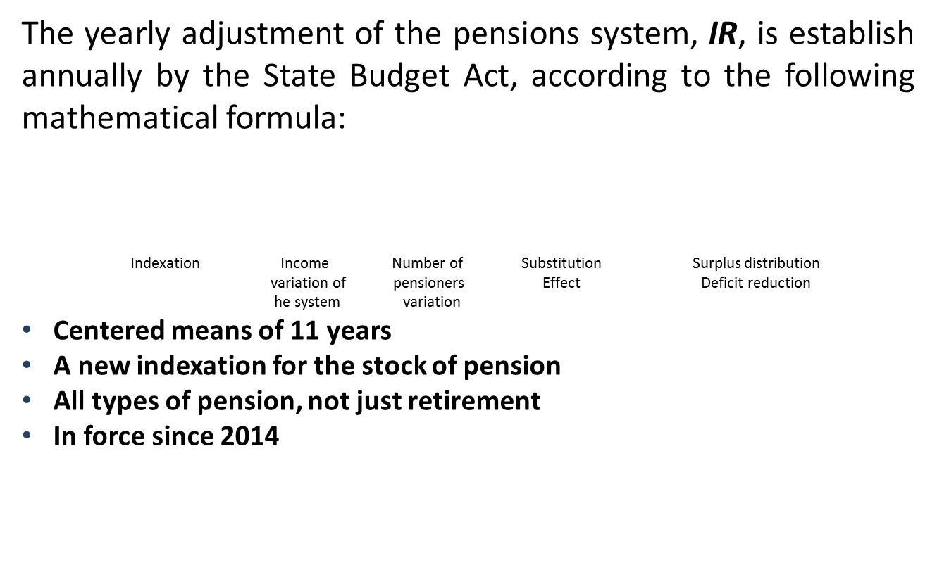
…Revaluation Pension Index
Minimum value of IR = 0.25
Maximum value of IR = CPI + 0.50

Slide 24
… EU approach: How to address these challenges?
The answer is active ageing
A Social Investment Approach
Empowering and supporting people in crucial stages of their lives, starting in childhood
Focusing on prevention (keeps larger economic and social costs from arising in the future)
Developing human capital (gives people the skills and capabilities to participate in society)

Slide 25
… EU approach: How to address these challenges?
The answer is active ageing
Long term care, Health care and Pensions
Policies reducing care demand (improving prevention, rehabilitation and the capacity for independent living)
Policies boosting care services quality (support informal carers; raise quality care provision; use of ICT in drives for higher productivity)
Ensuring accessible, high-quality and sustainable health care
Policies improving the sustainability and adequacy of public pension schemes

Slide 26
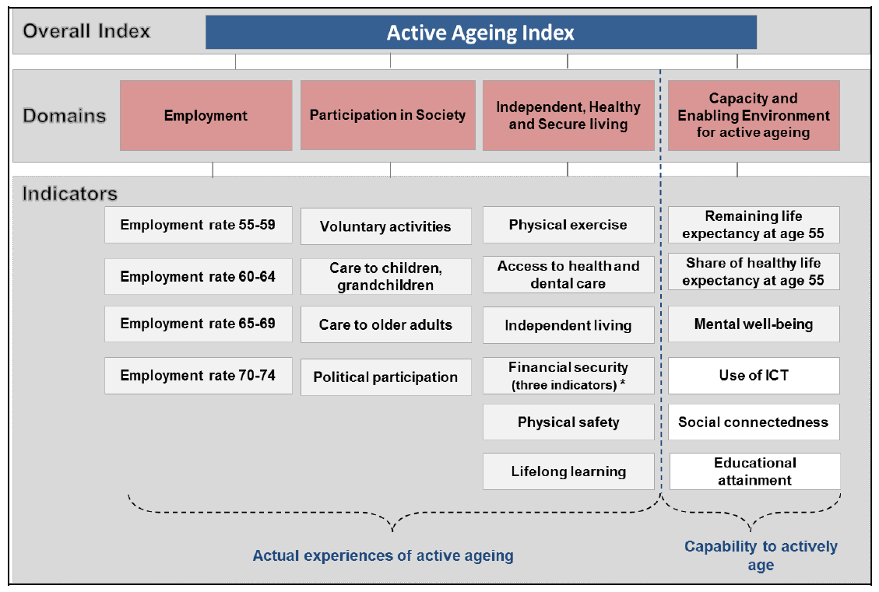
EU approach: Active Ageing Index
The Active Ageing Index (AAI) is a new analytical tool that aims to help policy makers in developing policies for active and healthy ageing

Slide 27
The Social Security Balance. New Targets Indicators
Longer working lives
  Pension expenditure 2014-2015 will grow up less than 2012
 | Before reforms 2012 | After reforms 2014 (Transitory period)
Increase effective retirement age | 63.9 years | 64.1 years
Decreases early retirement | 42.2% | 41.3%
Components of expenditure
 | 2013 (%) | 2014 (%) | 2015 (%)
Average benefit without revaluations | 1.7 | 1.6 | 1.6
Revaluations | 1.5 | 0.25 | 0.25
Number | 1.6 | 1.4 | 1.2
Total (%) | 4.9 | 3.3 | 3.0

Slide 28
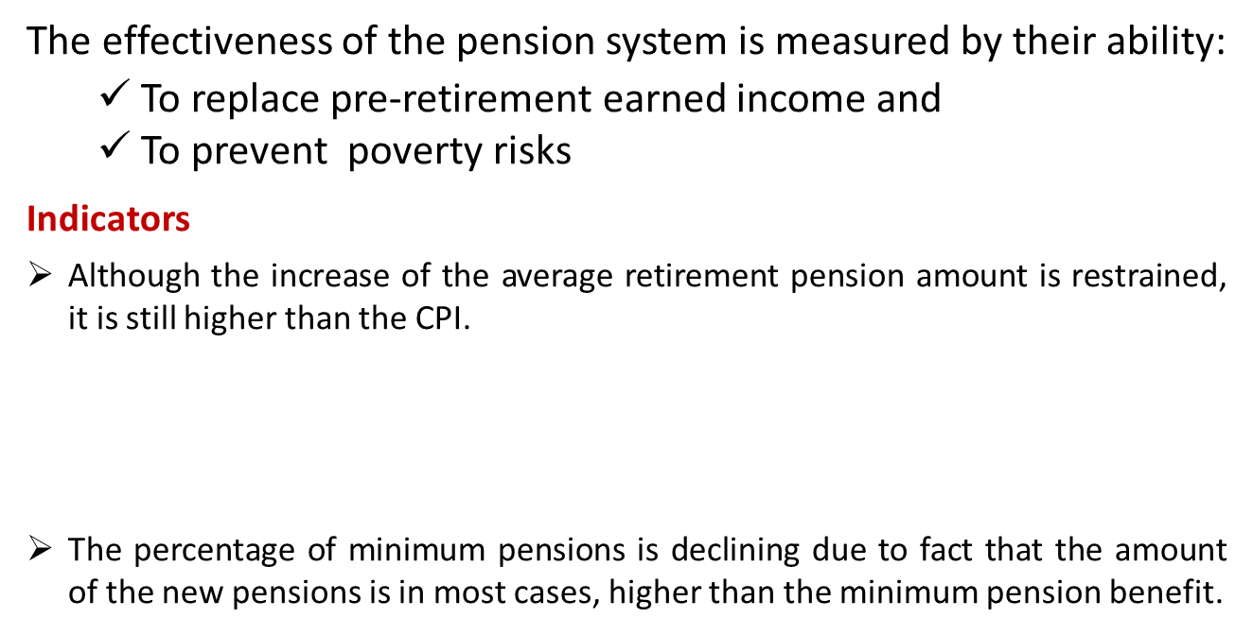
The adequacy. New Targets Indicators
 | 2012 (%) | 2013 (%) | 2014 (%)
Retirement pension | 3.5 | 3.4 | 2.1
CPI | 2.9 | 0.3 | -1.0
Ratio mínimum pension
 | 2012 | 2014
Retirement | 26.6% | 25.5%

Slide 29
The adequacy. Minimum Pension Provision
Tax Financed top-ups system for the contributory pensions.
Pensions top-ups will be applied in all cases:
  Full time or part-time workers. Temporary and indefinite contracts
  All types of activities.

Slide 30
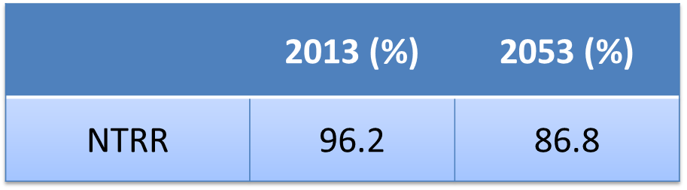
The adequacy. Minimum Pension Provision
The adequacy.
Net Theoretical Replacement Rate is one of the highest in the EU.
By law, the Government every five years will prepare a report, for its presentation to the Congress of Deputies and social partners about the reforms regarding the sufficiency and adequacy of the Social Security pensions.

Slide 31

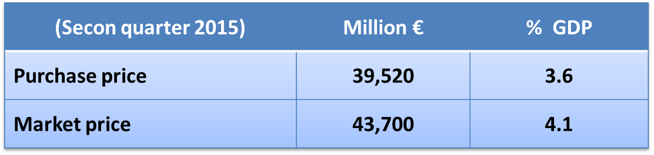
The Social Security Balance
Social Security pension expenditure (%GDP)
Future expenditure will be kept in a range of 10% - 11% GDP
The social security reserve fund has covered the deficit in past years and nowadays
The future surpluses and deficits are balanced with the reserve fund

Slide 32
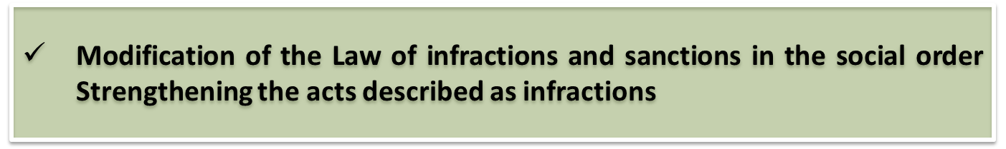
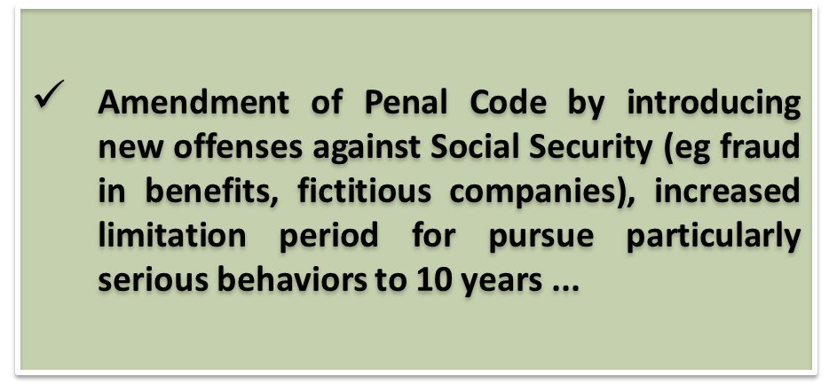

ANTI-FRAUD MEASURES REGULATIONS

Slide 33
Management reforms
Raising social contributions
The new direct system of payment of social contributions will allow to take an active role in the enterprise's payment process , moving from a model of self-settlement to a new billing model.
The priorities are to minimize the mistakes in the implementation of the contribution rules, to compare the data in advance and to facilitate the payment of the contributions through telematics means.
The system will automatically apply the price increases and/or reductions, achieving greater legal security, and will give an individual calculation for each worker‘ contribution. In conclusion, the system will be guarantee against possible irregular situations in the income of contributions.
The system apply to 1,500,000 companies with 13,000,000 employees, and more than 3,000,000 self-employed.

Slide 34
Management reforms
Informing the worker all his working life data
“Your social security” is a virtual space where citizens can access by digital signature to:
        Information about their working lives
        Make simulations of their future pensions
        Applications for benefits
New regulation for the citizens’ right to access the information in regard to the Social Security system
Electronic Administration

Slide 35
The new direct system of payment of social contributions will allow to take an active role in the enterprise's payment process , moving from a model of self-settlement to a new billing model.
THANK YOU
More information can be found at:
www.meyss.es
www.seg-social.es

