Slide 1
SELECTED EXAMPLES OF NATIONAL ACTIVE LABOUR MARKET POLICIES: BELGIUM
Dr. Koen Vleminckx
Component Two- 2016 Training Course “European practices in the Governance, Financial Management and Strategies for a Sustainable Social Security System”
Italy, October 16th -30th, 2016

Slide 2
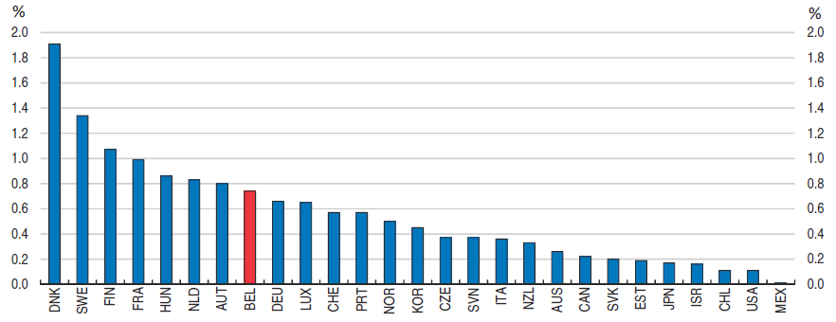
Public Expenditure on Active Labour Market Programmes (ALMP), %GDP, 2014
Source: OECD Economi Survey on Belgium, June 2017

Slide 3
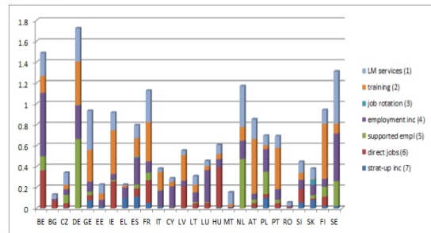
ALMP Expenditures by type of action

Slide 4
More emphasis on training?
There is scope to improve the spending mix and increase public expenditure
on training, which at 0.16% of GDP in 2014 is around the OECD average and
below the average level of neighbouring countries.
According to OECD, in Belgium these training programmes should primarily aim
to improve the skills of those with lower educational attainment.

Slide 5
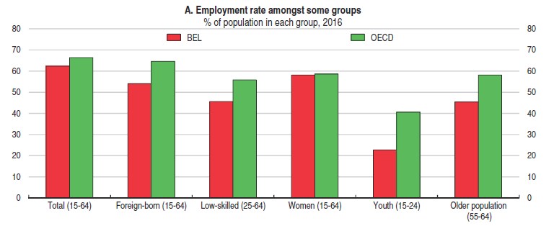
Employment rate, % of population in each Group, 2016

Slide 6
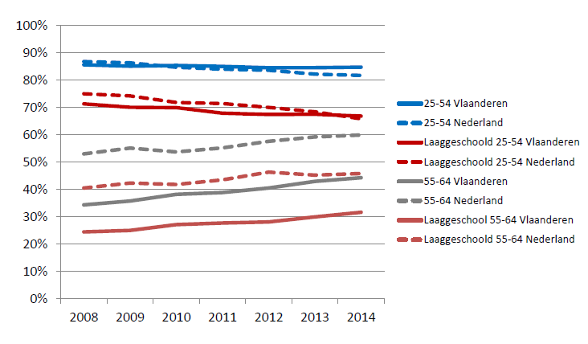
Belgium – Netherlands: Employment Low Educated

Slide 7
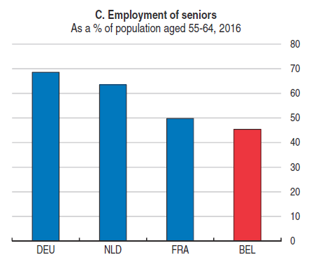
Employment of Seniors (aged 55-64 as % of population, 2016.

Slide 8
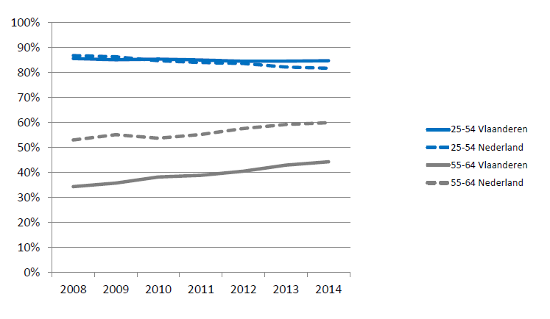
Employment Rates Compared: Belgium - Netherlands

Slide 9
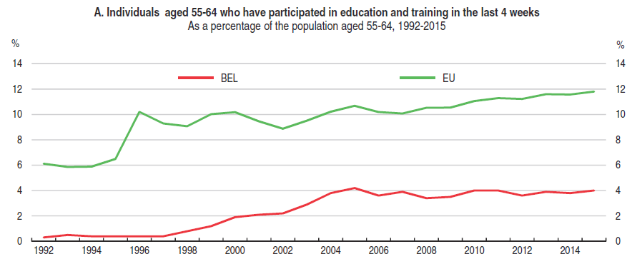
Low Participation of Seniors is Education and Training

Slide 10
Employment rate, % of population in each Group, 2016

Slide 11
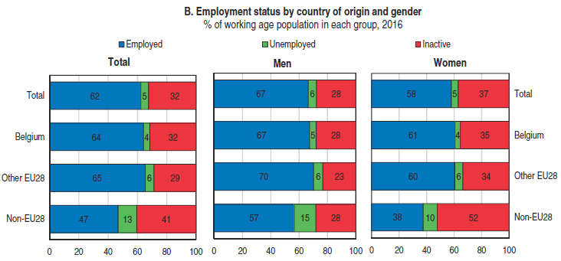
Employment Status Immigrants: Employment Status by Country of
Origin and Gender, % of Working Age Population,2016

Slide 12
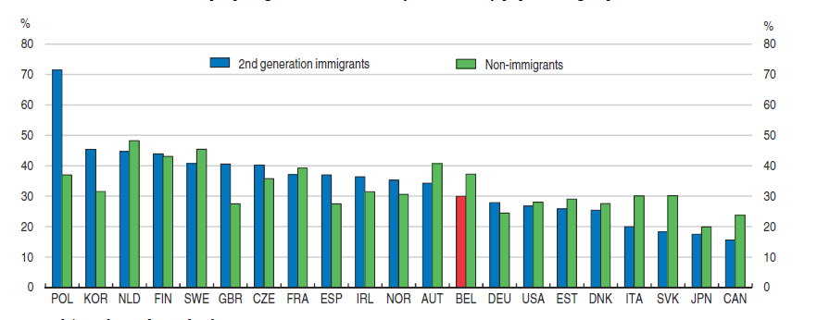
Share of people aged 25-34 with tertiary education by population group, 2012

Slide 13
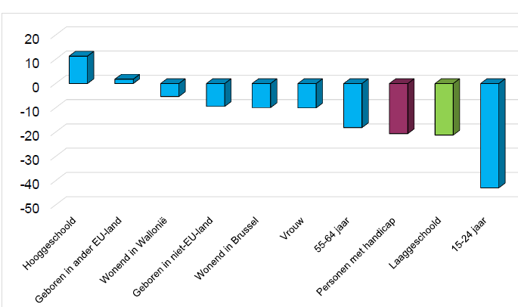
Probability of being employed in Belgium, 2013

Slide 14
POLICY PRIORITIES SINCE 2004
“Target Group Policy 25-54”: complex set of financial stimuli for the
recruitment and employment of disadvantaged target groups:
People with a work disability
People with low education/skills
Long-term Unemployed
Service vouchers system: subsidized employment for private households
Investing in care and home care
+ education: connection education-labor market, schools-VDAB (competences)
+ training within companies
+ job carving (customising job duties, usually basic-skilled tasks)

