Slide 1
The Future of Social Protection –
A European Perspective
社会保障的未来发展——来自欧洲的视角
Tianjin, 13 June 2019
2019年6月13日
Jean-Victor Gruat
圭亚
Notes:
This presentation on the Future of social protection in Europe reflects the opinion of the author only, and cannot be construed as representing the project or any other entity’s views. It is based on the author’s experience, on the materials worked out under SPRP framework and on activities conducted by others, notably international organisations specialised in the labour and social fields.
本演讲内容仅代表作者本人观点，不代表中欧社会保障改革项目或其他组织的观点和立场。本次演讲的内容来源于作者本人长期在社保领域的工作经验、中欧社会保障改革项目的相关报告资料、以及其他活跃在社会保障领域的组织机构尤其是国际组织的相关活动等。

Slide 2

Aspects of social protection in Europe to be reviewed:
欧洲社会保障领域的基本情况
A powerful tool
强有力的公共政策工具
Accumulation of reforms
改革沿革
An uncertain future
未来的不确定性
Notes:
Social security protection may be described by some as a colossus with clay feet. Others see it as a more than ever needed instrument at the service of the working class. Things are never as simple as one may pretend or hope they are.
有些人认为，社会保障制度是一个自身有巨大缺陷的庞大系统；也有人认为，它是用于保障劳工阶层的不可或缺的政策工具。不管人们多么一厢情愿，社保制度从来就不是一两句话能解释清楚的。

Slide 3
Social protection in Europe: a very powerful tool for public policies
欧洲社会保障制度：强有力的公共政策工具
Notes:
Be it for social benefits or for social expenditure more generally – includes benefits in kind such as health care – social protection represents quite a substantial proportion of GDP in European and other highly developped countries. With an average of 20%, it mobilizes more than 25% of GDP in 10 countries of great economic significance, and less than 15% only in a few, otherwise considered as vulnerable. Great leverage indeed in the hands of Governments.
不管是指狭义的社保福利还是更广义的社会公共支出（包括社会服务类福利，如医疗服务等），在欧洲及其他发达国家，社会保障在GDP中的比重都是非常可观的。在欧洲，经济最发达的10个国家，其社保支出都超过了GDP占比的25%，只有少数国家的社保支出占比低于15%，而这些国家的经济发展也处于劣势；综合来看，欧洲国家平均社保支出已达到GDP的20%。这对各国政府来说，是一笔巨大的财富。

Slide 4
Social protection seems to work for income redistribution
社会保障对收入再分配的影响
JY Hocquet, SPRP C1, Income distribution – 2018
中欧社会保障改革项目第一部分欧方报告《欧洲部分国家收入分配的相关政策条例——应对贫富差距的一系列举措》，JH Hocquet，2018
Notes:
According to a survey on 4 European countries with different approaches to social protection, documented in a SPRP project report in 2018, social security cash benefits always had a strong positive effect on equality in income distribution. Benefits in kind (health, education, services for children, housing) had an even stronger impact, with a prominent role for health care.
中欧社会保障改革项目2018年的研究报告中，有一项针对欧洲四国（法国、意大利、瑞典、英国）的调查，调查显示，不同的社会保障制度下，社保现金收益与收入分配的公平性有强正相关；服务及实物类福利（医疗、教育、儿童服务、住房服务等）对社会公平的影响更加显著，尤其是医疗服务。

Slide 5
In Europe, Social protection could respond to all major challenges it was confronted to.
在欧洲，社会保障能够抵御其设计范围内出现的所有主要风险。
CRISIS
灾害
AGEING
老龄化
VESTING
转移接续
NEW RISKS
新挑战
MANAGEMENT
管理
Notes:
Examples abound of European social security systems helping overcome economic difficulties and accompany societal changes – such as the alleviating the consequences of 2008 economic crisis and acting as counter-cyclical instrument, responding to demographic ageing through adaptation in benefits, introducing new types of coverage as society evolved, taking into account new family patterns, helping in workers’ mobility required by structural adaptation, accommodating technical upgrades and achieving highest levels of governance.
欧洲各国的社会保障体系旨在帮助民众应对经济困顿和社会变动，具体成效包括降低经济危机给个体带来的损失、作为反周期工具平衡社会分配、通过改善老年人福利应对人口老龄化挑战、根据经济社会发展情况及时引入新的保障内容、将新型家庭结构纳入体系、促进就业流动以适应经济结构调整、配合技术革新、实现最大程度的有效管理等。

Slide 6
Despite its successes and public support, the institution was under constant strain of reforming
尽管取得了巨大成效和公众支持，各国的社保制度始终面临改革的压力
Notes:
Social protection is a complex institution that requires stability to work efficiently and keep customers’ trust and confidence at high level. However, according to the database of the ISSA, over the 20 years between 1995 and 2015, 27 EU countries – all except Cyprus – and Switzerland underwent 58 major public pension reforms. Almost all of them impacted negatively on the current or future pensioners – retirement age, disability benefits, early retirement, benefits formula, indexation, qualifying conditions, opting out … were affected. Full table in Technical Notes under http://www.euchinasprp.eu
社会保障是一个复杂的制度体系，它需要保持一定的稳定性来维持其运作效率和受众对该体制的高度信心。然而，来自国际社会保障协会(ISSA)的统计数据显示，在1995到2015这20年间，27个欧盟成员国（除塞浦路斯以外的所有成员国）以及瑞士，总共进行了58项针对公共养老金的改革；几乎所有的改革举措都对目前及未来的老龄人口不利——负面影响包括退休年龄、残疾福利、提前退休、福利核算、替代率、领取条件、退出机制等。（详细表格见项目技术性报告http://www.euchinasprp.eu）

Slide 7
Somehow, the future may be in jeopardy
未来不容乐观
NEW FORMS OF EMPLOYMENT
新型就业
COST (SUSTAINABILITY)
成本（财政可持续性）
NEW RISKS
新的风险
INEQUALITIES
不平等现象
IDEOLOGICAL CONSIDERATIONS
意识形态问题
Notes:
European societies are changing – and these changes may strongly affect the future of their social protection systems. New forms of employment and working conditions, very different and more unfavorable to the workers, are spreading; decision makers act on behalf of employers less and less involved in productive activities but more vocal in their claims that cost of social security becomes unbearable; ageing population and shrinking families point to new risks and potential higher expenditure as time passes; social security is blamed for not solving basic social and economic inequalities it was not supposed to address; and, most important, the so-called “market forces” effected a very powerful come-back over the last 25 years, leading to a questioning of the fundamental values of social security institution itself – an institution they consider as incompatible with predominant free market approaches.
欧洲社会正在发生变化——这些变化可能会对欧洲各国的社保体系产生巨大的影响。新型的就业和劳动模式的出现和普及，可能对员工的社保福利带来不利影响；决策者更少参与生产活动、更多地站在雇主的立场上，言必称社保成本已经不可负担；人口老龄化、家庭少子化给社保制度的未来带来巨大挑战；社保制度也承受着无法解决最基本的社会经济不平等的责难，尽管这并不是它能够解决的问题；更重要的，所谓“市场的力量”在过去25年中不断占据主流意识形态，这使得社会保障制度的根本价值不断受到冲击和质疑——因为它被认为与终极的自由市场经济理念背道而驰。

Slide 8
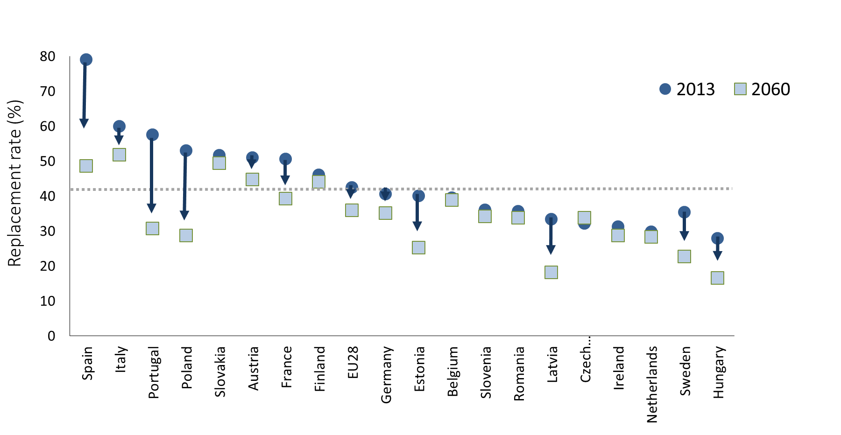
SUSTAINABILITY
可持续性
Notes:
The EU policy formulation framework for its member States attaches a very high importance to financial equilibrium in Government spending – hence a rather strict discipline imposed to public spending which directly affects the social sphere. This contributes to explaining why a multiplication of reforms in notably public pension schemes parameters (age, qualifying conditions, level of benefits, indexation, taxation …) that progressively build up compound effects. It is estimated on the basis of known reforms that at the horizon 2060 the public pension replacement rate will in the EU have fallen below the 40% threshold – the recognized minimum in 1952 . Decrease will be particularly important in certain countries, representing up to 30 percentage points in Spain, Portugal or Poland, despite efforts otherwise required concerning retirement age or length of contributions period. Since the most vulnerable will not be in a position to afford supplementary protection, the re-emergence of poverty among pensioners which had been successfully combatted across the EU seems to be looming back. People will work longer for lower pension benefits.
欧盟成员国的政策制定框架十分强调政府支出的财政平衡，因此，对于公共开支相对严格的要求和限制直接影响了社会运行的各个层面。这也在一定程度上解释了在社会保障领域，尤其是对公共养老金参数（年龄限制、领取条件、待遇水平、指数化、税务等）不断推行的改革措施，是如何一步一步产生了累积的效应。根据目前的改革进程，预计到2060年，公共养老金的替代率将降至40%的阙值以下——这是1952年认定的最低替代率水平。在一些国家如西班牙、葡萄牙或波兰，公共养老金的降幅甚至将超过30%，其他参数诸如退休年龄或参保年限的延长都将于事无补。社会中的弱势群体将无法负担补充保险，领取养老金的人群中出现贫困人口的惨淡状况将重现，而这正是欧盟各国在过去已经成功消除的情况。人们要工作更长的时间，得到的却是更低的养老金待遇。

Slide 9
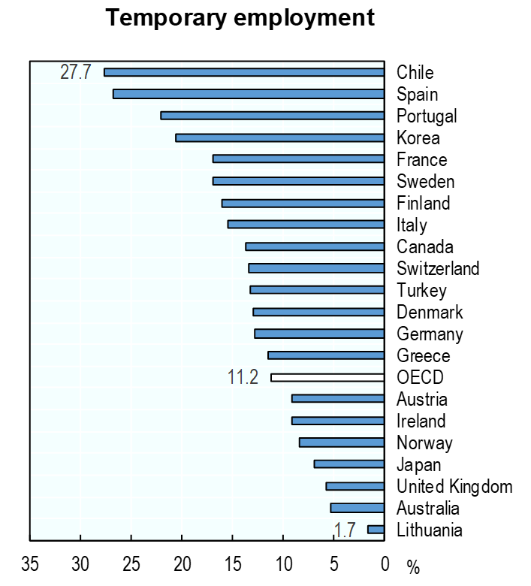
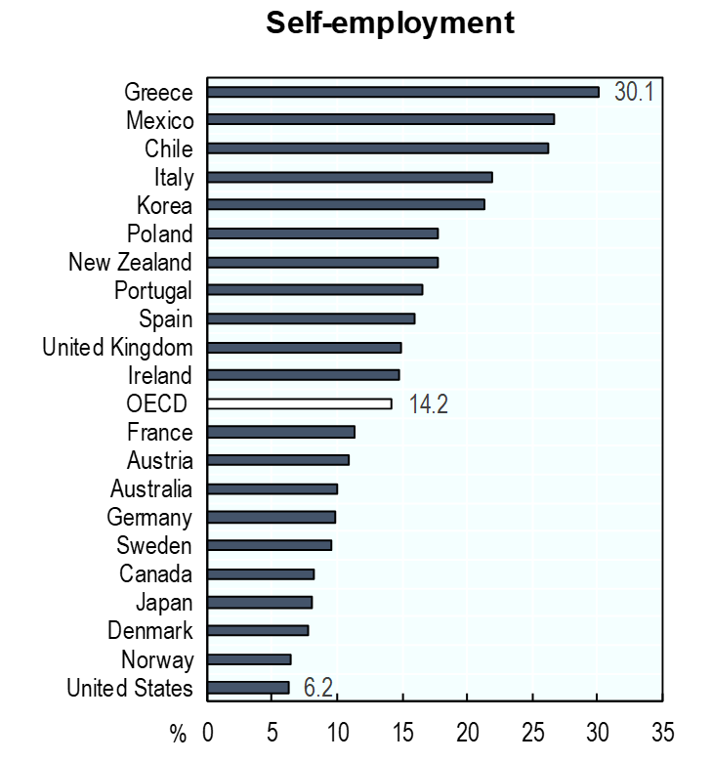
NEW FORMS OF EMPLOYMENT
新的就业形式
OECD Employment outlook, 2019
《OECD就业展望2019》
Notes:
Atypical forms of employment are not negligible throughout Europe and other highly developed economies. They are likely to spread further, since this model obviously responds to some expectations of leading theoreticians in terms of employment flexibility, labour cost and limited social responsibility. Workers will most likely be more and more to engage simultaneously with multiple employers, to experience loopholes in their careers and to suffer from incomplete or too low social security records. The fact that this will lead to lower levels of social security protection seems to be broadly “accepted” as a quid pro quo for less compensated unemployment. Solutions to efficient social protection for such workers are still to be identified. It might start from better employment conditions in individual countries and across Europe. The risk however is that of downwards pressure towards homogenization of protection at a minimal level.
非典型就业在整个欧洲和其他发达国家都不容忽视。目前来看，这种就业形式还会进一步扩散，而它的扩散也符合一些理论家关于灵活就业、劳动力成本和有限社会责任的理念。在未来，劳动者同时为多个雇主工作的情况将越来越常见，与此同时，职业发展的断裂点以及过低的社保记录也将无法避免。相比失业后领取更少的救济金，对人们来说，这种灵活就业带来的低水平社保似乎是“可以接受的”。如何给灵活就业人群提供高质量的社会保障，还没有明确的解决方案。也许，在各国以及欧洲层面改善就业条件是一个好的起点。然而，这也给均质化的最低保障带来进一步恶化的风险。

Slide 10
New social risk
新的社会风险
Notes:
Continued demographic ageing –a process that started decades ago across Europe – and the accompanying changes in living patterns where children less and less would host dependent parents until more and more advanced ages – has led to a growing concern on how to accommodate the expectations of dependent ageing – and otherwise disabled – persons to still leave a decent life. Alternative to hospitalization, long term care is often described as a new social risk per se, which may generate quite substantial expenditure. 40 years from now, long term care expenditure may represent up to 9% of GDP in certain countries (Norway), with a relative increase of 75% in other cases (Netherlands) and 1 to 1.5% GDP percentage points more to be allocated to long term care in 13 other countries. Of course, increase in expenditure is not only related to ageing, it has to do with the quality and extension of services available to the concerned population. Coverage of this risk as a specific branch of social security is not yet widely developed in Europe, and trend may continue towards this type of development. Simultaneously, progressive retirement and the pursuance of active ageing are seen as likely to slow down the development of long term care needs. The European Commission has established an ad hoc structure to review developments in ageing across member states https://europa.eu/epc/working-group-ageing-populations-and-sustainability_en , and the OECD also has established its own programme in this respect https://www.oecd.org/els/health-systems/long-term-care.htm.
欧洲的人口老龄化进程已经有数十年时间，与之伴随发生的情况是，老龄人口的子女愿意与父母同住并提供起居照料的情况也在不断减少，即使有这种情况，被照料的父母往往都已经年迈。如何保证老有所养、老有所依，保证有看护需求的老年人或者残障人士的生活质量，这一问题引起了人们的高度关注。长期护理作为长期医疗的替代方案，因为其高额的运行成本，常常被认为会带来新的问题。据估算，40年后，挪威的长期护理社会成本将达到GDP的9%；在荷兰，长期护理的社会成本将增加75%；在其他的13个国家，这一数字占GDP的比重都将有1%-1.5%的增幅。当然，支出的增加并不仅仅因为老龄化，也与长期护理服务质量的提高以及服务范围的扩大相关。在欧洲，主流上还没有将长期护理作为社会保障体系的一个特别分支对待，未来的发展趋势也并不倾向于这种途径。与此同时，渐进式退休和积极老龄化的风潮也有可能进一步延迟长期护理需求的出现。欧盟委员会已经成立特别专家组，以评估各成员国老龄化的程度和发展趋势（https://europa.eu/epc/working-group-ageing-populations-and-sustainability_en），经合组织也有类似的项目（https://www.oecd.org/els/health-systems/long-term-care.htm）。

Slide 11
Inequalities
社会不平等
Notes:
Among the most commonly used arguments in favor of dramatically reforming public social security, one finds the fight against alleged or real inequalities – inequalities between women and men with often as a result a decrease in women’s benefits; inequalities among generations, with often as a result a decrease in prospective guaranteed benefits for currently active population; inequalities among employees and between employees and other categories which often results in an alignment with the lowest levels of protection, etc. This trend may be confirmed in future. It is true that, while European GDP in individual countries - be it globally or per head count - has never been this substantial, resources seem to be lacking to finance public social protection through contributions based on salaries. The main reasons for this apparent contradiction may stem from the fact that the evolution in the cost of social protection is not strictly proportional to wages (e.g. cost of medical care grows at a far faster pace, especially when imparted by the private sector) on the one hand, and from wages not progressing at the same rhythm as labour productivity since the year 2000 on the other hand. High levels of unemployment is another factor adding to financial difficulties – and these “inequalities”- in income, in access to employment, in enjoying decent standards of living – should certainly be addressed by a forward looking European leadership.
所有支持对公共社会保障体系进行大力改革的论点，都绕不开消除社会不平等的主题——女性和男性在劳动力市场中的不平等，尤其是女性待遇地位较男性明显偏低的现象；社会保障待遇的代际不平等，即与上一代人相比，当前的劳动力人口的社保待遇呈下降态势；企业雇员待遇的不平等，以及企业雇员待遇与其他劳动者待遇的不平等，这导致最低保障的底线被拉低；等等。这些不平等现象在未来会越来越明显。毋庸置疑，尽管欧洲各国的GDP（GDP总量或人均GDP）已经达到空前的水平，基于工资收入收缴的社会保障费用却出现了明显的不足。出现这一矛盾的主要原因，一方面可能是由于社保成本的上浮与工资待遇的增长速度不成比例（例如，医疗服务的成本增长迅速，尤其是引入私营机构以后），另一方面，也是由于进入21世纪后，工资待遇的增长与劳动力水平的增长不匹配。除此以外，居高不下的失业率是另外一个加剧财政困境的因素。这些“不平等”的情况——收入水平、就业机会、生活质量——这些问题都应该得到一个具有进步和发展意识的欧洲政府的高度重视。

Slide 12
Ideological considerations
意识形态问题
ILO 2018 – Reversing pension privatization
《扭转养老金私有化趋势》，国际劳工组织，2018
Notes:
As a matter of fact, the values underlying social security protection like solidarity, non profit, democratic management, predictability, work as source of wealth and welfare … have been increasingly questioned in ruling European quarters where other values prevail, more linked to private, and above all, financial management. The fact that this type of approach produces allegedly unexpected results in terms of social development does not seem sufficient to run counter a very strong tendency – even though, after a few decades of experience, more than half – 18 out of 30 – of the countries that had opted for pensions privatization, once the flagship of neo-liberalism applied to social security – have decided to come back to public pensions management.
事实上，社会保障制度的底层价值体系——团结、非营利、民主管理、可预测性、同时为了财富积累和公共福利而工作……这些价值观正受到来自欧洲执政体系的持续冲击，因为它们与当今政府信奉的市场化、私营化、社会管理财政化等逻辑截然不同。尽管人们已经看到这种管理手段给社会发展带来了所谓“不曾预料到”的后果，但还是无法抵御强大的新自由主义市场经济对社会保障领域的影响。然而，经过数十年的社会实践后，在推行养老金制度私有化的欧洲国家中，已经有超过半数（30个中的18个）的国家决定重回养老金公共管理的轨道。

Slide 13
Is social security an obsolete instrument ?
社会保障制度过时了吗？
OECD 2017 – Measuring social protection for long term care
《社会保障与长期护理》，经合组织，2017
Notes:
Reducing social security protection down to its function of poverty alleviation, deciding a priori how much can be spent on overall welfare, sidelining from hardly any decision making in the field the main beneficiaries and financers of social security protection, i.e. salaried employees, is supposed to promote individual protection as an alternative to the collective and solidarity spirit that founds social security. There would then be, instead of universal unified protection proposed by social security, a dual approach : minimum benefits or services for the majority, and upgraded protection by steps according to the means devoted by individual to purchasing supplementary protection. This type of movement is quite widespread across Europe – where it generates discontent and opposition votes by the people that could lead to prevailing skepticism about democracy and the so-called European model and values. One may doubt anyhow that individual protection through insurance companies would provide to the vast majority of those in need appropriate responses to needs such as long term care, which cost levels definitely require solidarity between dependent and non dependent people to achieve universal coverage.
将社保制度的功能压缩为消除贫困、根据财政预算倒推可以提供的福利、将社会保障制度中最大的受益人和支付者——企业员工排除在社会保障决策体系之外……这些措施正在降低社会保障的集体性功效，并推动民众为自己的生活保障负责。这样一来，就会出现双轨制：社会保障为大众提供最低层次的保障和待遇水平；阶梯式补充保障则由个人自行支付购买。这一逻辑在欧洲大行其道，招致民众的不满和反对，也为民主制度以及所谓的欧洲模式和价值体系蒙上阴影。人们对私营保险公司的质疑在于，这些公司无法为最需要受到保障的民众提供个人保障——其成本之高，如果没有社会各界共同参与，根本无法实现全民保障。

Slide 14

Further data and information
参考资料
Notes:
The bilingual project website – http://www.euchinasprp.eu – contains a wealth of data and information on all aspects of social protection – in Europe as indeed in China.
关于中国及欧洲社会保障的更多资料，请参考项目官方网站（双语）——http://www.euchinasprp.eu。

