Slide 1
社保降费形势及参保意识提升
Reducing of Social Insurance Contribution
and Raising Participation Awareness
Tianjin, 13 June 2019
房连泉 Fang Lianquan
CASS

Slide 2
全国社保参保及基金收入情况 Social Insurance Revenue and expenditure
五项社会保险基金收入情况

Slide 3
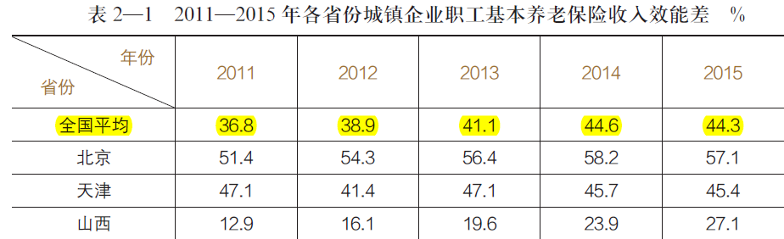
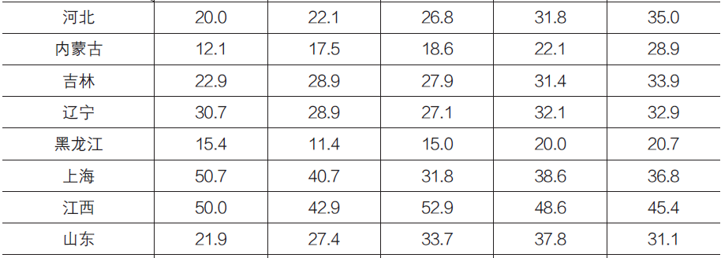
About 1/3 revenue gap on pension contribution collection
各地普遍缴费不足，理论上有1/3收入上升空间

Slide 4
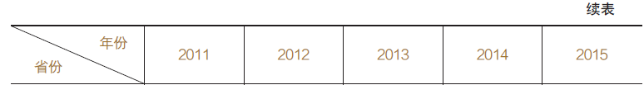
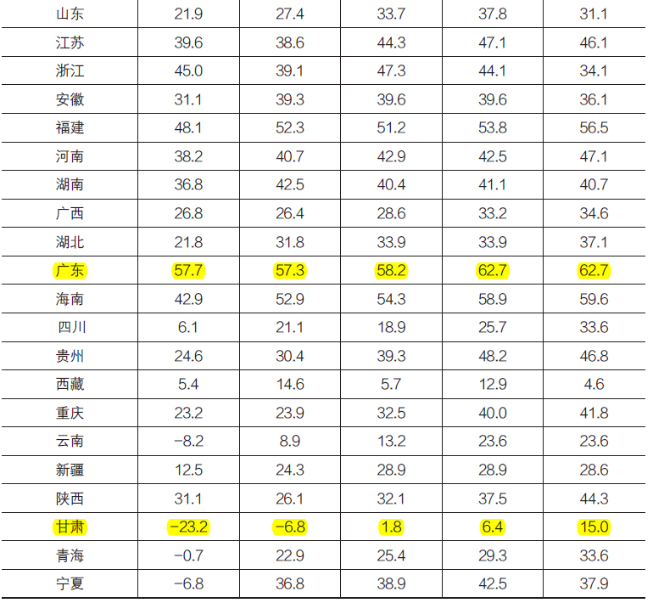
Revenue gap ctd.

Slide 5
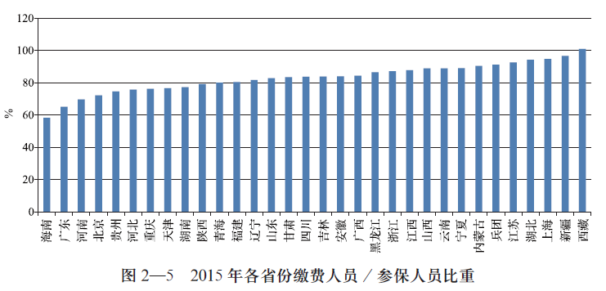
中断缴费的情况 Contributors gap

Slide 6
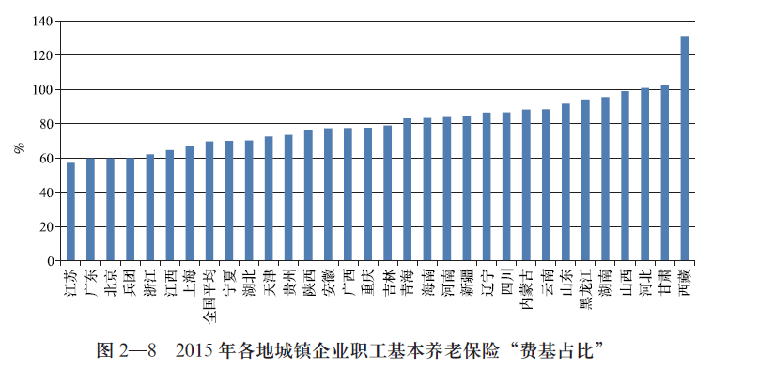
缴费基数不实的问题 (contribution base/ social wage %)

Slide 7
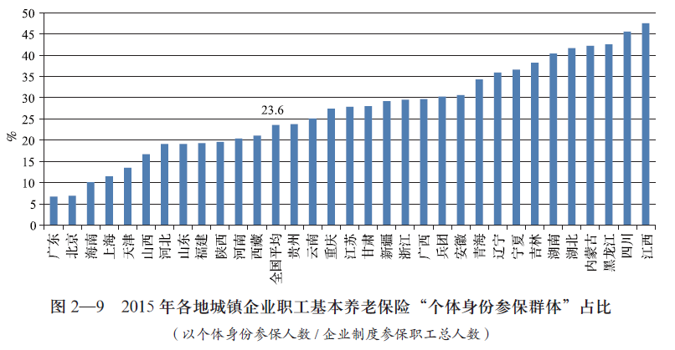
Self employed/ total participants % in urban pension system

Slide 8
Dual Reduction on social insurance contribution
双降政策
一是企业缴费由20%可降至16%
Firstly, the enterprise's contribution can be reduced from 20% to 16%.
二是调低最低缴费基数政策，采用新的加权社平工资口径
The second is to reduce the minimum payment base policy and adopt a new weighted social wage scale.

Slide 9
降低费率影响
以2018年为例，降4个百分点预计造成基金征缴收入减少(降负)4000亿元左右。
第一类为当前已处于“收不抵支”状态的七个省份（辽宁、黑龙江、吉林、内蒙古、浙江、青海、宁夏），主要分布在东北和中西部地区。这些省份的人口结构老化、历史负担沉重，降费后基金支出压力进一步加大。
第二类是基金结余量较小、收支维持基本平衡的十几个省份，主要分布在东部和中西部。这些省份实际社保缴费水平已处于高位。从测算结果看，如执行4个点的降费政策，2019年后将有9个省份基金结余“转盈为亏”（甘肃、山东、江西、广西、山西、陕西、湖北、上海、江苏）。
第三类为基金结余量较大的七、八个省份（广东、北京、四川、湖南、福建、云南、安徽等），主要分布东部沿海和中南部。这些省份的累计结余规模大，倾向于将费率“坐低”，从中受益。实际上，目前已有个别省份的政策费率低于16%（企业缴费部分），例如广东为14%。

Slide 10
Effects of Cutting 4% of pension contribution
Taking 2018 as an example, a 4 percent reduction is expected to result in a reduction of about 400 billion yuan in fund collection income.
The first category is the seven provinces (Liaoning, Heilongjiang, Jilin, Inner Mongolia, Zhejiang, Qinghai and Ningxia) which are in the state of "no income over expenditure", mainly distributed in the northeast and central and Western regions. The population structure of these provinces is aging and the historical burden is heavy. The pressure of fund expenditure is further increased after the cost reduction.
The second category is more than a dozen provinces with small fund balances and basically balanced revenue and expenditure, mainly distributed in the eastern and central and Western regions. The actual level of social security contributions in these provinces has been at a high level. From the calculation results, if the four-point fee reduction policy is implemented, the fund balances of nine provinces will "turn profits into losses" after 2019 (Gansu, Shandong, Jiangxi, Guangxi, Shanxi, Shaanxi, Hubei, Shanghai, Jiangsu).
The third category is seven or eight provinces with large fund balances (Guangdong, Beijing, Sichuan, Hunan, Fujian, Yunnan, Anhui, etc.), which mainly distribute in the eastern coast and the central and southern regions. The cumulative balances of these provinces are large and tend to benefit from "sitting low" rates. In fact, the policy rate of some provinces is less than 16% (enterprise contribution), for example, Guangdong is 14%.

Slide 11
4%降费对各省份基金当期结余的影响测算
（2019年） 单位：亿元
Estimation of the Impact of 4% Fee Reduction
on the Current Balance of Provincial Funds
(2019) Unit: $100 million
总起来看，上述三类地区的结构性矛盾是非常突出的：越是经济落后和社保财务状况差的地区，负担越沉重，降费政策越难以执行；越是经济发达和财务状况好的地区，负担越轻，降费进一步带来“利好”。
Generally speaking, the structural contradictions in the above three types of areas are very prominent: the more backward the economy and the poor financial situation of social security, the heavier the burden, the more difficult the implementation of the fee reduction policy; the more economically developed and financially well-off areas, the lighter the burden, the better the reduction of fees.

Slide 12
Effects of New contributory social wage base
采用“加权工资”口径调整后
各省实际费率
After adjusting the caliber of "weighted wage"
Actual rates of provinces

Slide 13
社保遵缴率与私营企业就业人员占比之间的回归分析结果
Contribution Compliance Relation with Private Employment

Slide 14
不同行业就业人员参保缴费回归分析结果
Contribution compliance relation with major industry sectors

Slide 15
为什么需要提升意识–WHY RISE AWARENESS
To change the mindset - 转换意识
COST INVESTMENT
费用 投资
SHORT TERM MEDIUM TO LONG TERM
短期 中期到长期
INDIVIDUAL COLLECTIVE
个人 集体

Slide 16
Theory hypothesis on Social Security Awareness
社保强制性的两个原因：
一是防止年轻人的储蓄短视（现金流动性约束）
二是再分配公平（社会价值观）
There are two reasons why social security is compulsory:
One is to prevent the savings shortsightedness of young people (cash flow constraints)
Second, redistribution equity (social values)
参保意识的两个基本假定:
一是“理性人”假设（回报最大化）
二是行为经济学假设（信息不对称、惰性、选择困难等 ）
Two basic assumptions of insurance awareness:
One is the hypothesis of "rational man" (maximizing returns)
Second, behavioral economics hypothesis (information asymmetry, inertia, difficulty in choosing, etc.)

Slide 17
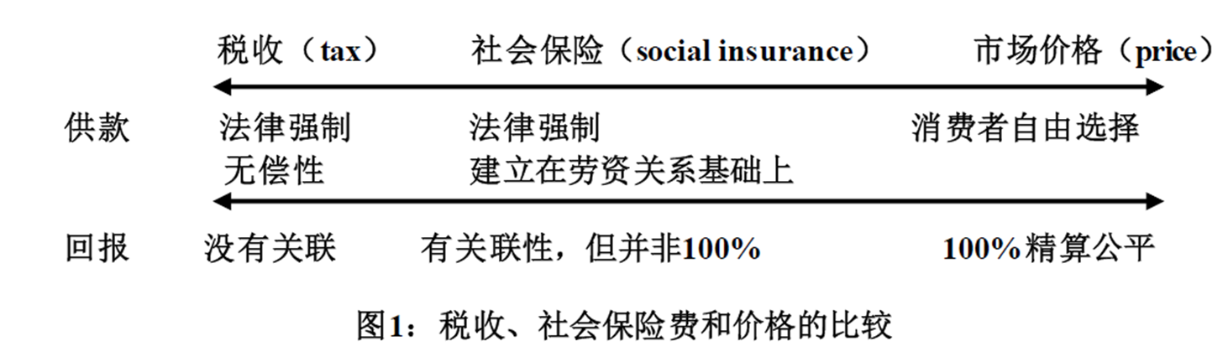
社保与税收的区别
Distinguish Social insurance contribution and tax
一是社保具有补偿性 First, social security is compensatory.
二是社保具有收入关联性 Second, social security has income relevance

Slide 18
制度吸引力：以养老保险为例
Incentive mechanism from pension system
社会统筹部分回报率为：工资增长率+人口增长率
The Return Rate of Social Coordination Part: Wage Growth Rate + Population Growth Rate
60岁退休，缴费满15年，余命16
回报率（不考虑工资增长率）= 15%*16 / （20%*15）=0.8
Retirement at the age of 60 with 15 years of payment and 16 years of remaining life
Return rate (excluding wage growth rate) = 15%*16/(20%*15) = 0.8
55岁退休，缴费满15年，余命21
回报率（不考虑工资增长率）= 15%*21 / （20%*15）=1.4
Retirement at the age of 55, with 15 years of payment and 21 years of remaining life
Rate of return (excluding wage growth) = 15%*21/(20%*15) = 1.4

Slide 19
Booking Interests on Pension individual account
个人账户记账利率：Personal Accounting Interest Rate:
2016、2017和2018年：城镇职工基本养老保险 个人账户记账利率分别为8.31%、7.12%和8.29%
In 2016, 2017 and 2018, the interest rates of individual accounts of basic pension insurance for urban employees are 8.31%, 7.12% and 8.29% respectively.
以年均记账利率7%为基准，不同年限缴费产生的年金额
Based on the average annual bookkeeping interest rate of 7%, the annual amount produced by different years of payment
10年 | 15年 | 20年 | 30年
13.8 | 25.1 | 40.9 | 94.4

Slide 20
流动人口参保率 Participation Rates among migrant workers
 | 企业 | 个人
养老保险 | 16% | 8%
医疗保险 | 10% | 2%
失业保险 | 0.8% | 0.2%
工伤保险 | 0.4%
生育保险 | 0.8%
合计 | 28% | 10.2%
五险缴费率（北京2019）
外出农民工2017（1.7亿人）参保情况
 | 养老保险 | 医疗保险 | 失业保险 | 工伤保险
参保总量(万人) | 6202 | 6225 | 4897 | 7807
参保率 | 36.09% | 36.22% | 28.50% | 45.43%

Slide 21
A survey on quitting pension participation

Slide 22
A survey on the attitude for pension individual account

Slide 23
增强参保意识的主要建议 major suggestions
改革社保制度，简单透明，增强参保激励性和便利性（social insurance reform, promoting incentives, simplification and portability ）
加强参保意识教育，普及社保知识
( Raising awareness education and social security knowledge)
推进社保法制环境建设，引导参保文化
（social security legislation and culture ）

Slide 24
谢谢，请指正
fanglq@cass.org.cn

