Slide 1
Status quo, problems and thoughts on the management of civil servants Pension System
Paris, 25 June 2015

Slide 2
The Italian Pension System
In Italy, the pension system is structured on the basis of the "pay-as-you-go" scheme. That means that the contributions that workers and companies pay to the social security bodies are used to pay the pensions of those who are now retired.
To face the payment of future pensions, therefore, it’s not provided any accumulation of reserves.
It’s clear that in a such organized system, the flow of the contributory revenues must be in balance with the amount of the cash outflow, for the payment of pensions.
In our Country, on one hand, the gradual increase of life expectancy means that the pension has to be paid for a longer time; on the other hand, the slowdown of the economic growth braked the contributory revenues.
To face this situation, a series of reforms was implemented aimed at bringing back under control the pension expenditure.

Slide 3
Constitutional Principle
The Italian Pension System
Anyone who has a job (self-employed, private employee or civil servant), is obliged to set aside a part of his/her income to finance his/her future pension
Art. 38 of the Italian Constitution
Paragraph 2
“Workers are entitled to adequate insurance for their needs in case of accident, illness, disability, old age, and involuntary unemployment.”
Paragraph 4
“These responsibilities are entrusted to public bodies and institutions established or supplemented by the State.”

Slide 4
The Evolution of the Pension System
During the last thirty years the Italian social security system has been interested by structural reforms aimed at obtaining the following results.
1
The gradual control of the public expenditure on pensions, which dimension was raising too much in comparison with the Gross Domestic Product (GDP);
2
The institution of a complementary social security system to be placed side by side to the public one;
3
The harmonization of the different existing insurance forms, included insurance schemes of civil servants:
gradual alignment and growth of the requirements to obtain pension;
gradual changes and alignment of the pensions calculation rules.
Following the implementation of the Monti-Fornero reform of the 2012, in the 2020 Italy will have the highest retirement age in Europe with 67 years, compared to the 65 years and 9 months of the Germany and 66 years of the Denmark.

Slide 5
Requirements to obtain pension
Below are presented the requirements to obtain old age pension for the civil servants
Current
Civil servants
Old age pension
66 years and 3 months for man and woman
20 years of contribution

Slide 6
Requirements to obtain pension
Evolution of the requirements for old age pension
Current requirements
Years | Age
2012 | 66 years
2013 | 66 years e 3 months
2014 | 66 years e 3 months
2015 | 66 years e 3 months
2016 | 66 years e 7 months
2017 | 66 years e 7 months
2018 | 66 years e 7 months
2019 | 67 years
2020 | 67 years
2021 | 67 years e 2 months
Forecast from 2019

Slide 7
Requirements to obtain pension
Below are presented the requirements to obtain pre – paid pension for the civil servants
Current requirements
Pre-paid pension
41 years and 6 months of contribution for female
42 years and 6 months of contribution for male

Slide 8
Requirements to obtain pension
Evolution of the requirements for pre - paid pension
Current requirements
Year | Contribution
 | Men | Women
2012 | 42 years old and 1 month | 41 years old and 1 month
2013 | 42 years old and 5 months | 41 years old and 5 months
2014 | 42 years old and 6 months | 41 years old and 5 months
2015 | 42 years old and 6 months | 41 years old and 5 months
2016 | 42 years old and 10 months | 41 years old and 10 months
2017 | 42 years old and 10 months | 41 years old and 10 months
2018 | 42 years old and 10 months | 41 years old and 10 months
2019 | 43 years old and 3 months | 42 years old and 3 months
2020 | 43 years old and 3 months | 42 years old and 3 months
2021 | 43 years old and 5 months | 42 years old and 5 months
Forecast from 2019

Slide 9
Calculation Systems
Below you can find the main calculation systems provided by the Italian Pension System.
Contribution-based
System
Wage-based System
Mixed System
Contribution-based system is applied to those who are lacking of contributory seniority before the 31/12/1995 or who choose for this system.
(article 1 of the law of the 8th August 1995, n.335).
Mixed system is applied to those who have a contributory seniority, before 31/12/1995, lower than 18 years old.
(article 1 section 12 of the law of the 8th August 1995, n.335).
Wage-based system pro-rata from 2012.
(article 24 section 2 of the Decree Law n. 201/2011 converted in law n. 214/2011)

Slide 10
Wage-based system (pro – rata 2012)
The calculation of the pension is based on the amount of the wages perceived during the last period of working life, evaluated through profit coefficients which are related to the contributory seniority years accrued until 31/12/2011.
QUOTA A
of wage-based pension (for seniority before 31/12/1992)
QUOTA C
of contribution-based pension (for seniority after 1/01/2012)
2011
1992
2012
t
QUOTA B
of wage-based pension (for seniority before 31/12/2011)

Slide 11
Mixed System (pro – rata 1996)
The calculation of the pension is based on the amount of the wages perceived during the last period of working life, evaluated through profit coefficients which are related to the contributory seniority years accrued until 31/12/1995.
QUOTA A
of wage-based pension (for seniority before 31/12/1992)
QUOTA C
of contribution-based pension (for seniority after 1/01/1996)
1995
1992
1996
t
QUOTA B
of wage-based pension (for seniority before 31/12/1995)

Slide 12
Contribution-based System
Contribution-based system is applied to those that are lacking of contributory seniority before the 31/12/1995 or who choose for this system
QUOTA C
of contribution-based pension (for seniority after 1/01/1996)
1996
t

Slide 13
Status before Pension reforms of 90s
Before the great pension reforms, realized since the 90s, the pension and all the related juridical institutions (redemptions, rejoining, calculations) were calculated, for civil servants, on the basis of the last annual wage perceived by the worker or on the basis of what they perceive at the date of the application, in case of request for other benefits.
At the time of employee retirement, the social security Body of civil servants supplied to pay the pension treatment, proceeding, in the same time, to correct the employer’s contributions and to offset the amounts due with those paid.
The forecast, made by the legislator, of an average wage related to a defined time frame and the creation of a pension fund for civil servants, have led INPS to develop a database that contains all the information required to the supply of the benefits.

Slide 14
Elements on the basis of the pension QUOTA A
QUOTA A
CPDEL
Latest perceived wage, inclusive of the Christmas bonus, without considering the accessory wage
CTPS
Latest perceived wage, without the Christmas bonus, with an increase of 18% of the wages items, without considering the accessory wage

Slide 15
Elements on the basis of the pension QUOTA B
QUOTA B
QUOTA B
Civil Servants
For civil servants it is made up of the average of the complete annual wages perceived in last 10 years:
X 12 monthly pay perceived during the whole time frame ( Government )
X 13 monthly pay perceived during the whole time frame ( other funds )
For the Government employees, from the 1/01/1996, have been considered also the “accessory” paid elements only for the part exceeding the 18% as established by the article 15 L. 177/76

Slide 16
Contribution-based System
Pension formula
For each contribution year is applied a conventional contribution of 33% of earning.
Contribution amounts are adjusted yearly, according to the average increase of the GDP within the last five years.
The pension amount is calculated by multiplying contributions amounts by an actuarial coefficient which varies according to age.

Slide 17
Contribution-based System
Actuarial coefficient
Età | Valori in % fino al 31.12.2009 | Valori in % fino al 31.12.2012 | Valori in % dal 01.01.2013
57 | 4,720 | 4,419 | 4,304
58 | 4,860 | 4,538 | 4,416
59 | 5,006 | 4,664 | 4,535
60 | 5,163 | 4,798 | 4,661
61 | 5,334 | 4,940 | 4,796
62 | 5,514 | 5,093 | 4,940
63 | 5,706 | 5,257 | 5,094
64 | 5,911 | 5,432 | 5,259
65 | 6,136 | 5,620 | 5,435
66 |  |  | 5,624
67 |  |  | 5,826
68 |  |  | 6,046
69 |  |  | 6,283
70 |  |  | 6,541

Slide 18
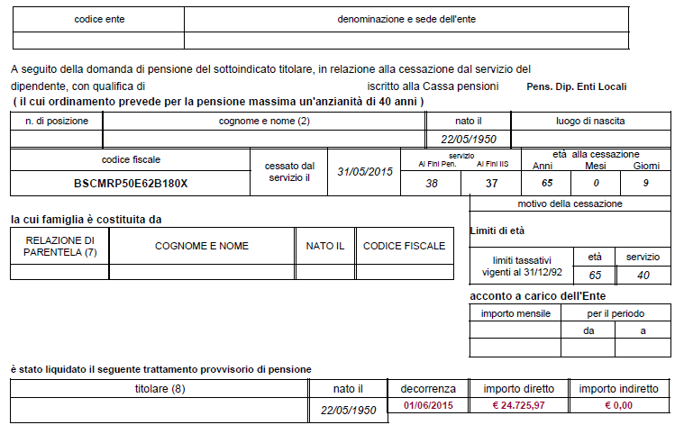
Example of Wage-based system (pro – rata 2012)

Slide 19
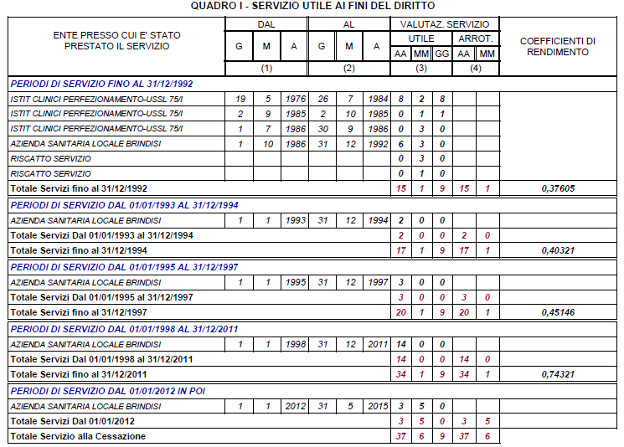
Example of Wage-based system (pro – rata 2012)

Slide 20
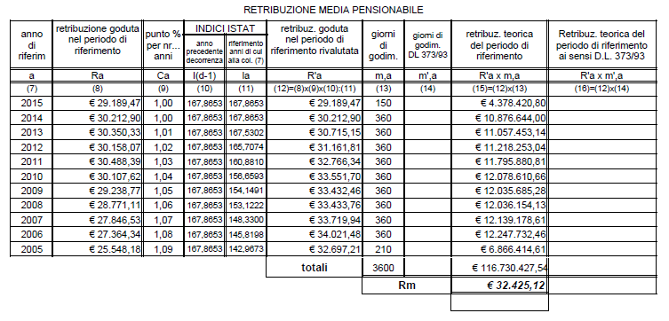
Example of Wage-based system (pro – rata 2012)

Slide 21
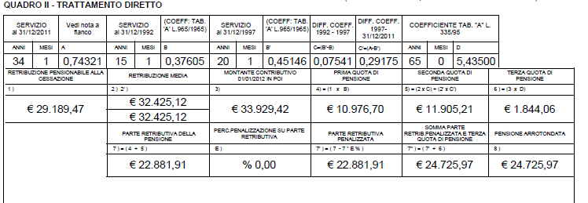
Example of Wage-based system (pro – rata 2012)
Quota A
Quota B
Quota C

Slide 22
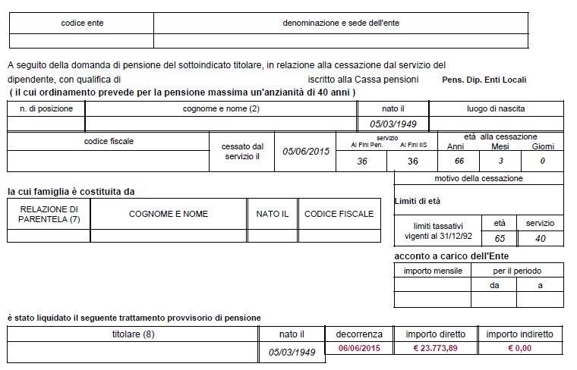
Example of Mixed system (pro – rata 1996)

Slide 23
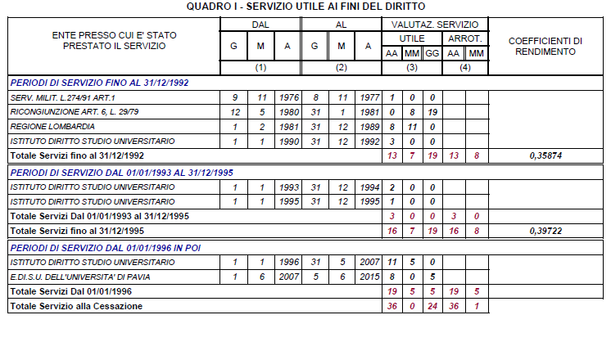
Example of Mixed system (pro – rata 1996)

Slide 24
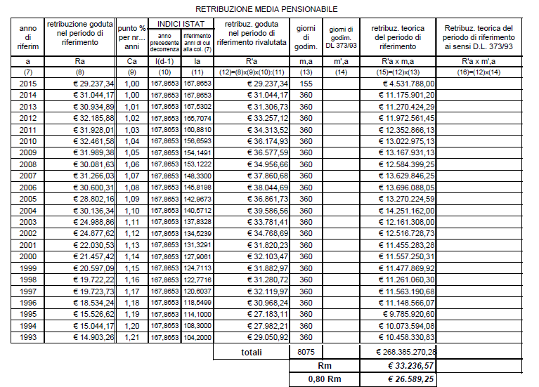
Example of Mixed system (pro – rata 1996)

Slide 25
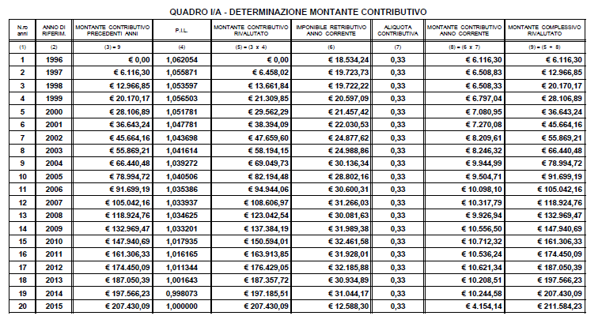
Example of Mixed system (pro – rata 1996)

Slide 26
Example of Mixed system (pro – rata 1996)
Quota A
Quota B
Quota C

Slide 27
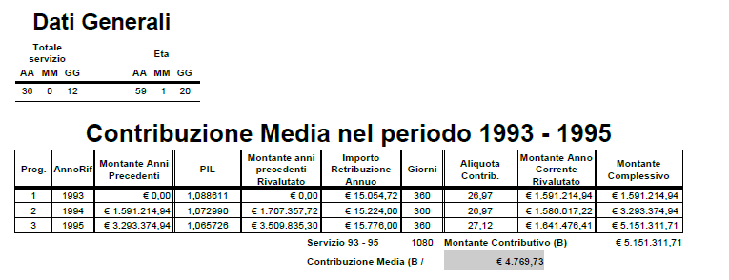
Example of Contribution-based System

Slide 28
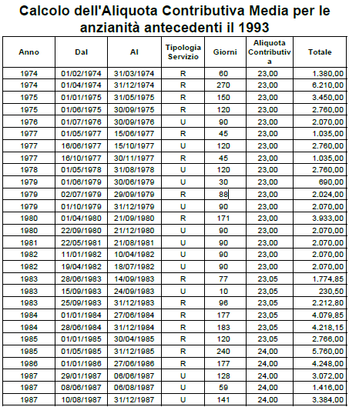
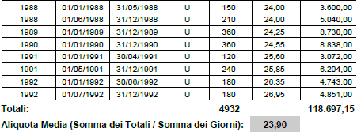
Example of Contribution-based System

Slide 29
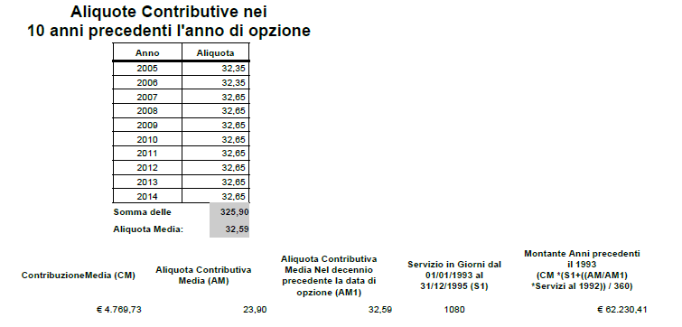
Example of Contribution-based System

Slide 30
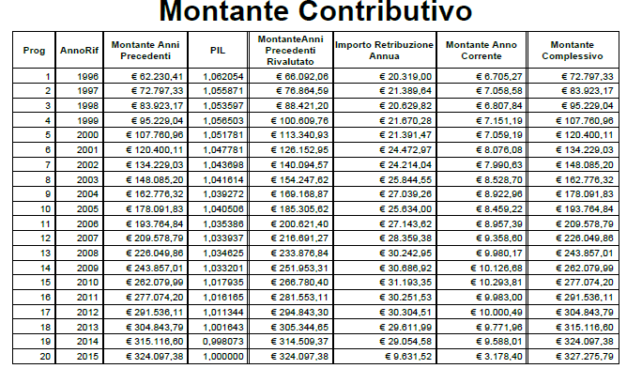
Example of Contribution-based System

Slide 31
Example of Contribution-based System
Quota C
Actuarial coefficient

Slide 32
Macro and micro-economic effects
The reforms caused important effects on:
Macroeconomic and financial sustainability
Equitable aspects
- with regard to the distribution within and between different age groups and
- between different categories of workers

Slide 33
Three-sided Social Security Relationship
From the 1st January 1996, also for Public Workers, has been introduced the three-sided social security relationship “Employer/Social Security Body/Employee”.
The separated management of pension treatments for the Public Workers has established in INPDAP
SOCIAL SECURITY BODY
1
EMPLOYEES
EMPLOYER
3
2
The public bodies are obliged to pay the contributions like any other employer
The contributory rate of financing for Public Workers is leveled to that one due to pension Funds for private employees

Slide 34
Peculiarities of the Civil Servants Insurance Positions
1
Uniqueness of "Massive Source" (DMA – Analytic Monthly Declaration) as the only source of data for the population of the Database related to the contributions declarations and the employment relationships.
2
Centralized Database of Insurance Positions in order to provide all benefits and pensions assured by INPS.
3
Full consistency between Legal, Retributive and Contributory positions.
4
Updating of the insurance position during the working life of the Civil Servant by the Employer through automatic tools (“DMA”, “UNIEMENS” and “ListaPosPA”).

Slide 35
Declaration of workers and payment of contributions
The employers monthly communicate, by telematics channel, the remunerative data of the workers and the information useful to the calculation of the contributions.
Before the 2010 the monthly communication - EMENS – concerned only the remunerative data.
From the 2010 the unified monthly statement - UNIEMENS – contains the remunerative data and the contributory data.
WAGE
CONTRIBUTION RATE
CONTRIBUTION TO BE PAID
ES :
1000
30%
300
The monthly flows are individual and aggregated for all the workers occupied into the company.
The remunerative data feed the insurance account (statement of account) and the contributory data allows to verify the due deposit for the interested month.
The payment occurs on the 16th day of the month and the statement is sent within the end of the month.

