Slide 1
Lyon - France, 30 June, 2015

Slide 2
Index
National context
Socio-demographic factors
Active Ageing Agenda and EU cooperation
Institutional capacity
Reform of the pensions system
Reform of the employment system
Reform of the social assistance system
Long term care
Conclusion
……

Slide 3
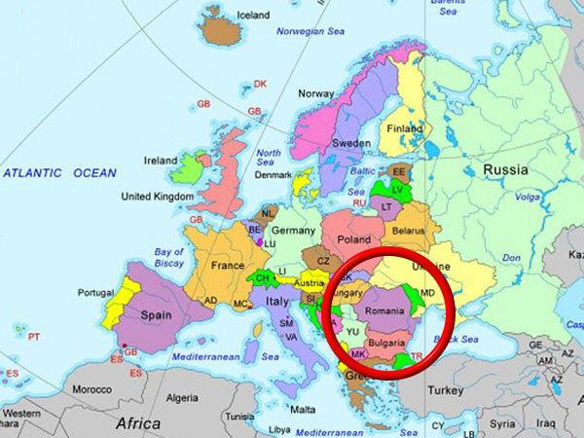
National context
Romania is situated in geographical center of Europe (south – east of Central Europe)
RO represents the twelfth country of this continent.
The Government form is republic, according to the Constitution adopted in 1991 and modified in 2003.
The Parliament (with two chambers – deputies and senate) represents the legislative power.
The Government has the executive power and the Prime Minister is nominated by the country`s president who is elected based on universal vote for a 5 years mandate.
Beginning with 2007 Romania is member of the European Union.

Slide 4
National context
  Population evolution
Romania has about 20.121.641 inhabitants (2011 census) and is characterized by a continuous decline of the population, due to the negative natural growth rate and the external migration.
  In Romania are 4.492.030 persons above 60 years old, representing 22,32%, while persons above 65+ represent 16,1%.
Source: National Commission for Prognosis

Slide 5
Socio-demographic factors
Population ageing is driven by three separate phenomena…all of which can be observed in Romania
Improvements in life expectancy
Declining fertility rates
Emigration

Slide 6
Socio-demographic factors
Life expectancy at birth have increased substantially in the last 60 years … and are expected to continue rising in the future with rising by about 12 years for females and 10 years for males.
  Life expectancy increasing trend
Source: National Commission for Prognosis

Slide 7
Socio-demographic factors
Total fertility rate in Romania has dropped from 2.9 in late 1960s to 1.3 children per woman by late 2000s
Source: UN population statistic

Slide 8
Socio-demographic factors
As a result … favorable demographic trends up until the 1970s are rapidly reversing course.
In figure below, the number of people in different age brackets from 1960 to 2060.
Source: UN World Population

Slide 9
Socio-demographic factors
Old age dependency ration
- the ratio between the number of older people (65 and over) and the number of working-age people (20 to 64)
- is projected to more than double by 2060: in 2010, there were roughly 25 people over the age of 65 for every 100 people of working age, which is projected to increase to 60 people over the age of 65 for every 100 people of working age by 2060.
Source: National Commission for Prognosis

Slide 10
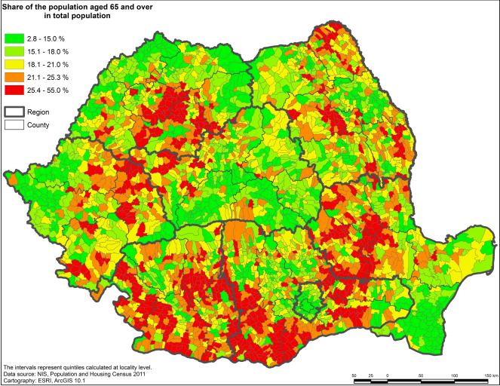
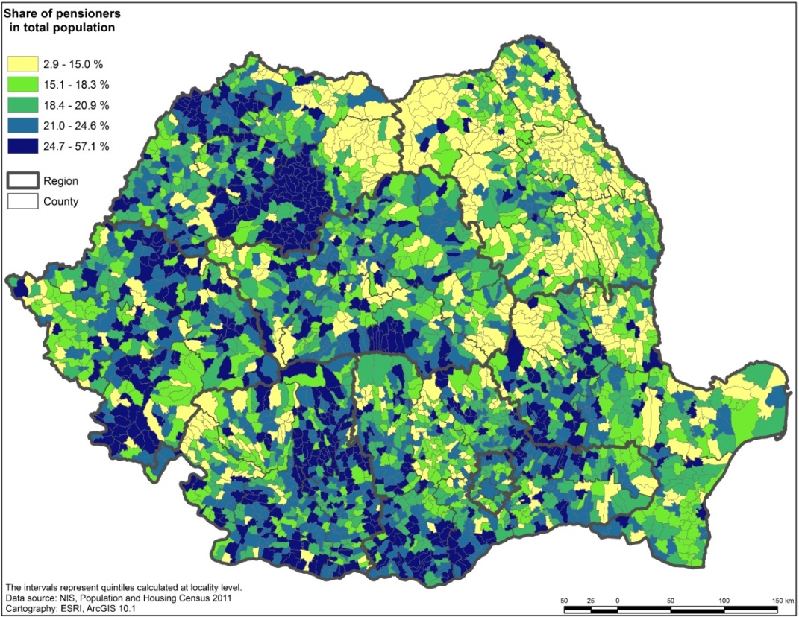
Socio-demographic factors
Population ageing in Romania has a pronounced regional dimension
Share of the population aged 65 and over
Share of pensioners in population

Slide 11
Socio-demographic factors
The challenge of providing medico-social services to rural older population is even greater if one looks at the geographical distribution of the oldest old

Slide 12
Socio-demographic factors
Life expectancy (LE) and Healthy life expectancy (HLE) at the age of 50
Romanians are living longer, but these gains are lower than in the rest of the EU, with many years lived with disability. At the age of 50, men can expect to live for another 25 years, only 13.1 of which would be spent in good health. By comparison, years lived with disability in Norway amount to only 8.8 for women and 5.6 for men.
Source: Eurostat, 2011 data

Slide 13
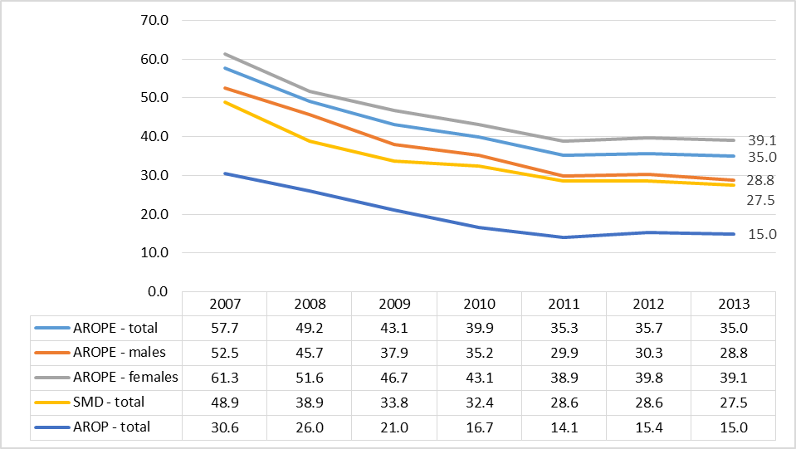
Socio-demographic factors
Elders' poverty and social exclusion rates (%)
Elders’ AROPE (35.0%) is lower then total population (40.4%), but there is a major gender gap. Also AROP is lower (15.0% as to 22.4%). All indicators had a significant decrease as compared to 2007. In 2013, 1,126 thousands elders were at risk of poverty or social exclusion, of which 484 thousands at risk of poverty and 886 thousands were severely materially deprived.
Source: Eurostat, 2011 data

Slide 14
Socio-demographic factors
AROP - at risk of poverty rates for elders (65+), %
Source: Eurostat,

Slide 15
Socio-demographic factors
THE MAIN PROBLEMS:
  Increased life expectancy, low fertility rates, an increased external migration (after 1990) conducted to an aged population and one of the sharpest drops in working-age population in the European Union, a trend that will likely impose a heavy burden on the economy.
  Romania lost 11,79 % of population between 1992 (22.810.035 persons) and 2012 (20.121.641 persons – 2011 Census).
  People aged 65 years and older who live alone, account for 4.2% of the population and are considered a potential vulnerable group, especially in terms of access to health care services.
  The risk of poverty among this segment of the population is about 30% in 2013. The indicator has decreased significantly since 2007 (when it was recorded at a rate of 44%), mainly due to the increase of pensions in 2008 and the introduction of social indemnity for pensioners in 2009.
  In Romania, the majority of dependent elderly are in the care of their family (and most caregivers are women – wives or daughters).

Slide 16
Social consequences in the medium and long term
THE MAIN PROBLEMS:
Demographic change will also put pressure on the fiscal situation of the country as the rapidly growing numbers of older people impose increased fiscal pressure on public pension, health and long-term care systems against the backdrop of declining labor tax revenues.
The number of elderly is projected to increase both in absolute numbers and as a share of the total population, resulting in increased demand for health and long-term care services, raising difficult questions on how to meet the growing needs.
In the absence of reform, demographic ageing may therefore lead to higher rates of poverty, social exclusion and dependence among the elderly.

Slide 17
Active Ageing Agenda and EU Co-operation
    World Health Organization introduced the concept of Active Ageing as a necessary condition for confronting the negative macro-fiscal and social effects of population ageing.
    As a response to population ageing, the European Union has adopted the goal of promoting active ageing: encouraging older people to remain active by working longer and retiring later, by engaging in volunteer work after retirement, and by leading healthy, dignified, and autonomous lives.
    In June 2010, the European Council approved the Europe 2020 Strategy. The Active Ageing concept being considered an essential element of achieving the Europe 2020 Strategy goals. Two of EU’s 2020 Strategy’s five targets are closely related to Active Ageing concept, namely:
      an employment rate of 75 percent for the 20-64 year-old population (70 percent for Romania)
      at least 20 million fewer people in or at risk of poverty and social exclusion (580 thousand fewer for Romania)
    In 2011, the European Council proposed to declare 2012 as the European Year of Active Ageing and Solidarity between Generations
  Two statistical tools have been developed at the EU level to inform the Active Ageing Agenda
    Active Ageing Index
    The Special Eurobarometer survey on Active Ageing

Slide 18
Active Ageing Agenda and EU Co-operation
  Active Ageing Index (AAI) - is an instrument, developed by European - Center for Social Welfare Policy and Research Wien, for measuring economic and social activity of older people as well as the capacity for active ageing in the EU and other UNECE countries.
  The Index regards 4 main domains, respectively:
* Employment (RO ranks #11 among 28 EU members)
* Social participation in society (#26)
* Independent, healthy, and secure living (#27)
* Capacity and enabling environment for active ageing (#28)
  As the Active Ageing Index showed in 2012, the Romanian older people have the less capacity for active ageing from all EU member states.
      The Special Eurobarometer survey on Active Ageing
      Useful tool developed to understand European citizens’ views and attitudes towards older people
      It takes stock of people’s readiness and willingness to adapt to the changing demographics and accept reforms that would promote active ageing

Slide 19
Active Ageing Agenda and EU Co-operation
A few results from Special Eurobarometer on Active Ageing in Romania
        In Romania, one is considered “old” at 61.3 years of age compared to the EU27 average of 64
        Romanians also indicate that they would need to retire on average four years before their EU27 counterparts (EU27-61.7 vs. Ro-57.7)
        According to survey results, slightly fewer people in Romania would like to continue working after reaching the pension age compared to EU27 average (EU27-33% vs. Ro-27%)
        Almost twice as many Romanian respondents totally disagree with the need for the retirement age to increase by the year 2030 as in the EU27 average (EU27-36 vs. Ro-69).
        In Slovakia (60%), Hungary (58%), Lithuania (56%), Romania (54%), Bulgaria (54%) and Poland (52%) an absolute majority of respondents support the idea of a lower retirement age for women on the ground that they tend to be younger than their partners. T
        he longest retirement is expected in France, Luxembourg, Sweden, Italy and Denmark (between 19.3 and 18.6 years).
        Within the EU, the shortest retirement is expected in Hungary, Romania and Bulgaria, where only a duration of 13 years is expected.

Slide 20
Institutional capacity
MINISTRY OF LABOUR, FAMILY, SOCIAL PROTECTION AND ELDERLY - ROMANIA
is a specialized public institution within the central public administration, subordinated to the Government
coordinates the application of the strategy and politicies of the Government of Romania in the fields of labour, family, social protection and elderly, according to the applicable legislation.
Institutions operating under the supervision or under the authority of MoLFSPE:
  A. Under the supervision of MoLFSPE:
    1. Labour Inspection;
    2. National Agency for Payments and Social Inspection;
    3. Naional Authority for Child Protection and Adoption;
    4. National Authority for Disabled Persons;
    5. Department for Equal Opportunities between Men and Women;
  B. Under the authority of MoLFSPE:
    1. National House of Public Pensions;
    2. National Agency for Employment.

Slide 21
Reform of the pensions system
The present Romanian pension system, set up between 2005-2008, consists of three pillars: public pension system (pay as you go system - PAYG scheme, based on intergenerational solidarity, the pensions/benefits are being paid directly from current workers' contributions), privately administered pension funds (mandatory defined contribution scheme, part of the individual contribution from the public pension system being accumulated in individual accounts) and voluntary private pensions (defined contribution scheme, voluntary participation, individual accounts).
Till 2005, Romania has had the PAYG scheme only.
Starting with January 1, 2011, the public system is regulated by Law 263/2010 on the unified pension system, which replaced the former Law 19/2000 on public pensions and other social insurance rights.
The new Pension Law came into force establishing gradually increasing of the retirement age for women from 60 years to 63 years by 2030 and for men to 65 years by 2015.
The new legislative act is reducing the number of pension systems (e.g. for civil servants from armed forces, police, foreign affairs/diplomacy) and is improving the financial sustainability of the pension system - more restrictive access to early retirement pensions and abusive sickness pensions.

Slide 22
Reform of the pensions system
A. Main Pension Reform Measures implemented started with 2010
Equalizing the standard retirement age for both women and men to 65 years by 2030
Integration of special pension systems
Indexing the pension point value according to inflation rate and real growth of gross wage
Recalculation of all special pensions
Increasing the number of contributors
Discouraging Partial Early Retirement Pension by increasing the percentage of the penalties
Implementation of more stringent criteria regarding access to Invalidity Pension
Funding attendant allowance for invalidity pensioners from the State Budget
B. In 2013, COUNCIL’S RECOMMENDATION on Romania’s National Reform Programme stated that “Romania is now one of the two Member States that have not yet decided to equalize the pensionable age for women and men and the employment rate of older workers (41.4% in 2012) is substantially below the EU average.” Therefore the Council Recommends that Romania should take action within the period 2013-2014 to: “Equalize the pensionable age for men and women and underpin the pension reform by promoting the employability of older workers”

Slide 23
Reform of the pensions system
Romanian Pension System
PILLAR I
State administered
Mandatory
Pay As You Go (PAYG)
Intergenerational solidarity
Public scheme
PILLAR II
Privately administered
Mandatory
Defined contributions
Individual accounts
First contributions: May 2008
PILLAR III
Privately administered
Voluntary
Defined contributions
Individual accounts
First contributions: May 2007

Slide 24
2013 Reform
Gradually increasing the pensionable age for women to 65 years by 2035
Reform of the pensions system
standard retirement age
for women
The law awaits the Parliament’s decision
65 years
On December 2013 the Government proposed a law:
2035
63 years
2030
?

Slide 25
PENSIONS GRANTED BY THE PUBLIC PENSION SYSTEM
Reform of the pensions system
  Old Age Pension
  Early Retirement Pension
  Partial Early Retirement Pension
  Invalidity Pension
  Survivor’s Pension

Slide 26
Old Age Pension conditions
Reform of the pensions system
standard retirement age
minimum mandatory contribution period
Old Age Pension

Slide 27
Old Age Pension
Reform of the pensions system
WOMEN MEN
standard retirement age
minimum contribution period
full contribution period
63 years
65 years
2030
2015
15 years
2015
35 years
35 years
2030
2015

Slide 28
Old Age Pension formula
Reform of the pensions system
OAP = AAS*PPV
based on a points system
the pension amount is determined by multiplying the average annual score (earnings related) achieved by the insured during the contributory period, with the pension point value
Pension Point Value 2014 = 790.7 lei (approx. 175 €)

Slide 29
Pension indexation
Reform of the pensions system
Since 1st of January 2013, the pension point value is indexed annually with:
  100% of inflation rate
  50% of the effective increase in the average gross earnings
Pension Point Value 2014 = 790.7 lei (approx. 175 €)

Slide 30
Pillar I – statistics
Reform of the pensions system
Pension type | Number of participants | Average pension
Old Age Pension | 3.371.560 | 1.019 lei (€ 226)
Early Retirement Pension | 22.679 | 1.073 lei (€ 238)
Partial Ealry Retirement Pension | 87.404 | 635 lei (€ 141)
Invalidity Pension | 674.516 | 584 lei (€ 130)
Survivor’s Pension | 522.126 | 454 lei (€ 100)
TOTAL | 4.678.285 pensioners
Source: National House of Public Pensions – May 2015

Slide 31
MINIMUM PENSION
Reform of the pensions system
is granted since 2009 to the Public Pension System retirees whose pensions are below it
it represents the difference between the minimum pension and the pension due or paid
minimum pension pensioners is: 484.951 (May 2015)
- pension: 400 lei (89 €)

Slide 32
TAXATION
Reform of the pensions system
5.5% social insurance contribution for health
applied only to pensions bigger than 740 lei (€168) and only to the amount that exceeds the 740 lei threshold
16% income tax
applied only to pensions bigger than 1.000 lei (€225) and it applies only to the amount that exceeds the 1.000 lei threshold

Slide 33


Reform of the pensions system
Contributions to the pension system
1st Pillar
Normal working conditions
Difficult working conditions
Special working conditions
2nd Pillar
In 2014, the contribution for the mandatory private pension system is 4,5%, included in the employee's social insurance contribution (10,5% - Pillar I).
10,5% employee
31,3%
20,8% employer
10,5% employee
36,3%
25,8% employer
41,3%
10,5% employee
30,8% employer

Slide 34
Pillar II and Pillar III statistics
Reform of the pensions system
Pillar | Number of participants | Total amount of funds
Mandatory Private Pensions | 5.925.264 | 11.967.849.793 lei (€ 2.659.522.176)
Voluntary Private Pensions | 303.364 | 712.321.038 lei (€ 158.293.564)
Source: Financial Supervisory Authority

Slide 35
Reform of the pensions system
MAJOR PROBLEMS:
Annual trend growth of GDP deficit caused by the increase in total pension expenditures
Chronic annual deficits of the State Social Insurance Budget
Unsustainable dependency ratio
The increased number of Invalidity Pension cases
The increased number of Partial Early Retirement Pensions
Poor social security coverage caused by income registration avoidance
Low real average retirement age for both men (56 years and 6 months) and women (55 years and 7 months)
The existence of a large number of laws and other regulations governing the organization and operation of various public pension systems - some of them establishing discretionary pensions for distinct professional groups
Major pensions discrepancies - the biggest special pension (37,241 lei) and the lowest minimum public pension (400 lei)

Slide 36
Reform of the pensions system
System’s Sustenability - Projection of State Social Insurance Budget deficit in GDP
Reform Former legislation
Source: World Bank prognosis

Slide 37
Reform of the employment system
Priority is given to:
  Developing new and improving existent active labour market policies in order to quickly adjust to the economic context and labour market requirements.
  Implementation of measures designed to stimulate employment in order to be more attractive for both jobseekers and employers.
  Facilitating transition from unemployment or inactivity to employment;
  Strengthening the labour force skills.
  the Law no. 76/2002 on the unemployment insurance system and employment stimulation, with subsequent amendments includes a series of provisions regarding activation measures, especially by providing incentives for the employers to keep or employ an older worker.
    employers are exempt from paying the contribution to unemployment insurance budget for a period of 12 months and receive monthly an amount equal to the social indicator in force (500 lei approximately 120 Euro) for every registered unemployed person over 45 that they employ, they are obliged to maintain employment relationship at least two years.
    an incentive equal to the social indicator in force for employers that hire unemployed persons who have five years until they are entitled to early retirement, partial early retirement or standard retirement.
  In order to create alternative jobs for the population resident in rural areas, Ministry of Agriculture and Rural Development provided financial support under EARDF, through the National Rural Development Programme, for the investments in non-agricultural activities.

Slide 38
Reform of the social assistance system
A comprehensive reform of the social assistance system is ongoing.
During the period 2005-2010, in Romania the social benefits system, including 14 types of benefits, it was developed without a coherent strategy, a coordination and correlation with the social services and active measures, and especially, without a result-based approach.
The Strategy of the Government (2011) in this field, sets the ground for the reform, based on clear results, regarding the equity and efficiency.
The objectives of the Government reforms in social assistance, aim at:
  Increasing the fairness of the system by extending the principle of granting assistance to those who need it the most;
  Reduction of fiscal costs of the system;
  increasing the proactive approach of the system by granting incentives to families who invest in the education of their children and to adults searching and keeping jobs;
  simplifying the administration of the system;
  establishing clear objectives for the programmes and monitoring their results for improving the performance management.

Slide 39
Reform of the social assistance system
The Romanian social assistance system has some very good characteristics, that the Government is using for its enhancement.
The Guaranteed Minimum Income (GMI) is one of the best programmes, in the region and in the world, in what concerns the accuracy of identifying the target group, by which Romania identified a way for targeting its scarce budgetary resources towards those really in need, a programme well adapted to the circumstances of the country, a programme which can be multiplied on a large scale.
The system processing the payments (SAFIR), the management information systems and the financial management arrangements are well structured.
The supervision and control institutions and mechanisms, including those aiming at reduction of error and fraud are also stable.

Slide 40
Reform of the social assistance system
Major step - on December 2011, it was adopted the Law no. 292/2011 regarding national system of social assistance.
Social assistance system includes social assistance benefits and social services
Social assistance benefits and social services are regulated by special laws.
The purpose of new law is to:
  create an unified and coordinated legal and institutional framework for granting the social assistance measures.
  represent a necessity under the current demographic trends, changes in family structure, negative dynamics of the labor market and reduction of public spending, as well as the lack of specialized personnel in the welfare system.
  guarantee to all Romanian citizens and the foreign persons who have the residence in Romania, the right to social assistance.

Slide 41
Reform of the social assistance system
Social assistance measures and actions are performed so that:
  social assistance benefits and social services to be one package of interrelated and complementary measures;
  social services take priority over social assistance benefits, if their cost and impact on beneficiaries is similar;
Social assistance benefits are granted in order to ensure a minimal standard of living and a form of support to promote social inclusion and increase quality of life of certain categories of persons.
Social benefits are addressed to low income families and for family policies, as well as for categorical programs, such as for persons with disabilities.
Social assistance benefits, are classified as follows:
a) for the prevention and combating poverty and social exclusion;
b) for child and family support;
c) to assist people with special needs;
d) for special situations.

Slide 42
Reform of the social assistance system
    Low income households programs
Social aid (GMI),
  granted for the families and persons without incomes or small incomes, set as the difference between the GMI levels and the monthly net income of family; the amount of benefit is increasing with 15% if one person from HH has a job.
  in terms of promoting social inclusion, this is the best targeted program (World Bank source), including incentives to work (increase with 15% of the amount in the situation of eligible persons who have a job) and promoting the principles of responsibility and active participation of beneficiaries by their involvement in the work and actions of community interest.
Family allowance is means tested and is granted for poor families with children. Benefit is reduced or discontinued if child does not attend school regularly.
Heating benefit program for families with low or medium incomes.

Slide 43
Reform of the social assistance system
    Other programs
Child state allowance - is granted on a monthly basis, in a fixed amount, no matter the revenues of the family. It is granted based on the principle of universality for all the children until de age of 18, without discrimination.
Child raise benefit and incentive: the parents can make their option for two modalities of receiving the parental leave and child raise indemnity:
  Option I: Parental leave and child raise indemnity until the child fulfils one year old, and the parent receives monthly child raise indemnity and monthly insertion incentive granted until the age of 2 years old in a monthly amount.
  Option II: Parental leave and child raise indemnity until the child fulfils two years old:
- monthly child raise indemnity, in amount of 75% from the average of the professional net incomes realized in the last 12 months before the child’s birth date, but minimum 1,2 SRI (600 lei) and maximum 2,4 SRI (1.200 lei).
- monthly insertion incentive is not granted for this option

Slide 44
Reform of the social assistance system
Social services represent the activity or set of activities designed to meet social and special, individual, family or group needs to overcome difficult situations, preventing and combating social exclusion risk, promoting social inclusion and increasing the quality of life.
Social services are organized by the public or private social services providers for vulnerable groups.
The social services providers has to be accredited in order to provide a social service. Accredited social service providers and the related social services have to be registered in the single electronic registry set up at the national level.
The social service has to be organized by respecting the general and specific quality standards established by law.
The social services can be organized in different forms:
      in community
      at home (home care services)
      in day care centres, public or private residential institutions
      in social canteens

Slide 45
Reform of the social assistance system
Social services:
temporary care centres;
residential centres/hostels
residential care centres/similar to nursing homes;
sheltered housing; multifunctional centres.
home care services, in residential centres, in day centres, at the house of the persons providing the services, in the community
day centres (senior clubs, counselling centres)
memory centres for those affected by dementia
respite centres
palliative care centres
socio-medical units.
As mentioned previously, social services are provided in decentralized system, at local level
Social Services providers are:
public providers: services for social assistance
private providers - non-governmental organizations; religious cults; economic operators, as provisioned by special regulations.

Slide 46
Reform of the social assistance system
For Romania it is a priority to implement measures targeted to the most disadvantaged groups.
So, there were adopted the following regulations:
  Law 276/2010 for modification of the Law on the guaranteed minimum income;
  Law 277/2010 on the family allowance;
  Strategy on the reform of the social assistance;
  New law on social assistance, Law 292/2011;
  Strategy for child protection 2014-2020;
  Strategy for the social inclusion and poverty reduction 2015 – 2020.
During the last period, in order to increase the life quality of persons belonging to vulnerable groups, including older people, Romania is to reorganize and modernize the system of social services.
The new law on social assistance establishes a new classification and definition of the social services in order to facilitate the access to services of all categories of people in need, including elderly persons, and providing the system sustainability at the same time.

Slide 47
Reform of the social assistance system
Financing social assistance system
Older persons social services:
local authorities budget
state budget social assistance financing
state budget subsidies for NGOs (in 2013: 88 home care services; 49 residential centres
state budget national interest programs for public social services and NGOs (“Developing the national network of residential centers for aged persons” 2011 – 2013)
state budget investment financing to co-finance works of buildings’ construction, repairing and refurbishment of social assistance centres (e.g. 49 older persons residential centres during 2000 – 2011).
Social benefits:
State budget (central) – main benefits for low income households and family policies are being paid by the state budget
Local budget – the social benefits which are sustained by the local authorities, depending on their financial capacity. The Ministry of Labour has not a registered situation of those.

Slide 48
Reform of the social assistance system
For example.. Older people affected by poverty or disability can receive
Social benefits:
minimum guaranteed income,
care indemnity
disability allowances,
facilities for transport, means of communication and information etc
in kind support: food (including from social canteens), clothing, medicine, medical equipment
social indemnity for pensioners
Facilities for retired persons:
free access to public transport, in urban areas and discount for inter-urban travels tickets;
discount for tv, radio, cable subscription;
free access to social canteens.

Slide 49
  Reform of the social assistance system
For example.. Older people affected by poverty or disability can receive
Health care facilities:
free accessibility to health care services for retired persons with an average pension under 740 lei (164 Euro);
free access to the health system for the elderly with low income, war veterans or war invalids, who suffered due to political or ethnical reasons, disabled elderly persons – the contribution for health insurance is supported from the state budget and social insurance system;
access to subsidised medicine – the costs of medicine drugs are covered from the health insurance fund in different percentages: 90% or 100% and the list of medicine with subsidised costs is annually approved by the minister of health;
the old persons, beneficiaries of the guaranteed minimum income, receive free medical care, as their contribution to insurance are being paid from the state budget
access of chronically ill persons with social problems to health care delivered by hospitals – socio-medical units for poor and chronically ill persons, providing health care services after the hospitalisation in a unit for acute diseases;
access to home medical care at the discharge of the patient from acute diseases hospitals - services are delivered by non profit organisations.

Slide 50
LONG TERM CARE
For example.. Older people affected by disability can receive
Elderly persons with handicap/disability, are entitled to receive social benefits granted according to the degree of handicap (medium, advanced and high) and care services.
Persons with the highest level of handicap can choose between a monthly care indemnity or the services of a personal assistant, employed by local authorities. Personal assistant is responsible for the personal care and individual rehabilitation plan of the person assisted and can be recruited from the family members of the beneficiary.
According to statistical figures by 30th of June 2013, the number of persons with disabilities was 700.736 (adults and children), with a ratio of 3.71 persons with disabilities per 100 inhabitants. Out of them, 61.043 (8,7%) are children under 18 years old and 639.693 are adults (91,3%). Of all persons with disabilities, 622.892 (88,89%) are in the care of their families and/or are living an independent life. The rest of persons with disabilities, respectively 16.801 live in public social assistance specialised residential care institutions.
From the analysis of statistical data, centralized at the MLFSPE, aproximately 1,4 million persons are confronted with different disabilities (persons with disabilities and persons with invalidity) that limit their work capacity. Out of total, 56% of persons with disabilities declare that they never worked.
Persons with disabilities are confronted with difficult access to health, social and employment services, that usually are not adjusted to their special needs, including to phisical disabilities, or their financial capacity. By 30.06.2013, there were employed 12,71% persons with disabilities, compared to 7,57 % in 2005.

Slide 51
Long term care
Main problems
Following the sustainability of the pensions system issue, another challenge is to respond to the increasing needs health and long term care of older persons.
The changes of the traditional model of extended family, the requirements of the labor market that does not provide, yet, enough measures and models to ensure the reconciliation of professional life with family life are having as a consequence the fact that more and more older persons are living alone increased this need .
In this context, Romania has to adapt health and social assistance systems to respond to the need, by involving the public social protection and the private support. Developing LTC services network is one of the commitments of the Romanian Government in order to respond to the real needs of elderly persons, to assure a decent level of life, in dignity and full respect.
Taking into account that the Romanian social services system is being organized in a decentralized model, the responsibility of developing LTC services belongs to the local authorities, which are completed by NGOs interventions.

Slide 52
LONG TERM CARE
Programs implemented by the MLFSPE
Therefore, beyond the local budget effort, the MLFSPE can finance national programs, such as the 2011 program to transform the inefficient medical units in hostels for old aged persons.
Additionally, the Ministry finances yearly, on a competitive process bases, a program of subsidies for NGOs – social services providers. The program is implemented constantly since 1998 and almost 45% from the total annually funds are spent for elderly care services that, for example, supported 129 social services provided for an average number of 15,825 elderly persons, while in 2007 a number of 106 social services (residential, day care and domiciliary care units) supported an average number of 6,689 old beneficiaries.
During 2007-2009, the Ministry had a national program to train about 300 formal caregivers and pay a part of their salaries (65%) for the project implementation period in order to develop home care services. During the program implementation 277,876 elderly persons received formal care. The weakness of this kind of program was that after the program completion, a part of the care givers migrated towards other EU countries for better wages.

Slide 53
THE SOCIAL ASSISTANCE SYSTEM
  HOW DO WE INTEND TO IMPROVE THE SOCIAL ASSISTANCE SYSTEM?
  Reduction and limitation of dependence on state aid through the active participation of the person / family;
  Establishing and providing social benefits and social services in a coordinated and complementary package of measures;
  Simplification of administrative procedures by setting up a single point of submission and by establishing a single application form to claim social assistance benefits
  Targeting the social benefits to those who are in the highest risk of poverty and social exclusion.
  Unifying 3 programs for low income households (Guaranteed minimum income, family allowance, heating benefit) into one program to tackle poverty – minimum social insertion program
  Improving Management Information System and reducing error and fraud for the social benefits programs.
  Empowering the local public authorities regarding the citizens' needs and encouraging the public/public and public-private partnership;
  Ensuring the development of the social services network.

Slide 54
conclusion
the fight against poverty and social exclusion continues to be a national priority;
implementation of the measures for the promotion of the social inclusion of disadvantaged people by encouraging them to actively participate in the labour market and in the society;
special attention will be paid to avoid the creation of dependence on receiving social benefits;
special measures will be taken in order to encourage vulnerable people to find an active place for themselves in society.
The inaction is not an option because:
    Healthy skilled population contributes to economic growth and provides care to dependant population
    Sick, disabled, vulnerable, unproductive and dependant people draw on country’s financial and human resources
    When the first group shrinks and the second expands, economic growth slows, taxes go up, incentives to emigrate increase, quality of services and incomes decline
    Today 2 workers are supporting one older person. With no change in policies in 30-40 years 1 worker will be supporting 1 older person. Can taxes be doubled? Can benefits be cut in half? – costs of inaction are too high!

Slide 55

CONCLUSION
Romania drafted a national strategy on active ageing and elderly protection for 2015-2020
The goals of the strategy are:
Postpone Physical Aging
Utilize everyone’s capacity to contribute economically and socially
Decrease dependence of elderly population
Enjoy the benefits of longer, healthier and more fulfilling lives

Slide 56
But…..
How to achieve Active Aging goals?
    Healthy life styles, medical advances and better health care systems should allow to postpone physical aging
    Automation of physically difficult tasks at work and at home, advances in transport and communication technologies, expanded availability of services should make physical limitations less disabling
    Changes in education system and new ways to organize work should allow late change of careers, part time work, use of mixed age teams and other strategies to utilize gradually decreasing capacity to work
    Policies on unemployment, invalidity, disability, retirement, education and labor protection should change focus on reactivating people rather than assigning benefits
    Societal norms should be actively reshaped so that older population is respected, understood, and valued
    Social services, including long term care, should focus on protecting and restoring independence of the elderly
    Individual responsibility and community involvement should be encouraged

Slide 57
We need …..
Only multi-sectoral Active Aging Strategy will be successful
Needed investments in health might be too expensive if resulting healthy life years are not turned into productive years;
Increased retirement ages should coincide with substantially reduced age discrimination in labor market;
building skills in rural areas would not work without a good road and transportation system and increased productivity of agriculture;
increased social participation and independence require more accessible public environment;
adequate long-term care may necessitate rethinking of the structure of public finances; and
failed improvements in education might lead to contracting tax base and decreased affordability of social programs needed in the aging society.

Slide 58
Thank you and tell us what you think!

