Slide 1
The impact of the economic crisis on pension system reforms in OECD countries
Monika Queisser
Head of Social Policy Division
Directorate for Employment, Labour and Social Affairs
Notes:
Introduction.

Slide 2
Structure of presentation
Part I: Comparison of indicators for OECD countries
Part II: Policy action 2012-2014
Notes:
Part I: Challenges in Denmark and elsewhere.
Part II: Policy action 2012-2014.

Slide 3

Net replacement rates vary strongly across countries
The long-term net replacement rate for a person entering the labour market in 2012
Notes:
Net replacement rates for low and average income earners are high in Denmark, especially so for low income earners. Where they are estimated to be the highest.
The net replacement rates are calculated for an individual entering the labour market at age 20 in 2012 with the rules that applied the same year.
Price inflation is assumed to be 2.5% per year. Real earnings growth of 2% per year Individual earnings are assumed to grow in line with the economy-wide average. This means that the individual is assumed to remain at the same point in the earnings distribution, earning the same percentage of average worker earnings in every year of the working life.
The real rate of return after administrative charges on funded, defined-contribution pensions is assumed to be 3.5% per year. The discount rate (for actuarial calculations) is assumed to be 2% per year. The baseline modelling uses country-specific projections of mortality rate from the United Nations population database for the year 2060.

Slide 4
Employment rates of older workers fall strongly from age 60
Employment rate of older people in 2013
Employment to population ratio, %
Notes:
Employment rates are generally high in Denmark, especially for people aged 55-59, where they are considerably higher than the OECD average.
However, Danes work less at higher ages, employment rates for people aged 60-64 and 65-69 are considerably lower. And lower than the OECD average. In Iceland the employment rate for 65-69 is higher than in Denmark the employment rate of 60-64.
Employment rate of older workers has, however, increased in most countries throughout and despite the crisis (past pension reforms, tightening of early retirement, age composition and gender effects).

Slide 5
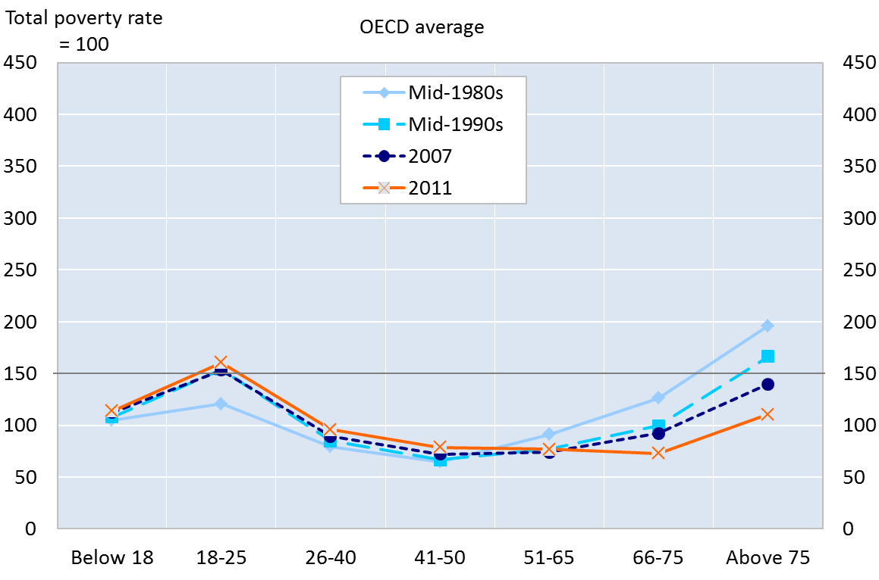
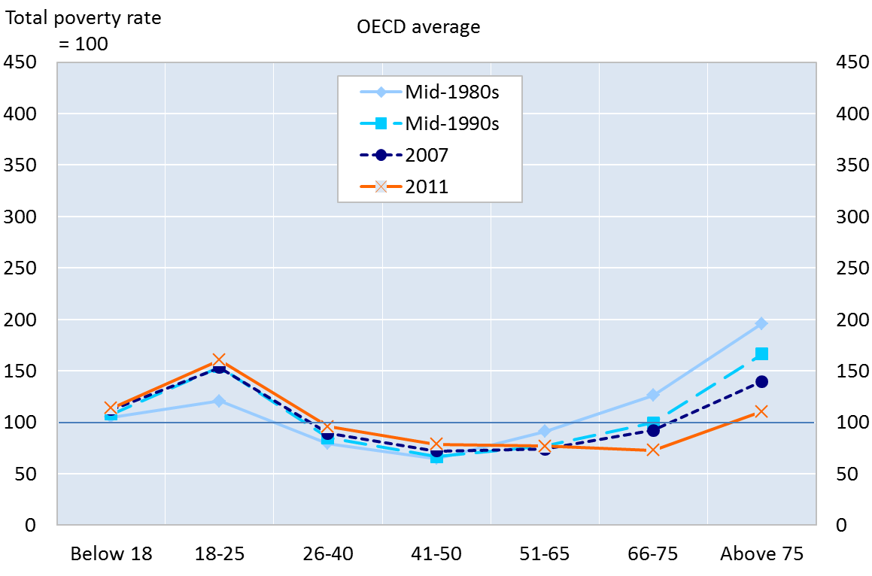
Poverty has shifted from the old to the young
Source: OECD Income Distribution Database
Notes:
Since the mid-1980s relative income poverty has shifted from the old to the young.
NOTE: Relative income poverty by age group relative to total (100) for mid-1980s, mid-1990s, 2007 and 2011.

Slide 6
Part II: Policy action 2012-2014

Slide 7
Economic crisis means difficult times for OECD pension systems
Fiscal pressure is intense
Low economic growth, high unemployment, low contributions, low returns translate into
low internal returns in PAYG schemes, and financial sustainability issues
low financial returns which generate retirement-income adequacy concerns
loss of confidence in private pensions, mistrust that public pensions will deliver promises
Population ageing prospects poses a persistent long-term challenge and can amplify these effects

Slide 8
  Recent policy action 2013-2014
Acceleration of pension reforms
Future pensions are likely to look very different from those of current retirees
Financial sustainability of pension systems was improved in the majority of OECD countries
Pension benefits might be reduced in some as a result. Yet, about half OECD countries introduced measures improving adequacy for certain groups of people
Serious challenges remain

Slide 9
  Reforms to improve the financial sustainability of pension systems
About two thirds of OECD countries took measures to improve the financial sustainability of their pension system
The impact is expected to be especially important in countries worst hit by the crisis (Greece, Hungary, Italy and Portugal)
No nominal cuts in benefits (except in Greece; in Portugal they were ruled out by the Constitutional Court)

Slide 10
  Three main types of financial sustainability measures …
Less favourable indexation
CZE, ESP, FIN, FRA, GRC, ITA, LUX, POL, HUN, SVK
Example: In Czech Republic, the indexation of pension benefits (old age, survivor and disability) was lowered from full annual inflation adjustments to only 33% of inflation adjustments between 2013-2015.

Slide 11
  Three main types of financial sustainability measures …
Longer working lives (higher retirement age, longer contribution period, tightening of early-retirement, stronger financial incentives)
AUT, AUS, BEL, CAN, DNK, ESP, FIN, FRA, GRC, HUN, IRL, ITA, LUX, NLD, POL, PRT, SVN
Exemple: In Ireland the pension age increased from 65 to 66 in 2014; and will continue to increase to 67 from 2021 and to 68 from 2028.

Slide 12
Trends in pension ages in the OECD
Pensionable age, years
66
65
Men
64
63
Women
62
61
60
1950
1960
1970
1980
1990
2000
2010
2020
2030
2040
2050
Source: OECD Pensions Outlook
Notes:
Planned increases from today to 2050. Equalisation between men and women (except Chile, Italy, Poland and Switzerland). NB: in 2030 pension age for men will only return to its level in 1960.

Slide 13



























67 will be the new 65
Number of OECD-34 countries
20
15
AUT
BEL
CHL (60F)
EST
FIN
AUS
10
HUN
CAN
JPN
FRA
KOR
DEU
LUX
ISL
MEX
ISR (64F)
5
NZL
NLD
PRT
NOR
SVN
POL
CZE
SWE
SVK
GRC
CHE (64F)
ESP
IRL
DNK
0
TUR
USA
GBR
ITA
61
62
63
64
65
66
67
68
69
70
Notes:
Since the crisis most countries have introduced measures to improve fin. Stab. Increasing the retirement age, early withd.

Slide 14
Pension ages are being raised in different ways
Germany: Age 65 and 1 month. The normal pensionable age is rising gradually to age 67 by one month each year until 2024 and by 2 months until 2029.
USA: the pension age is increasing by 2 months per birth cohort until it reaches 67 for those born in 1960 in 2027.
France: the qualifying period for a full pension is increasing by 3 months per birth cohort by decree.
Spain: Age 65 rising gradually to 67 from 2013 to 2027.
United Kingdom: The pension age is currently 65 for men and 60 for women born on or before 5 April 1950. Women’s pension age is increasing from 60 to 65. Further increases from 65 to 66 between 2018 and 2020 are also planned. Adding to this increases are due to take place to 67 between 2034 and 2036 and 68 between 2044 and 2046.
Australia: Age 65 (men, gradually rising to age 67 from 2017 to 2023) or age 64 and 6 months (women, gradually rising to age 65 by July 2014 and to 67 from 2017 to 2023)

Slide 15
Promoting longer working lives
Improve work incentives for older workers in social protection systems
Remove employment barriers and promote recruitment of older workers
Offer more work flexibility
Train older workers better
Adapt work places for older workers
Improve public employment services for older workers

Slide 16
  Three main types of fiancial sustainability measures …
Increased taxation or contributions in defined-benefit pension schemes
CAN (Quebec), FRA, FIN, HUN, IRL, LUX, NLD
Example: In France the contribution rate will increase by 0.3 percentage points for both employees and employers by 2017.

Slide 17
Financial sustainability of pension systems remains a challenge in some countries
Public expenditure on pensions 2013 and 2060
Source: The 2015 Ageing Report

Slide 18
  Implications for pension adequacy
As a result of recent reforms pension benefits will be reduced in some countries, in particular in Greece, Italy, Portugal, but also in Finland, the Slovak Republic and Spain (unclear for CZE, FRA, LUX)
Example:
Some countries took some action to address adequacy concerns

Slide 19
  Main pension adequacy measures
Extended coverage :
pension credits (DEU, EST, FRA, JPN)
auto-enrolment/financial incentives (CHL, GBR, LUX, NZL)
new schemes (AUS, CAN, CZE, KOR)
Example: In Korea a new basic pension was introduced in July 2014.

Slide 20
  Main pension adequacy measures
Increase in benefits targeting vulnerable groups
(IRL, JPN, LUX)
Example: In Luxembourg the basic pension is increasing slightly as a result of the new pension reform (on average by about 0.44% per year) from October 2012.

Slide 21
  Main adequacy measures
Increase in defined-contribution schemes’ contribution rate (GBR, ISR, NZL)
Example: In Israel employees’ contribution to the mandatory DC occupational plans increased from 2.5% to 5% in 2013 and employers’ contribution increased from 2.5% to 10%.

Slide 22
Main adequacy measures
Lower taxes for pensioners (JPN, MEX, SWE, USA)
Example: In Sweden the basic pension income
tax deduction for people over 65 was increased in 2014. This measure reduced taxation of pension benefits by slightly more than SEK 100 per month.

Slide 23
Main adequacy measures
Better governance of DC schemes (AUS, CHL, GBR, NZL)
Example: In New Zealand KiwiSavers (DC) providers will be required to post information on their websites regarding performance, fees, returns, portfolio and key staff information on quarterly basis (2013).

Slide 24
  Remaining key challenges
    Ensuring longer effective working lives: both demand and supply issues
    Maintaining income adequacy while concerns arise from labour market, social and financial risks
    Dealing with fiscal pressure on pension systems induced by population ageing
    Better sharing the financial burden across generations
    Addressing inequalities in remaining life expectancy
    Increasing coverage / contributions in private schemes
    Reducing pension administration costs and management fees

Slide 25
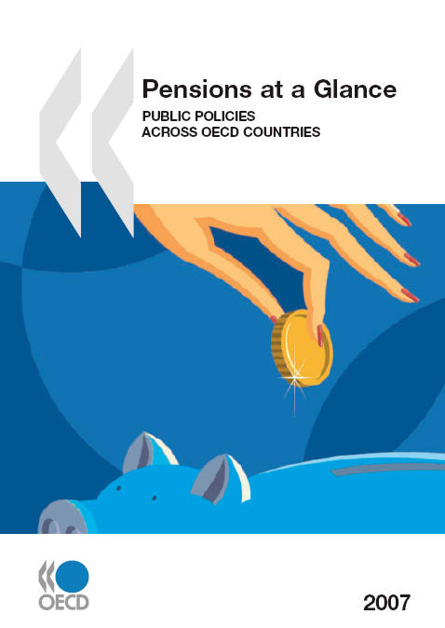
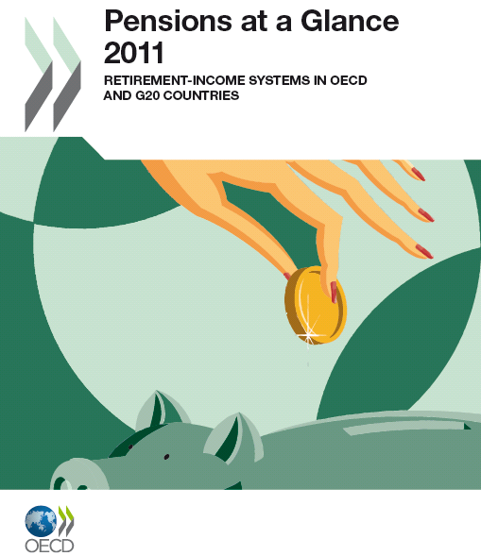
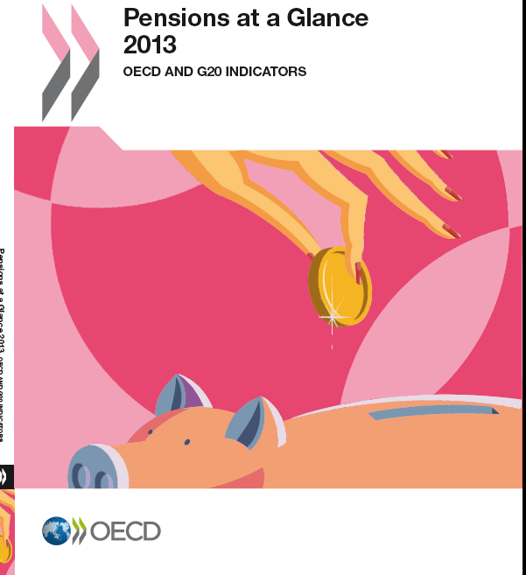

Pensions at a Glance 2013
OECD and G20 INDICATORS
Pensions Outlook 2014
NEW Pensions at a Glance
forthcoming in November 2015
monika.queisser@oecd.org

Slide 26
More information
http://www.oecd.org/els/public-pensions/pensionsataglance.htm
www.oecd.org/els/employment/olderworkers
http://www.oecd.org/els/public-pensions/oecd-pensions-outlook.htm

