Slide 1

EU Social Security Financial Administration
and Information Construction
欧盟社会保障财政管理及信息建设
Dr. Koen Vleminckx
科恩 弗莱明克斯 博士
2016. 04. 27 Guangdong

Slide 2
Social Security 社会保障
Is a set of publicly organised contributions, benefits and institutions that guarantee an adequate income to citizens when they are confronted with the negative consequences of the occurence of a “social risk”.
是公共组织的缴费、待遇系统，为了保障公民在经受社会风险带来的负面影响时依然能够享有足够水平的收入
Insures against 保障应对:
  the loss of income because of sickness, invalidity, professional accidents or diseases, unemployment, old age.
  因疾病、伤残、职业意外伤害或疾病、失业、老年等而失去收入来源
  higher expenses because of sickness, the cost of raising children, …
    疾病、育儿等方面的庞大开销
Redistribution throughout the life-cycle 生命周期内的再分配

Slide 3
Social Security Insures Risks 社会保障预防风险
Premiumi = Chancei X Benefiti ( + Adm)

Slide 4



Why social and not private insurance?
为何选择社会保险而非私人（商业）保险？
Adverse selection, e.g. unemployment, sickness
反向选择，如失业、疾病
collective mandatory insurance
集体强制性保险
ex-ante solidarity
事前整合
Moral hazard, e.g. unemployment, sickness, …
道德危害，如失业、疾病
franchise not always acceptable
特许经营权并不总能被接受
government regulation & control
政府监管和控制
Collective component (e.g. unemployment)
集体组成 （如失业）

Slide 5
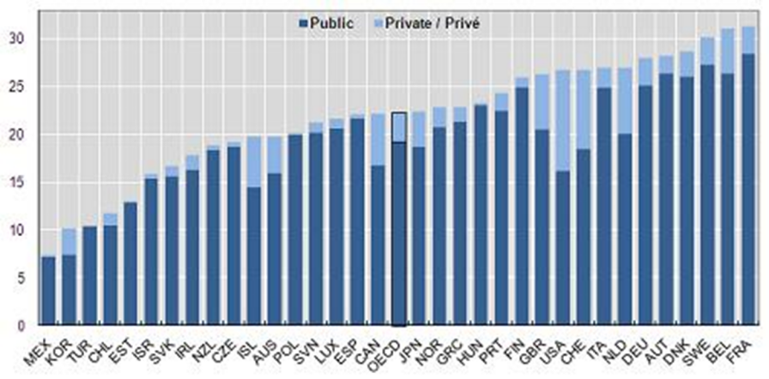
Public-Private Mix
公私混合

Slide 6
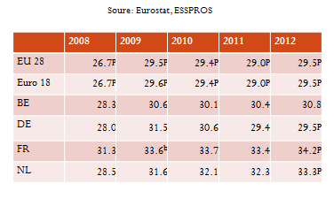
Social Protection as a % of GDP
社会保障占GDP百分比

Slide 7
Social Benefits by Function, EU
欧洲不同功能的社会待遇
住房
失业
家庭/儿童
疾病/健康
遗属
社会剥离
残疾
养老

Slide 8
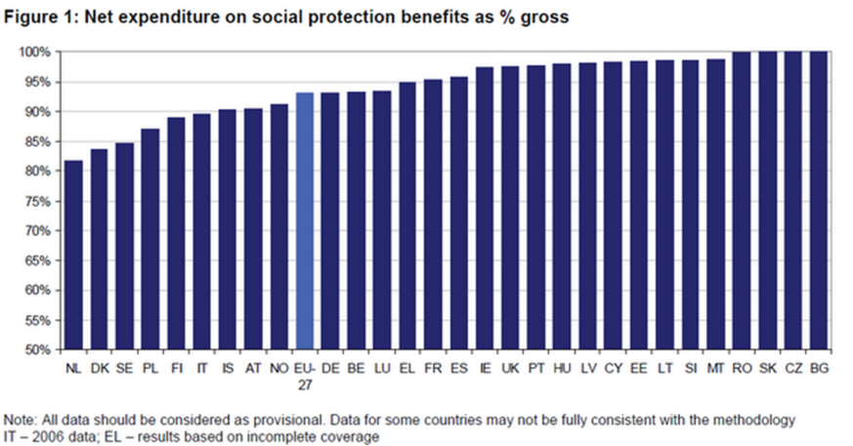
FISCAL CLAW-BACK 财政弥补性收入
社会保障待遇净支出占GDP百分比

Slide 9

资金来源

Slide 10
Main options to finance Social Security
社会保障经费筹集的主要方式
Contribution-based systems: Belgium, France, Germany, ...
缴费型系统：比利时、法国、德国
    Close connection between contributions and benefits received
    缴费水平与待遇水平高度相关
    Advantage: accumulation of rights promotes stable professional careers
    优势：权利的累积促进职业稳定性
    Disadvantage: increases cost of labour
    劣势：提高劳动力成本
Tax-based systems: Denmark, Ireland, Netherlands, U.K.
税收型体系：丹麦、爱尔兰、荷兰、英国
    Direct taxes (progressive)
    直接税收 （累进式）
    Indirect taxes , such as VAT (regressive)
    间接税收，譬如增值税 （递减式）

Slide 11
Distribution of government revenues
政府收入分配

Slide 12
Impact of crisis on revenue by contribution
欧债危机对收入的影响

Slide 13
Receipts of social security
社会保障收入来源
Social Security Contributions 社会保障缴费
  Employers social contributions 雇佣方的社会缴纳
  Social contributions by protected persons 受保障方的社会缴纳
General Government Financing 一般性政府财政拨款
  Earmarked taxes 指定用途税
  General revenue 一般性收入
Other receipts v 其他收入来源

Slide 14
Social security funding
社会保障经费来源 2014 (1,000 €)
Source 来源 | Employees 职工 | Self-employed 自雇 | Health-care 健康 | Outside GFM | Overseas (OSSOM) 海外
Contributions 缴费 | 43,647,262 | 3,801,502 | 1,017,965 | 4,611,941 | 71,371
State subsidies 补贴 | 11,939,554 | 2,005,621 |  |  | 311,774
Alternative funding 其他资金来源 | 13,167,036 | 1,010,811 | 2,839,074 | 128,759
Earmarked receipts 指定用途谁 | 1,444,781 | 18,993 | 1,157,378 | 245,000 | 1,600
External transfers 外部转移 | 592,440 | 400 | 1,212 | 150,530 | 1,500
Return investment 投资回报 | 222,978 | 14,689 | 3,018 | 50,399 | 1,921
Diverse 其他 | 823,630 | 1,191 | 448,599 | 10,911 | 3,373
Total 总计 | 71,837,681 | 6,852,807 | 5,467,246 | 5,197,540 | 391,539
Transfer GFM |  |  | 25,492,176

Slide 15
Trends in funding Employees 1999-2010
1999-2010 职工待遇资金来源变化趋势

Slide 16
Manageing Funding Flows
资金流管理

Slide 17
Funding principles
资金给付原则
Pay-as-you-go systems
现收现付型
  Currently active pay for current beneficiaries
  当前在职职工给付当前待遇领取人
Capitalization systems
资本化型
  Accumulation of contributory savings account
  缴费型储蓄账户的积累
Defined Benefit 待遇确定型
Defined Contribution 缴费确定型

Slide 18
Social protection expenditures 社会保障支出
TOTAL EXPECTED SOCIAL SECURITY EXPENDITURE
社会保障预估总支出
Excludes administrative Cost

Slide 19
Fluctuating expenditures 波动性支出
Some expenditure trends evolve with economy: e.g. unemployement (due to economic restructuring etc.)
部分支出随经济形势变化：如失业（由于经济结构性调整）
Some expenditure are highly predictable, e.g. population ageing
部分支出具有高度预见性：如人口老龄化

Slide 20
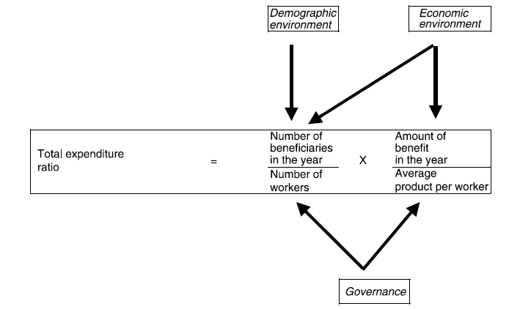
Determinants of social security expenditure
社会保障支出的决定性因素
人口形势
经济形势
当年领取人人数
当年待遇总值
总支出比率
职工人数
职工平均产值
政府治理

Slide 21
Social benefits expenditure 社会保障待遇支出 (% GDP)

Slide 23
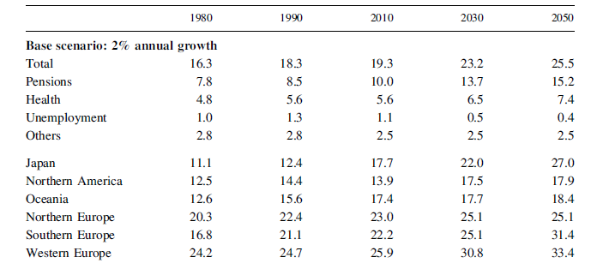
Estimated trends of social protection expenditures
社会保障支出变化趋势预估

Slide 24

Organisation 组织系统

Slide 25
Organisation of Social Security Budget
社会保障预算组织
Global Financial Managment
统筹式财政管理
Financial Managment by scheme
特定计划的财政管理

Slide 26
1. Mandatory payroll contributions 强制性收入缴费 (1/01/2014)
Employees 职工
Sector 项目 | Employee 职工 % | Employer 雇佣方 % | Total 总计 %
1. Sickness & invalidity 疾病及残疾
- health-care 健康 | 3.55 | 3.80 | 7.35
- Invalidity benefits 残疾补助 | 1.15 | 2.35 | 3.50
2. Unemployment 失业 | 0.87 | 1.46 | 2.35
3. Pensions 养老金 | 7.50 | 8.86 | 16.36
4. Family benefits 家庭福利 | 0.00 | 0.30 | 0.30
5. Industrial accidents 工伤意外保险 | 0.00 | 1.00 | 1.00
6. Professional diseases 职业病 | 0.00 | 1.00 | 1.00
Total 总计 | 13.07 | 24.77 | 37.84

Slide 27
Three-monthly contributions self-employed (main occupation)
自雇人员主要职业收入季度性缴费
Based on net professional income 3rd calender year (reference year) preceeding contribution year
基于缴费年前第三个自然年（基准年）的职业净收入
Start-ups pay contribution calculated on temporary basis
处在创业初期的自雇人员缴费以临时性就业标准计算
Net Profession Income by bracket 净职业收入分段 | Contribution 缴费水平
Up to 12,870.43€ | 707.87 € per quarter
Between 12,870.43 and 55,576.94 € | 22.00 % of net professional income
Between 55,576.94 and 81.902,81 € | 14.16 % of net professional income
Higher than 81.902,81 € | 0 €

Slide 28
Seperate versus Global managment
分离式管理VS统筹式管理
Seperate funding of social security branches
社会保障不同分支的独立筹资
    Result: some branches had shortages, other had suprluses？
    结果：部分分支筹资不足，另一些分支筹资过量
Global funding: all funding collected by Social Security Fund
统筹资金：社会保障金筹得的所有资金
Within each scheme: branches financed on the basis of their needs
各个社保计划内部：资金实行按需分配
Need = expenditures – own receipts
资金需求=支出 – 自筹收入

Slide 29
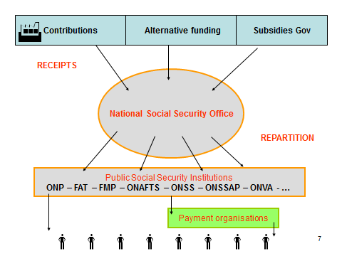
缴费
其他融资渠道
政府补贴
收入
再分配
待遇给付组织

Slide 30

Informatisation 信息化

Slide 31
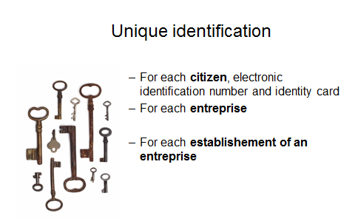
独一无二的身份标记
对于每一个公民，电子身份号码及证件
对于每一个企业
对于每一个企业下设机构

Slide 32
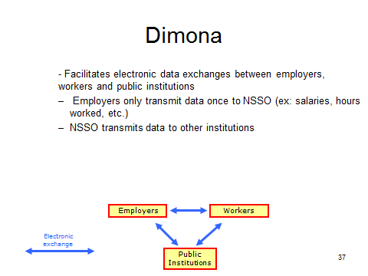
- 促进雇佣方、职工及公务机构间电子数据的交换
- 雇佣方仅需向NSSO一次性传输数据（如薪酬、工时等等）
- NSSO 向其他相关机构传输数据

Slide 33
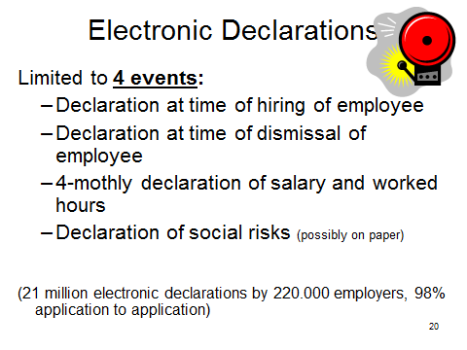
电子声明
仅需在4种情形下提供
- 雇佣员工时
- 雇佣关系接触时
- 每4个月申报薪酬、工时信息时
- 社会风险声明 （通常以书面方式呈现）

Slide 34
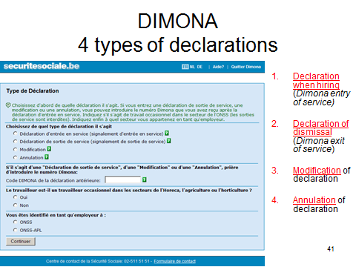
4 大声明类型

Slide 35
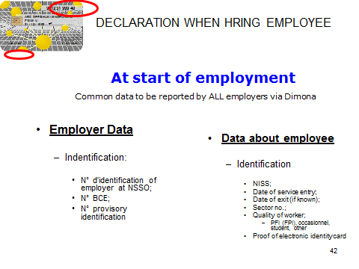
员工雇佣声明

Slide 36
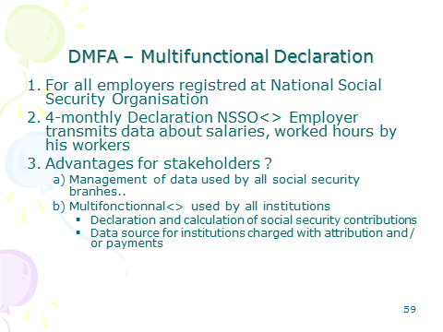

Slide 37
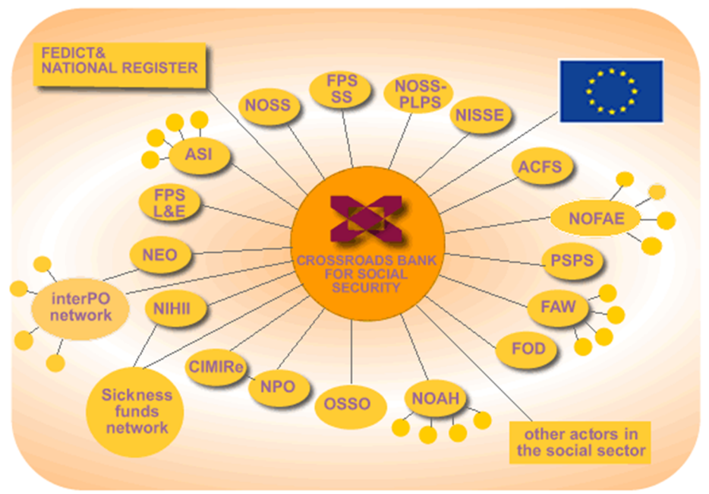

Slide 38


Slide 39
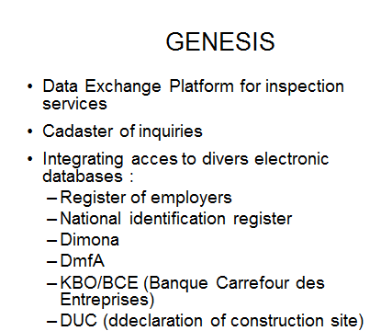
- 数据交换平台，主要服务于监察工作
- 查询地籍图
- 整合多类电子数据库信息存取路径
* 雇佣方注册信息
* 国民身份注册信息
* Dimona
* DmfA
*比利时经济部企业资料库
* DUC

Slide 40
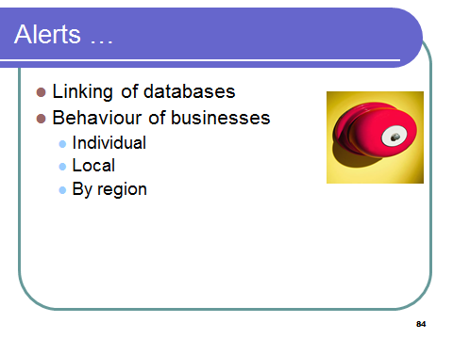
数据库建的链接
商业行为
  个人
  地方
  区域

Slide 41

Challenges of Social Security Funding 社会保障筹资面临的挑战

Slide 42
Challenges of Social Security Funding 社会保障筹资面临的挑战
Balancing the social security budget
均衡社会保障预算
  Inactivity rate 非在职率
  Population Ageing (inactivity & pension expenditures)
  人口老龄化 （非在职及养老金支出）
  Health expenditures 健康支出
2. Competitivity and taxation on labour income
竞争力及劳动收入税收

Slide 43
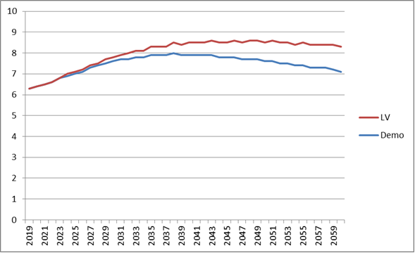
Impact of population ageing on pension spending
人口老龄化对养老金支出的影响

Slide 44
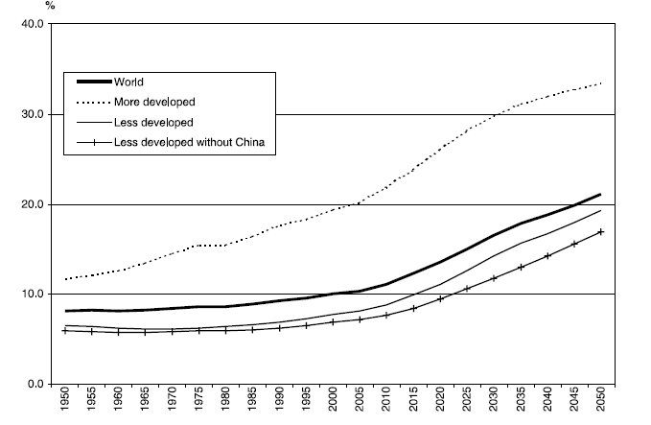
Velocity of demographic ageing, population aged 60 and over as a % of population 人口老龄化速率，及60岁以上人口占总人口比例

Slide 45
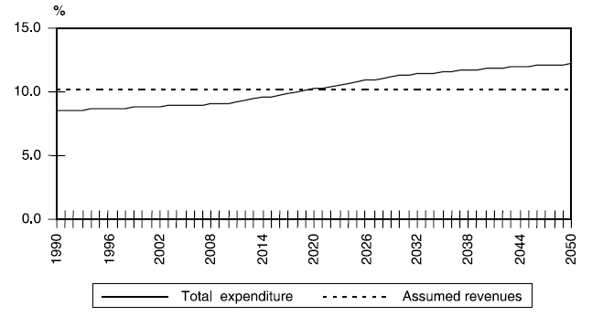
Consolidated potential pension deficit, 养老金潜在赤字总量
OECD 1990-2050

Slide 46
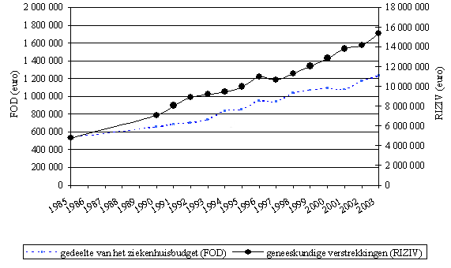
Evolution of health expenditure
健康支出变化

Slide 47


