Slide 1


EUROPEAN
PILLAR OF
SOCIAL RIGHTS
#SocialRights

Slide 2
Why
What
=> the 20 principles
Who and How
=> examples

Slide 3
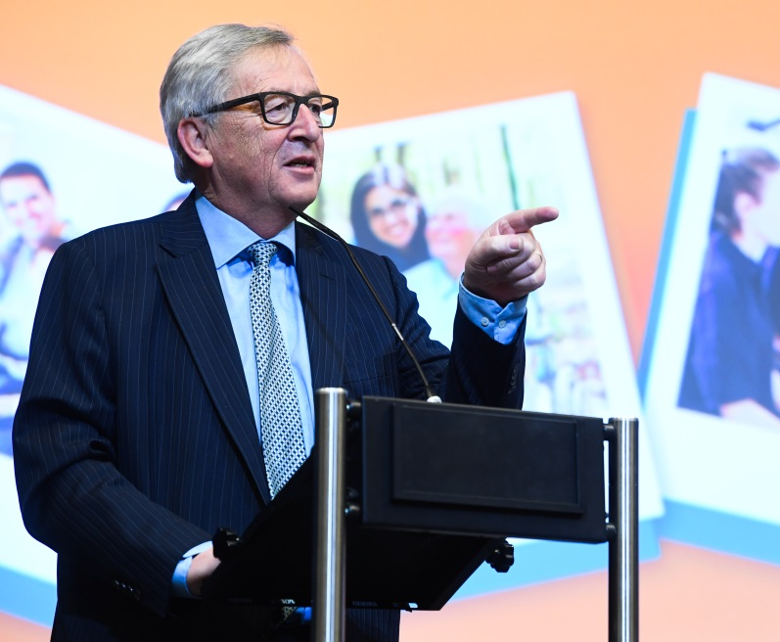
"Il convient maintenant d'agir concrètement. Les gens en ont marre de nous entendre nous référer toujours aux théories sur l'Europe sociale. Ils voudraient voir des actions concrètes."
Jean-Claude Juncker during the Conference on the European Pillar of Social Rights, 23 January 2017

Slide 4
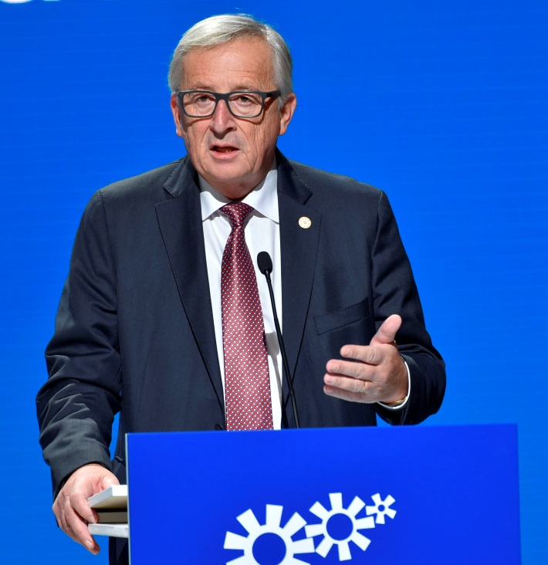
"The European Pillar of Social Rights is not a poem. It is first of all a programme of principles but also an action plan."
"If we want to be credible, we have to deliver."
Jean-Claude Juncker during the Social Summit for Fair Jobs and Growth in Gothenburg, 17 November 2017

Slide 5
What is the European Pillar of Social Rights?
A reference framework for upwards convergence
Building on the existing EU social law
A scoreboard of employment and social indicators
Several concrete initiatives
20 principles and rights

Slide 6
The 20 principles and rights at a glance
Equal opportunities and access to the labour market
Education, training and life-long learning
Gender equality
Equal opportunities
Active support to employment
Fair working conditions
Secure and adaptable employment
Information about employment conditions and protection in case of dismissals
Social dialogue and involvement of workers
Work-life balance
Healthy, safe and well-adapted work environment
Adequate and sustainable social protection
Childcare and support to children
Social Protection
Unemployment benefits
Old age income and pensions
Minimum income
Health care
Inclusion of people with disabilities
Long-term care
Housing and assistance for the homeless
Access to essential services
Wages

Slide 7

Education, training and life-long learning
Right to quality and inclusive education, training and life-long learning to participate fully in society
People with disabilities or those from disadvantaged backgrounds should be ensured access on an equal basis
Emphasis on skills required during labour market transitions
Education, training and life-long learning

Slide 8

^{Gender equality}
Ensuring equal treatment and opportunities between women and men in all areas (including participation in the labour market, employment conditions and career progression)
Emphasis on the need to foster equality between women and men proactively through positive action
Right to equal pay for work of equal value
^{Gender equality}

Slide 9

^{Equal opportunities}
Right to equal treatment and opportunities in employment, social protection, education, and access to goods and services
Grounds covered: gender, racial or ethnic origin, religion or belief, disability, age or sexual orientation
Emphasis on specific measures (positive action) necessary to foster equal opportunities
Specific attention to under-represented groups
^{Equal opportunities}

Slide 10
^{Active support to employment}
Right to timely and tailor-made assistance to improve employment or self-employment prospects
The focus is on the provision of assistance to find work, which can include employment services, such as job-search counselling and guidance, or participation in 'active measures', such as training, hiring subsidies or re-insertion support
It extends the scope of Youth Guarantee and the Recommendation on long-term unemployed
^{Active support to employment}

Slide 11


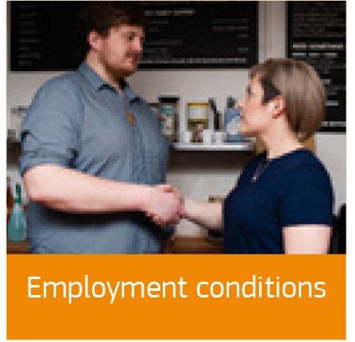

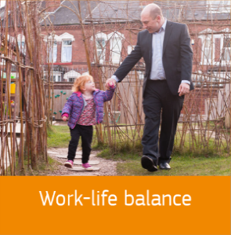

Fair working conditions
Secure and adaptable employment
^{Wages}
^{Employment conditions}
^{Social dialogue}
^{Work-life balance}
^{Safe work environment}

Slide 12
Secure and adaptable employment
Right to fair and equal treatment regarding working conditions, access to social protection and training
Employers should have the necessary flexibility to adapt swiftly to changes in the economic environment
Innovative forms of work, entrepreneurship and self-employment shall be encouraged
Precarious working conditions shall be prevented, including by prohibiting abuse of atypical contracts
Preventive measures to address precariousness: providing earned income tax credits or creating bonus malus systems for the social security contributions
Secure and adaptable employment

Slide 13
^{Wages}
Fair wages should provide a decent standard of living
Adequate minimum wages shall be ensured and in-work poverty shall be prevented
Wages shall be set in a transparent and predictable way according to national practices and respecting the autonomy of the social partners
  transparency means that well-established consultation procedures should be followed when setting the (minimum) wage
  predictability can be ensured for example through the definition of rules such as adjustment to the cost of living for minimum wages
^{Wages}

Slide 14
^{Employment conditions}
Written information should be provided to the worker about his or her working conditions at the start of the employment relationship
Prior to any dismissal, workers have the right to be informed of the reasons and be granted a reasonable period of notice
Workers should have access to effective and impartial dispute-resolution procedures
The Pillar also introduces the right to adequate redress in case of unjustified dismissals, such as re-instatement or monetary compensation
^{Employment conditions}

Slide 15
^{Social dialogue}
Right for social partners to be involved in the design and implementation of employment and social policies
All workers in all sectors to be informed and consulted directly or through their representatives on matters relevant to them such as the transfer, restructuring and merger of undertakings and collective redundancies
Capacity building for social partners to promote social dialogue
^{Social dialogue}
Notes:
.

Slide 16
^{Work-life balance}
Right to suitable leave, flexible working arrangements and access to care services
Women and men shall have equal access to special leaves of absence – balanced use should be encouraged (by adjusting the level of payment, or conditions related to flexibility and non-transferability)
^{Work-life balance}

Slide 17
^{Safe work} ^{environment}
Right to a high level of protection of health and safety at work
Right to have personal data protected in the employment context
Right to a working environment adapted to the professional needs and longer professional career
^{Safe work environment}

Slide 18



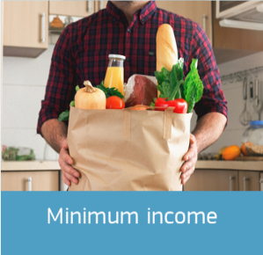
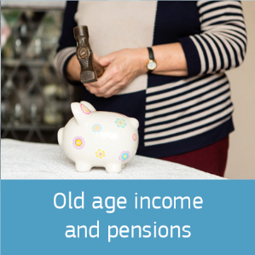


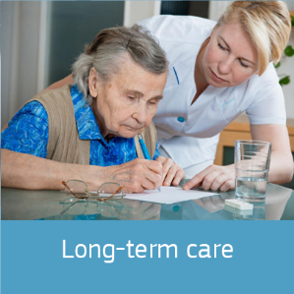
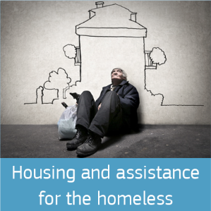
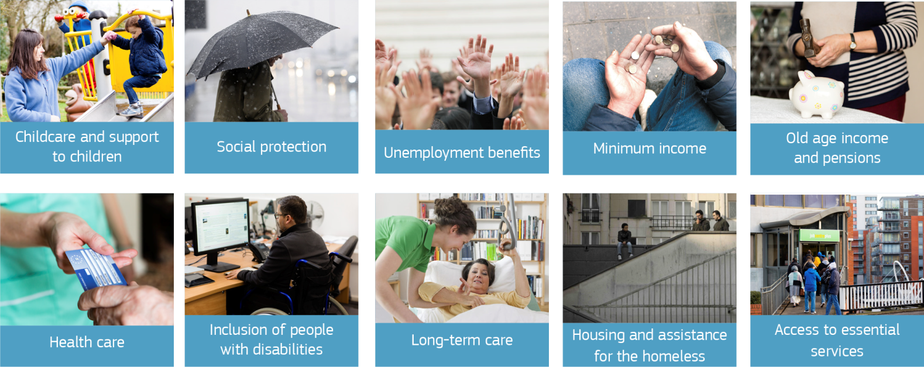
Access to social protection
Childcare and support to children
^{Social protection}
^{Unemployment benefits}
^{Minimum income}
^{Old-age income and pensions}
^{Healthcare}
Inclusion of people with disabilities
^{Long-term care}
Housing and assistance for the homeless
^{Access to essential services}

Slide 19

Childcare and support for children
Right to affordable early childhood education and care of good quality (from birth to compulsory primary school age)
Right to protection from poverty
For children from disadvantaged backgrounds (e.g. Roma, migrant or ethnic minority, special needs or disabilities, households at particular risk of poverty etc.) right to specific measures (reinforced and targeted support) to enhance equal opportunities
Childcare and support to children

Slide 20
^{Social protection}
Right to adequate social protection for workers, and, under comparable conditions, the self-employed
This applies regardless of the type and duration of the employment relationship (including non-standard contracts)
It covers both social assistance and social security, contributory and non-contributory schemes
^{Social protection}

Slide 21

^{Unemployment benefits}
Right to adequate activation support and adequate unemployment benefits of reasonable duration
Reasonable duration: it is important to allow sufficient time to find a job matching the skills of the jobseeker
Benefits should not create disincentives to work
^{Unemployment benefits}

Slide 22
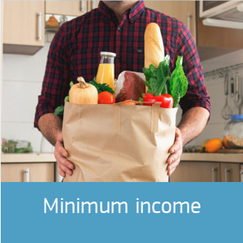
^{Minimum income}
Minimum income is a safety net of last resort
Right to adequate minimum income benefits ensuring a life in dignity at all stages of life, and access to enabling goods and services
Benefits should be combined with incentives to return to the labour market
^{Minimum income}

Slide 23
^{Old-age income and pensions}
Right of both retired workers and self-employed to a pension commensurate to their contributions and ensuring an adequate income
Equal opportunities for women and men to acquire pension rights
Attention to preventing poverty in old age and maintaining retired people's standard of living: right for everyone in old age to resources for a life in dignity
^{Old-age income and pensions}

Slide 24
^{Healthcare}
Right to timely access to affordable, preventive and curative healthcare of good quality
Everyone should be able to access healthcare whenever they need it
People should not be prevented from using necessary care because of the cost
Healthcare should be relevant, appropriate, safe and effective
^{Healthcare}

Slide 25
Inclusion of people with disabilities
People with disabilities have the right to income support that ensures living in dignity
Services that enable them to participate in the labour market and in society
And a work environment adapted to their needs
Emphasis on dignity, participation, equal opportunities and targeted support
Inclusion of people with disabilities

Slide 26
^{Long-term care}
Right to affordable long-term care services of good quality, in particular home care and community-based services
Emphasis on improving the autonomy of people in need of such care, and the right to live in dignity, independently and in the community
^{Long-term care}

Slide 27

Housing and assistance for the homeless
Providing access to social housing or housing assistance of good quality to those in need (e.g. housing benefit, income support, rental guarantees and tax deductions)
Right of vulnerable people to appropriate assistance and protection against forced eviction (e.g. affordable legal representation, advocacy and mediation; or protective measures, such as access to debt management schemes)
Providing the homeless with adequate shelter and services to promote their social inclusion
Housing and assistance for the homeless

Slide 28
^{Access to essential services}
Right to access essential services of good quality, including water, sanitation, energy, transport, financial services and digital communications
Emphasis on support for access to such services for those in need
^{Access to essential services}

Slide 29
WHO and HOW: Putting the Pillar into action, a joint effort
MEMBER STATES
Update EU legislation, step up enforcement
Social dialogue
Funding
Civil Society
European Semester

Slide 30
Initiatives at EU level
Work-life Balance:
Directive + policy measures currently discussed
Working conditions:
Proposal for a Directive in December 2017
Working Time:
Legal guidance on Directive 2003/88/EC
Access to Social Protection
Proposal for a Recommendation in March 2018
European Labour Authority
Proposal for a Regulation in March 2018

Slide 31
Integration into the European Semester
  The European Semester provides a framework for the coordination of economic policies across the European Union. It allows EU countries to discuss their economic and budget plans and monitor progress at specific times throughout the year based on factual analysis
  Country Reports and
  Country Specific Recommendations (CSRs)
Monitoring of societal progress on the Social Pillar is integrated in the EU Semester

Slide 32
Monitoring societal progress
Social Scoreboard
To serve as a reference framework to monitor employment and social performances of Member States in a holistic way
12 areas along three dimensions
of 'societal progress':
To be used in the framework of the European Semester, in particular in the Joint Employment Report
Equal opportunities and labour market access
Dynamic labour markets and fair working conditions
Public support, social protection and inclusion
14 headline and 21 secondary indicators
Based on existing data from e.g. EU-LFS, EU-SILC, the Structure of Earnings Survey and the OECD's PISA survey

Slide 33
EU Funding 2021-2027
European Social Fund/ESF+:
a dedicated budget line of 100 billion, “Investing in people cluster”
European Regional and Development Fund
Cohesion Fund

Slide 34
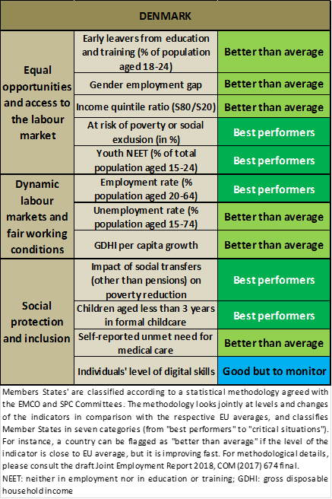

Slide 35
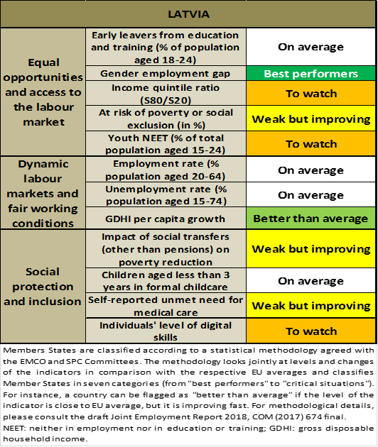
Country specific recommendation to Latvia:
Reduce taxation for low-income earners by shifting it to other sources, particularly capital and property, and by improving tax compliance.
Improve the adequacy of minimum income benefits, minimum old-age pensions and income support for people with disabilities. Increase the labour market relevance of vocational education and training, and foster upskilling of low-skilled workers and jobseekers. Increase the accessibility, quality and cost-effectiveness of the healthcare system.

Slide 36
Thank you!

