Slide 1
EU-China Social Protection Reform Project – Component 1 Training
Dr. Markus Collet
Partner Paris-Berlin
Corporate Value Associates
THE IMPACT OF TECHNOLOGICAL INNOVATION ON PRIVATE COMPANIES: CONCRETE EXAMPLES FROM EUROPEAN COMPANIES
Rome, October 22, 2018

Slide 2
Introduction (1/2)
Digital Technologies have made a Step Change since the 2000’
Digital Technologies have a profound impact on how work is done and how it is organized
Different fundamental Drivers:
Digital (“0” and “1”) reduces need for human intervention on processes (automation, emulation…) and the interaction of stakeholders (transaction costs)
The cost of operating Digital systems has fallen drastically, due to lower stockage (“Cloud”) and processing costs. Scalability of Digital is often considered as “free”
Elimination of “technical” limits of computing power lead to what is commonly called “Big Data”, which lavishly uses computing resources to fully exploit data power with innovative approaches
Customers are not driving this process, but their fundamental wish to consume what, how and when they like, and this at the lowest cost, is an infinitely deep value pool
This leads to completely new uses of IT / Digital: Much more cost efficient, with vastly more significant functional capabilities, targeting not only “low added value” activities, but making Man+Machine Systems globally more intelligent

Slide 3
Introduction (2/2)
Disruptiveness of Changes will be way beyond what has been experienced before
Compared to Internet, which somehow “added onto legacy”, Digital Transformation replaces legacy. Consequently it is infinitely more disruptive as to how companies operate and how they interact with each other
Operations: The endgame for operations is full automation, where only selected residual activities are taken over by humans (e.g. banks: customer advice on wealth management across generations)
Transactions: The endgame for transaction is equally full automation, through distributed systems, which “program” conditions, closure and execution of contracts, making set-up, analysis, decision taking, audit and enforcement superfluous (Blockchain…)
This opens the door to fundamentally new ways of doing business and serving the customer, with decrease of cost, improvement of service (real-time, STP…) and opening new business systems (Blockchain…) deeply intertwined
It’s in this environment that General Management needs to position the evolution of their company, both in the short-term and the medium- / long-term
One of the critical inputs in their decision-taking is the will / capability of political decision-takers to “digest” and even accompany such development

Slide 4







Digital Enablers
Digital allows new fundamental layers of technology enablers e.g. Blockchain, AI, & RPA
“Simple” Auto-mation
Data collection & analytics
Data Mgmt. / infrastructure
Robotic Process Automation
Natural Language Processing
Artificial Intelligence
Advanced
Un-structured data lakes
Internal & client reporting processes
Customer Service chatbots
Outcome prediction
Telematics & connected car data
Virtual Reality
Self-learning RMT cost control
IoT
Invoice matching
Sales virtual agents
Data-lab-as-a-service
Classification / pattern matching for risk models
Blockchain
Sales & on-sell calculation processes
Text analysis for contracts
Cloud
Technological Readiness

Slide 5


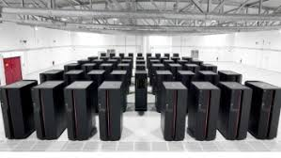

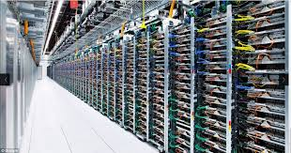
Illustration: Gap Between most businesses and the state of the art
If enablers such as data management, analytics, and AI capability have become readily available, companies are far from fully embracing them
Dedicated hardware (e.g. GPUs)
Massively parallel processing architecture
High end PC
Single HD
Typical corporate customer x product database, containing a few million lines of structured data, totalling a few tens of GB
Server
Google Open Images dataset of URLs for roughly 9 million images, categorised and labelled (6.2TB total download)
By the mid-2020s
“Square km Array”
157TB per second of raw data produced
Requires computers capable of 300 petaflops*
Storage need equal to 5x today’s total global Internet traffic
Current state of the art big data & ML**
Cloud
* The fastest computer in the world today is the Sunway Taihulight, rated at 93 petaflops. It consists of over 10 million processing cores and consumes 15MW of electricity
** ML = machine learning

Slide 6
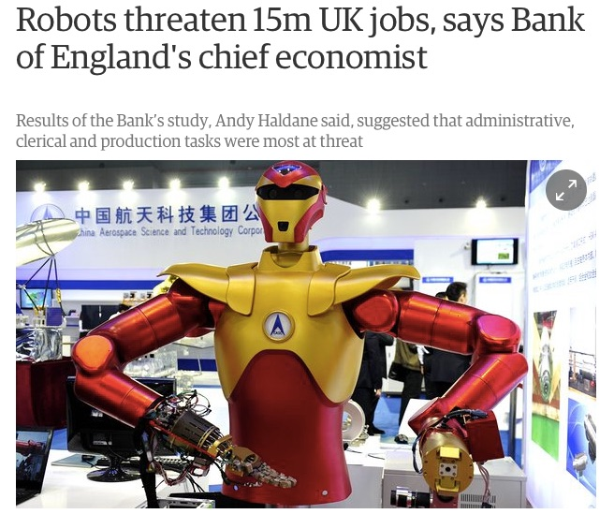
Operations Efficiency
The asymptotic end point – in some sectors – is a business model with zero employees, and everything run by software
Tech firms have demonstrated that exceptionally valuable businesses can be created with relatively few employees
Ratio of market capitalisation to employee numbers
Barclays Bank $0.4m
Deutsche Bank $0.3m
vs
PayPal $5.4m
Stripe $9.0m
Facebook $21.6m
“There will be Kodaks in the next several years, who missed the pivot”
John Sculley, CEO of Apple, 1983-93

Slide 7


Competition Becoming Painful – Illustration China
Natively Digital players achieve unprecedented levels of automated customer features and cost efficiency – Example of WeBank
Key Information
Operation Efficiency
WeBank is the first private-owned internet bank established in China, sponsored by internet technology giant Tencent
Establishment: 2014.12
Key shareholders
Tencent (30%), Liye Group (20%), Baiyeyuan Investment (20%), Other 7 Companies (30%)
Revenue: RMB 6.75 bn (2017)
Net profit: RMB 1.45 bn (2017)
# of employees: 1,200
Business overview
Deposit from individuals and SMEs
Loan for individuals and SMEs
Weili Loan – small loan between RMB 500~300k
Wei Car Loan – easy accessible auto finance
Wealth management
Human resource efficiency
2017, thousand
# of existing customers
With similar # of employees (~1,200), WeBank is serving almost 25 times as the # of customers as incumbent bank
WeBank’s efficiency relies on its highly-digitalized operation process
40,000
38,000
WeBank
2,000
Incumbent
WeBank presents higher cost-income ratio than bank industry avg. due to high investment in technology R&D …
…but the enhancement of tech capabilities will significantly decrease staff and operating cost, cost increase with customer number is negligible (“scalability”) and revenues per customer will increase with product width
0
# of staff
Cost-income ratio
2016-2018E, %
60%
52%
50%
40%
40%
30%
30%
20%
2016
2017
2018E
Banking industry avg. level of 2017

Slide 8





















Impact on Transactions
Digital Transaction management has created a host of new players, but also wiped out or seriously diminished the business of traditional players
Housing
Asset-heavy business model of hotels and hostels
Usage based subscription service; on-demand house sharing via app
Power-tools
Ownership based usage of power tools
Renting tools from your neighbor's garage via an app and website
Movie
Format updates but based on tangible product ownership
Shift to monthly subscription service; on-demand and huge range of choice
Music
Computer / phone based subscription; no additional assets
“Fixed location” music product
“On-the-move” music solution
Books / Press
Purchase of Paper copies every morning - delivery
Information-on-demand and digital platforms for business

Slide 9
“Physics” of Digital Disruption
There is a coherent pattern how Digital Players disrupt, showing the challenge that traditional players need to face
FROM…
… TO
Description
Balance sheet
“Pure” service
Unbundling of balance sheet and asset / transaction management, increasing “margin bang for asset-buck”, eliminating complexity…
Dedicated asset use
Fractional asset use
Maximizing utilization of assets by matching supply and demand in real time, enabling rationales of marginal revenues, etc.
Scale via standardization
Scalable personalization
Situationally customized experience anticipating customer spot needs at little or no additional cost
Optimization
Elimination
Adoption of AI and bots, eliminating low-value, but also high-value rule-based tasks
Reactive
Predictive
Accurately predict events leveraging data (incl. telematics) and data science capabilities, increasing customer and operational benefits
Value chain
Value sources
Optimizing activity not (only) to serve a single set of customers, but enabling activity of multiple stakeholders
Data around processes
Processes around data
Deterministic, linear use of data in processes is replaced by cultivation of data richness and granular, versatile analyses, prompting action
Run
Build
Rationale to shift attention from current operations – often “pushed to the cloud” to continue building / changing the company

Slide 10
Introduction to Case Study
Player in Specialized Finance, a sector mostly traditional (managing contracts for customers, transacting with 3rd parties such as retailers, managing services…)
Several factors became apparent to CEO
Opportunity of value creation (vs financial markets) through disruption of how the company operates, how it interacts with other players (application, blockchain-based funding…)
Opportunity of entering into other areas, which are not (yet) core for the company, but which are dominated by traditional players far away from digital excellence (service platform…)
Threat of new players entering the sector, first taking away the best customers, best contracts, best business segments… and finally eliminating the Company
This is why shareholders, CEO and management board asked CVA to
Develop the Digital Vision of the End Game (“where will all of this go to”)?
Sketch out a Trajectory of how to get there as a Winner
Concretely design the Transformation Program Set-Up
Help implement the Program
This kind of request represents an increasing part of CVA’s activity

Slide 11




Digital Trajectory for Company
The Company sketched out a long-term development trajectory with distinct but overlapping phases
Horizon 3 – New digital models
Intermediating clients & non clients
Structuring the Ecosystem
Wildcard – External Growth
“Digital Synergies”: Applying cost / margin benefits to additional volume
Horizon 2 – Digital Intelligence
Intelligent Pricing & Sourcing
Horizon 1 – Digital Cost & Service
Automation & robotization of core customer journeys
Horizon 0 - Traditional
Standardized best practices
Quick replication of innovation

Slide 12
“Size of the Prize”
PRELIMINARY
This is supposed to nearly triple the Profit Before Tax!
3,200
Horizon 3 – New digital models
Company getting >1% of shared use market + delivering new platforms
100
“Tripling” PBT with New Business Models
Wildcard – External Growth
Growing volumes by 25% or more through mergers
100
“Doubling” PBT on Core Business
Horizon 2 – Digital Intelligence
Accessing at least €150 extra per customer
400
Horizon 1 – Digital Cost & Service
Operating increased volume at less than 50% of its cost base
Base Business Value
Horizon 0
Accessing €400M of OPEX & gross margin value
Total Value (M)

Slide 13
Levers of Improvement
Horizon 1 - Most immediate value potential through “radical” digitization of core business
~11k FTEs
Procurement
Commerce
3rd party Service
Insurance
Customer Service
Finance
Legal
IT
HR
Digitization Levers
§
Tasks with high
digitization potential
20-30%
Automation
Man-Machine Interaction
Tasks with some digitization potential
25-35%
Centrali-zation
Additional Estimated FTE saving (%)*
-15%
-35%
-35%
-25%
-45%
-25%
-40%
-15%
-40%
Tasks with lower digitization potential
35-55%
High impact
Moderate impact
Not impacted

Slide 14
Next-Gen Operating Model
Application of the timeline of efficiency improvements on the Company’s cost base yields an FTE Base reduced by 57%, at strongly growing volumes
FTEs
100%
7%-10%
8%-11%
14%-18%
50%-67%
7%-10%
7%-23%
43%
Current
Classic IT
Digitization
Robotization and automation
Centralization and outsourcing
Subtotal
Digital Model
Aspiration

Slide 15
“Spending Less to Do More” – Principle for Banking Sector
This reflects the typical trajectory, where transformations require new capabilities, before building back existing legacy and associated FTE positions
Digital Capabilities
Today’s Legacy
Many branches
Few clients visiting branch several times per month
Costly legacy MO and BO processes
Multichannel
Future landscape
Integration of financing in application application domains (“verticals” in housing, auto, retail…)
Banalization of Mass Retail (Revolut, Orange Bank…)
Lean, digital models like N26 (500k+ clients with 300 employees, o/w 75% IT/Digital)
37 Boutiques Nespresso in France
Legacy
Legacy
Decreased Legacy
Native Digital Capabilities
Replaced Legacy
Decreased Legacy
Yesterday
Today
Tomorrow
Day after tomorrow

Slide 16
Outlook – Business
Disruptive Digital Models are going to impose themselves in probably all Industry Sectors
Incumbents have some time to adjust, due to:
Lack of assets, credibility… of natively digital players (“too small”)
Slowness of large Incumbents to play the natively digital game (“too inertial”)
Structural limits (regulation, law…) slowing down some disruptive models (Uber…)
However, we advise Incumbents to move strongly now, as:
Build-up of competencies takes time
Roll-over of employees requires time…
In many sectors, network / scale economies generate strong “first-mover advantages”
It is likely that a number of Incumbents will simply not make it and suffer the fate of the Dinosaurs who did not manage to adapt

Slide 17
Requirements – Digital Capabilities
Digital has created a number of skills and positions not known still 10 years ago
Researcher
Communication Specialist
Digital Recruiter
PMO
Copywriter
Digital Ambassador
Back end Developer
Scrum Master
Digital Marketing
Data Scientist
SEA Specialist
SEO Specialist
Programmatic Marketer
Data Engineer
CRO Specialist
Data Analyst
Product Owner
Visual Designer
Interaction Designer
Front end Developer
Content Strategist
Full stack Developer
Scrum Master
Rollout Coordinator
Business Analyst
Sitecore Developer
Matrix Developer
DevOps Engineer
Solutions Architect
Tech lead Webservices
UX Designer
Business Analyst
Digital Architect
Display
AWS
Engineer

Slide 18
Backups

Slide 19





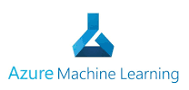















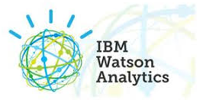













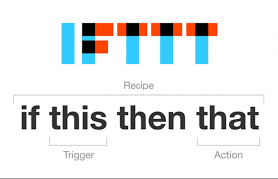

External perspective: landscape mapping
4a
The landscape of what is possible is complicated, spanning data management, automation, various AI technologies, as well as enablers such as blockchain and others
Generically, “AI”
A field of active and rapid R&D
Lots of different technologies
Lots of different but overlapping solutions…
… from lots of vendors, both established and emerging…
… catering both for ‘build in house’ and ‘outsource’ strategies
Although there are lots of vendors, both established and merging, the usual tech giants are likely to dominate solution provision
Big data
Rules-based automation
Descriptive analytics
Deep learning
Machine learning
Intelligent agents
Veles
‘Small data’
Distributed ledger technologies (blockchain)
Enablers
Augmented / virtual reality
Need a structured understanding of what is out there (and what is coming), what it can do, and what others are doing with it

Slide 20






Approach to reflection about the digital vision
Proven Disruptors have been analyzed in depth, in order to transpose their successes into Target and Initiatives of our client
Disruptive Vision needs to be thought from the future backwards rather than forward from today
No industry role model – the digital vision of Company requires genuine invention
Customers and general “dimensions of digital disruption” as only reference points
Two-step ideation approach
Induction: From concrete evidence to general “dimensions of disruption”
Deduction: Applying “dimensions of disruption” to Company
Results then applied to customer sectors
Concrete evidence
Who has successfully disrupted?
Company XXX vision
Who & what could the future Company XXX be?
Induction
Deduction
How did they disrupt?
How to apply to Company XXX & its customers?
“Dimensions of disruption”
What are the general physics of successful disruption?

Slide 21
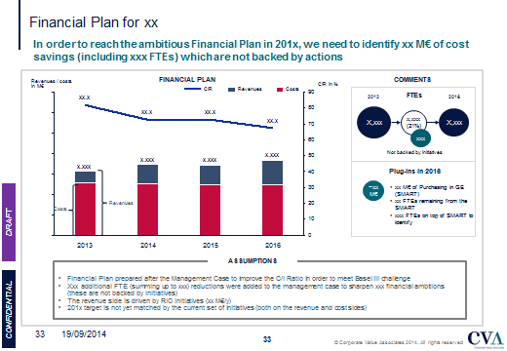
As a Reference: Traditional Transformation Program
Traditionally, Transformation Programs take a philosophy of progressive, coherent and cumulative change
Bank
Services
Commissions
Bank Marketing
Trade Platform

