Slide 1
Long Term care: Public Intervention, Role of the Market & Third Sector
Prof. Giovanni Fattore, Bocconi University Milan
Component One- 2018 Training Course
Milan, 25th October 2018

Slide 2
Index
Long term Care and its specificities
Possible funding arrangements
Variety of LTC arrangements in Europe
What China can learn from the variety of European experiences and models

Slide 3
Definition of Long Term Care (LTC)
LTC is care needed by individuals with reduced physical or mental capacity who cannot perform basic activities such as bathing, dressing, getting in and out of bed or a chair, moving around and using the bathroom (often referred as Activities Daily Living (ADL)
It includes
(i) non-acute healthcare (patients have chronic medical conditions)
(ii) personal care (help with bathing, dressing, etc.)
(iii) help with other activities such as housework, meals shopping, etc…
(iv) accommodation for individuals who cannot live independently
It is important to keep healthcare and LTC distinct (the former is often the cause of the need of the latter but they are different in nature)

Slide 4
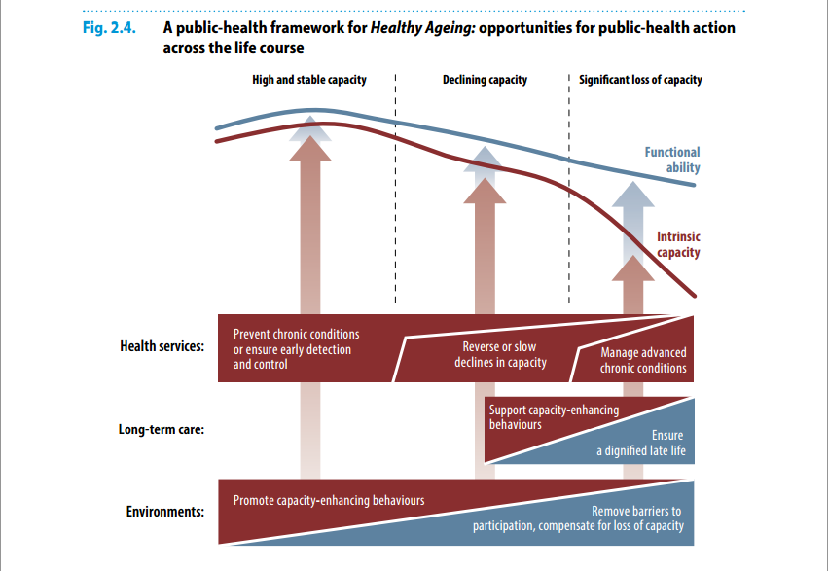
WHO World Report on Ageing and Health

Slide 5
Health and Long Term Care (LTC)
Part of LTC is health care in nature but the prevalent need of these patients is personal and social care and support rather than specialized acute healthcare
  Patients are not in an acute phase of a disease that requires hospital care (although inappropriate use of hospital care is common)
  But they are dependent on others to live!
  It is estimated that about 2/3 of LTC patients have mental problems (e.g., depression, dementia, Parkinson, Alzheimer)
  Most of LTC clients are elderly (but children and adult as well may require LTC)
  Integration with primary and hospital care
  In Europe about 65/70% of beneficiaries are women

Slide 6
Provision of Long Term Care (LTC)
Some health care is generally provided by health professionals (but availability largely varies across systems and setting)
Non-healthcare care is provided by social care professionals (with various types of skills), informal caregivers (migrants) and family members
Formal Care Informal Care
Residential Care (typically at home)
Care Homes (mainly women)
Nursing Homes
Home care

Slide 7
Provision of Long Term Care (LTC): the past
Lower life expectancy and shorter life-spans with disabilities
Larger families
Family members less geographically dispersed
Lower participation of females to the labor market

Slide 8
Provision of Long Term Care (LTC): the present and the future
Given present socio-economic and demographic trends, families and other informal caregivers will not be able to provide adequate LTC to their elderly as it was in the past
Cost of LTC tends to be catastrophic (individuals and their families risk ending up in poverty)
  Otherwise, risk of poor quality of life in the final phase of life
Then 3 main funding strategies
  Self-insurance
  Voluntary private insurance
  Public Insurance

Slide 9
1. Self-insurance
No-insurance and no government intervention
Several elderly would try a) to save to cope with possible costs of LTC; b) to rely on children resources
Financial burden and caregiving on families
Many individuals end up with large amounts of unspent savings (as not everybody needs long-term care); saving rates probably too high!
Those who do not save remain without any protection (if no informal care)
Major burden on families, part of the elderly without adequate minimal protection (however a component of Self-insurance may be desirable)

Slide 10
2. Voluntary insurance
Patients pay a premium to receive LTC coverage in case of need later in life
It tends to be costly (high administrative costs; prediction of costs in the long term is difficult; moral hazard increases premiums of policies)
It is affordable if purchased earlier in life (but often individuals maybe myopic or simply underestimate the need of future LTC)
Empirical evidence of rather low uptake of voluntary private insurance even in the US (where people are familiar with voluntary insurance systems and saving rates are very modest)
Unless very strong financial incentives, widespread uptake of voluntary LTC is unlikely!!!
Nevertheless, a part of the population (better of, more risk adverse) may be interested in policies that only partially protect against the risk of disability and LTC
Voluntary insurance may be offered by employers (fiscal incentives may be important)

Slide 11
3. Compulsory insurance
It mandates everybody or categories of individuals to be insured
Public versus private (typically public no benefits from competition; but competition may lead to cream skimming (poorer quality offered to high-risk (less convenient) patients)
If private, market structure important to keep the competition working (regulation by government agencies) (regulation capacity)
With public compulsory insurance choice between general taxation (UK, Nordic countries) and social insurance contributions (contributions on payrolls) (taxation is generally more redistributive)
Risk of crowding out of informal care
Moral Hazard (tendency towards excessive use of LTC services by insured people) (with all type of Insurance)

Slide 12
EC Joint report on health care and long-term care systems & fiscal sustainability. 2016

Slide 13
EC Joint report on health care and long-term care systems & fiscal sustainability. 2016

Slide 14
OECD Classification (from Colombo et al.. Help Wanted. OECD 2011)
Comprehensive, universal, tax-funded systems
Nordic countries
More comprehensive
Wider access
More expensive
Universal LTC insurance
- more comprehensive
Netherlands, Japan
- larger copayments
Germany, Korea
Mixed systems
Multiple universal systems
Income-related universal benefits
Mix of universal and means-tested benefits
Italy, Czech Republic
France, Ireland, Austria
Switzerland, Spain
Means-tested safety net system
England, United States
Notes:
This is how we categorised LTC payment systems in our 2011 report Help Wanted
Categorisation is only approximate – and the implied ranking of generosity even more so
In general, all systems require some sort of user copayment, although this might be means-tested or covered by separate social assistance systems
But the size of these copayments varies dramatically between countries
There is no such thing as a universal, free at the point of use LTC system like we see in some countries for health

Slide 15
EC Joint report on health care and long-term care systems & fiscal sustainability. 2016

Slide 16
Possible lessons about LTC from Europe (cont.d)
There is not a European model for long term care (large variations and a variety of different models/experiences to fund and to provide LTC)
  In Europe health care systems and pension systems appear more homogenous than LTC systems
  Likely, a large country like China cannot have just one model (personal note)
Market forces alone are unlikely to cope with the increased demand of formal care…… But full universalism covered by the government probably not sustainable; any system is likely to require collective and private resources

Slide 17
Possible lessons about LTC from Europe (cont.d)
Special funding arrangement for LTC needed to support both home care and care homes and nursing homes (when the patient cannot live in his/her home)
  At which level? National? Provincial? Municipality?
  Compulsory? For whom
  Ownership of funds for LTC
    Government (most frequent solution in Europe)
    Non-government organizations (but with a social mission and governance; no-profit generation and distribution)
    Private for profit (commercial entities)

Slide 18
Possible lessons about LTC from Europe (cont.d)
Need of adequate measures of need of LTC
  Level of dependency (to define eligibility)
  Level of benefits (in kind and/or cash benefits)
  Means testing (in no universal coverage, need to identify level of contribution from private sources (income and asset)
  These are technical aspects that are anyway crucial (need to develop appropriate capacity)

Slide 19
Possible lessons about LTC from Europe (cont.d)
Policies to keep the elderly in their community and to delay institutionalization in care homes and nursing homes
  A number of possible measures to support informal caregivers (family members) (training, cash benefits, flexible working conditions)
  However, excessive rely on family members may be detrimental for the general job market (low labor partecipation rate and low productivity)
  Expanding formal home care (professionals delivering services typically at the home of the person)
  In many European countries often formal home care delivered by immigrants with limited professional training (need to specialize these caregivers)

Slide 20
Possible lessons about LTC from Europe (cont.d)
Promote the development of provision of efficient and good quality long term care by professional organizations (that is somehow distinct from healthcare)
  Private (expanding in Europe)
  Public (government-owned)
  Private non-profit
  Different incentives to pursue efficiency
  Risk of selection and exploitation of “weak consumers”

Slide 21
Possible lessons about LTC from Europe (cont.d)
Regulation activities are very important (especially if there is competition and private entities)
  Financial regulation
  Licensing and minimum requirements to provide services (national and regional rules everywhere in Europe)
  Quality Assurance activities (e.g., health data collections, tootls to measure quality of life, inspections, protocols of care)

Slide 22
Possible lessons about LTC from Europe (cont.d)
Training, retention and motivation of personnel is a major issue with LTC
  Working in LTC typically stressful, emotionally demanding and not well rewarded
  All European countries faces issues with the quality of their professionals
  No easy solution!!! But area of growing concern

Slide 23
Possible lessons about LTC from Europe (cont.d)
Coordination between different actors dealing with the patient (within LTC and between LTC and specialist healthcare)
  Without collaboration (risk of inadequate medical care and hospital bed blocking)
  Collaborative governance (typically between social care and health care institutions)
  Point of co-ordination at patient level (someone is specifically responsible to coordinate activities for the patients across sectors of care)

