Slide 1
The GIG economy
Ferdinando Montaldi
Component Two- 2018 Training Course “Effects and tendency on income redistribution policy”
Italy, October 14th -28th, 2018

Slide 2
Index
The GIG economy:
The definition
The operation of the digital platform
Coworking and crowdworking
Types of contracts and compulsory insurance

Slide 3
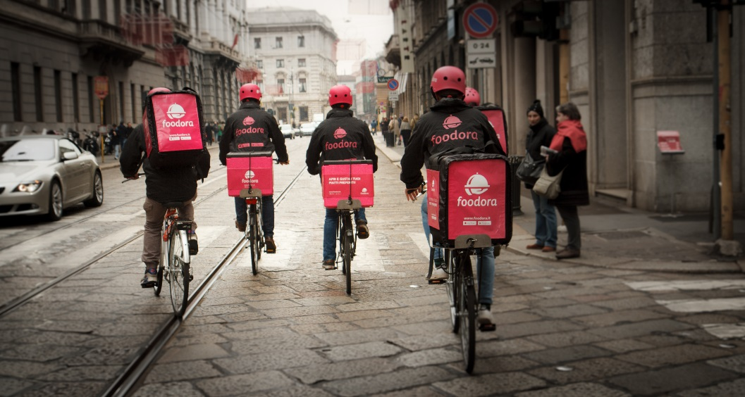
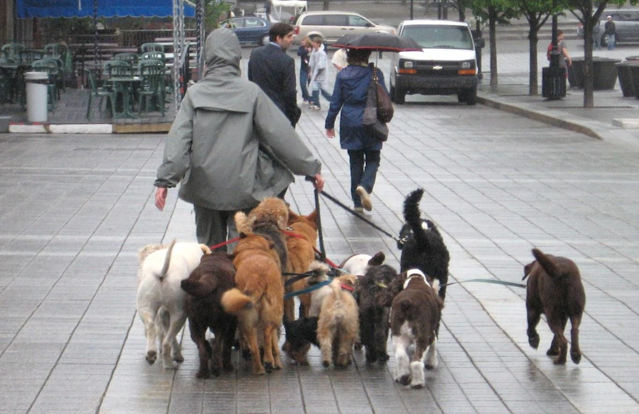
GIG economy
The definition
What’s the GIG economy ?
The casual/intermittent jobs based on a digital platform
Gig (slang) = a little job, a very short term job, a job performed during free time, …
According to recent research, by the De Benedetti foundation, in Italy there are 600.000-750.000 people operating in the GIG economy (1,5%-2,00% of the population within 18-64 year old age group)

Slide 4
GIG economy
The operation of the digital platform
What’s the link between the worker and the digital platform ?
Types of models:
Operation limited to match supply with demand
Global operation

Slide 5
GIG economy
The operation of the digital platform
Operation limited to match supply with demand
Features:
The platform facilitates the matching of workers and customers
The job relationship is established between customer and worker
The platform provides a lot of services (tracking skill of workers, administrative service, standard work documents, …)
As an example:
Taskhunters (link between students and companies)
Le cicogne (nursery services)
PetMe (dogsitter and catsitter services, Italian provider working in more than 30 cities, about 10.000 workers)

Slide 6
GIG economy
The operation of the digital platform
Global Operation
Features:
The job relationship is established between platform manager and worker
The customer is always provided by the platform manager
The worker can decide if and when to give his availability
When the worker gives his availability, the digital platform manages all aspects of the job performance of the worker (relation with the customer, time, deadline, …)
The worker generally uses own their instruments (car, bicycle, …)
As an example:
Food delivery company: Deliveroo (GB), Foodora (D), Moovenda
Facility management company: Yougenio, Prontopro, Helpling, Ernesto

Slide 7
GIG economy
Coworking and crowdworking
Other types of jobs based on a digital platform
Coworking: people work together as independent workers
“working together as equals” (Bernard De Coven)
Crowdworking: people work as independent workers in a competitive system managed by a digital platform
The digital platform provides customers and offers the task to all interested workers all over the world
The interested workers propose the guidelines of the development of the task (or: the completed task)
The platform or the customer chooses the best or the more adequate proposal (or: task)
The identified worker develops the task, delivers the job and is paid by the digital platform or directly by the customer
As an example: UpWork, Freelancer, Amazon Mechanical Turk, Crowdflower, Vicker

Slide 8
GIG economy
Coworking and crowdworking
The perspectives
Coworking Crowdworking
The key issues:
What types of job relationships are there ?
What social insurance is available for workers ?

Slide 9
GIG economy
Types of contracts and compulsory insurance
GIG economy workers
We focus on Gig economy based on global operation platform (eg. food delivery)
Two questions:
What is the adequate job relationship ?
What the compulsory insurance are available ?

Slide 10
GIG economy
Types of contracts and compulsory insurance
The types of work relationships for CIG economy
Independent casual work (independent)
Continual and coordinated work (independent)
Continual work organized by the company (become employee)
Casual work as an employee (employee)
Intermittent work (employee)

Slide 11
GIG economy
Types of contracts and compulsory insurance
1 - Independent casual work (independent)
Rules:
Not continuous job (casual)
No connection to the company
Compulsory insurance:
Pension insurance: YES (but only for remuneration over € 5.000 a year)
Disease and maternity insurance: N/A*
On the job injury and disease: N/A
Unemployment insurance: N/A
*: not applicable

Slide 12
GIG economy
Types of contracts and compulsory insurance
2 - Continual and coordinated work (independent)
Rules:
Personal job (not organized as activity of enterprise)
Continuous job (not casual)
Coordination by the company
No organization of work by the company (time and type of work)
Compulsory insurance:
Pension insurance: YES (from 1995)
Disease and maternity insurance: YES (maternity from 1995; disease from 2007, maximum 61 days a year)
On the job injury and disease: YES
Unemployment insurance: YES (recently introduced, maximum 6 months)

Slide 13
GIG economy
Types of contracts and compulsory insurance
3 - Continual work organized by the company
→ the same rights of an employee
Rules:
Personal job (not organized as activity of enterprise)
Continuous job (not casual)
Coordination by the company
Organization of work by the company (time and type of work)
Compulsory insurance:
Pension insurance: YES
Disease and maternity insurance: YES
On the job injury and disease: YES
Unemployment insurance: YES

Slide 14
GIG economy
Types of contracts and compulsory insurance
4 - Casual work as an emplyee(employee)
Rules:
Casual job
Management of work by the company
Minimum wage: € 36 a day (4 hours)
Only for small company: maximum 5 permanent contract workers
Only for short jobs: maximum € 2.500 a year for the same worker and € 5.000 a year for all casual workers
Compulsory insurance:
Pension insurance: YES
Disease and maternity insurance: N/A
On the job injury and disease: YES
Unemployment insurance: N/A

Slide 15
GIG economy
Types of contracts and compulsory insurance
5 - Intermittent work (employee)
Rules:
Management of work by the company
Job on demand according to the need of the company (production peaks)
Only for discontinuous jobs provided by the law
Only for people under 25 e over 55 years old
Collective labour agreement can modify the law conditions regarding the types of discontinuous jobs and the age of the worker
Compulsory insurance:
Pension insurance: YES
Disease and maternity insurance: YES (disease protection maximum for the same working day during the previous year)
On the job injury and disease: YES
Unemployment insurance: YES (13 working weeks during the previous year)

