Slide 1

THE FUTURE OF WORK
Paolo Falco
Labour Market Economist
Skills and Employability Division
Directorate for Employment, Labour and Social Affairs
EU-China Social Protection Reform Project
Rome, 22 October 2018

Slide 2

Mega-trends changing the world of work
Changing:
What jobs will be created
How, where and by whom they are carried out
Ageing Societies
Globalisation
Technology
Digitalisation

Slide 3
The 3 mega-trends
Technology is changing the workplace
Estimated worldwide annual supply of industrial robots
Populations are ageing
Old-age dependency ratio 65+/(15-64)
OECD average
The world has become more integrated
Share of business sector jobs sustained by consumers in foreign markets, 2011 (%)

Slide 4
What can we expect from the 4th industrial revolution?
Jobs with high and medium potential for automation
Percentage of jobs with 70 % and between 50 % et 70 % of substitutable tasks
Source: Survey of Adult Skills (PIAAC); , Nedelkoska and Quintini (2018)

Slide 5
What can we expect
from the 4th industrial revolution?
Jobs with high and medium potential for automation
Percentage of jobs with 70 % and between 50 % et 70 % of substitutable tasks
Tasks that lower risk of automation:
Presenting
Influencing
Reading books and/or professional publications
Writing articles
Using programming language
Training others
Tasks that increase risk of automation:
Exchanging information
Selling
Using fingers or hands
Source: Arntz et al (2016), Table 3.
Source: Survey of Adult Skills (PIAAC); , Nedelkoska and Quintini (2018))

Slide 6
The fallacy of Technological Determinism
In which areas is the application of robots most/least acceptable?
Source: Eurobarometer.

Slide 7
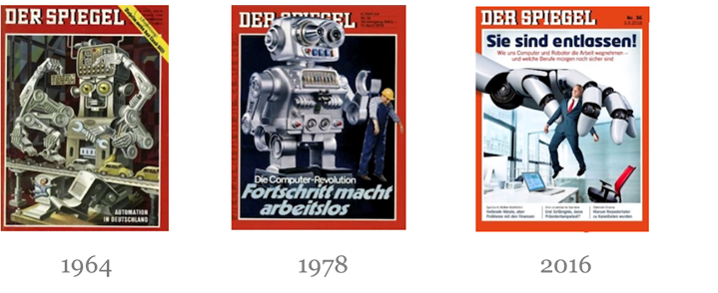
This is not a new debate

Slide 8
Technology or Globalisation?
The labour m
Industrial and Occupational Structure
Globalisation
Technology
Digitalisation
DE-INDUSTRIALISATION

Slide 9
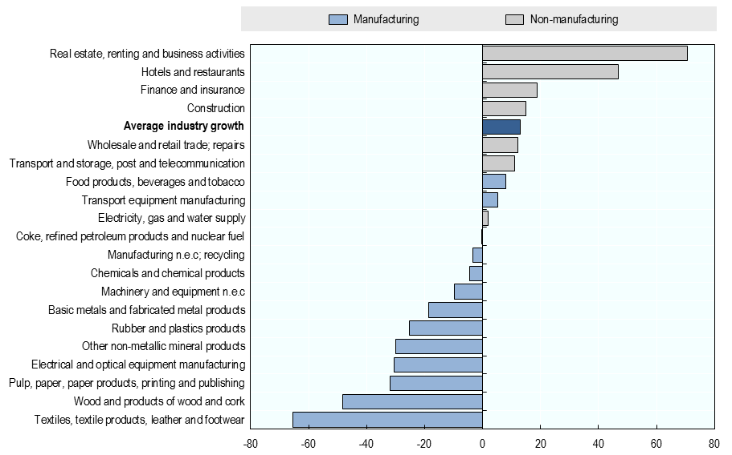
The decline of the manufacturing sector
Percentage change in total employment within industry for selected OECD countries
Source: OECD (2017), OECD Employment Outlook 2017, forthcoming.

Slide 10
Technology or Globalisation?
The labour m
Industrial and Occupational Structure
Globalisation
Progresso Tecnologico
DE-INDUSTRIALISATION
JOB-POLARISATION

Slide 11
The labour market continues to polarise
LM Polarisation, selected OECD countries by region, 1995 to 2015
Percentage point change in share of total employment
Source: OECD (2017), OECD Employment Outlook 2017, forthcoming.

Slide 12




Inequality has been rising
Richest 10% v. poorest 10%
9x
7x
25 years ago
Now

Slide 13
Technology or Globalisation?
The labour m
Industrial and Occupational Structure
Globalisation
Technology
Digitalisation
DE-INDUSTRIALISATION
JOB-POLARISATION
OECD Employment Outlook 2017:
TECHNOLOGY PLAYS THE CLEAREST ROLE

Slide 14












The rise of new forms of work?
  Greater income, efficiency and flexibility?
  Less social protection and greater precarity?
Greater risk for individuals who manage their jobs, protection and training?

Slide 15





The platform economy remains small (but may be growing)
New and filled platform vacancies
May 2016 to February 2018
28-day moving average, May 2016=100
5%
3%
0.5%
1%
Source: Kässi, O. & Lehdonvirta, V. (2016), Online Labor Index.

Slide 16
We know very little about platform workers
Earnings?
Where?
Who?
What?
Primary or supplementary?
Choice?

Slide 17
But non-standard employment is not new
OECD Average

Slide 18
Key policy areas
Social Protection
Skills
Labour Market Regulation
Supporting conditions
Collective Bargaining
Activation

Slide 19
Do workers have the skills for the new jobs?
Problem-solving skills in Technology-Rich Environments
Percentage of the working-age population (aged 15/16-64)
Many workers lacking ICT skills
Few high-skilled workers
Source: OECD (2013), OECD Skills Outlook 2013: First Results from the Survey of Adult Skills , OECD Publishing.

Slide 20
Job-related training – most in need get the least
Percent of workforce in job-related education and training by level of proficiency in literacy
Source: OECD (2013), OECD Skills Outlook 2013: First Results from the Survey of Adult Skills , OECD Publishing.

Slide 21





The future of work requires a change to how we think about social protection
Statutory access to social protection for the self-employed
Source: Spasova et al. (2017).

Slide 22
The self-employed risk slipping through the (social safety) net
54.5%
The share of self-employed (15-64) in the EU at risk of not being entitled to unemployment benefits
37.8%
The share of self-employed (15-64) in the EU at risk of not being entitled to sickness benefits
46.1%
The share of self-employed women (15-49) in the EU at risk of not being entitled to maternity benefits
Source: EC (2016): “Non-standard employment and access to social security benefits”

Slide 23


Options for improving social protection coverage
Repair?
Replace?
Reduce abuse and misclassification of workers
Address tax avoidance
Provide adequate social protection:
  Statutory access
  Effective access
Advantages of a basic income
  Simple
  No one left behind
  Less paternalistic
  Reduces stigma
But is it realistic?
  Costly
  Winners and losers

Slide 24


Thank you
Contact: Paolo.FALCO@oecd.org
Read more about our work Follow us on Twitter: @OECD_Social
Website: www.oecd.org/els/social
Newsletter: www.oecd.org/els/newsletter

