Slide 1
Technological change, employment and welfare
Prof. Stefano Sacchi
President, National Institute for Public Policy Analysis (INAPP)
Component Two - 2018 Training Programme “Effects and Tendency of Income Redistribution Policy”
Italy, October 14th - 28th, 2018

Slide 2
Outline
Context and literature
Evidence for Italy
Key research questions
Data and descriptive evidence
Econometric results
Conclusions and policy challenges
2

Slide 3
Context
All across the world economy, workers are increasingly exposed to sources of uncertainty affecting (and potentially reshaping) their behaviour and preferences
Among these sources a privileged place is held by labor-disruptive technological change that is recognized as a key driver of polarization and inequality in terms of employment and income
Tech-related uncertainty may
  induce precautionary behavior (consumption and savings)
  affect workers’ preferences for redistributive policies
3

Slide 4
Impact of tech change on economy and society
Impact of technological change on:
Employment and wages
Welfare state
State capacity to fund the welfare state
The politics of the welfare state
Political participation
4

Slide 5
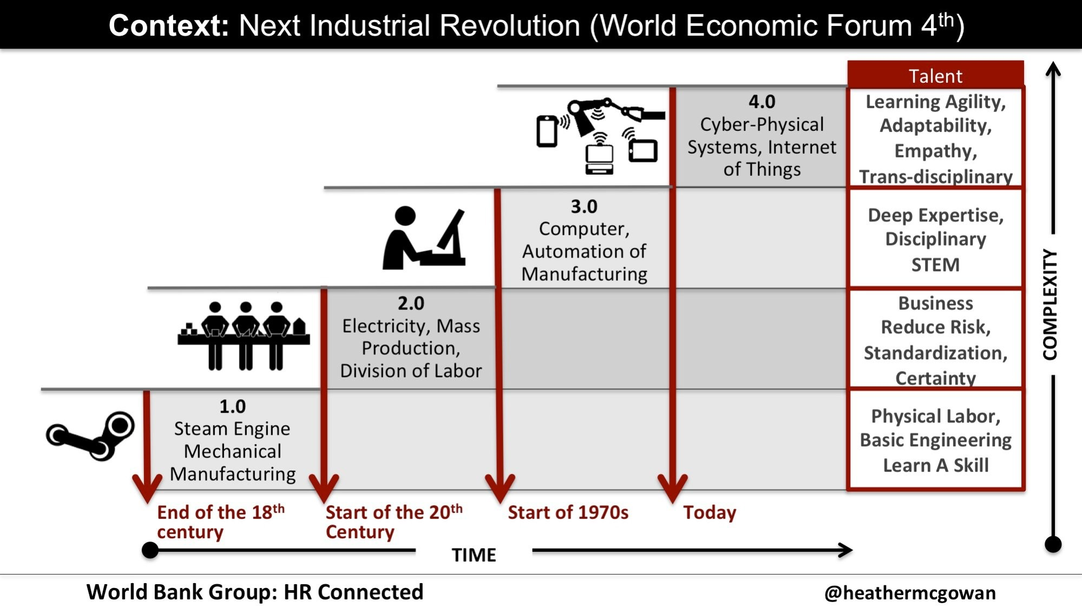

Slide 6
Labor markets
Routine Biased Technological Change
Employment and Wages: occupations and tasks
Polarization of employment opportunities and wages
Previous “revolutions” have brought about more employment
AI and ML: Is this time different?
Labor-saving tech change and role of redistribution of productivity growth
Platform work: quality of work, industrial relations
Taxation in the digital economy and funding the welfare state
6

Slide 7
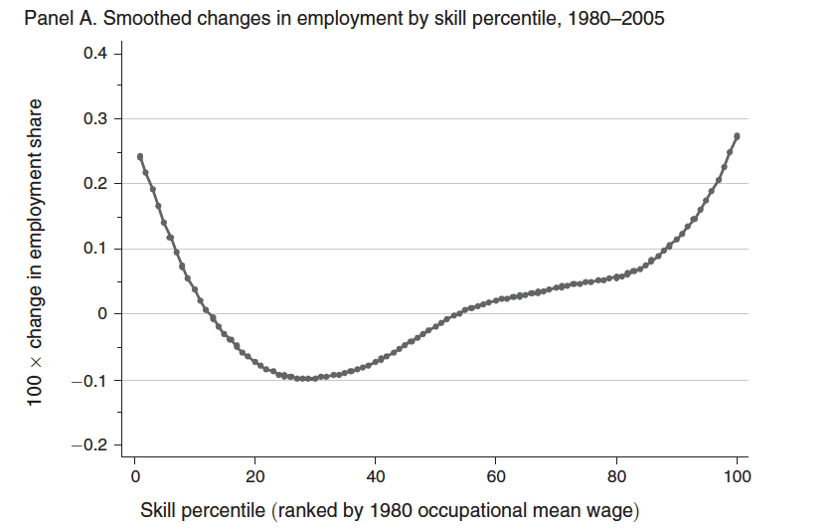
Source: Autor and Dorn, 2013

Slide 8
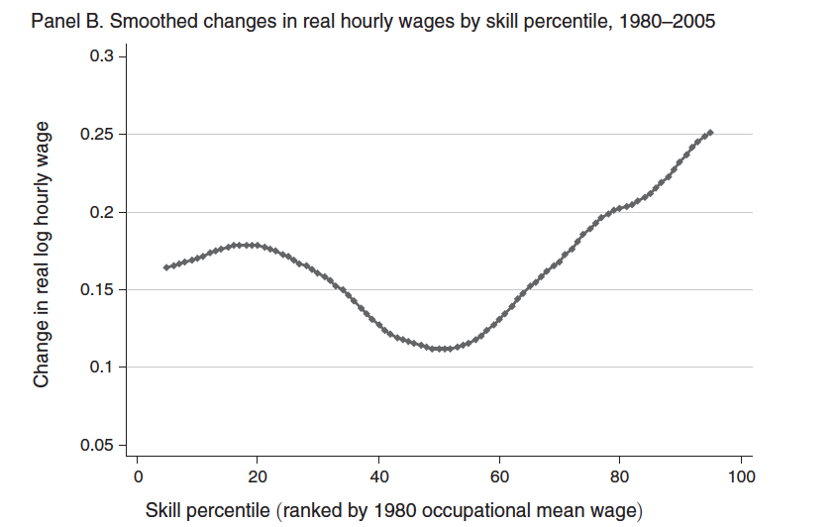
Source: Autor and Dorn, 2013

Slide 9
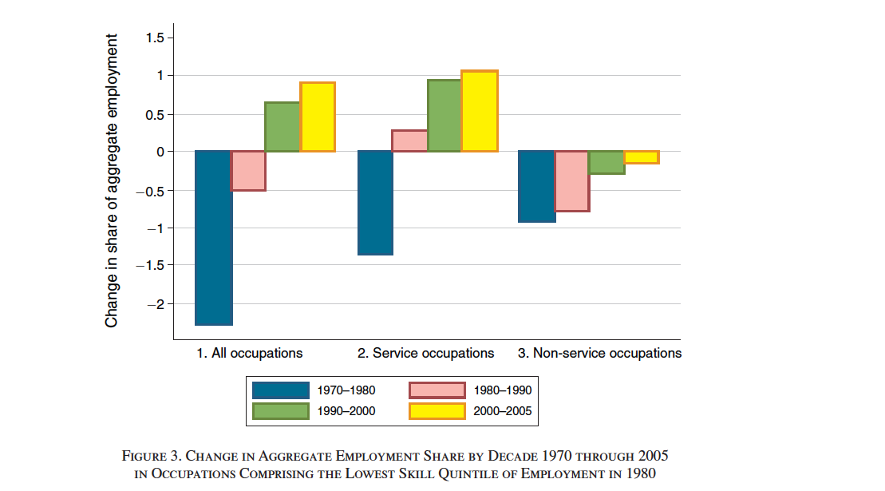
Source: Autor and Dorn, 2013

Slide 10
Impact of technological change

Slide 11
Mediating factors
Politics (law and ethics) of technological change impacts upon pace of adoption of innovations
Relevance of skills (soft skills) and skills-formation institutions
In any case: transitional period – management of (new?) social risks and demand for compensation
11

Slide 12
Welfare state
Three strands of research (Busemeyer et al):
Impact of tech change on preferences for redistribution
Collective representation, industrial action and workers’ power resources in the digital era: mediated by institutions or market power will have its way?
Social policy responses
Iversen and Rehm:
  External modernization effect (tech change inducing new demands, both compensation and social investment – skills!)
  Internal modernization effect (use of new tech in welfare state provision)
12

Slide 13
Acceptability of robots
Source: Eurobarometer 2012.

Slide 14




Slide 15
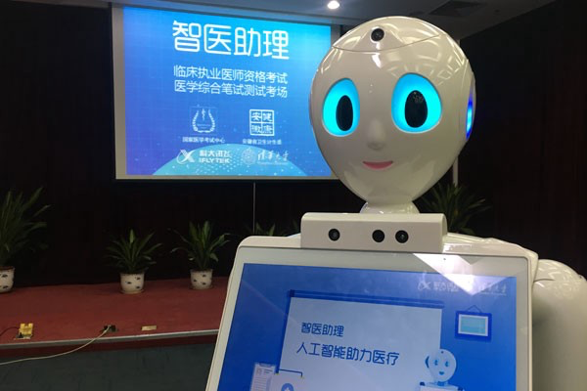
Xiao-Yi passed China’s National Medical Licencing Examination

Slide 16
Support for redistribution
Expectation: tech change related to support for redistribution and insurance (Meltzer and Richard 1981, Rehm 2016); similarly to globalization (Walter 2010). Link btw being a globalization loser and voting for populist right (Colantone and Stanig)
Very little research
Kitschelt and Rehm (2014): occupations play an important role in shaping attitudes towards the welfare state
Dekker et al (2017): fear or robots at work related to labor market vulnerabilities (low education, female, unemployed, manual)
Thewissen and Rueda (2017): exposure to tech-change related employment risks (RTI) correlated to support for redistribution
Politics of social status (Gidron and Hall 2017 on Brexit, Hochschild 2016 on US right): importance of subjective perceptions of tech change alongside objective measures
16

Slide 17
To recap
Fear of massive tech-unemployment and economic studies aimed at quantifying such risks
These fears may be among the causes of the rapidly changing political sentiment and attitudes in many advanced countries
Nevertheless, no specific attention (with the exception of Thewissen and Rueda, 2017) in the literature so far devoted to identify the role of exposure to tech-unemployment risks in accounting for political preferences and behavior
17

Slide 18
Contribution by Sacchi, Guarascio and Vannutelli (2018)
This paper:
a) provides evidence of routine-biased technological change in Italy, relying on INAPP ongoing research program and findings;
b) links together an economics approach to the technology-employment relationship with a comparative political economy approaches investigating the relationship between labor market insecurity and socio-political preferences
RQ – Is there a relationship between the exposition to tech-unemployment risks and policy preferences with respect to redistributive policies?
18

Slide 19
Data and descriptive evidence
Employment dynamics vs degree of task routinarity (RTI (2012) quintiles, % 2011-2016)
19

Slide 20
Data and descriptive evidence
Support for basic income and minimum income vs degree of task routinarity (RTI quintiles)
20

Slide 21
Econometric strategy and results
Support for basic income vs RTI and controls
 | Supports UBI | Supports UBI | Supports UBI | Supports UBI
High-RTI | 0.012 | 0.061 |  | 0.121**
 | [0.036] | [0.041] |  | [0.057]
Perceived tech unempl. up to 15-34% |  |  | -0.004 | -0.011
 |  |  | [0.067] | [0.067]
Perceived tech unempl. over 35% |  |  | 0.087 | 0.072
 |  |  | [0.064] | [0.064]
ESS controls | Yes | Yes | Yes | Yes
Constant | 1.033*** | 1.060*** | 1.511*** | 1.318***
 | [0.231] | [0.271] | [0.357] | [0.362]
Observations | 1069 | 790 | 364 | 359
R2 | 0.031 | 0.047 | 0.108 | 0.120
Controls:
Positive correlation with vars. capturing estimated (non-tech) unemployment as well as with variable re. income support to migrants working since at least one year
Negative correlation with ‘female’ dummy as well as with vars. capturing regional unemployment (puzzling)
21

Slide 22
Econometric strategy and results
Support for minimum income vs RTI and controls
 | Supports GMI | Supports GMI | Supports GMI | Supports GMI
High-RTI | 0.066** | 0.090*** |  | 0.142***
 | [0.030] | [0.034] |  | [0.050]
Perceived Tech Unempl 15-34% |  |  | -0.046 | -0.050
 |  |  | [0.057] | [0.056]
Perceived Tech Unempl over 35% |  |  | 0.011 | -0.001
 |  |  | [0.055] | [0.056]
ESS controls | Yes | Yes | Yes | Yes
Constant | 0.461** | 0.675*** | 0.656** | 0.466
 | [0.188] | [0.220] | [0.294] | [0.288]
Observations | 1046 | 775 | 359 | 355
R2 | 0.058 | 0.093 | 0.099 | 0.118
Controls:
Positive correlation with ESS vars. capturing support for generic redistributive policies, estimated (non-tech) unemployment, as well as (strong) with variable re. income support to migrants working since at least one year
Negative correlation with interaction btw regional trade openness and regional unemp. rate
22

Slide 23
Econometric strategy and results
Opposition to both UBI & GMI vs RTI and controls
 | None | None | None | None | None
highRTI | -0.062** | -0.069** | -0.109** | -0.024 | -0.106**
 | [0.026] | [0.031] | [0.044] | [0.047] | [0.043]
Female | 0.003 | 0.025 | 0.036 | 0.052 | 0.034
 | [0.023] | [0.027] | [0.040] | [0.040] | [0.040]
age | 0.001 | 0.003*** | 0.001 | 0.002 | 0.001
 | [0.001] | [0.001] | [0.002] | [0.002] | [0.002]
Years of full-time education completed | -0.005 | -0.006 | -0.012** | -0.004 | -0.011**
 | [0.003] | [0.005] | [0.005] | [0.008] | [0.005]
Supports Govmt Redistribution (dummy) | -0.081 | -0.090 | -0.029 | -0.126 | -0.028
 | [0.053] | [0.060] | [0.077] | [0.092] | [0.076]
Other ESS controls | Yes | Yes | Yes | Yes | Yes
Constant | 0.324** | 0.176 | 0.292 | 0.507 | 0.323
 | [0.160] | [0.202] | [0.263] | [0.315] | [0.261]
Observations | 1143 | 834 | 382 | 359 | 382
R-sq | 0.04 | 0.08 | 0.09 | 0.17 | 0.10
Controls:
Negative correlation with ESS vars. capturing support for estimated (non-tech) unemployment, as well as (strong) with variable re.income support to migrants working from at least one year
23

Slide 24
Summary of findings
Key results:
Perceived tech-unemployment (based on individuals' assessment of their occupational risk) is somewhat – but only lightly – correlated with an objective measure based on task substitutability (RTI)
The Italian case displays high levels of support for both UBI and GMI, but with the highest support for GMI, thus for a means-tested, conditional measure - support confirmed by both descriptive evidence and econometrics
Despite mixed evidence as regards UBI, the RTI is strongly correlated with support for GMI and significantly reduces opposition to the introduction of some sort of income protection measure
24

Slide 25
Conclusions
The risk of technological unemployment is an urgent issue not only per se but also due to its impact on socio-political preferences
Additional research (both quantitative and qualitative) is needed on preferences for redistribution and effects of tech-change-related risks on social status and perceptions
Research needed to devise how to craft social and labor policies that address such issues. Well-crafted redistributive policies may contribute to reduce fears and reconcile objective and perceived social conditions
25

